Slide 1
Racial Disparities in the Central Puget Sound Region
Meeting Title

Slide 2
Planning for Equity at PSRC
The central Puget Sound region has a long history of racism that continues to cause enormous harm. Generations of discrimination, disinvestment, and inequitable opportunities have helped lay the groundwork for a region where people of color and white residents too often have completely different experiences. As a planning agency, PSRC makes decisions that shape transportation, land use, and the built environment. The agency has a responsibility to dismantle systems of inequity and re-imagine a region where race can no longer predict life outcomes.
PSRC is developing a Regional Equity Strategy to improve outcomes for marginalized communities and how the agency operates internally. The agency will lead with race, which has proven to be an effective method for not only increasing equitable outcomes for people of color but developing a framework, tools, and resources that can remove barriers for other marginalized groups. The Regional Equity Strategy will provide guidance to help members work in a coordinated manner towards the region’s goal of providing an exceptional quality of life and opportunity for all. It will also provide guidance and training for staff to ensure the agency effectively uses its roles to advance racial equity.
The work plan is anticipated to be finalized in spring 2021, for the next budget and work program. Initial phases of the strategy will be finalized in 2022. This work will be ongoing and the current draft timeline is:

Slide 3
Educational Opportunities

Slide 4
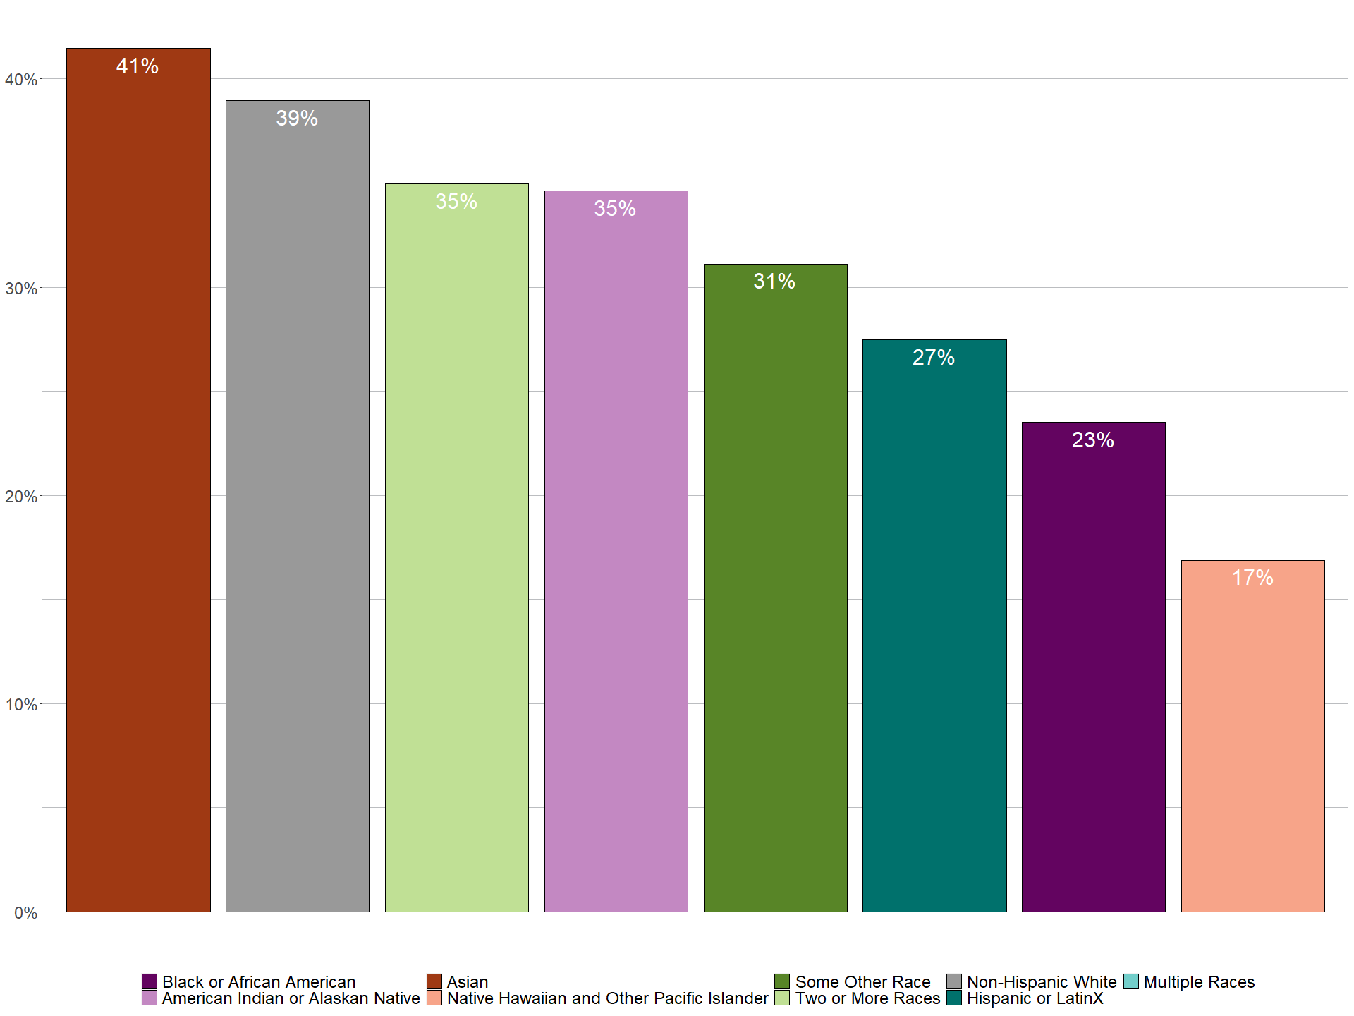
Pre-School Enrollment
xxx
xxx

Slide 5
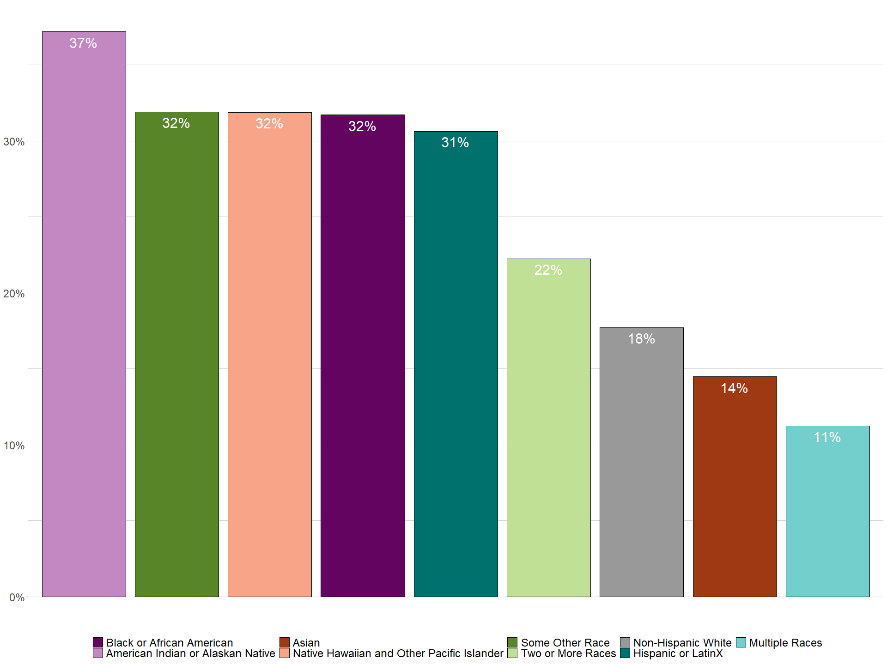
Access to Broadband Internet at Home
xxx
xxx

Slide 6
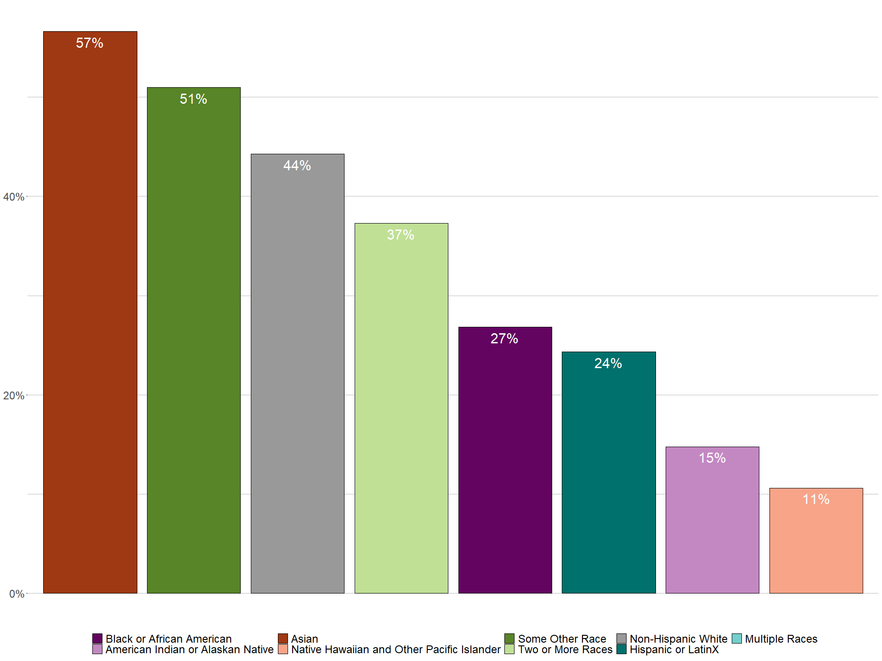
People with at Least a Bachelor’s Degree
xxx
xxx

Slide 7
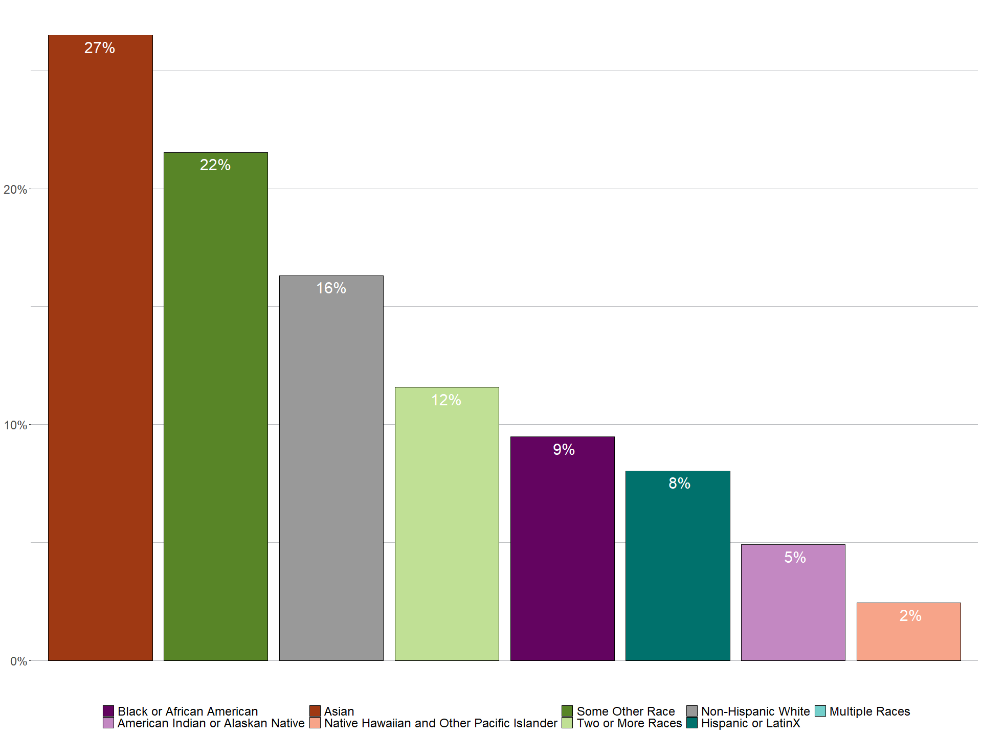
People with an Advanced Degree
xxx
xxx

Slide 8
Employment Opportunities

Slide 9
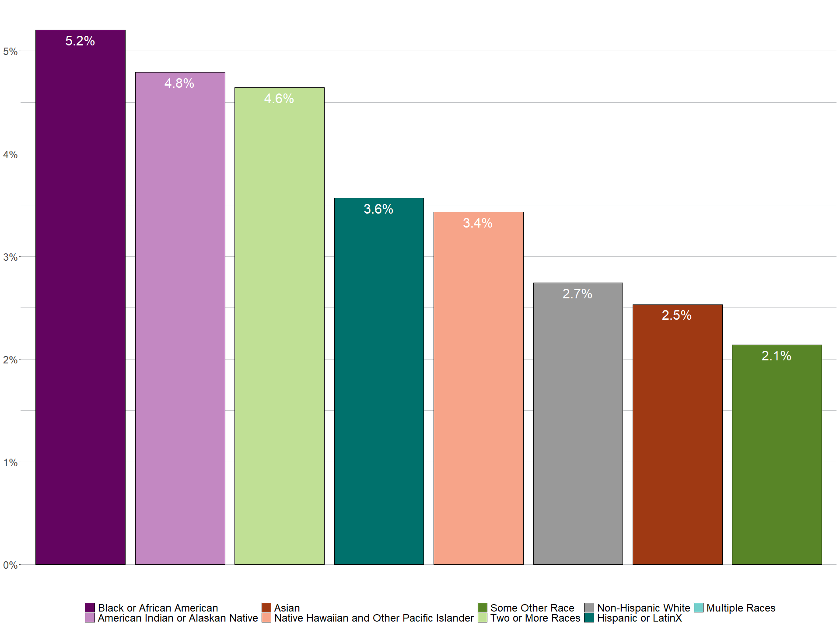
Unemployment Rate
xxx
xxx

Slide 10
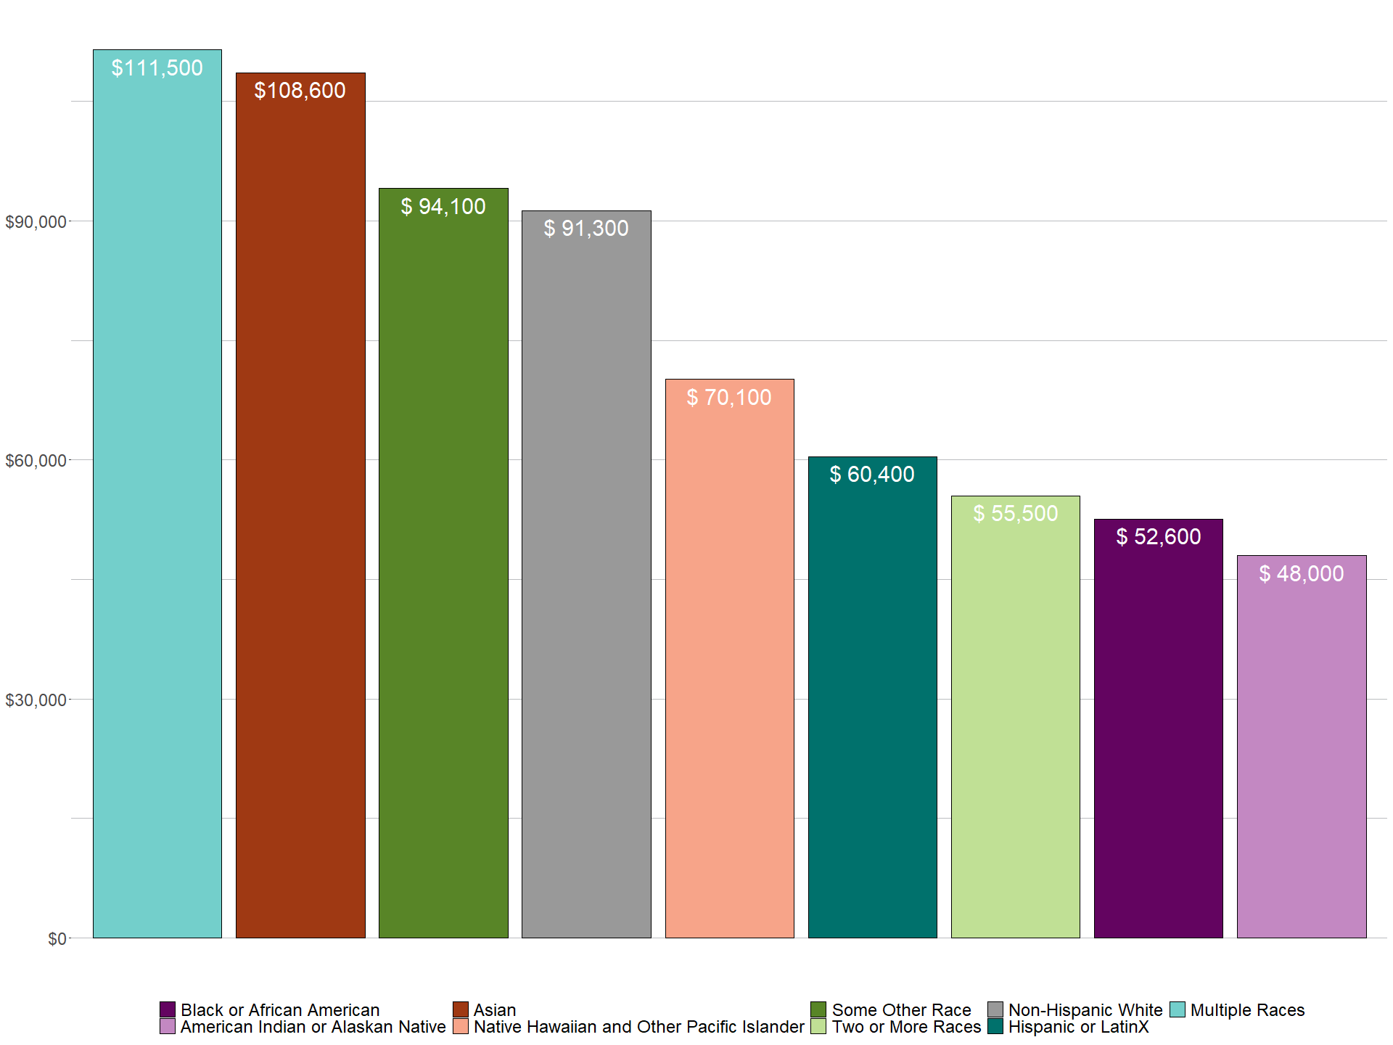
Median Income
xxx
xxx

Slide 11
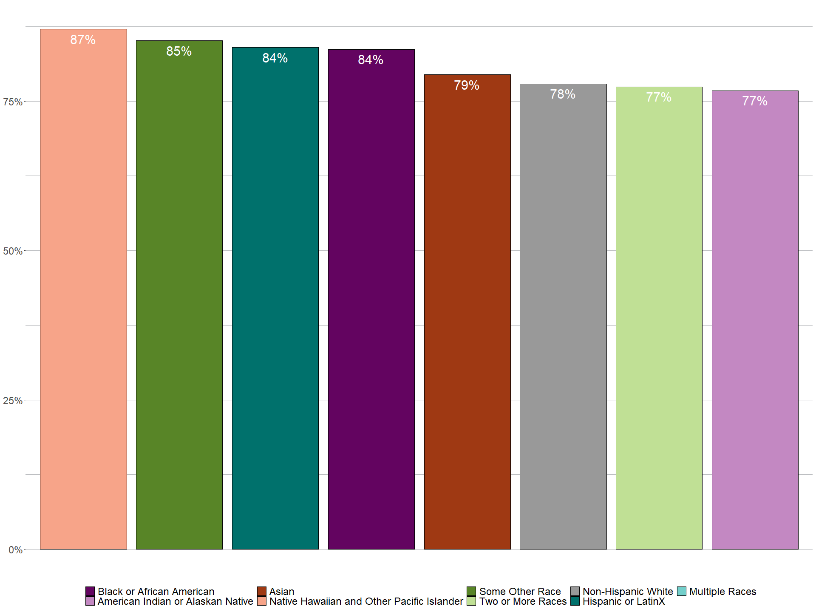
Essential Workers
xxx
xxx

Slide 12
Home Ownership

Slide 13
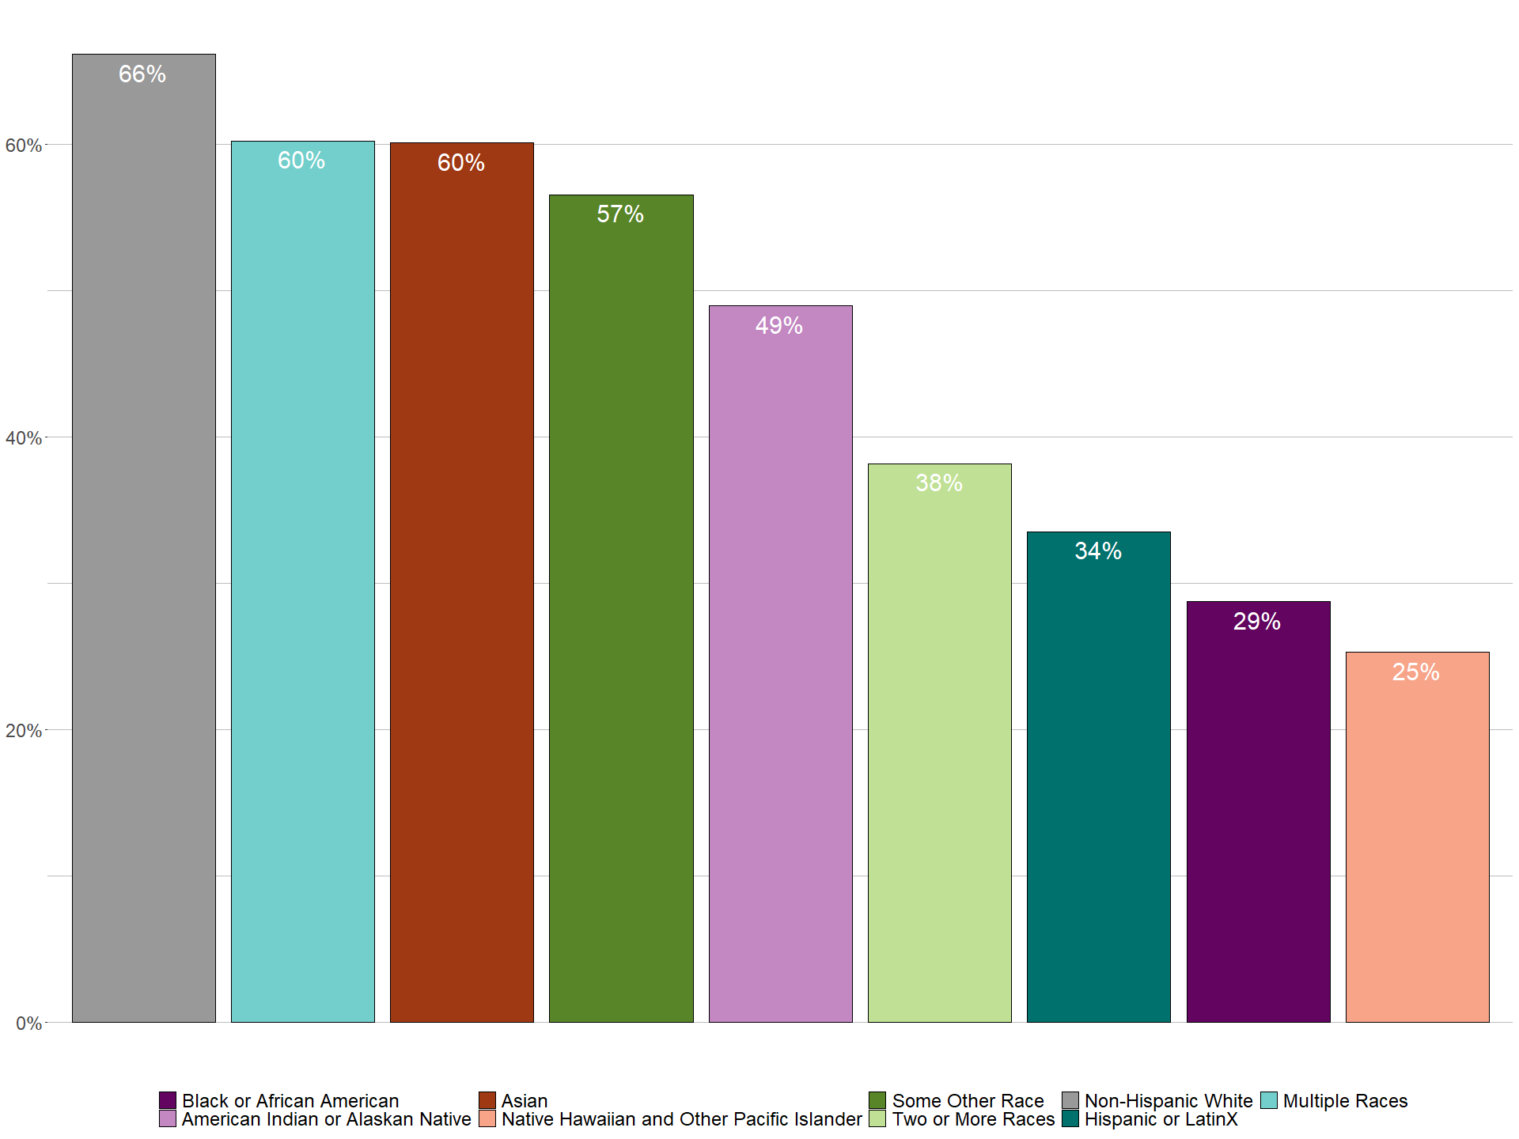
Home Ownership Rates
xxx
xxx

Slide 14
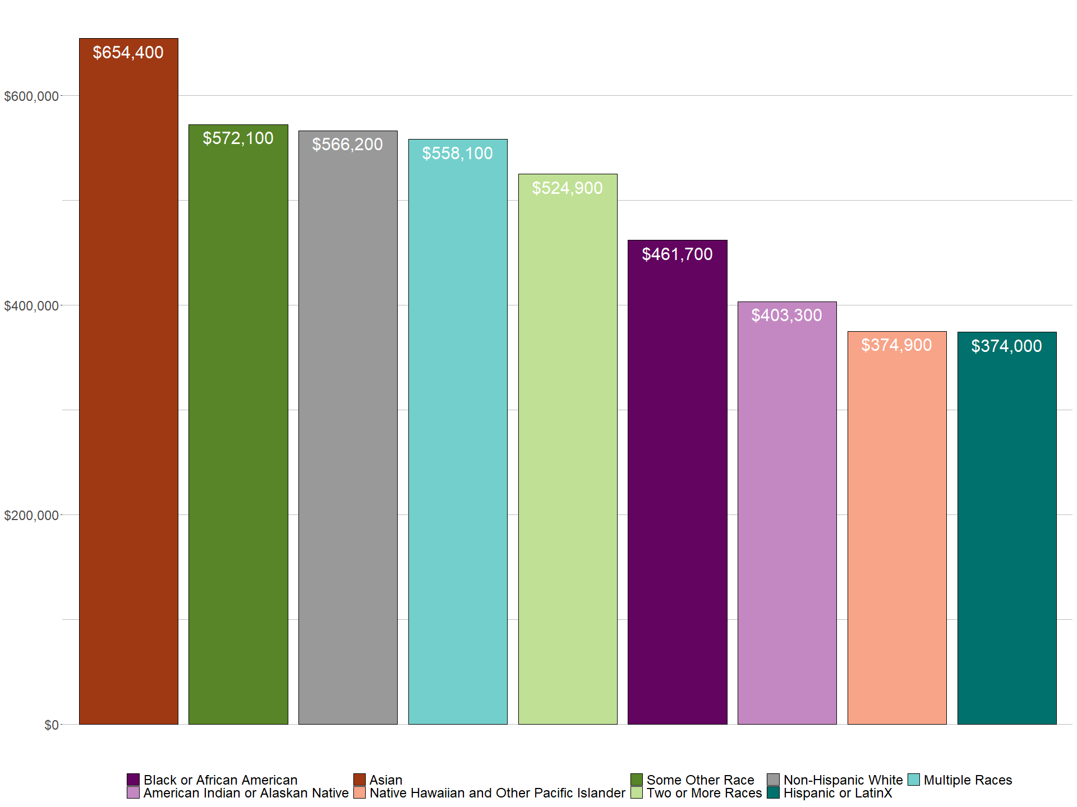
Median Home Value
xxx
xxx

Slide 15
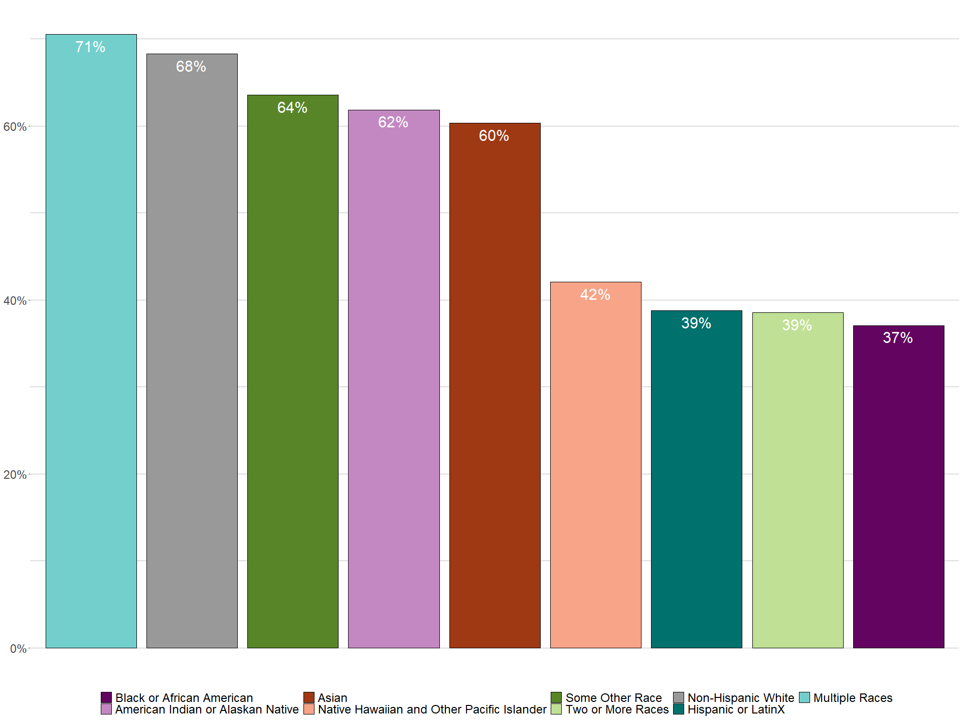
Single Family Households
xxx
xxx

Slide 16
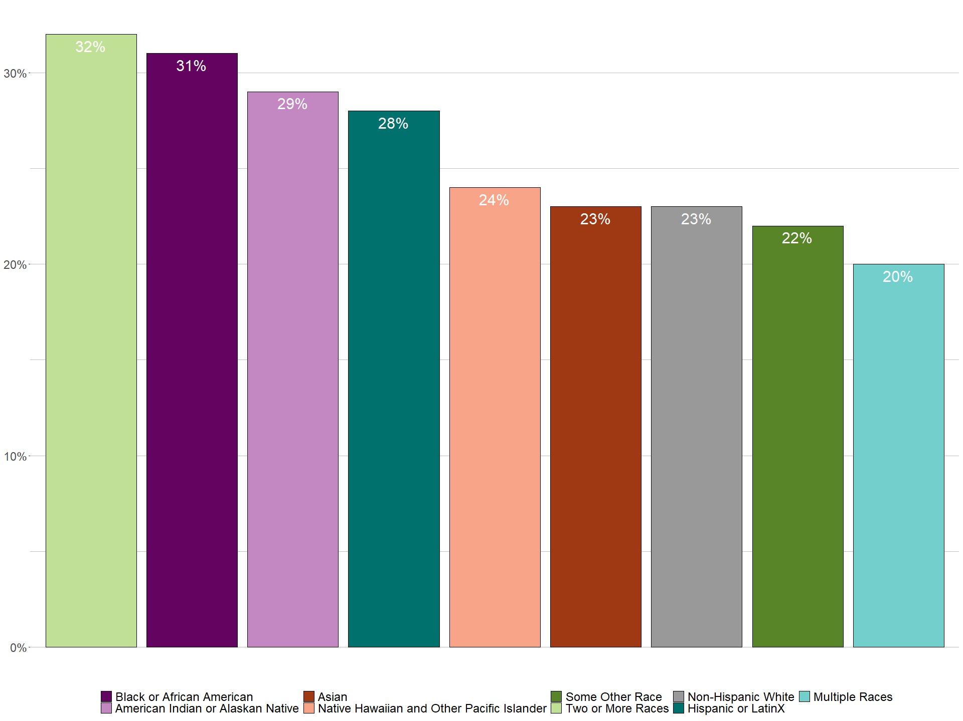
% of Income Spent on Housing
xxx
xxx

Slide 17
Travel to Work

Slide 18
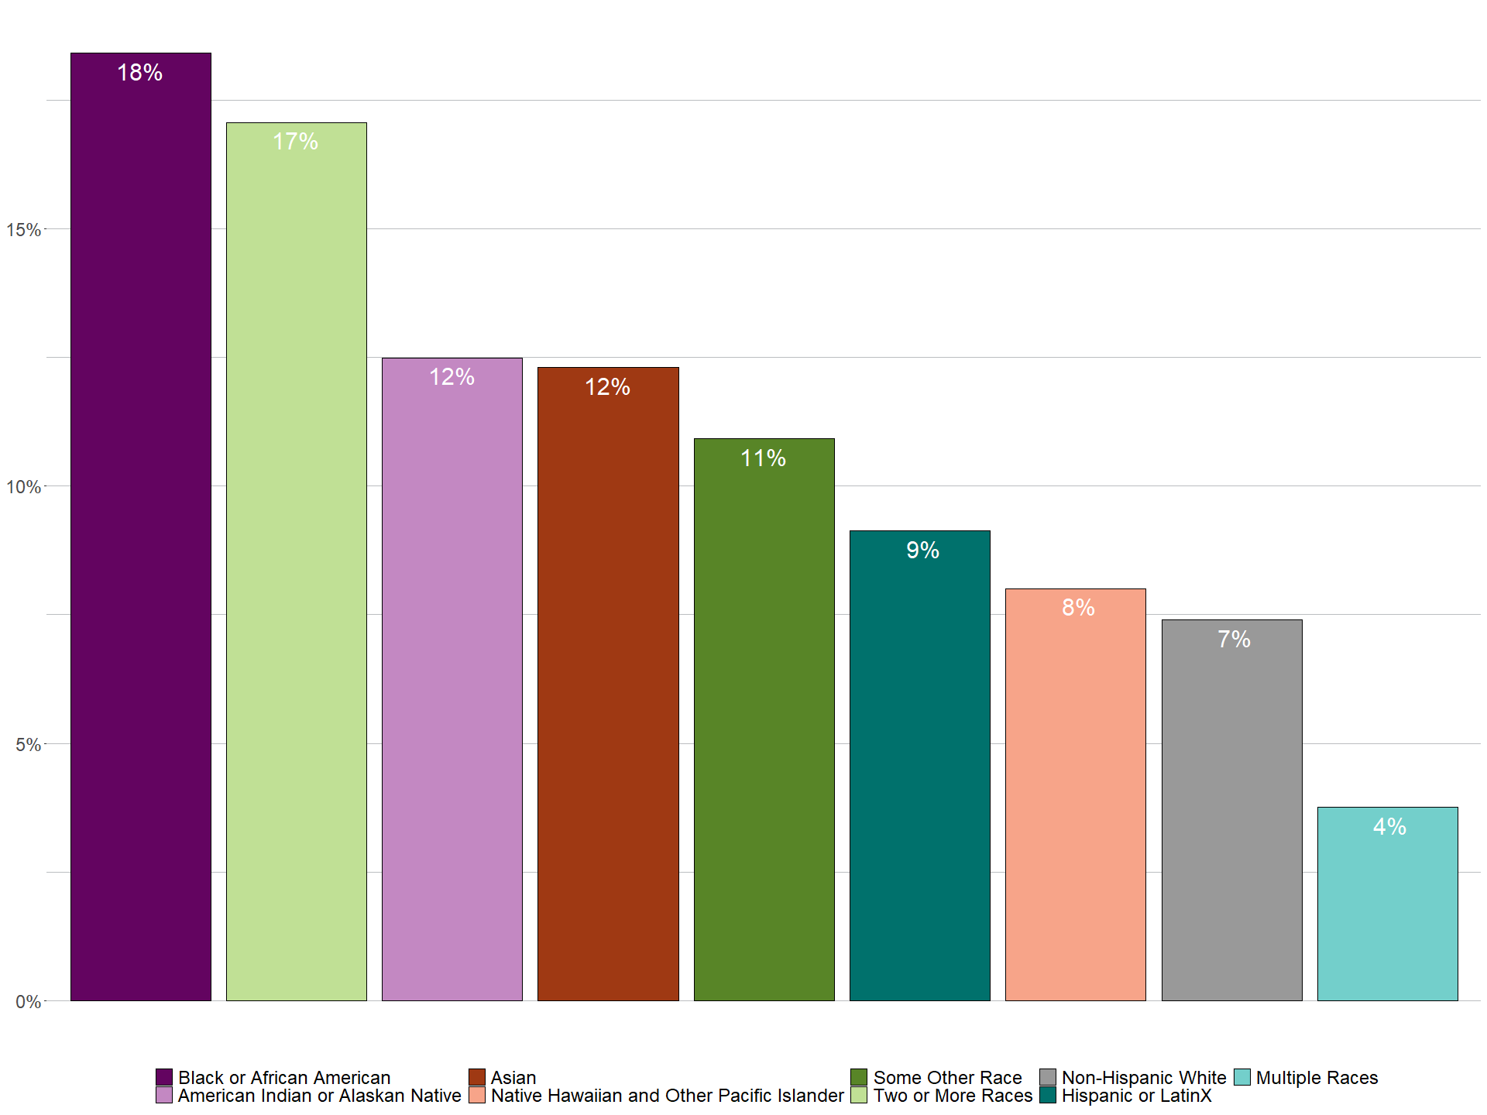
Vehicle Availability
xxx
xxx

Slide 19
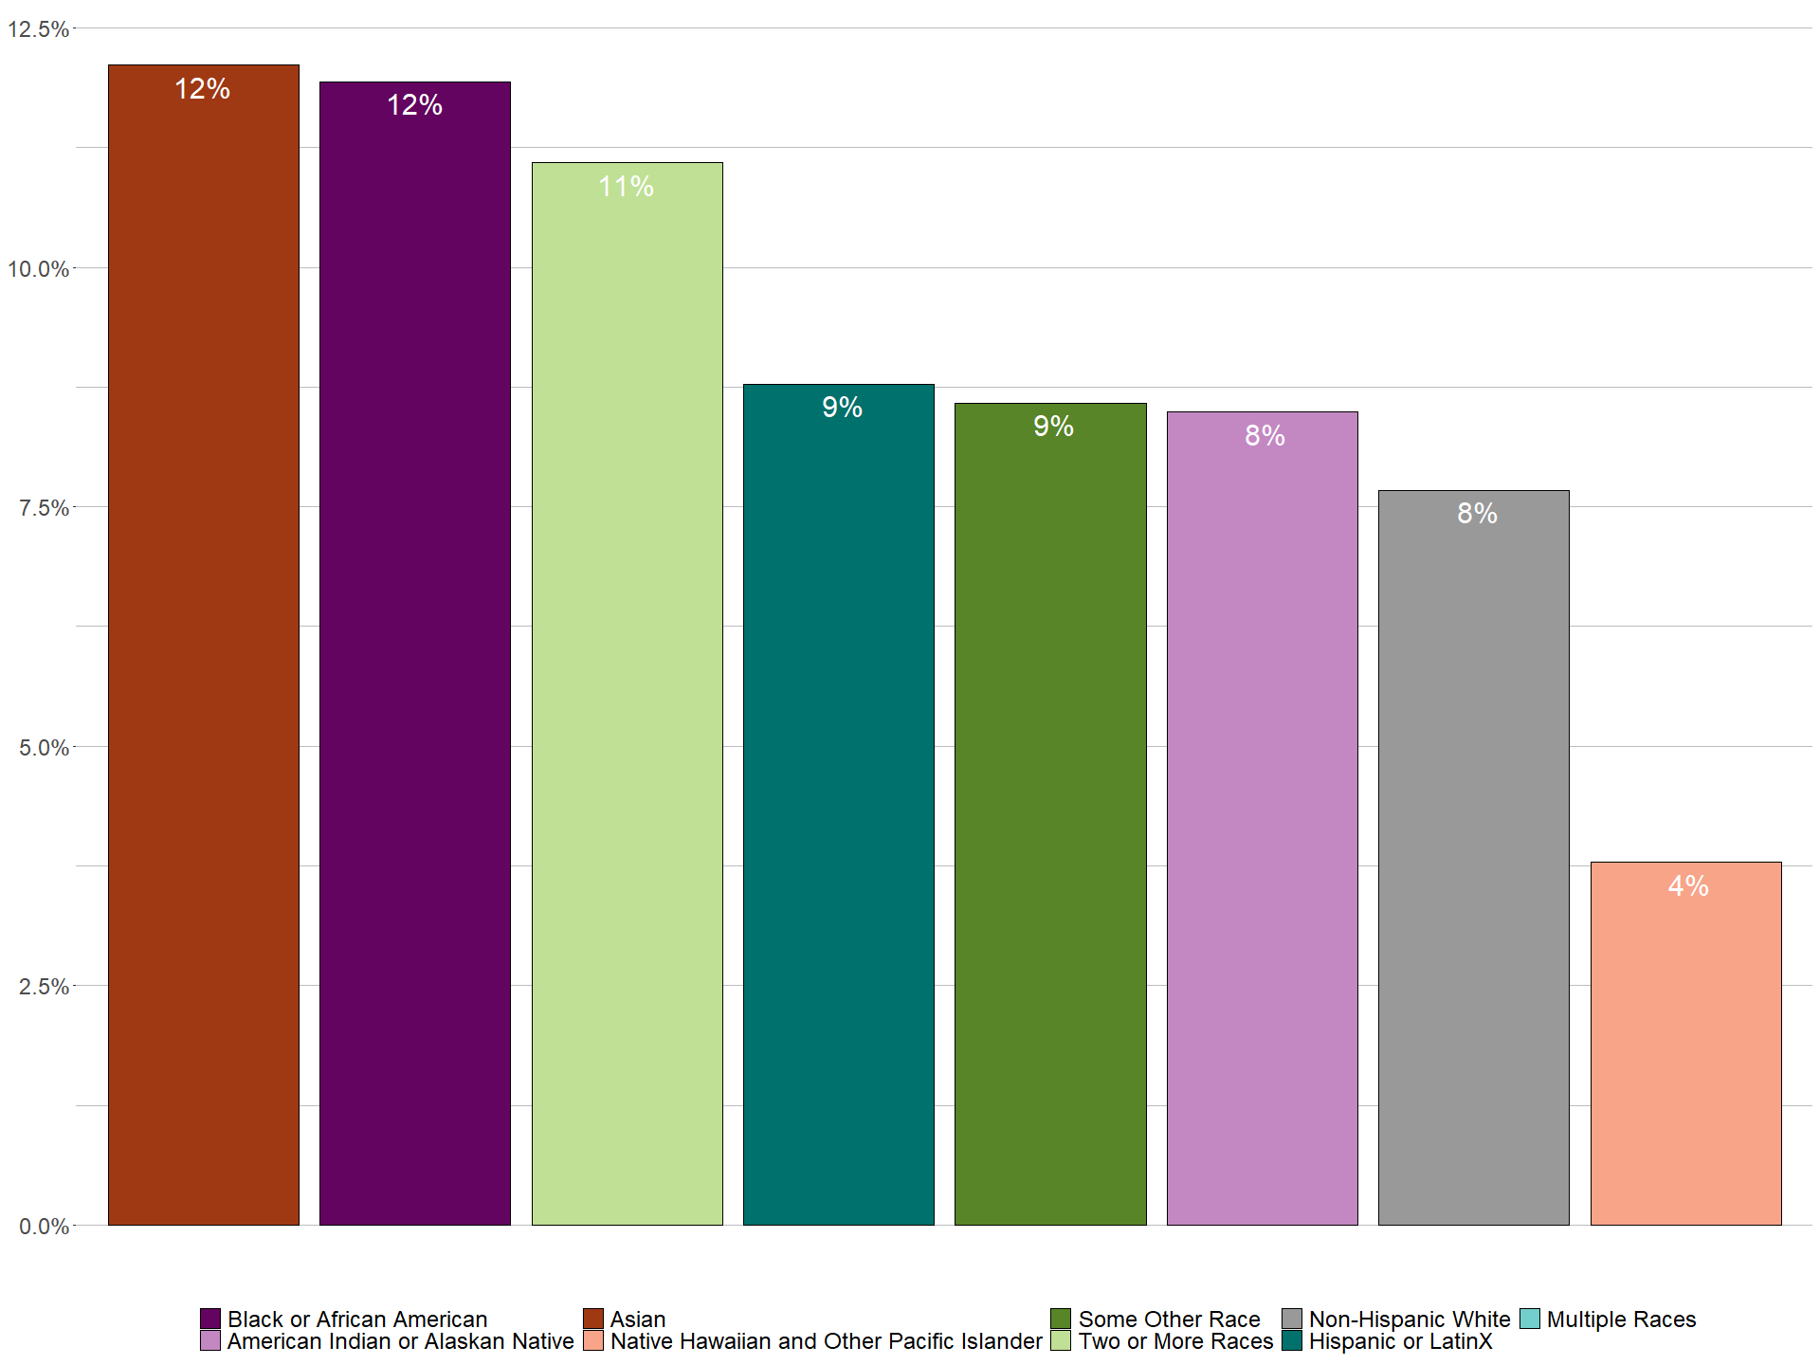
Transit Mode to Work
xxx
xxx

Slide 20
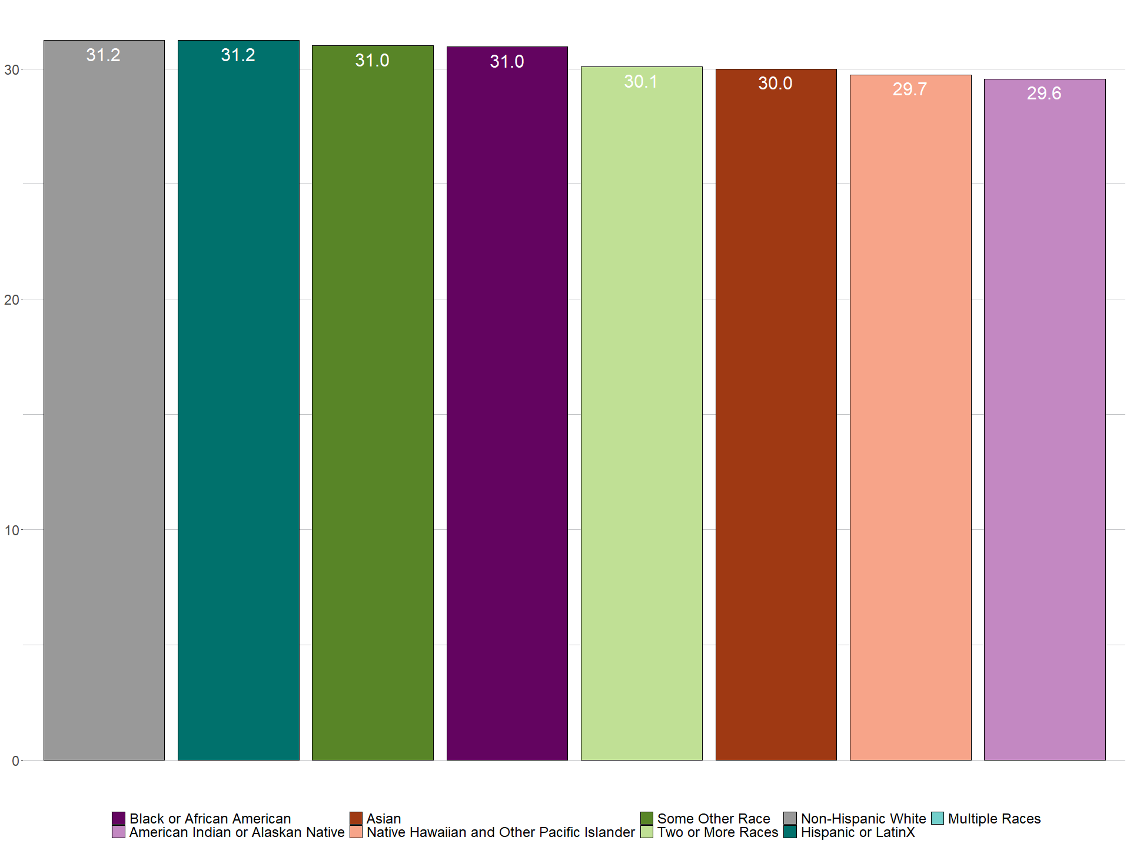
Travel Time to Work (minutes)
xxx
xxx

Slide 21
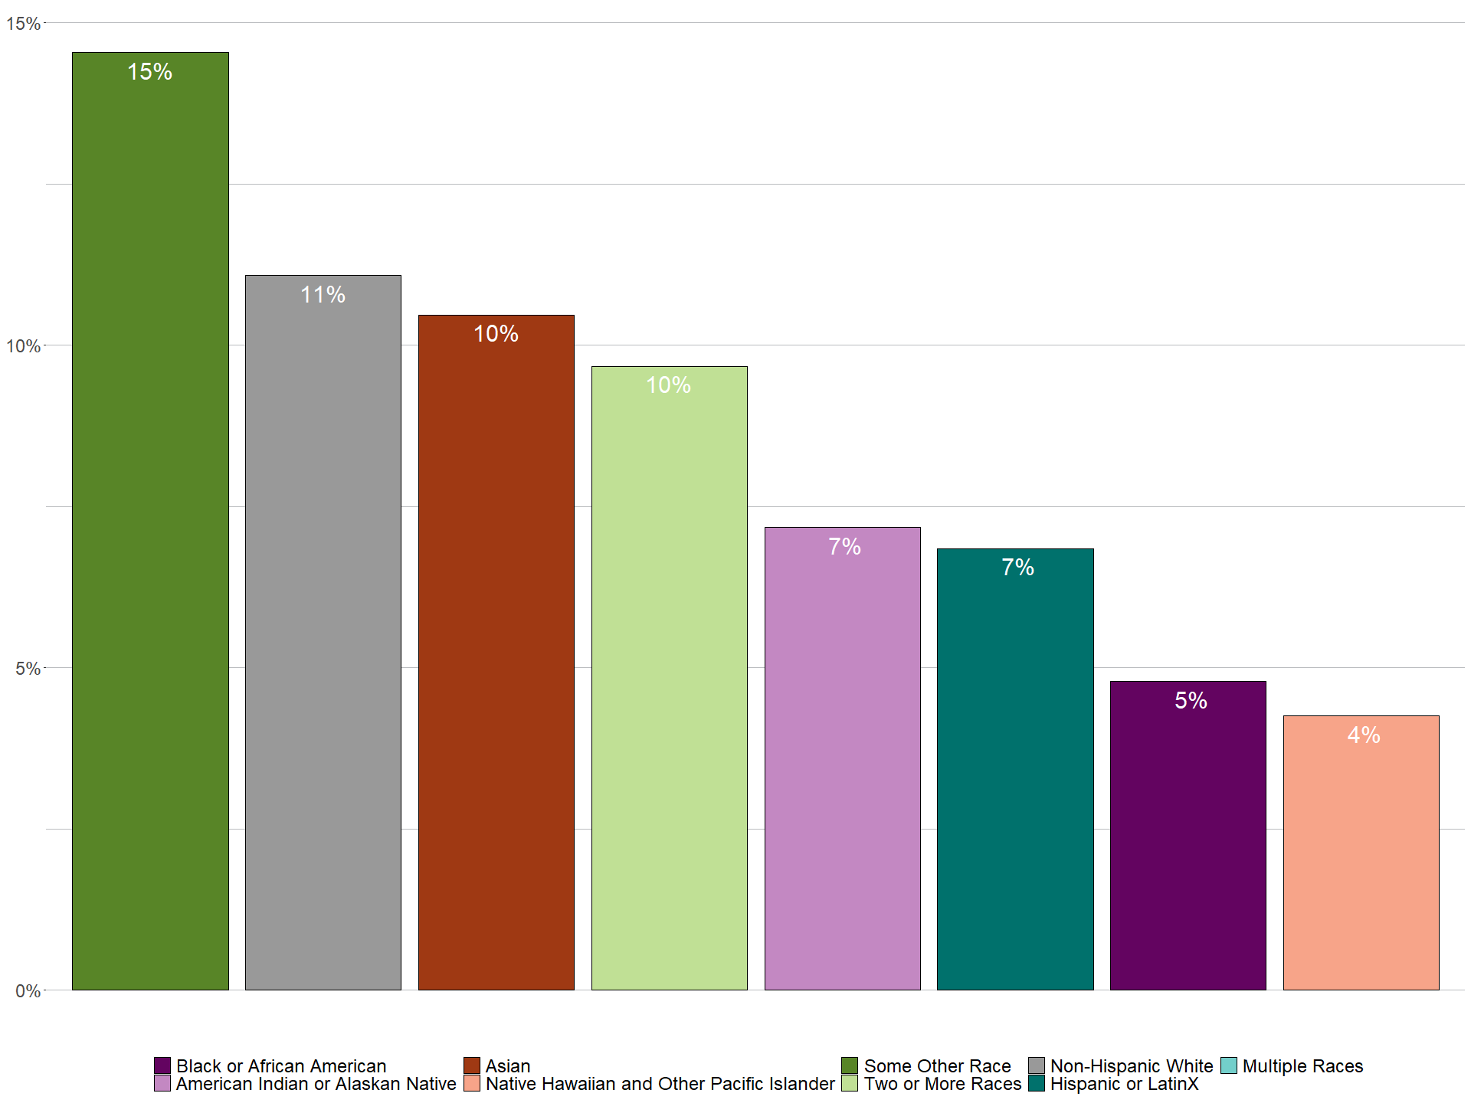
Work from Home (Pre-Pandemic)
xxx
xxx

Slide 22
Health Outcomes

Slide 23
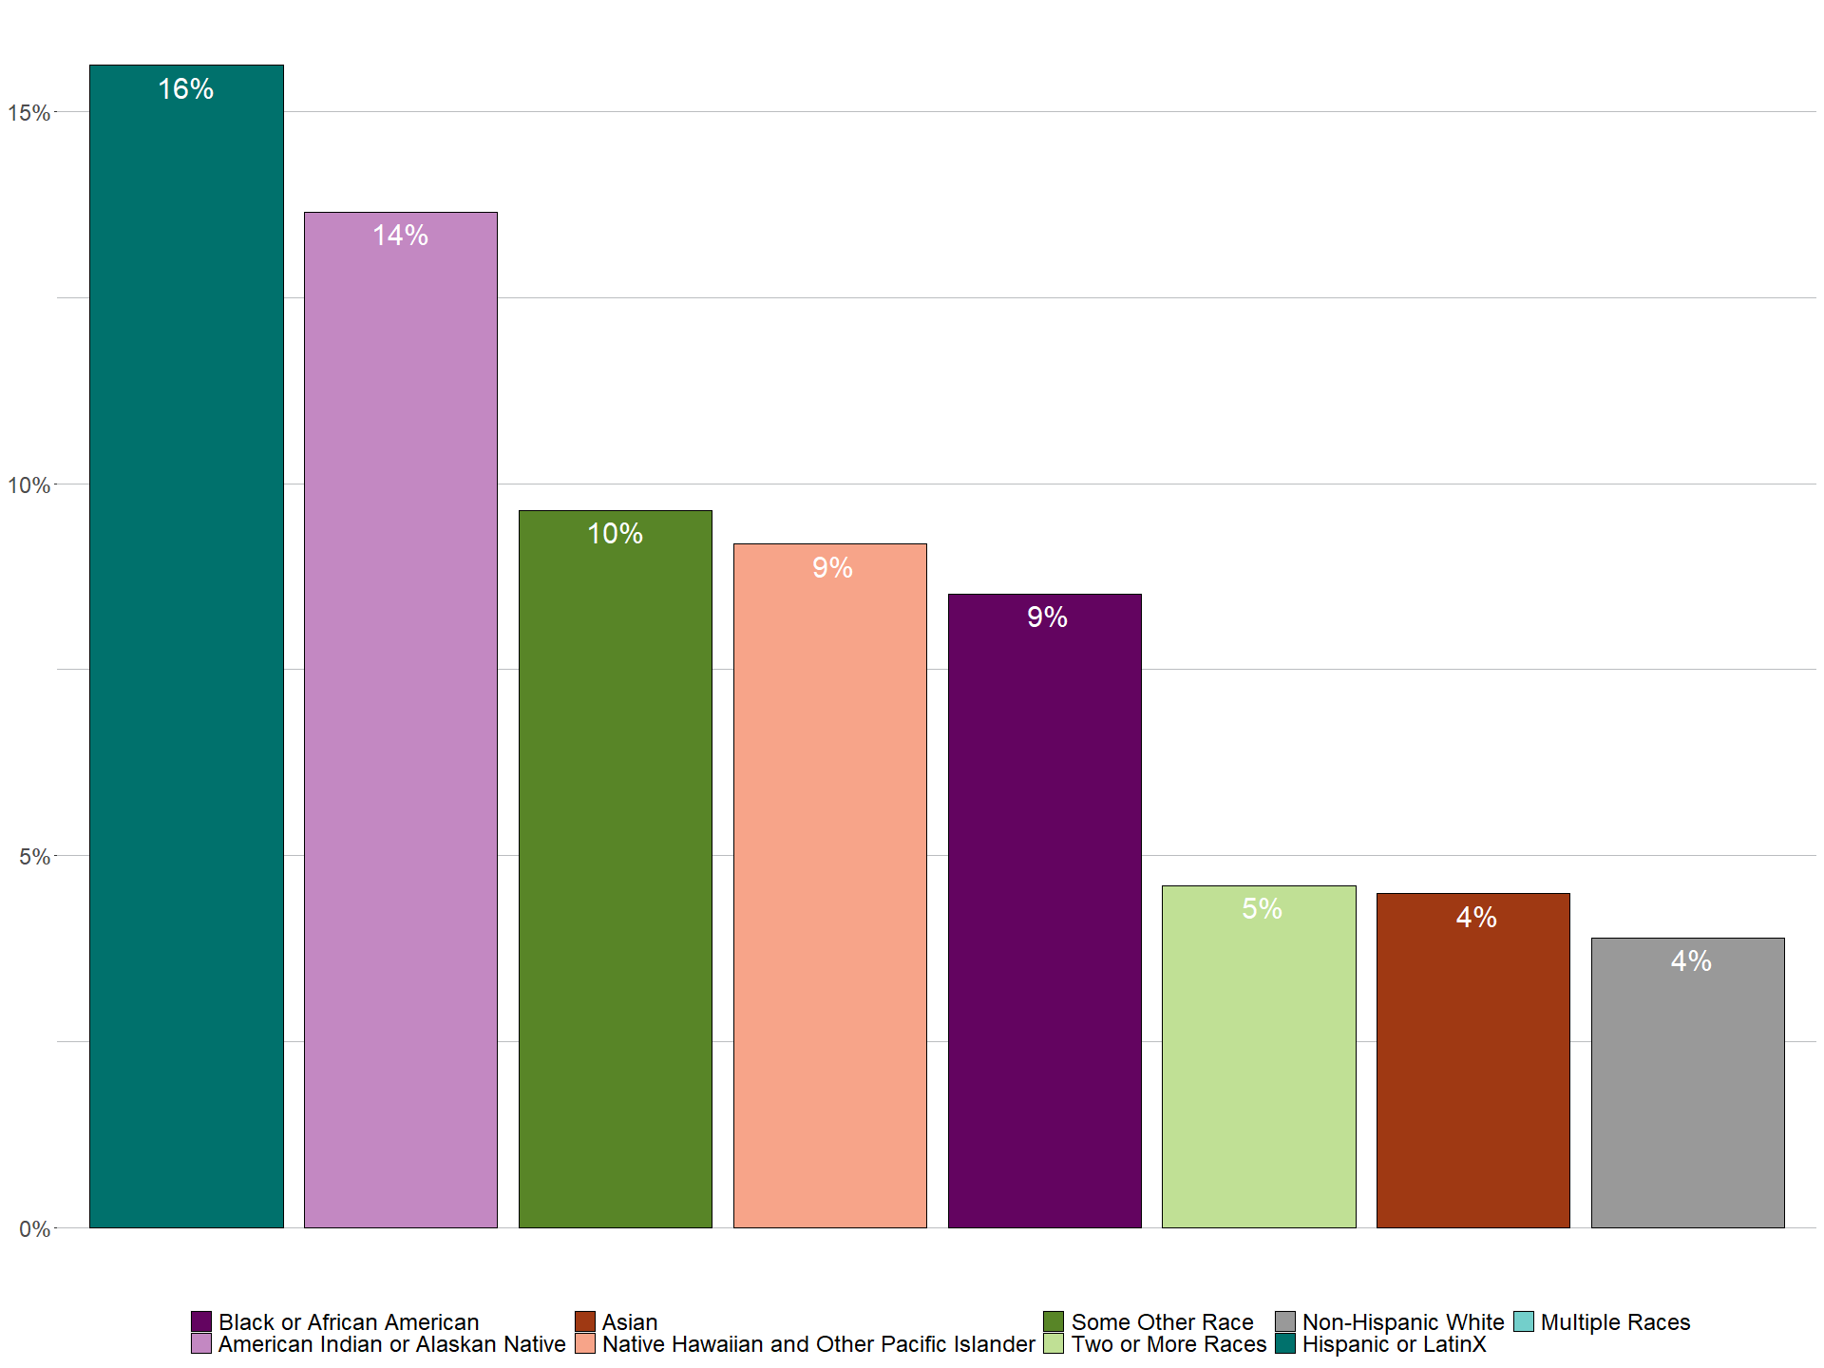
People without Health Insurance
xxx
xxx

Slide 24
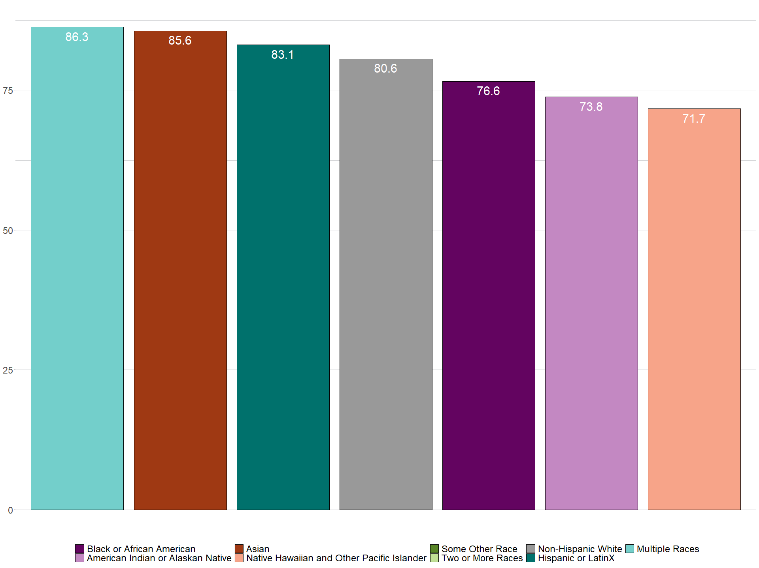
Life Expectancy
xxx
xxx

Slide 25
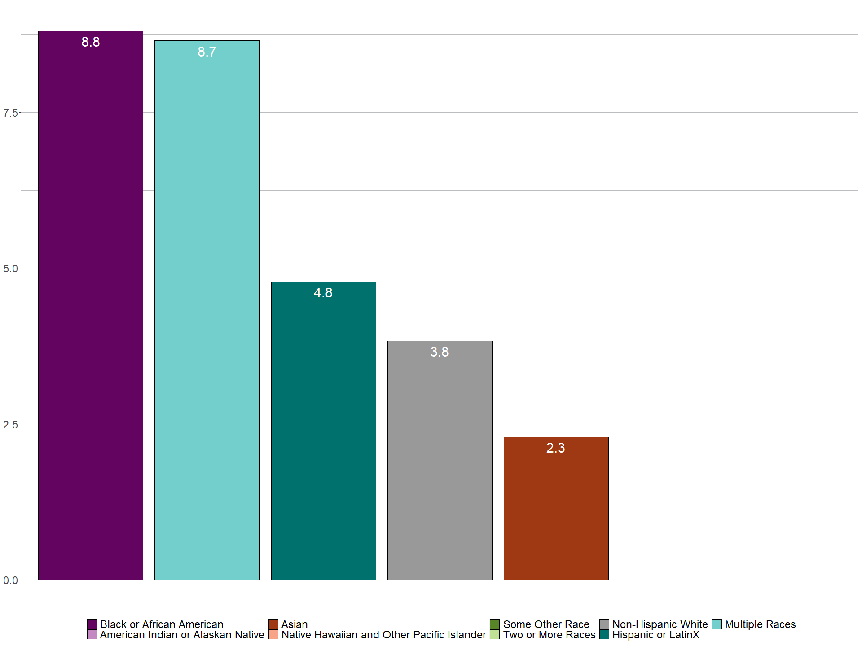
Infant Mortality Rate per 1000 Births
xxx
xxx

Slide 26
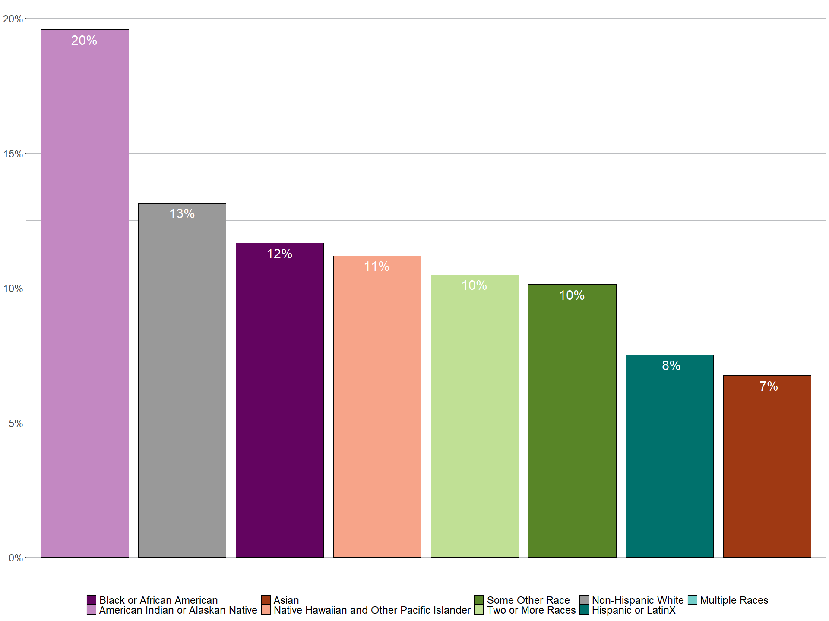
People with a Disability
xxx
xxx

Slide 27
Questions? cpatton@psrc.org

