Slide 1
Puget Sound Trends
R Trainging Series Puget Sound Regional Council

Slide 2
Overview
Topics covered in today’s presentation:
How many jobs are there?
Where do people work?
SeaTac Airport passenger volume changes

Slide 3
Employment & Wage Trends

Slide 4
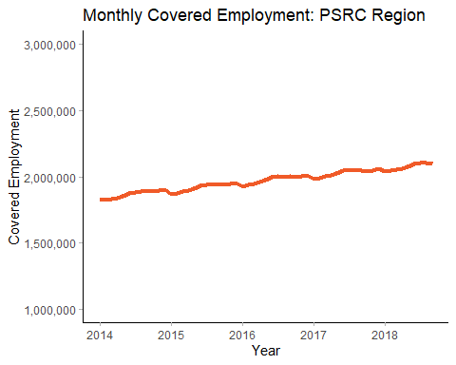
Regional Employment Continues to Increase
In September of 2018 there were 2,096,610 in the region, an increase of over 274,280 jobs (a 15.1% change) since 2014.
King County has added over 197,160 jobs (71.9% of the regional increase).
Kitsap County has added over 9,760 jobs (3.6% of the regional increase).
Pierce County has added over 41,310 jobs (15.1% of the regional increase).
Snohomish County has added over 26,050 jobs (9.5% of the regional increase).

Slide 5
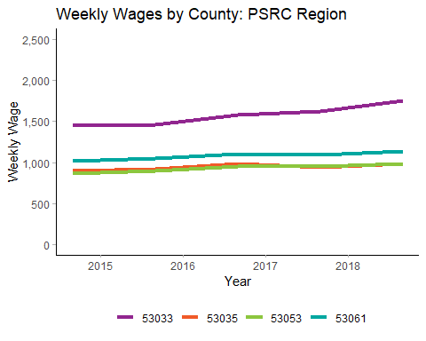
Wages are increasing - but at different rates
Between September of 2014 and September of 2018, wages have been growing at different rates across the four counties.
Average weekly wages in King County changed from $1,450 to $1,750 (a 20.7% change).
Average weekly wages in Kitsap County changed from $900 to $980 (a 8.9% change).
Average weekly wages in Pierce County changed from $870 to $990 (a 13.8% change).
Average weekly wages in Snohomish County changed from $1,020 to $1,130 (a 11.1% change).

Slide 6
Where do People Live?

Slide 7
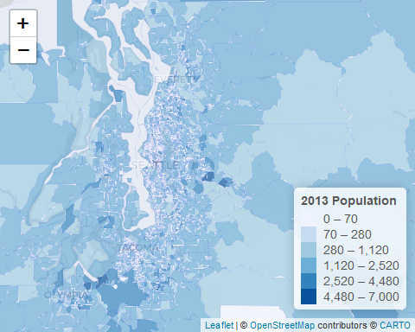
Fifteen Largest Cities in Washington: 2013
City | Population
Seattle | 625,690
Spokane | 199,150
Tacoma | 192,260
Vancouver | 167,790
Bellevue | 128,440
Kent | 109,450
Everett | 101,880
Renton | 94,690
Federal Way | 90,210
Yakima | 87,050
Spokane Valley | 78,970
Kirkland | 77,470
Kennewick | 74,320
Auburn | 73,150
Bellingham | 67,670

Slide 8
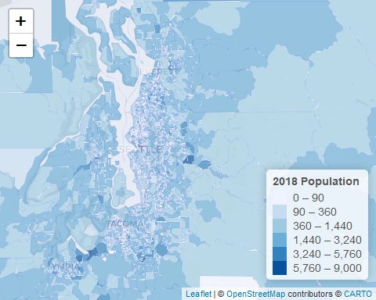
Fifteen Largest Cities in Washington: 2018
City | Population
Seattle | 729,500
Spokane | 205,040
Tacoma | 200,260
Vancouver | 180,620
Bellevue | 138,630
Kent | 115,980
Everett | 108,740
Renton | 102,550
Federal Way | 98,060
Yakima | 88,500
Spokane Valley | 82,900
Kirkland | 82,310
Auburn | 81,290
Kennewick | 78,290
Pasco | 72,650

Slide 9
R Markdown
This is an R Markdown presentation. Markdown is a simple formatting syntax for authoring HTML, PDF, and MS Word documents. For more details on using R Markdown see http://rmarkdown.rstudio.com.
When you click the Knit button a document will be generated that includes both content as well as the output of any embedded R code chunks within the document.

