Slide 1
AZ-SMART
Data and Models
May 18 2007

Slide 2
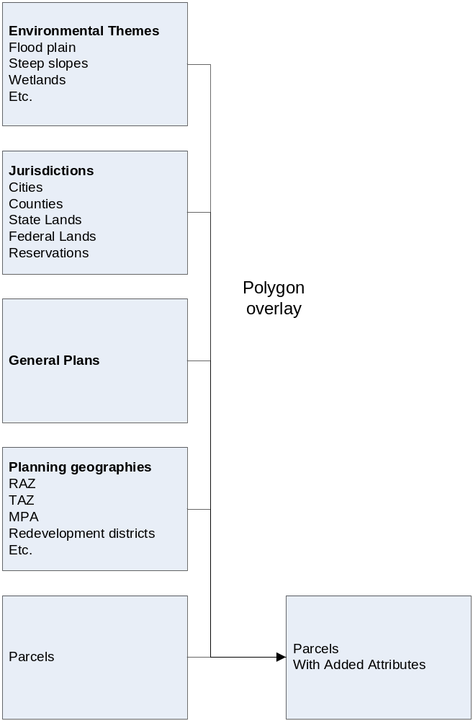
‘Pre-Model’ Geoprocessing
This process of data
Integration would be
done in ArcGIS prior
to running the model.
We define the model
to be post-GIS
geoprocessing.

Slide 3
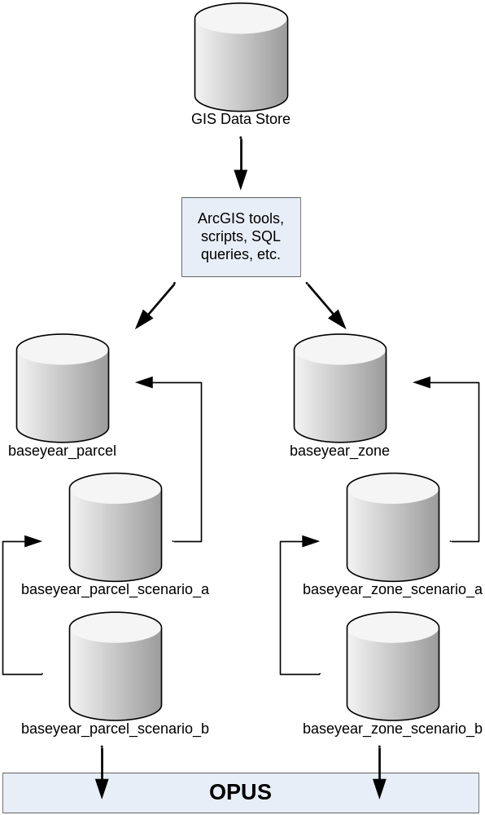
GIS DataStore and Baseyear
Database
Note that the GIS data store
is translated into a baseyear
database that is combined
with possibly nested scenario
databases to create inputs to
the model system.
Also note that databases can
be ‘chained’ to create a way
to store changes efficiently,
and to maintain a transactions
history.

Slide 4
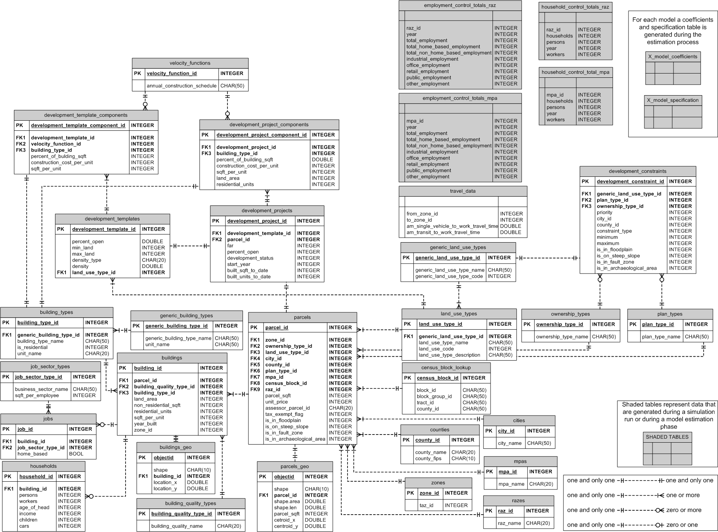
This is the ‘Target Data Model’

Slide 5
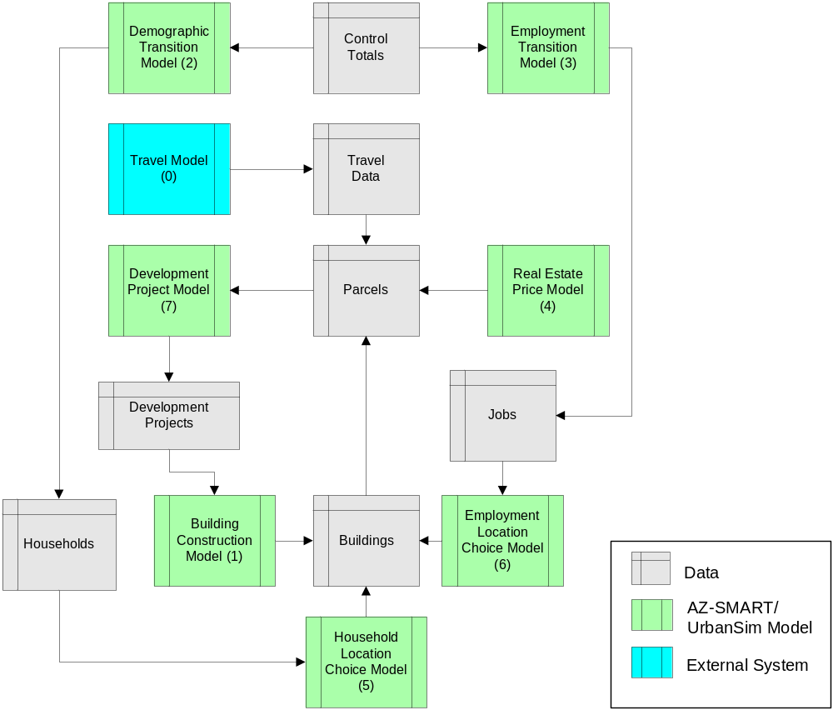
AZ-SMART Model Sequence

Slide 6
AZ-SMART Model Sequence
Step 0: Travel Model
Need to run Travel Model for
Each time step, to produce
Travel Data – zone to zone
Travel times by mode

Slide 7
AZ-SMART Model Sequence
Step 1: Building Construction Model
Loads Development Projects that have
‘Active’ status.
Looks up their Velocity Function
Adds records to the Buildings DataSet
These New Buildings are now Vacant
and counted in the inventory of space
for vacancy calculations, and for
occupation by jobs and households.

Slide 8
AZ-SMART Model Sequence
Step 2: Demographic Transition Model
Loads Control Totals (e.g. by RAZ)
Sums Population in the Households
DataSet
Adds new records to the Households
DataSet to meet the Control Totals
These new households now have no
location information.

Slide 9
AZ-SMART Model Sequence
Step 3: Employment Transition Model
Loads Control Totals (e.g. by RAZ)
Sums Employment in the Jobs
DataSet
Adds new records to the Jobs
DataSet to meet the Control Totals
These new jobs now have no
location information.

Slide 10
AZ-SMART Model Sequence
Step 4: Real Estate Price Model
Loads Parcels, Buildings, Jobs,
Households, Travel Data
Predicts Price per Unit for all parcels.
- Price per square foot of land for
non-residential and vacant land
- Price per residential unit for
residential land uses
- Separate submodel for each
Land Use Type
Stores the new price per unit on the
Parcel.

Slide 11
AZ-SMART Model Sequence
Step 5: Household Location Choice Model
Loads Residential Buildings, Jobs,
Households (with no location), Travel Data
Predicts building_id for unplaced households
- Within ‘filtered’ set of alternatives, e.g.
vacant units within a specified RAZ
Stores the building_id on the household.

Slide 12
AZ-SMART Model Sequence
Step 6: Employment Location Choice Model
Loads Non-Residential Buildings, Households,
Jobs (with no location), Travel Data
Predicts building_id for unplaced jobs
- Within ‘filtered’ set of alternatives, e.g.
vacant sqft within a specified RAZ
Stores the building_id on the job.

Slide 13
AZ-SMART Model Sequence
Step 7: Development Project Choice Model
Loads Parcels, Buildings, Development
Projects, Development Templates,
Development Constraints
Predicts Development Projects to ‘Activate’
- Checks General Plan for each Parcel
- Checks Development Constraints that apply
- Selects Development Templates that are feasible
- Adds these proposals as ‘Tentative’ Development Projects
- Computes ROI on all ‘Planned’, ‘Proposed’, and ‘Tentative’ Projects
- Compares ROI, and selects projects to change to ‘Active’
- Stops when expected vacancy rate for a building type exceeds threshold
Note: this is quite different than the SAM use of target density, min, max.
Need to discuss the implications of this.

Slide 14
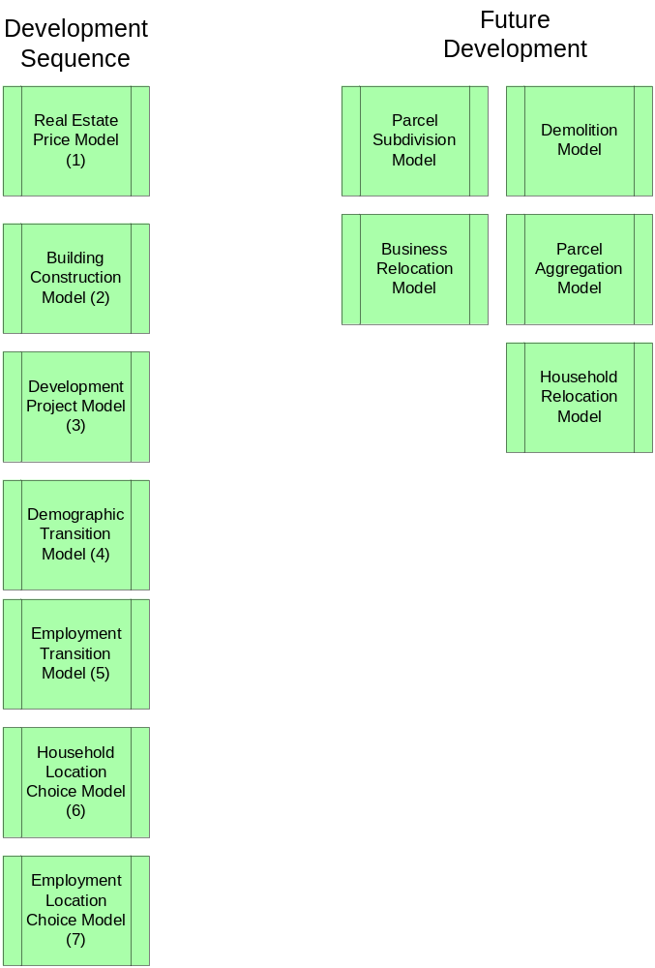
AZ-SMART
Model
Implementation
Sequence
(proposed)
Phase 1 would produce
an incremental model
(no movement of
jobs and households),
and would not include
demolition, or simulate
parcel aggregation or
subdivision. Parcel
aggregation/subdivision
would be handled in the
GIS as preprocessing.

Slide 15
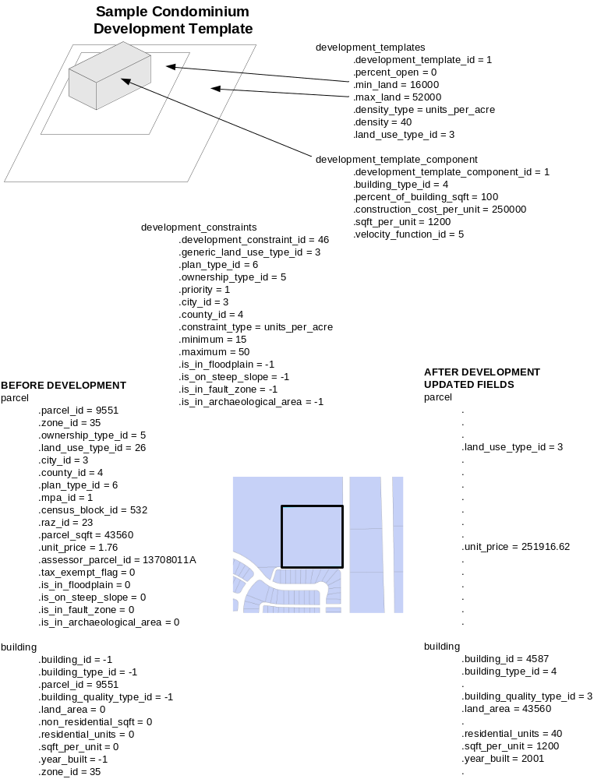
An Overview of the Developer Model

Slide 16
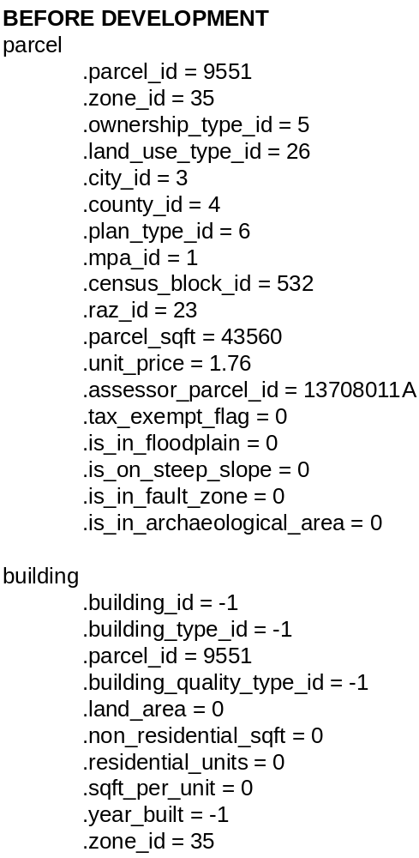
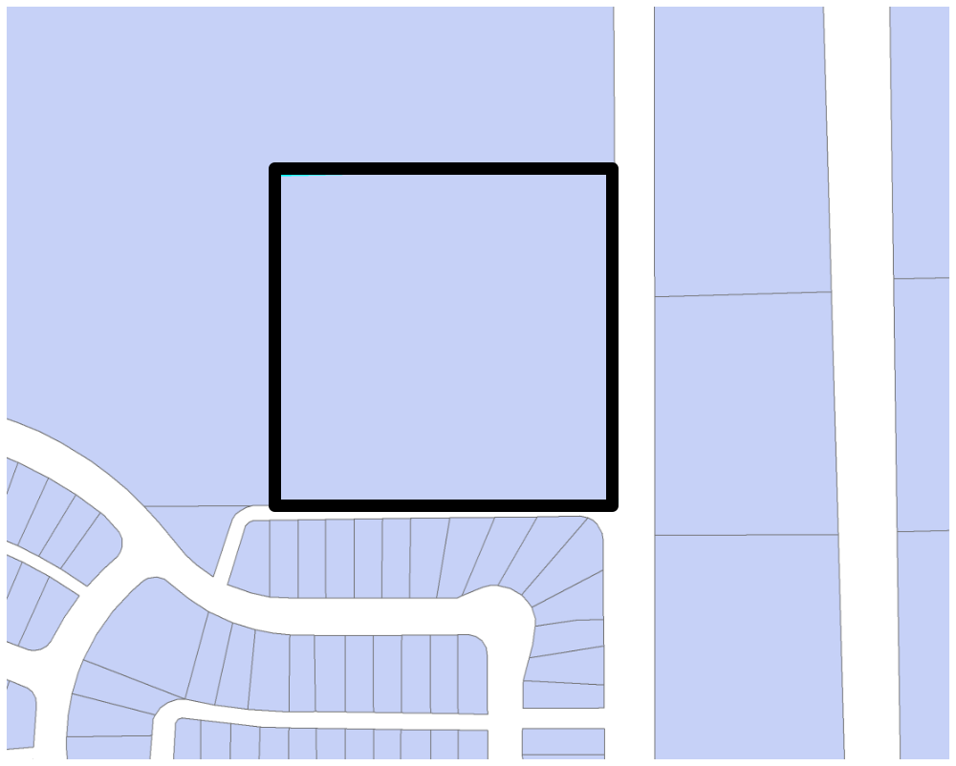
Developer Model Step 1:
Select Parcel for Evaluation

Slide 17
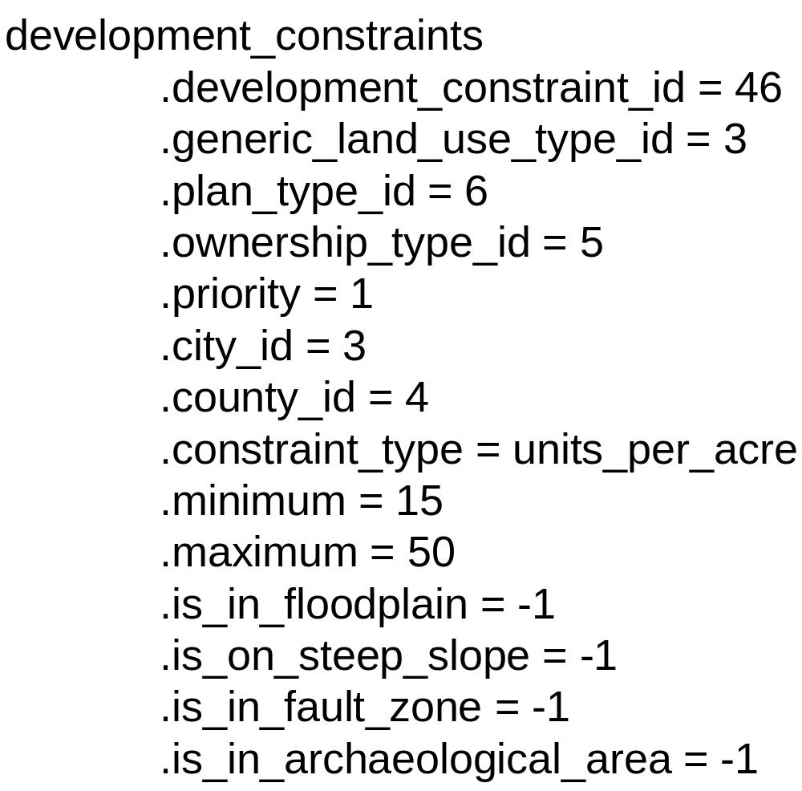
Step 2: Based on Plan Type, Evaluate Development Constraints

Slide 18
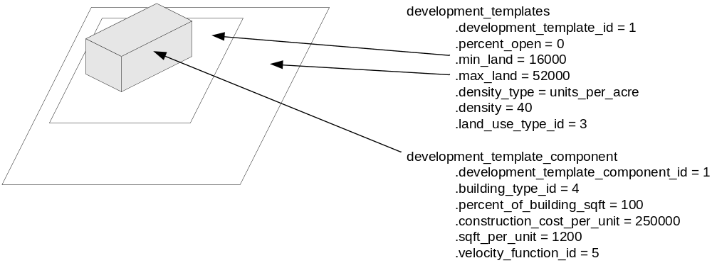
Step 3: Constraints Identify Allowed Development Templates
Development templates can be defined in a number of different ways, including
using the known development projects as the basis, or general plans, or a
statistical analysis of recent developments. Need to decide which approach will
be used for AZ-SMART project. PSRC project is using the latter approach.

Slide 19
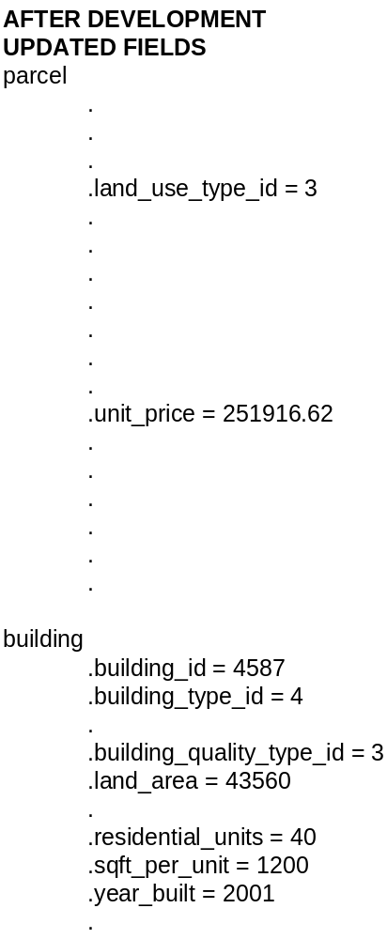
Step 4: Evaluate Development Proposal Based on Template
A hedonic price model predicts the price of
a post-development proposal on the parcel,
and subtracts the predicted cost of site
acquisition, and other costs such as site
preparation, demolition of existing buildings,
extension of infrastructure, financing, and
other costs that can be incorporated. This
is used to generate an estimate of the
Return on Investment (ROI) for each proposal.
Proposals are selected using a probability
that is proportional to their expected ROI.
When projects are accepted, they result in
Development Projects with status set to
‘Active’. These projects are then loaded
By the Building Construction Model, which
Uses Velocity Functions to Construct Buildings.

Slide 20
More on Development Templates
Alternative Ways of Creating them:
  Parcel data: select parcels that have been developed over past 5-10 years, generate statistical profile of these (see PSRC wiki)
  Development Projects: analyze projects that have been built and generate templates from these.
  General Plan: generate templates that conform to specific targets in the general plan.

