Slide 1
PCFG estimation with EM
The Inside-Outside Algorithm

Slide 2
Presentation order
Notation
Calculating inside probabilities
Calculating outside probabilities
General schema for EM algorithms
The inside-outside algorithm

Slide 3
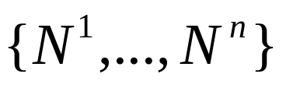
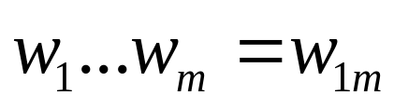
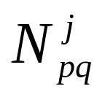
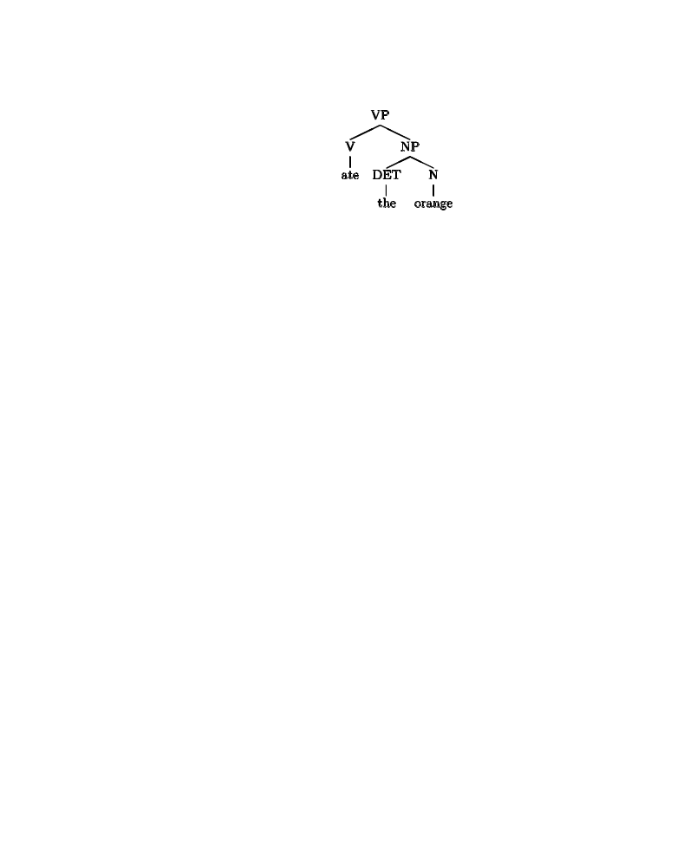
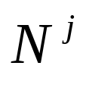
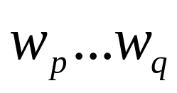
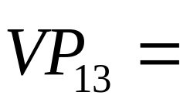



Some notation
Non-terminal symbols (hidden variables)
Sentence (observed data)
spans in string

Slide 4



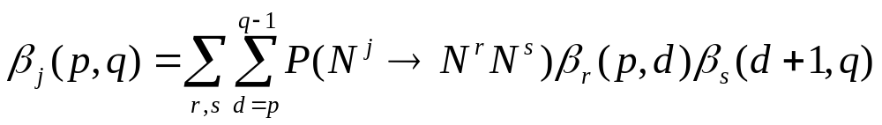
Inside probability
Definition:
Computed recursively, base case:
Induction:

Slide 5





Inside probability example
Consider the following PCFG fragment
NP→DET N 0.8 NP→N 0.2
DET→a 0.6 DET→the 0.4
N→apple 0.8 N→orange 0.2

Slide 6
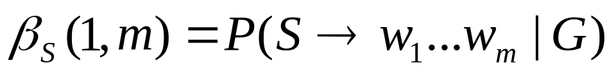
Inside probability example
Consider the following PCFG fragment
NP→DET N 0.8 NP→N 0.2
DET→a 0.6 DET→the 0.4
N→apple 0.8 N→orange 0.2
What is the probability of a sentence under a PCFG?

Slide 7

Outside probability
Definition
That is, the joint probability of starting with N¹ (commonly called S) and generating words w₁…w_{p-1},the non-terminal N^{j}, and words w_{q+1}…w_{m}.
N¹(=S)
outside
N^{j}
w₁
w_{p-1}
w_{p}
w_{q}
w_{q+1}
w_{m}

Slide 8





Calculating outside probability
Computed recursively, base case:
How do we calculate in terms of this base case?
Recall the definition:
Intuition: must be either the L or R child of a parent node. We first consider the case when it is the L child.

Slide 9


Outside probabilities: decomposing the problem
The shaded area represents the outside probability which we need to calculate. How can this be decomposed?
w₁
. . .
w_{p-1}
w_{p}
. . .
w_{q}
w_{q+1}
. . .
w_{e}
w_{e+1}
. . .
w_{m}

Slide 10


Outside probabilities: decomposing the problem
Step 1: We assume that is the parent of . Its outside probability, , (represented by the yellow shading) is available recursively. How do we calculate the cross-hatched probability?
w₁
. . .
w_{p-1}
w_{p}
. . .
w_{q}
w_{q+1}
. . .
w_{e}
w_{e+1}
. . .
w_{m}

Slide 11


Outside probabilities: decomposing the problem
Step 2: The red shaded area is the inside probability of , which is available as .
w₁
. . .
w_{p-1}
w_{p}
. . .
w_{q}
w_{q+1}
. . .
w_{e}
w_{e+1}
. . .
w_{m}

Slide 12
Outside probabilities: decomposing the problem
Step 3: The blue shaded part corresponds to the production N^{f} → N^{j} N^{g}, which because of the context-freeness of the grammar, is not dependent on the positions of the words. It’s probability
is simply P(N^{f} → N^{j} N^{g}|N^{f}, G) and is
available from the PCFG without
calculation.
w₁
. . .
w_{p-1}
w_{p}
. . .
w_{q}
w_{q+1}
. . .
w_{e}
w_{e+1}
. . .
w_{m}

Slide 13

Outside probabilities: decomposing the problem
Multiplying the terms together, we have the joint probability corresponding to the yellow, red, and blue areas, assuming N^{j} was the left child of N^{f}, and given fixed non-terminals f and g, as well
as a fixed partition e in [q+1,m].
w₁
. . .
w_{p-1}
w_{p}
. . .
w_{q}
w_{q+1}
. . .
w_{e}
w_{e+1}
. . .
w_{m}

Slide 14
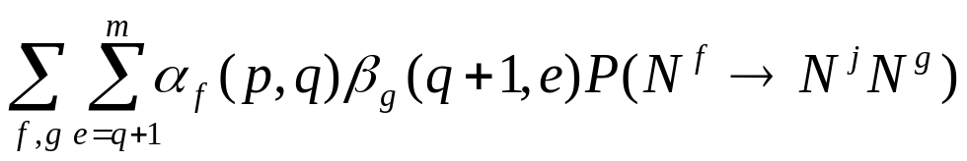
Outside probabilities: decomposing the problem
The total joint probability for a left sided N^{j} can be calculated by summing over all non-terminals f and g and partition e.
w₁
. . .
w_{p-1}
w_{p}
. . .
w_{q}
w_{q+1}
. . .
w_{e}
w_{e+1}
. . .
w_{m}

Slide 15
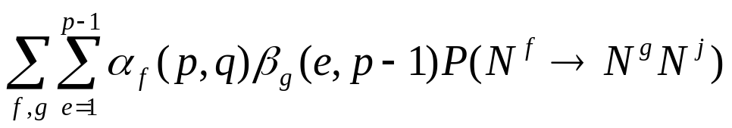


Outside probabilities: decomposing the problem
The total joint probability for a right-sided N^{j} is shown schematically in this diagram. The relevant calculation is:
w₁
. . .
w_{e-1}
w_{e}
. . .
w_{p-1}
w_{p}
. . .
w_{q}
w_{q+1}
. . .
w_{m}

Slide 16


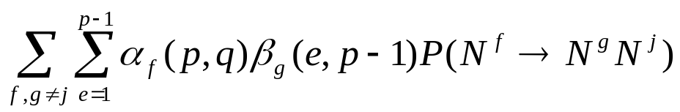

Calculating the outside probability: final form
w₁
. . .
w_{e-1}
w_{e}
. . .
w_{p-1}
w_{p}
. . .
w_{q}
w_{q+1}
. . .
w₁
. . .
w_{m}
w_{p-1}
w_{p}
. . .
w_{q}
w_{q+1}
. . .
w_{e}
w_{e+1}
. . .
w_{m}
Since N^{j} may be either the left or right child, we have to add both terms. And, since N^{f}→N^{j} N^{g}/N^{g} N^{j} will get counted twice when g=j, it must be discounted on one side.

Slide 17
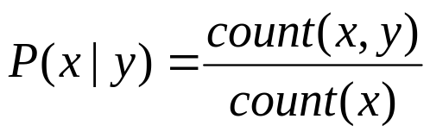
General schema for certain EM algorithms
Given two events, x and y, the maximum likelihood estimation (MLE) for their conditional probability is:
If they are observable, it’s easy to see what to do: just count the events in a representative corpus and use the MLE or a smoothed distribution.

Slide 18
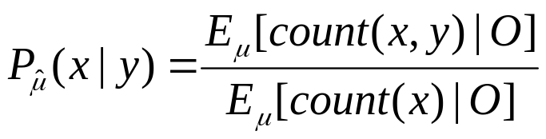
General schema for certain EM algorithms
What these are hidden variables that cannot be observed directly?
Use a model μ and iteratively improve the model based on a corpus of observable data (O) generated by the hidden variables:
It is worth noting that if you know how to calculate the numerator, the denominator is trivially derivable.

Slide 19
General schema for certain EM algorithms
By updating μ and iterating, the model converges to at least a local maximum.
This can be proven, but I will not do it here.

Slide 20
The inside-outside algorithm
Goal: estimate a model μ that is a PCFG (in Chomsky normal form) that characterizes a corpus of text.
Required input:
  Size of non-terminal vocabulary, n
  At least one sentence to be modeled, O

Slide 21
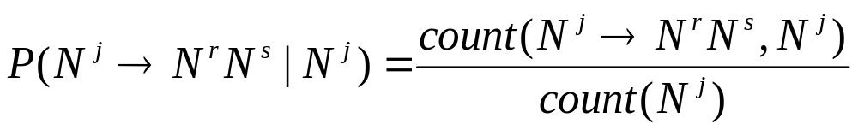
The inside-outside algorithm
Stated with the general schema described earlier, we seek to the MLE probabilities for productions in the grammar.
(Observe that this would be trivially easy to calculate this with a treebank, since the non-terminals are observable in a treebank)

Slide 22
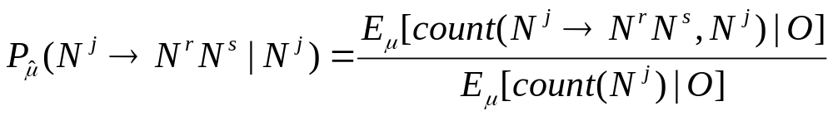
The inside-outside algorithm
Since the non-terminals are not visible, we can use EM to estimate the probabilities iteratively:

Slide 23
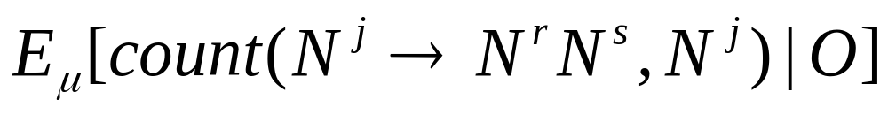
The inside-outside algorithm
We begin by taking the numerator alone:

Slide 24







The inside-outside algorithm
What we want is, for given non-terminals r and s, a probability that N^{j} is both used at some point in the derivation and accounts for span w_{pq}. Since there are two rules on the RHS, we need to pick a partition between the p and q, call it d:
w₁
. . .
w_{p-1}
w_{p}
. . .
w_{d}
w_{d+1}
. . .
w_{q}
w_{q+1}
. . .
w_{m}

Slide 25
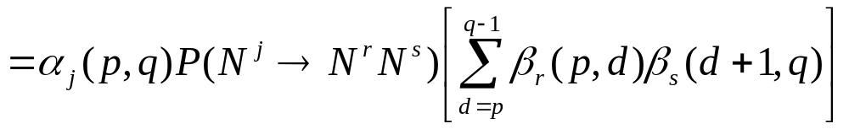
The inside-outside algorithm
Summing gives the total probability for any partition d:
Expectation just involves summing the probabilities of all possible opportunities for using this rule in the derivation of w_{1m}. Each such opportunity is a span p,q of 2 words or more in w_{1m} (since we are dealing with binary rules).

Slide 26

The inside-outside algorithm
We can use the definition of conditional probability
to turn into
Therefore, the expected value of the numerator in the EM equation is
P(O|μ) is just the inside probability

Slide 27
The inside-outside algorithm
Notice the analogy with the forward-backward algorithm.
Probability of getting from the start to the point where the latent event happens according to μ.
(Outside ≈ Forward)
Probability of the latent event according to μ.
(Rule ≈ Transition)
Probability of getting the rest of the way according to μ. (Inside ≈ Backward)
Number of opportunities for the unobservable event to happen.
(Spans ≈ Time steps)
Probability of the entire observed string being generated, according to μ (uses solution to “first fundamental problem”)

Slide 28
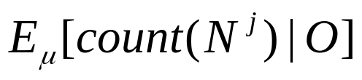
The inside-outside algorithm
What is the denominator ?
One possibility is to calculate the value of the numerator and sum the result over all non-terminals r, s.

Slide 29
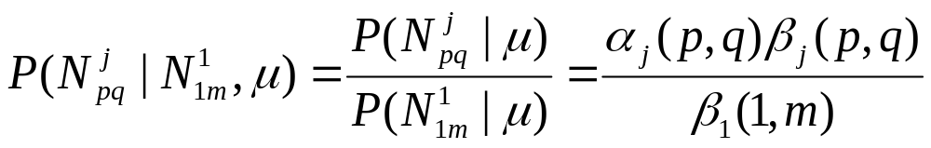
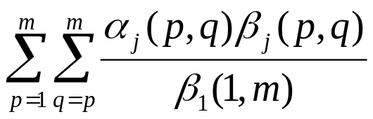
The inside-outside algorithm
Also, intuitively, it can be thought of as a sum of the probabilities over ALL spans in the w_{1m} that N^{j} generated. The probability for a production N^{j} in a given span p,q is:
Thus, the expectation count of using the production in a given sentence is:

Slide 30
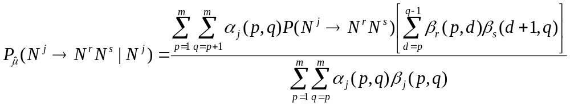
The inside-outside algorithm
Putting the pieces together yields:
Notice that the indices on the summations are slightly different. This is because the numerator deals exclusively with binary rules, which must span at least two terminals!

