Slide 1


Department of Information Technology V R Siddhartha Engineering College
Multiclass Classification of Gangrene and Ulcer Using MaxVit with Grad-CAM++ Explainability
Deep Learning and Medical Image Analysis
B.Tech in Information Technology
Major Project Review Presentation
Presented by
Potluri Sri Teja (228W1A12I2)
Kamisetty Deekshitha (228W1A12F8)
Under the guidance of
Dr. Y. Sangeetha, Assoc.Prof.

Slide 2
AGENDA
Introduction and Problem Statement
Objectives and Outcomes of the Project
Literature Summary
Datasets and Requirements specifications
Algorithms involved
Architecture diagram
Implementation steps
Results
Conclusion and Future work
References

Slide 3
Introduction
This project focuses on developing an explainable deep learning system for medical image classification, aimed at identifying severe skin conditions such as gangrene, ulcer, and normal cases. Early and accurate detection of these conditions is critical, as delayed diagnosis can lead to serious complications including infection spread and tissue damage.
Traditional diagnosis relies on visual examination, which may vary based on expertise and conditions. To address this limitation, advanced deep learning techniques are used to automate and improve classification accuracy.
The proposed system utilizes the MaxViT (Multi-Axis Vision Transformer) architecture to capture both local and global image features, along with Grad-CAM++ for visual explanation of model decisions. This combination ensures not only high accuracy but also interpretability, making the system reliable for real-world clinical applications.

Slide 4
Problem Statement
Accurate and early detection of severe skin conditions such as gangrene and ulcers is critical for effective treatment and prevention of complications. However, current diagnosis mainly relies on manual visual examination, which is time-consuming, subjective, and dependent on clinical expertise. Variations in wound appearance, lighting conditions, and patient diversity further increase the chances of misclassification.
Existing deep learning models improve accuracy but often function as black-box systems, providing predictions without clear explanations, which limits their adoption in clinical practice.
Therefore, there is a need for a system that can accurately classify medical images while also providing interpretable and reliable explanations, ensuring both high performance and clinical trust.

Slide 5
Objectives and Outcomes
Objectives:
To develop a deep learning model for accurate classification of medical images into gangrene, ulcer, and normal categories.
To implement the MaxViT architecture for capturing both local and global image features effectively.
To integrate Grad-CAM++ for generating visual explanations and improving model interpretability.
Outcomes:
Achieved high classification accuracy of 97.19% across all three classes.
Developed a model with strong generalization capability on unseen medical images.
Provided interpretable predictions using Grad-CAM++, increasing reliability and clinical trust.

Slide 6
LITERATURE SUMMARY
Title | Year | Description | Dataset | Algorithm | Conclusion
Image-Based Gangrene Disease Classification | 2020 | This study focuses on early detection of gangrene using image-based analysis. It uses traditional machine learning techniques to identify visual patterns such as tissue discoloration, necrosis, and infection spread. The work highlights the importance of automation in reducing dependency on manual diagnosis. | Medical images of gangrene cases | Traditional ML (Feature extraction + classification) | The study confirms that automated gangrene detection is feasible using image-based methods. However, traditional machine learning approaches struggle to handle variability in real-world data, highlighting the need for more advanced deep learning techniques for improved accuracy and robustness.
Advances in Image-Based Diagnosis of Diabetic Foot Ulcers Using Deep Learning Techniques | 2025 | This paper provides a comprehensive review of CNN-based approaches for detecting and classifying diabetic foot ulcers. It discusses how deep learning models improve identification of ulcer severity and progression, while also addressing challenges such as dataset imbalance and variability in wound appearance. | Diabetic foot ulcer image datasets | CNN-based models | The study concludes that CNN-based deep learning models significantly outperform traditional approaches in ulcer detection tasks. However, limitations such as lack of interpretability, sensitivity to dataset imbalance, and inability to capture global context indicate the need for more advanced and explainable architectures..

Slide 7
Title | Year | Description | Dataset | Algorithm | Conclusion
Enhanced Tuberculosis Detection using Vision Transformers and Grad-CAM | 2025 |  | Chest X-ray dataset | Vision Transformer + Grad-CAM | The results show that Vision Transformers achieve higher accuracy compared to CNNs by effectively capturing global relationships in images. Additionally, the use of Grad-CAM improves interpretability. However, the approach requires large datasets and high computational resources, which may limit practical deployment.
Explainable Deep Learning Framework for Diabetic Foot Ulcer Classification Using Grad-CAM | 2025 | This work develops an explainable deep learning framework using CNNs combined with Grad-CAM visualization. The model highlights important regions in ulcer images, helping clinicians understand the basis of predictions and improving transparency in decision-making. | Ulcer image dataset | CNN + Grad-CAM | The study demonstrates that integrating explainability techniques like Grad-CAM improves transparency and trust in model predictions. However, the reliance on CNN architecture limits performance in complex cases, suggesting the need for more advanced models that can capture both local and global features.
This study applies Vision Transformer models to detect tuberculosis from chest X-ray images. It integrates Grad-CAM for visual explanations, allowing identification of important regions influencing predictions. The approach demonstrates the advantage of transformers in capturing long-range dependencies in medical images.
Mulberry Leaf Disease Detection by CNN-ViT with XAI Integration | 2025 | This study proposes a hybrid CNN-ViT model that combines local feature extraction with global attention mechanisms for disease classification. Explainable AI techniques are integrated to visualize important regions, demonstrating improved performance in complex classification tasks. | Plant disease image dataset | CNN + Vision Transformer + XAI | The study concludes that hybrid models combining CNN and Vision Transformer architectures provide improved classification performance by capturing both local and global features. The integration of explainable AI further enhances model transparency, making such approaches highly suitable for complex image classification tasks.

Slide 8
Dataset and Requirements Specification
Dataset:
Source: Gangrene-v4 dataset from Roboflow.
Total images: 1653 color images (224×224px).
Train/Val/Test Split: 70% / 15% / 15%.
Requirements:
Software Requirements: Python with deep learning frameworks for model development and training.
Hardware Requirements: GPU-enabled system (NVIDIA Tesla T4) with sufficient RAM and storage.
Libraries: PyTorch/TensorFlow, OpenCV, NumPy, Pandas, Scikit-learn, Matplotlib, and Seaborn.

Slide 9
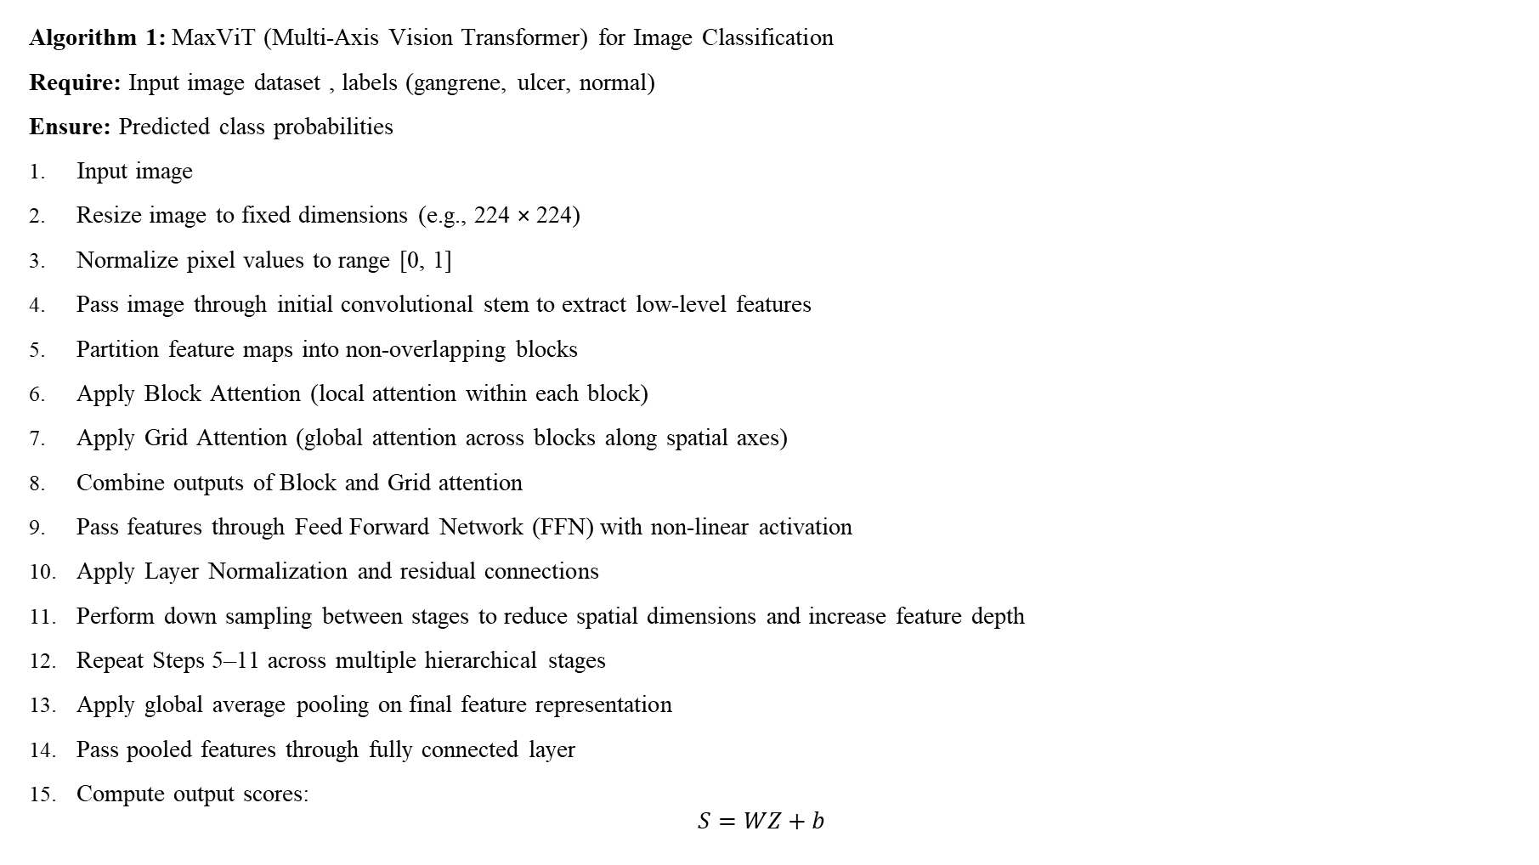
Algorithms
Algorithm 1: MaxViT (Multi-Axis Vision Transformer) for Image Classification
Require: Input image dataset , labels (gangrene, ulcer, normal)
Ensure: Predicted class probabilities
Input image
Resize image to fixed dimensions (e.g., 224 × 224)
Normalize pixel values to range [0, 1]
Pass image through initial convolutional stem to extract low-level features
Partition feature maps into non-overlapping blocks
Apply Block Attention (local attention within each block)
Apply Grid Attention (global attention across blocks along spatial axes)
Combine outputs of Block and Grid attention
Pass features through Feed Forward Network (FFN) with non-linear activation
Apply Layer Normalization and residual connections
Perform down sampling between stages to reduce spatial dimensions and increase feature depth
Repeat Steps 5–11 across multiple hierarchical stages
Apply global average pooling on final feature representation
Pass pooled features through fully connected layer
Compute output scores:
$$S=WZ+b$$

Slide 10

Apply Softmax function:
$$\hat{Y}=\text{Softmax}(S)$$
Assign predicted class based on maximum probability
Return predicted class probabilities
Algorithm 2: Grad-CAM++ for Visual Explanation
Require: Input image , trained model , target class
Ensure: Refined heatmap highlighting important regions
Input image to trained model
Perform forward pass to obtain class scores
Select target class score
Identify last convolutional layer feature maps
Compute first-order gradients:
$$\frac{∂y^{c}}{∂A^{k}}$$
6. Compute second-order gradients:
$$\frac{∂^{2}y^{c}}{∂(A^{k})^{2}}$$
7. Compute third-order gradients:
$$\frac{∂^{3}y^{c}}{∂(A^{k})^{3}}$$

Slide 11

8. Calculate weights :
$$α_{ij}^{kc}=\frac{\frac{∂^{2}y^{c}}{∂(A_{ij}^{k})^{2}}}{2\frac{∂^{2}y^{c}}{∂(A_{ij}^{k})^{2}}+\sum_{a,b}{A_{ab}^{k}}\frac{∂^{3}y^{c}}{∂(A_{ab}^{k})^{3}}}$$
9. Compute importance weights:
$$w_{k}^{c}=\sum_{i}{\sum_{j}{α_{ij}^{kc}}}⋅\text{ReLU}\left(\frac{∂y^{c}}{∂A_{ij}^{k}}\right)$$
10. Compute weighted combination of feature maps:
$$L^{c}=\sum_{k}{w_{k}^{c}}A^{k}$$
11. Apply ReLU to obtain final heatmap:
$$L_{Grad−CAM++}^{c}=\text{ReLU}(L^{c})$$
12. Upsample heatmap to match input image size
13. Overlay heatmap on original image
14. Return visualization map

Slide 12
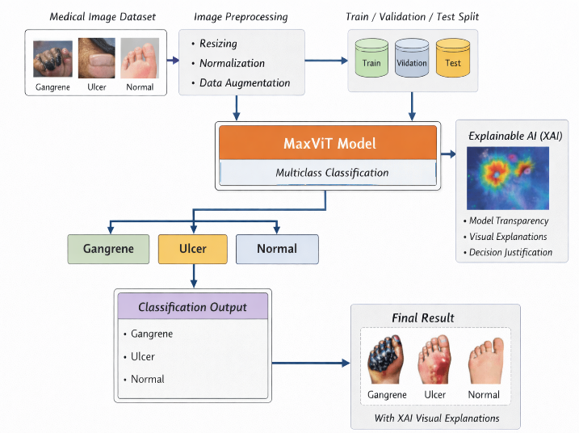
Architecture Diagram

Slide 13
Implementation steps
Data Collection: A dataset of 1653 medical images categorized into gangrene, ulcer, and normal classes was used. The dataset includes variations in texture, severity, lighting, and background conditions.
Data Preprocessing: Data cleaning was performed to remove inconsistencies. The dataset was split using stratified sampling into training (70%), validation (15%), and testing (15%). All images were resized to 224×224 and normalized.
Data Augmentation: Techniques such as rotation, flipping, zooming, and brightness adjustment were applied to improve model generalization and handle dataset variability.
Model Design: The MaxViT architecture was selected for classification. It combines convolutional operations for local feature extraction with transformer-based attention mechanisms for capturing global dependencies.

Slide 14
Model Training: The model was initialized with ImageNet pretrained weights. Training was performed in two stages: a warm-up phase (3 epochs) followed by fine-tuning (30 epochs). AdamW optimizer with differential learning rates was used.
Prediction: The trained model outputs probability scores for each class using the Softmax function, and the class with the highest probability is selected as the final prediction.
Explainability: Grad-CAM++ was applied to generate heatmaps that highlight important regions influencing model decisions, improving interpretability.
Model Evaluation: Performance was evaluated using accuracy, precision, recall, and F1-score. Confusion matrix analysis was used for detailed class-wise performance assessment.

Slide 15
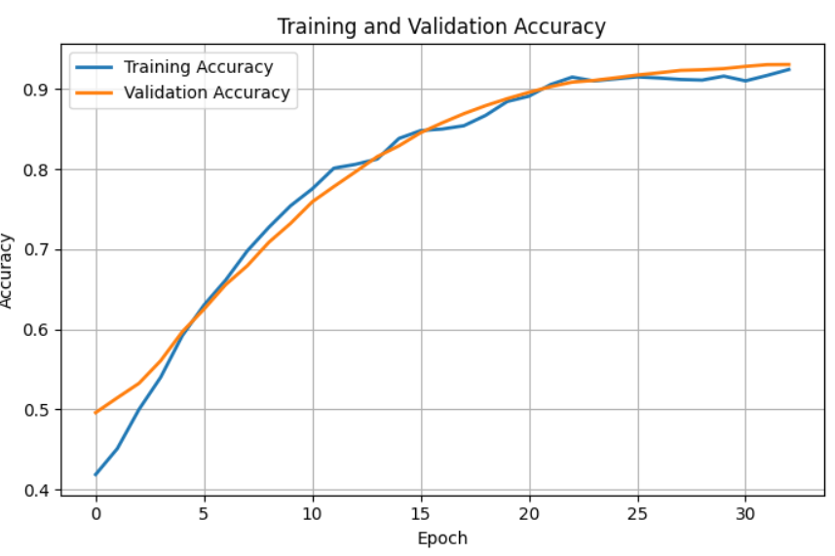
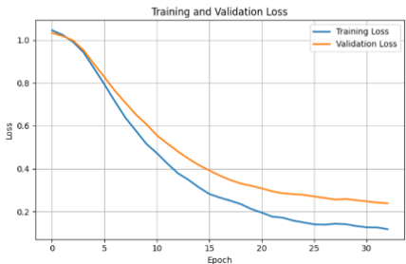
Results
Fig 1. Training vs Validation Accuracy
Fig 2. Training vs Validation Loss

Slide 16
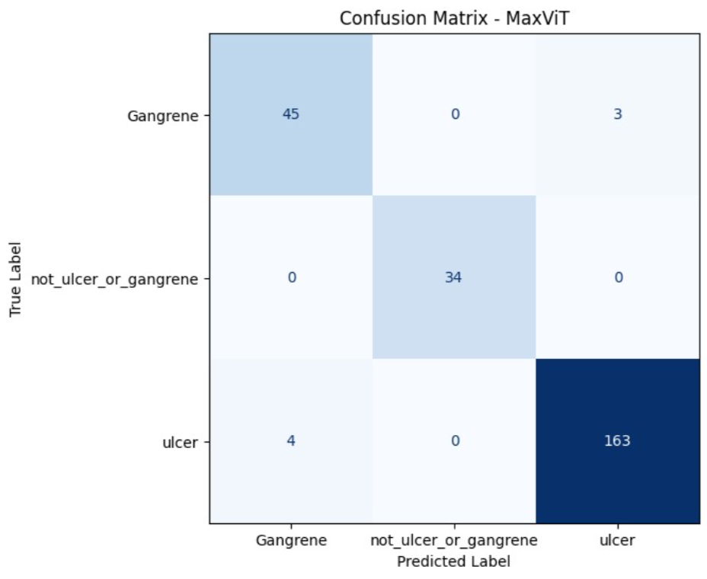
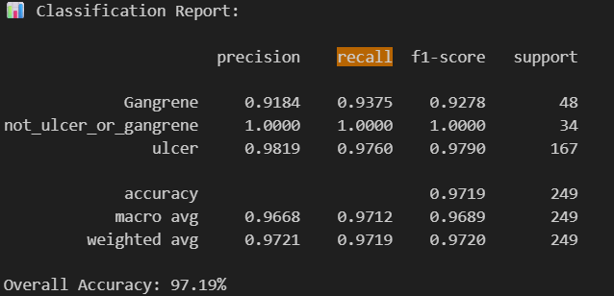
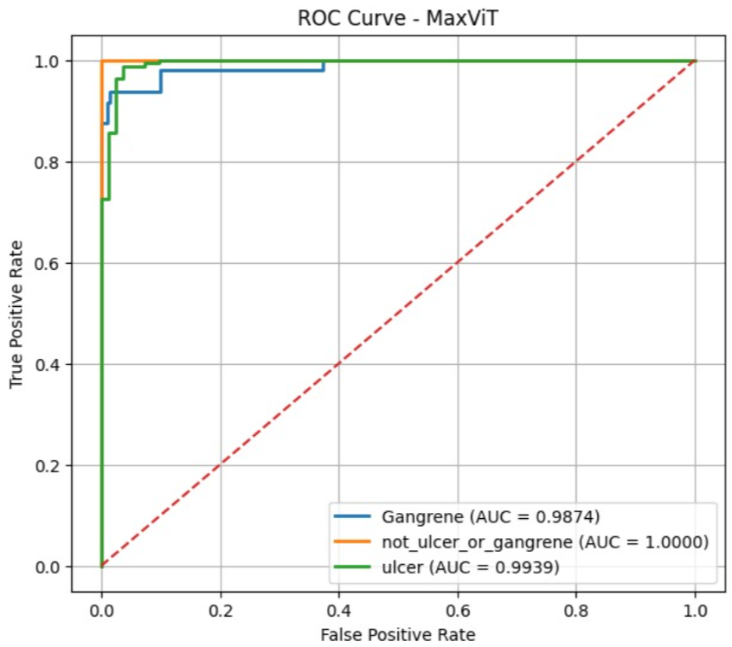

Slide 17
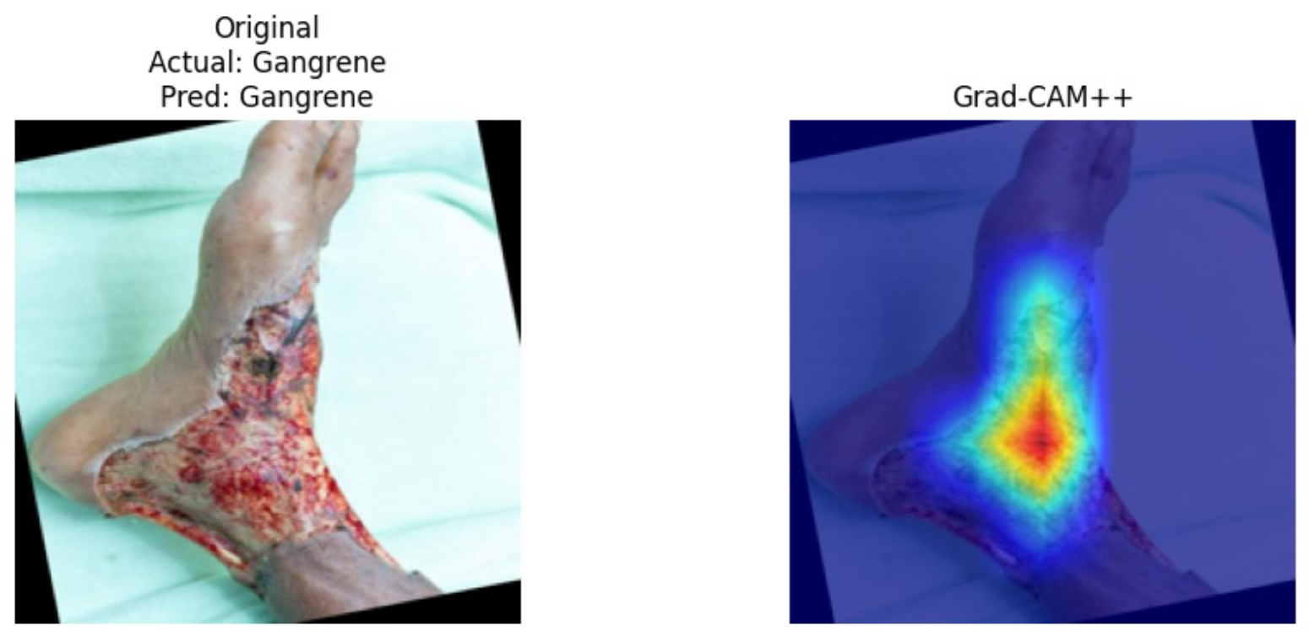
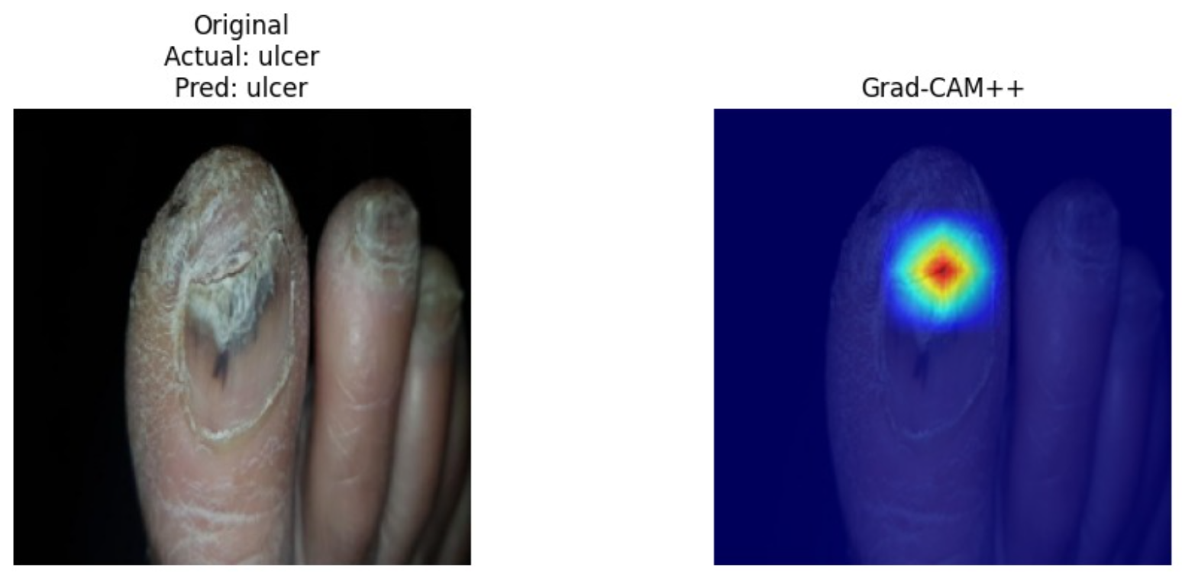
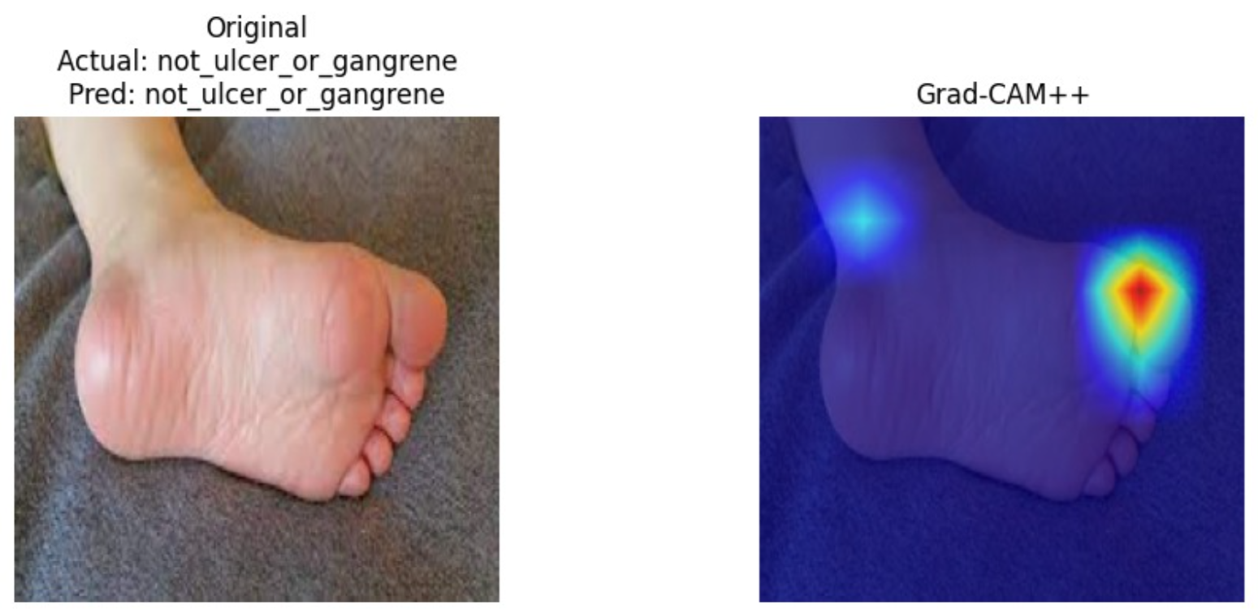

Slide 18
Conclusion and Future work
Conclusion:
The proposed system successfully classifies medical images into gangrene, ulcer, and normal with high accuracy (97.19%).
The use of MaxViT architecture enabled effective extraction of both local and global features.
Integration of Grad-CAM++ improved interpretability by highlighting clinically relevant regions.
The model demonstrated strong generalization and stable performance, making it suitable for real-world applications.
Future Work:
Extend the model to support more skin disease categories.
Optimize the model for real-time and mobile-based deployment.
Improve performance using larger and more diverse datasets.
Integrate the system into clinical decision support tools for practical usage.

Slide 19
REFERENCES
[1] P. S. Nair, T. A. Berihu, and V. Kumar, “An Image-Based Gangrene Disease Classification,” Int. J. Electr. Comput. Eng., vol. 10, no. 6, pp. 6001– 6007, 2020. [Online].
[2] H. F. Alhasson, M. Alshammari, and A. Alshammari, “Advances in Image-Based Diagnosis of Diabetic Foot Ulcers Using Deep Learning Techniques,” Diagnostics, vol. 15, no. 2, pp. 1–20, 2025. [Online].
[3] K. Vanitha, T. R. Mahesh, V. V. Kumar, and S. Guluwadi, “Enhanced tuberculosis detection using Vision Transformers and explainable AI with a Grad-CAM approach on chest X-rays,” BMC MEDICAL IMAGING, 2025.
[4] S. Khan, A. Rehman, and T. Saba, “Explainable Deep Learning Framework for Diabetic Foot Ulcer Classification Using Grad-CAM,” Biomed. Signal Process. Control, vol. 88, p. 105432, 2025. [Online].
[5] M. A. Hasan et al., “Mulberry leaf disease detection by CNN-ViT with XAI integration,” PLoS One, 2025.
[6] V. Kukreja and S. Mehta, “A Multi-Branch ConvNeXt–MaxViT Fusion Transformer Model for Radiographic Knee Osteoarthritis Severity Assessment with Grad-CAM++ Explainability,” 2025.
[7] H. Fardin, H. Imran, H. Rahman, and A. Sakib…, “Robust and explainable poultry disease classification via MaxViT with attention- guided visualization,” 2025.

Slide 20
[8] R. R. Selvaraju et al., “Grad-CAM: Visual Explanations from Deep Networks via Gradient-Based Localization,” 2017.
[9] M. Pritom, R. Oyshi, and M. Uddin…, “LeMaxViT: Lightweight Vision Transformer for Explainable Multi-Class Ocular Disease Detection Using Simple Eye Images,” 2026.
[10] A. Pranta, H. Fardin, J. Debnath, and A. Hossain…, “A novel maxvit model for accelerated and precise soybean leaf and seed disease identification,” Computers, 2025
[11] S. S. Yadav, A. K. Singh, and P. Sharma, “Deep Learning-Based Automated Classification of Diabetic Foot Ulcers Using Convolutional Neural Networks,” IEEE Access, vol. 12, pp. 98765–98778, 2024. [Online]. Available: https://doi.org/10.1109/ACCESS.2024.3325678
[12] R. K. Jain, V. Kumar, and S. Gupta, “Explainable Deep Learning Approach for Skin Disease Classification Using Grad-CAM,” Multimed. Tools Appl., vol. 83, pp. 12345–12360, 2024. [Online]. Available: https://doi.org/10.1007/s11042-024-12345-6

Slide 21
Thank You

