Slide 1
Add Reset Map to Existing Systems

Slide 2
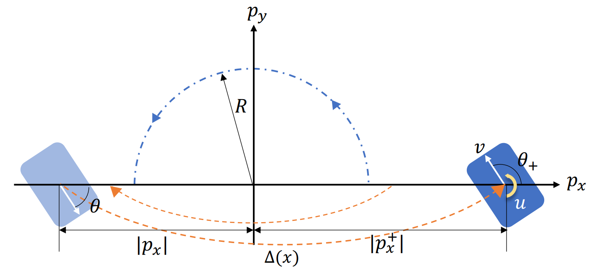

motivation
Standard dubins car dynamics, with
$$\left\{\begin{aligned}x_{post}=−\frac{x}{2} \\ y_{post}=y \\ θ_{post}=θ+π \end{aligned}\right.$$
When the car hits x-axis heading down
What if we have systems with discontinuous state changes upon contact (state reset).
We want to calculate the region of attractions for such systems using helperOC.
J. J. Choi, A. Agrawal, K. Sreenath, C. J. Tomlin and S. Bansal, "Computation of Regions of Attraction for Hybrid Limit Cycles Using Reachability: An Application to Walking Robots," in IEEE Robotics and Automation Letters, vol. 7, no. 2, pp. 4504-4511, April 2022, doi: 10.1109/LRA.2022.3151143.

Slide 3
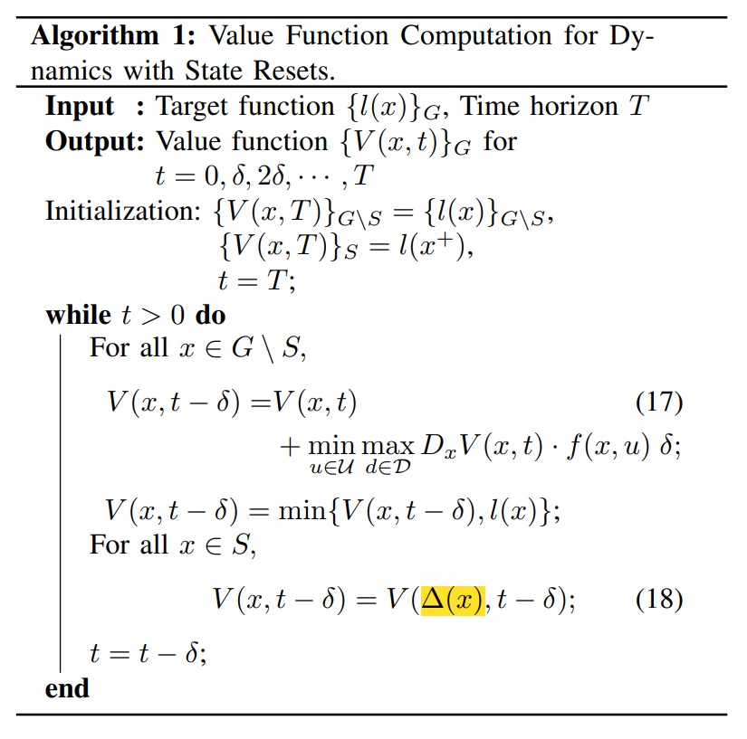
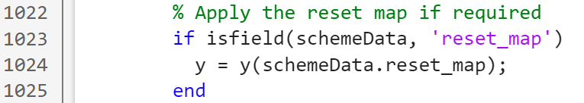
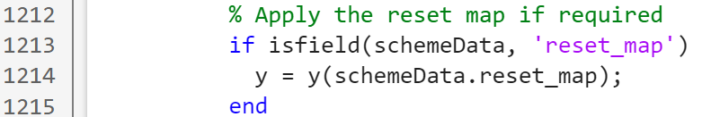
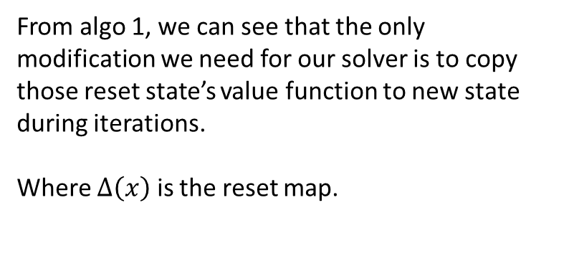
CALC HJI-pde WITH RESET MAP
From algo 1, we can see that the only modification we need for our solver is to copy those reset state’s value function to new state
during iterations.
Where $∆\left(x\right)$ is the reset map.
Modifications in HJIPDE_solve.m’s main iteration loop.
J. J. Choi, A. Agrawal, K. Sreenath, C. J. Tomlin and S. Bansal, "Computation of Regions of Attraction for Hybrid Limit Cycles Using Reachability: An Application to Walking Robots," in IEEE Robotics and Automation Letters, vol. 7, no. 2, pp. 4504-4511, April 2022, doi: 10.1109/LRA.2022.3151143.

Slide 4
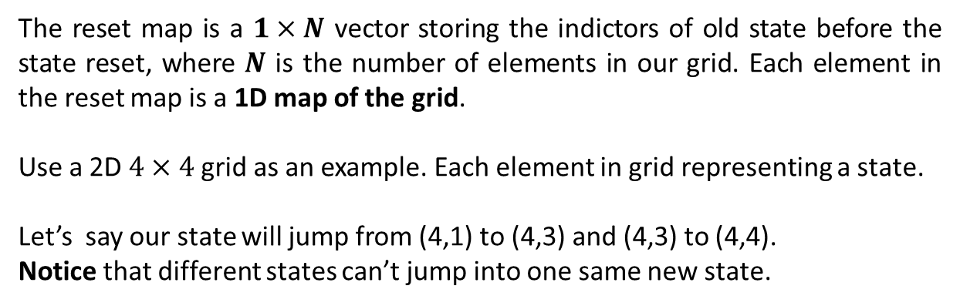
How to define the reset map
1,1
1,2
1,3
1,4
The reset map is a $1×N$ vector storing the indictors of old state before the state reset, where $N$ is the number of elements in our grid. Each element in the reset map is a 1D map of the grid.
Use a 2D $4×4$ grid as an example. Each element in grid representing a state.
Let’s say our state will jump from (4,1) to (4,3) and (4,3) to (4,4).
Notice that different states can’t jump into one same new state.
2,1
2,2
2,3
2,4
3,1
3,2
3,3
3,4
4,1
4,2
4,3
4,4
1D index for the grid, MATLAB defaults column first ranking
1,1
2,1
3,1
4,1
1,2
2,2
3,2
4,2
1,3
2,3
3,3
4,3
1,4
2,4
3,4
4,4
Known index’s order, simplify with only 1 number for each grid
1
2
3
4
5
6
7
8
9
10
11
12
13
14
15
16
Swap index, this is the reset map we get. It means grid 12 will be jumped from grid 4, etc.
1
2
3
4
5
6
7
8
9
10
11
4
13
14
15
12

Slide 5
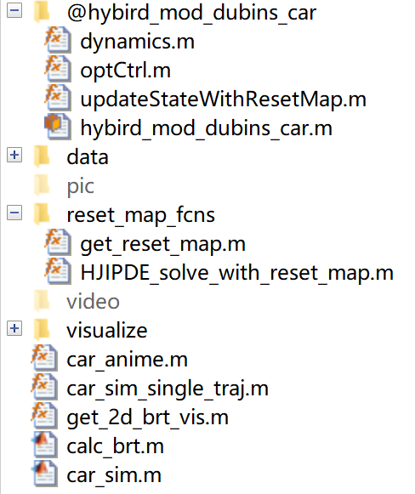
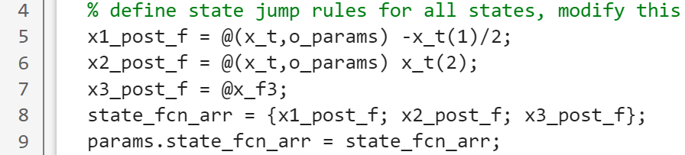
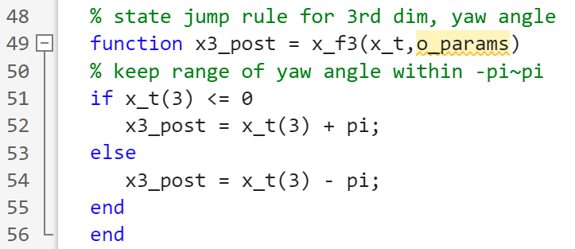

CODE Implementation
First we want to modify get_reset_map.m
Define state jump rules based on your system, al rules are stored in the cell ‘state_fcn_arr’
$$\left\{\begin{aligned}x_{post}=−\frac{x}{2} \\ y_{post}=y \\ θ_{post}=θ+π \end{aligned}\right.$$
Define functions for each variables in state.
We can also define them in separate functions.
Where x_t is the system state vector,
o_params are the optional parameters passed through to describe state reset rules.
Notes:
Define functions using the whole state as input

Slide 6
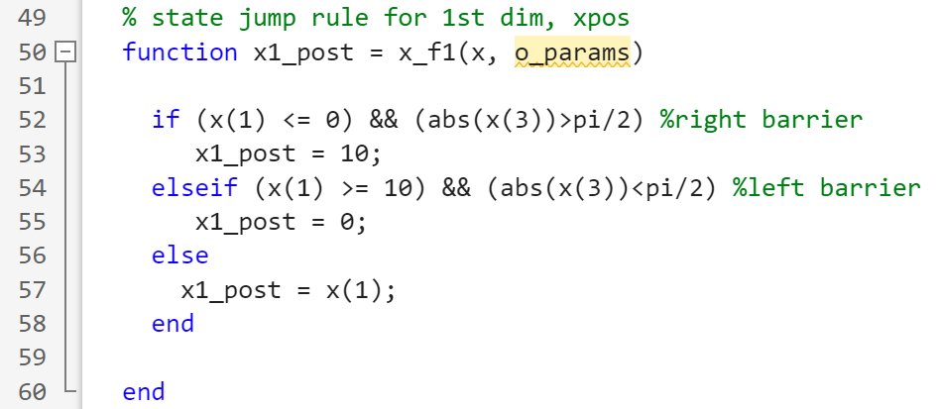
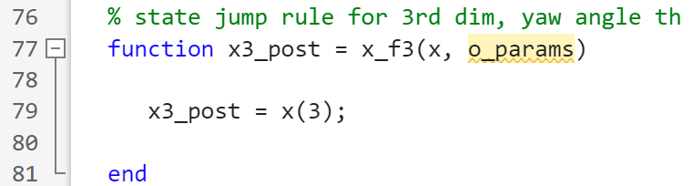
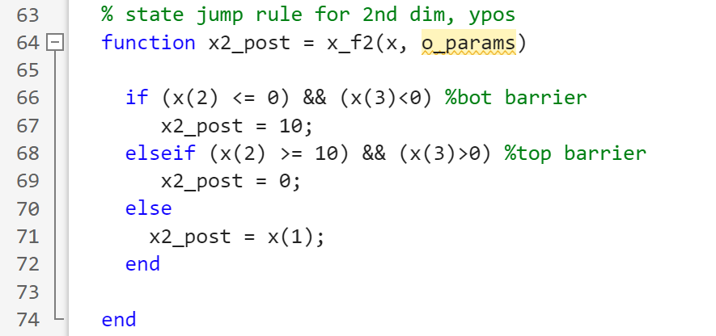
EXAMPLE OF A COMPLEX RESET EVENT - 1
Use different states to define a reset rule.
Notes:
Same as before, multiple reset trigger handling

Slide 7
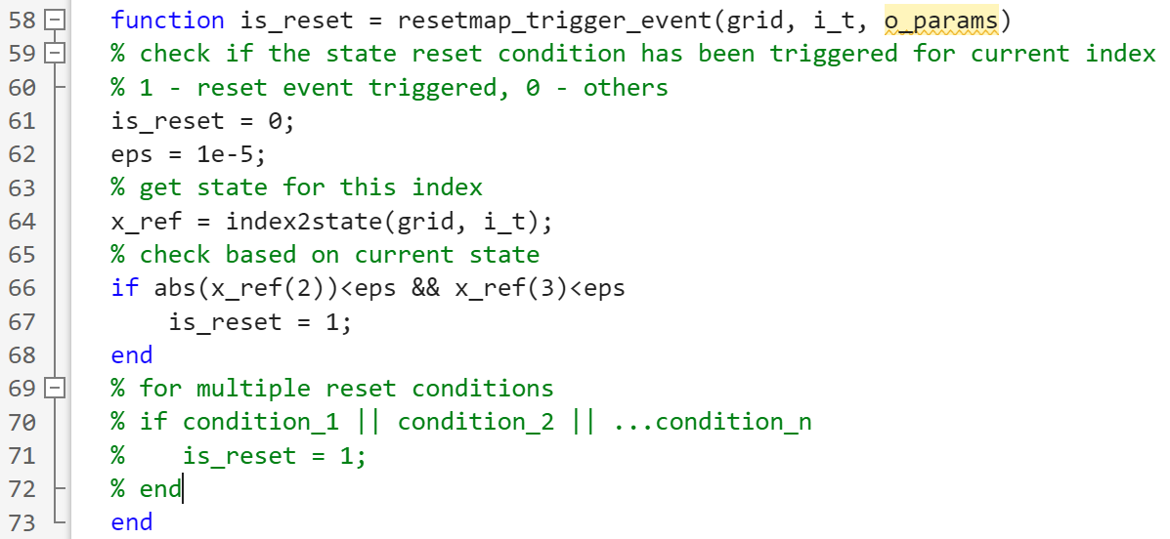

CODE Implementation
Also in the get_reset_map.m
Define the state reset condition. In our case, It’s when the car hit x-axis heading down
$$\left\{\begin{aligned}y=0 \\ θ<0\end{aligned}\right.$$
We use a very small value eps for condition check.
Because the state for each grid can’t be perfect zero or some integer values due to the limited grid resolution.
Notes:
How to handle multiple conditions for triggering a reset

Slide 8
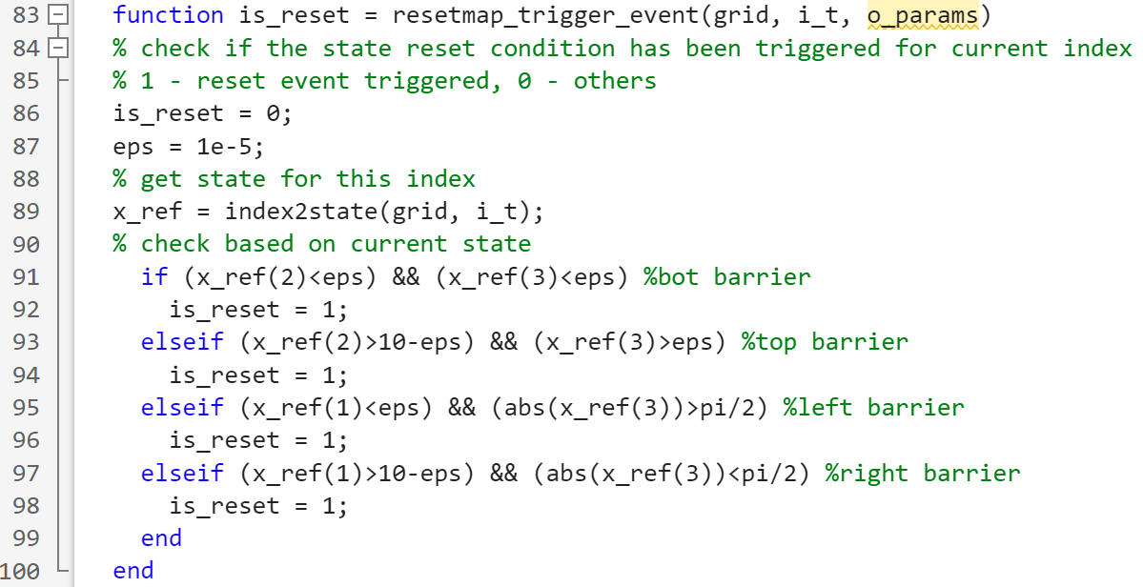
EXAMPLE OF A COMPLEX RESET EVENT - 2
Multiple reset trigger handling
Notes:
Same as before, multiple reset trigger handling

Slide 9
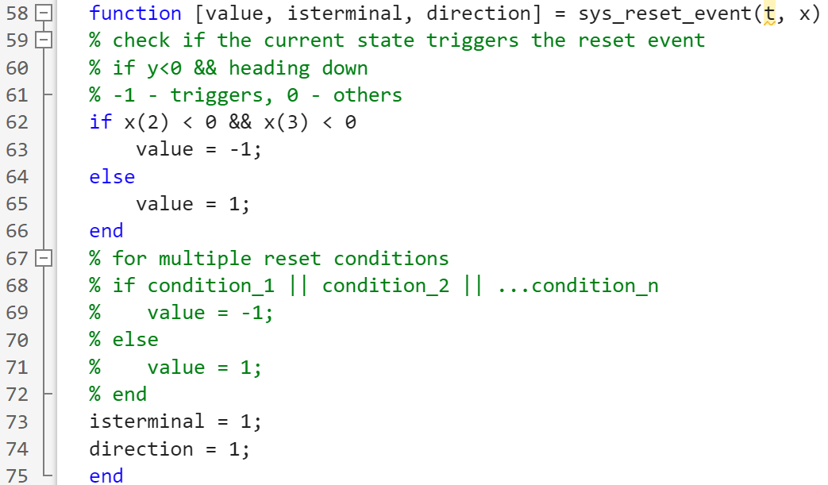
CODE Implementation
Second we want to modify updateStateWithResetMap.m
It’s an inherited function from dynSys.updateState
Define the state reset condition, so that the ode can reset state during the simulation process.
When simulating, we’re handling more ‘continuous’ states, thus there’s no need to use eps for condition checks.
Notes:
Same as before, multiple reset trigger handling

Slide 10
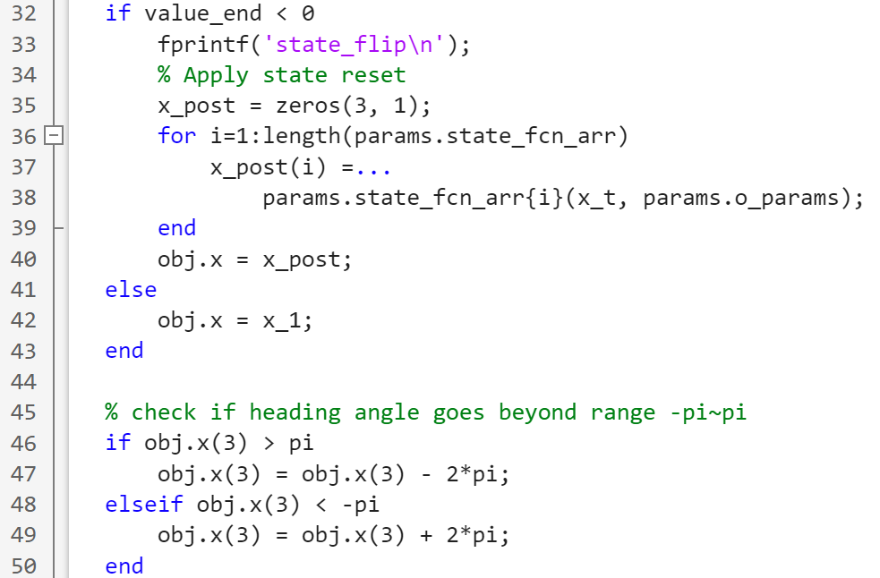
CODE Implementation
If there’s a state reset, we’ll use the reset rules earlier defined to calculate new states.
Notes:
Same again

Slide 11
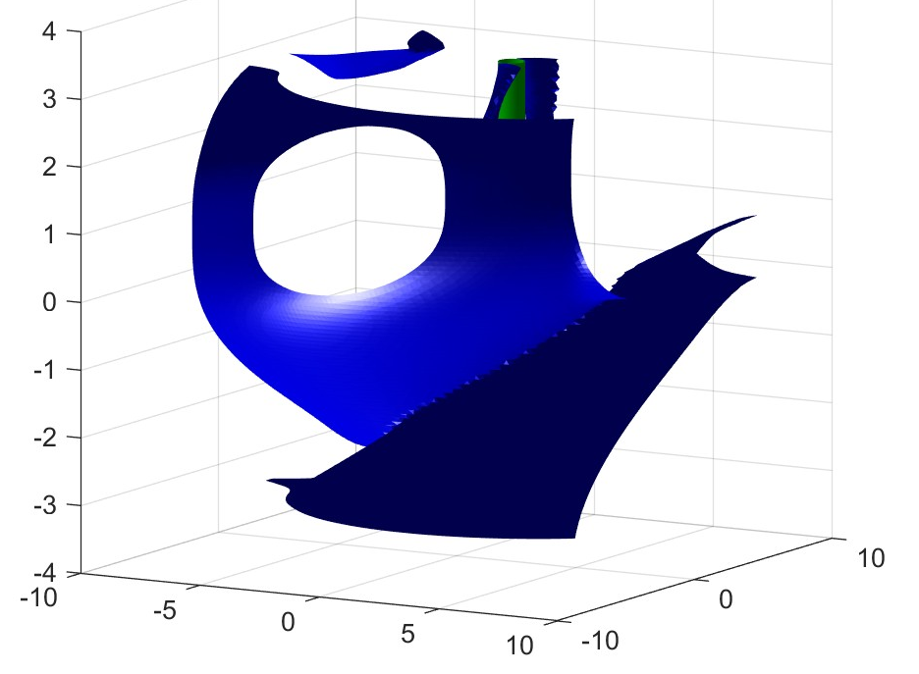
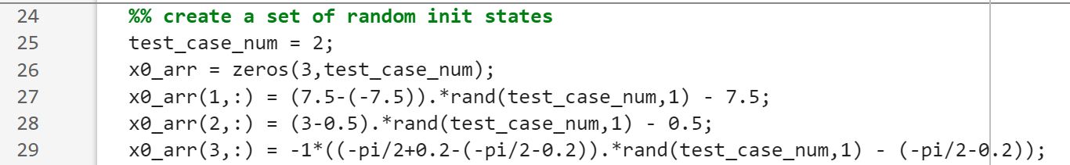
Get BRT and simulation
First run the calc_brt.m
The BRT will be saved
under data\ subfolder.
Then run car_sim.m
Test case numbers and initial states can be modified at
Simulation result will be saved at video\ subfolder.
Code – https://github.com/psrobotics/reachability_reset_map_tutorial

