Slide 1

Introduction to Artificial Intelligence
By Shrinivasan Patnaikuni (P.S.R. Patnaik)
Founder@CloudLab.in

Slide 2

Trainer Profile
Master in Computer Science & Engineering
Currently pursuing PhD in Artificial Intelligence
AWS Certified Solutions Architect
Microsoft Certified Specialist in Architecting Azure Solutions.
9+ years of experience in Cloud, Big Data, AI and IoT

Slide 3
Training Agenda Day wise
Day – 1: Introduction to AI and Mathematical Foundations for AI
Day – 2 : Introduction Machine Learning & Algorithms
Day – 3 : Artificial Neural Networks
Day – 4 : Hands on Tensor Flow and related tools (requires Python knowledge)

Slide 4
Day-1
Learning Objectives:
To develop clear understanding of “What is AI ?”.
To introduce basics of statistics, probability and calculus required for modeling and developing AI applications.

Slide 5
Introduction to AI (Artificial Intelligence)
Why to know ?
“What is AI ?”

Slide 6
In 2016, the AI market was worth $644 million. In 2017, the market value of AI is expected to double and continue to grow exponentially until it reaches $38.6 billion in less than 10 years.
src: https://www.tractica.com/newsroom/press-releases/artificial-intelligence-revenue-to-reach-36-8-billion-worldwide-by-2025/

Slide 7
What is AI ?
How is it different from ? Is there any difference at all ?
Data Science
Data Mining
Machine Learning
Curious readers can go to StackOverFLow Question on difference.
Lets us see……..

Slide 8
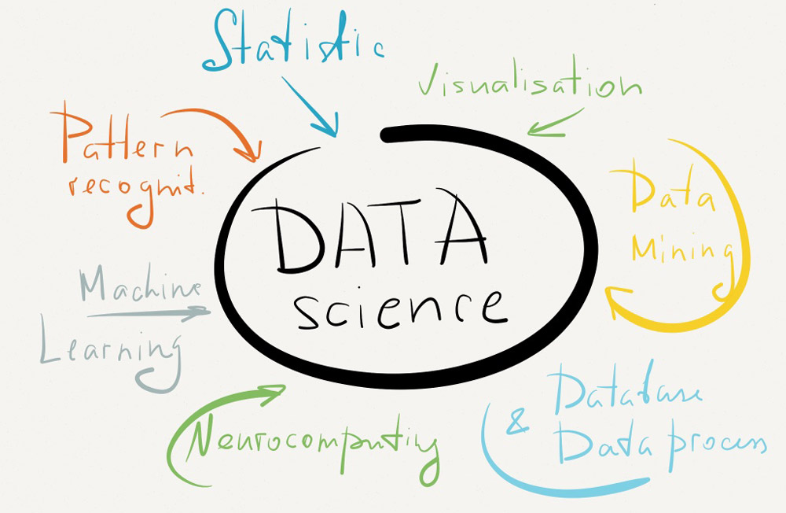

Slide 9
ML (Machine Learning)
Stanford: Machine learning is the science of getting computers to act without being explicitly programmed.
Wikipedia: Machine learning is the subfield of computer science that gives computers the ability to learn without being explicitly programmed

Slide 10
ML and Data Mining
Machine Learning = Data Mining? NO
Machine learning focuses on prediction, based on known properties learned from the training data.
Data mining; which is the analysis step of Knowledge Discovery in Databases focuses on the discovery of (previously) unknown properties on the data.

Slide 11
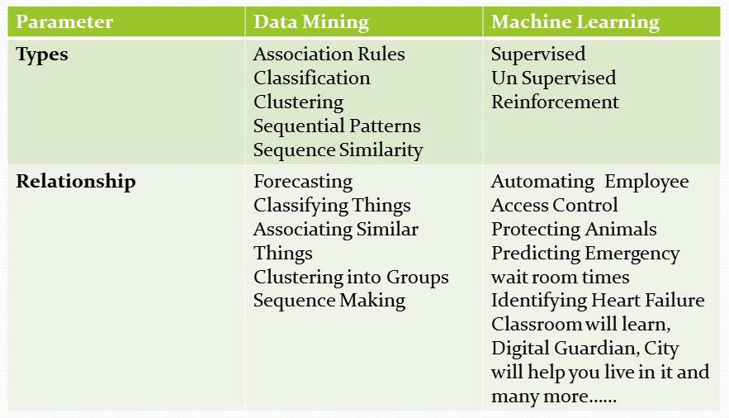
ML vs. Data Mining

Slide 12
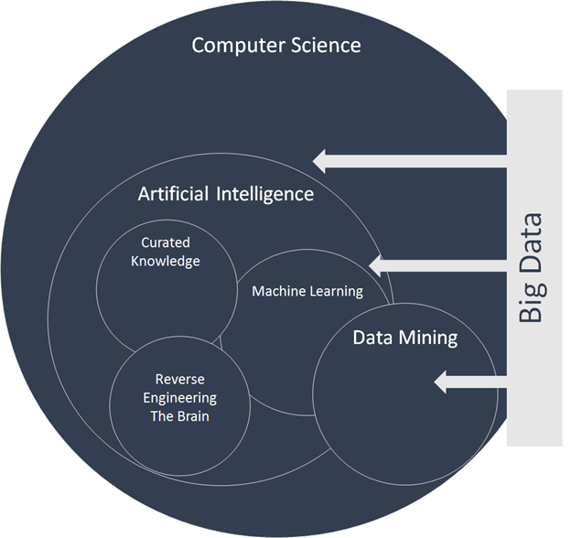
src: https://inovancetech.com/buzzwords.html

Slide 13
src: https://inovancetech.com/buzzwords.html

Slide 14
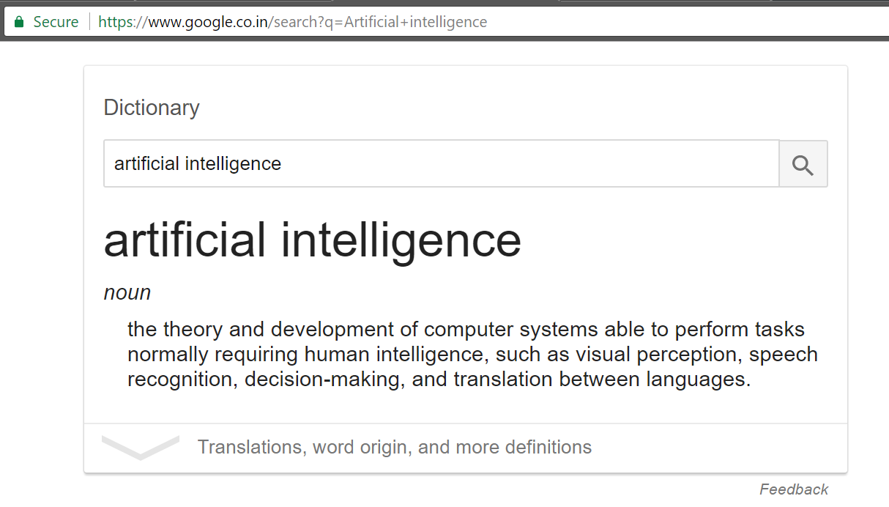
And here’s what Google tells me

Slide 15
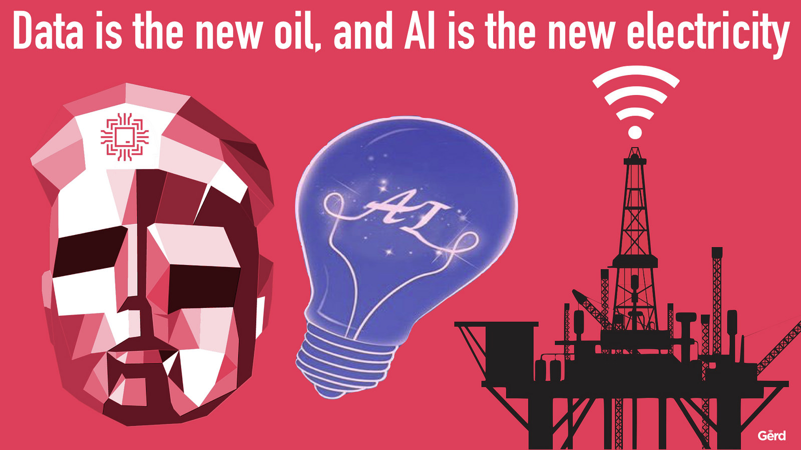

Slide 16
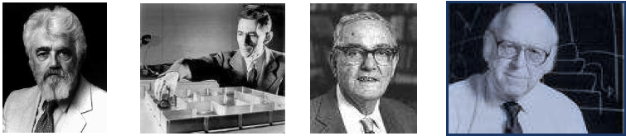
Brief history of AI
The birth of artificial intelligence
1956: Dartmouth Conference - "Artificial Intelligence" adopted
The term ‘Artificial Intelligence’ was coined in a proposal for the conference at Dartmouth College in 1956
The term stuck, though it is perhaps a little unfortunate . . .

Slide 17
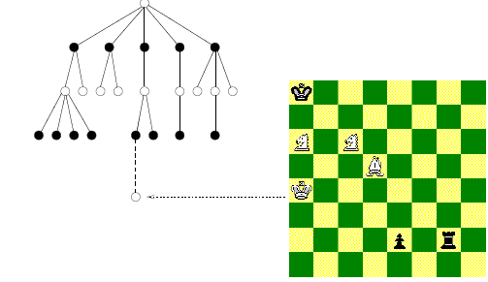
Brief history of AI
One of the early research in AI is search problem such as for game-playing. Game-playing can be usefully viewed as a search problem in a space defined by a fixed set of rules
Nodes are either white or black corresponding to reflect the adversaries’ turns.
The tree of possible moves can be searched for favourable positions.

Slide 18
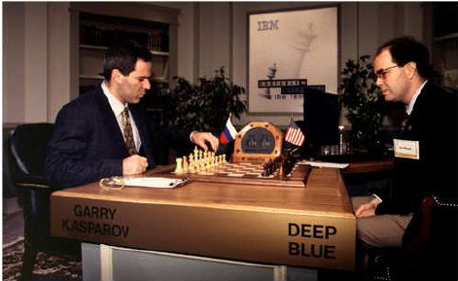
Brief history of AI
The real success of AI in game-playing was achieved much later after many years’ effort.
It has been shown that this search based approach works extremely well.
In 1996 IBM Deep Blue beat Gary Kasparov for the first time. and in 1997 an upgraded version won an entire match against the same opponent.

Slide 19
Brief history of AI
Another of the early research in AI was applied the similar idea to deductive logic:
All men are mortal
Socrates is a man man(Socrates)
Socrates is mortal mortal(Socrates)
The discipline of developing programs to perform such logical inferences is known as (automated) theorem-proving
The idea was to code common sense knowledge as logical axioms, and employ a theorem-prover.
But logic is rigid to a formalism to accommodate many aspects of common-sense reasoning.
Major problem: deductive logic systems do not allow for the phenomenon of uncertainty.

Slide 20
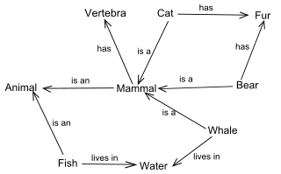
Brief history of AI
Semantic Networks
A semantic net is a network which represents semantic relations among concepts. It is often used as a form of knowledge representation.
Nodes : used to represent objects and descriptions.
Links : relate objects and descriptors and represent relationships.

Slide 21
Brief history of AI
Problems then:
Limited computing power: There was not enough memory or processing speed to accomplish anything truly useful
Intractability and the combinatorial explosion: In 1972 Richard Karp showed there are many problems that can probably only be solved in exponential time (in the size of the inputs).
Common-sense knowledge and reasoning: Many important applications like vision or natural language require simply enormous amounts of information about the world and handling uncertainty.

Slide 22
AI Today ?
AI today greatly benefits from:
the incredible power of computers today
a greater emphasis on solving specific sub problems
the creation of new ties between AI and other fields working on similar problems
a new commitment by researchers to solid mathematical methods and rigorous scientific standards, in particular, based probability and statistical theories
Significant progress has been achieved in neural networks, probabilistic methods for uncertain reasoning and statistical machine learning, machine perception (computer vision and Speech), optimisation and evolutionary computation, fuzzy systems, Intelligent agents.

Slide 23
So…..
AI has been into existence since 1956
AI was not into the mainstream IT until late 2012
Then why now AI is back ?
Availability of cheap and incredibly high compute and parallel processing capabilities
Rapid Research into the niche mathematical fields pertaining to AI.
Deep Learning !
Probabilistic and Statistical Approach
Success achieved in recent times by “Tech Giants” in IT
ref: https://blogs.nvidia.com/blog/2016/07/29/whats-difference-artificial-intelligence-machine-learning-deep-learning-ai/

Slide 24
AI Applications
Natural language processing such as
Natural Language Understanding
Speech Understanding
Language Generation
Machine Translation
Information retrieval and text mining
Pattern recognition and machine perception, e.g.,
Computer vision
Speech recognition

Slide 25
AI Applications
Social and business intelligence such as
Social and customer behaviour modelling
Deduction, reasoning, problem solving such as
Theorem-provers, solve puzzles, play board games
Knowledge representation such as
Expert systems
Automated planning and scheduling
Motion and manipulation such as
Robotics to handle such tasks as object manipulation and navigation, with sub-problems of localization (knowing where you are), mapping (learning what is around you) and motion planning (figuring out how to get there)

Slide 26
