Slide 1

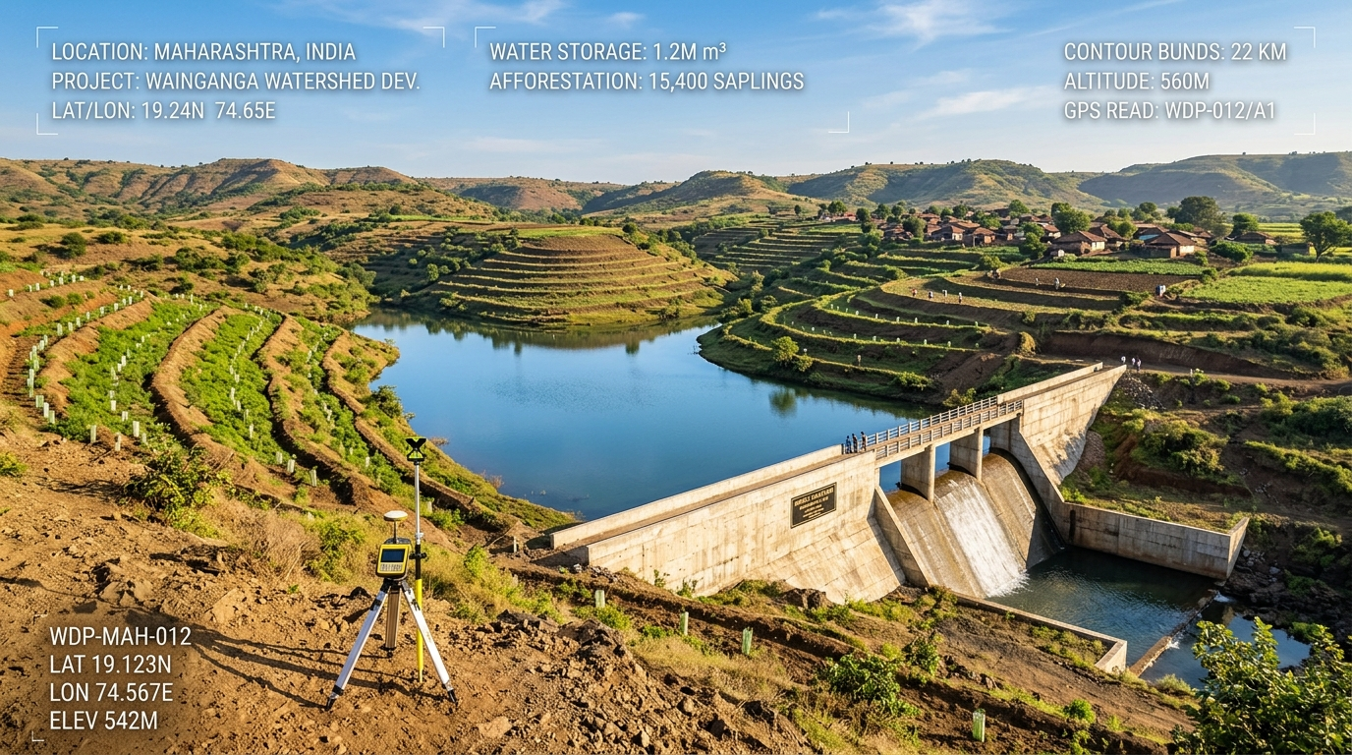

SMART INDIA HACKATHON 2025
TITLE PAGE
Project Name: WatershedVision
Tagline: Converting field photographs and satellite data into actionable watershed decisions.
Problem Statement ID: 26015
Problem Statement Title: Application of Geospatial Techniques for visualization and analysis to interpret Geo-Coded Images to enhance watershed Development Outcomes
Ministry / Dept: Department of Land Resources (DoLR), Ministry of Rural Development
Theme: Agriculture, FoodTech & Rural Development
PS Category: Software
Team Name: WatershedVision Team [SIH-2025-WV01]
Institution: [Registered College / University Name]
Team Members & Depts: 6 Members (CSE, AI & Data Science, Civil/GIS, IT)
Mentor Name: [Domain / Faculty Mentor Name]

Slide 2
IDEA TITLE
WatershedVision Team
Proposed Solution (Describe your Idea/Solution/Prototype)
Problem Statement Realities:
  • Massive Photo Archives: Thousands of geo-tagged ground images collected without automated classification.
  • Slow Manual Auditing: Inspection teams take weeks to identify damaged or silted structures.
  • Data Silos: Ground photos, satellite rasters, and cadastral boundaries are disconnected.
  • Reactive Maintenance: Field officers lack real-time decision support to triage repair budgets before monsoons.
Detailed Explanation of Proposed Solution:
  • Command Centre: Merges field photographs, GPS EXIF, satellite imagery, and multimodal AI.
  • Civil Classification: Automatically identifies check dams, ponds, and bunds with structural integrity and siltation scoring.
  • Satellite Outcome Tracking: Computes multi-temporal NDVI and NDWI deltas over multi-year treatment periods.
  • Evidence-Based Reporting: Generates statutory MoRD/DoLR audit dossiers with cryptographic verification seals.
Innovation & Technical Uniqueness:
  • Passive to Active: Converts legacy photo archives into verified geospatial intelligence.
  • 3D Anti-Spoofing: Cross-checks smartphone EXIF altitude against SRTM 30m DEM to eliminate mock GPS tampering.
  • Cadastral Linking: Enforces PostGIS point-in-polygon checks against registered micro-watershed boundaries.
  • Workflow: Field Photo + GPS → AI Multimodal Analysis → Satellite Comparison → Health Score → Statutory Report.

Slide 3
TECHNICAL APPROACH
WatershedVision Team
Technologies to be used & Implementation Methodology
Technologies to be Used:
  • Frontend UI/GIS: React 18, Vite, Tailwind CSS, Leaflet JS, Recharts data visualization.
  • Backend Services: Python 3.11, FastAPI (async/await), Uvicorn ASGI, Docker containerization.
  • Spatial Database: PostgreSQL 15 + PostGIS spatial extensions for polygon boundaries and OGC queries.
  • Earth Observation: Google Earth Engine (GEE), Copernicus Sentinel-2 MSI (10m), Landsat 8/9.
  • Multimodal Vision AI: Gemini Vision API + PyTorch feature classifiers for civil structure inspection.
  • Data & Protocols: RESTful JSON APIs, OGC GeoJSON FeatureCollections, GDAL / Rasterio geoprocessing.
Methodology & Implementation Process:
  • Pipeline: Field Photos + GPS → EXIF/DEM Validation → Vision AI Classification → Sentinel-2 Processing → PostGIS DB → Command UI.
  • Automated EXIF Extraction: Extracts coordinates, altitude, and capture timestamps from survey photographs.
  • 3D Elevation Cross-Check: Cross-examines photo elevation with SRTM 30m DEM; flags discrepancies >35m as tamper alerts.
  • Satellite Change Detection: Pre-monsoon vs. post-monsoon NDVI/NDWI raster difference computation.
  • Bilingual Field Accessibility: Complete English and Hindi (हिंदी) localization for Gram Panchayat and SLNA officers.

Slide 4
FEASIBILITY AND VIABILITY
WatershedVision Team
Feasibility Analysis, Potential Challenges & Mitigation Strategies
Feasibility Analysis:
  • Proven Stack: Built on robust open-source frameworks (FastAPI, PostGIS, Leaflet) eliminating proprietary licensing.
  • Live Web Prototype: Fully operational and deployed on cloud container infrastructure with zero client-side installs.
  • High Throughput: PostGIS handles thousands of micro-watersheds with sub-second spatial queries.
  • Cloud Satellite Processing: Google Earth Engine offloads heavy multispectral raster math from field machines.
Potential Challenges & Risks:
  • Missing GPS Metadata: Certain camera apps strip EXIF geolocation metadata.
  • Variable Photo Quality: Blurry, low-light, or occluded photographs taken during adverse field weather.
  • Monsoon Cloud Cover: Optical Sentinel-2 imagery obscured during critical post-monsoon acquisition windows.
  • External API Latency: Network outages or rate limits on cloud AI endpoints.
Mitigation Strategies & Scalability:
  • Interactive Correction: Surveyors can manually verify or drop coordinates on cadastral boundary maps.
  • Confidence Gating: Predictions under 75% confidence are flagged for human inspection by district engineers.
  • Temporal Composites: Multi-date cloud-masked compositing (May–Oct) penetrates cloud gaps using QA bands.
  • Scalability: Scalable from micro-watersheds to district (DWDC) and state (SLNA); offline-first PWA sync ready.

Slide 5
IMPACT AND BENEFITS
WatershedVision Team
Stakeholder Value, Operational Outcomes & Environmental Sustainability
Target Beneficiaries:
  • District Watershed Officers: Holistic dashboard tracking intervention progress and fund allocation.
  • Field Surveyors: Rapid smartphone image upload with instant geofence and elevation validation.
  • GIS & Remote Sensing Cells: Ready-to-use vector drainage, NDVI deltas, and intervention density heatmaps.
  • Government Administrators: Standardized, audit-ready compliance reporting across thousands of projects.
Operational & Governance Benefits:
  • Faster Photo Auditing: Replaces manual scanning with automated classification and structural grading.
  • Anti-Fraud Verification: Point-in-polygon and DEM elevation checks eliminate fraudulent location reporting.
  • Objective Prioritization: Ranks physical interventions by siltation severity and capacity retention.
  • Transparent Reporting: One-click generation of official DoLR/MoRD format dossiers with QR verification.
Environmental Outcomes & Impact Statement:
  • Plantation Survival: Measures canopy cover recovery over 3-year periods to verify afforestation success.
  • Soil Conservation: Identifies drainage channels requiring emergency gully plugs or contour bunds.
  • Water Security: Maps surface water body expansion across post-monsoon cycles.
  • Impact Statement: 'WatershedVision helps administrators move from reactive inspection to proactive, data-driven watershed management.'

Slide 6
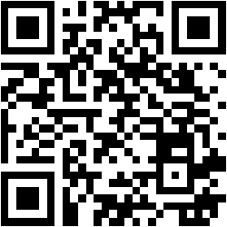
RESEARCH AND REFERENCES
WatershedVision Team
Details / Links of Reference & Research Work, Project Verification
Official Standards & Scientific Literature:
  • WDC-PMKSY 2.0 Operational Guidelines: Department of Land Resources (DoLR), Ministry of Rural Development.
  • Bhuvan SRISHTI & DRISHTI Framework: National Remote Sensing Centre (NRSC) / ISRO.
  • Copernicus Sentinel-2 Technical Guide: European Space Agency (ESA) · 10m Multi-Band Optical Surface Reflectance.
  • USGS Landsat 8-9 Surface Reflectance: U.S. Geological Survey & NASA · Earth Observation Spectral Archive.
  • Google Earth Engine: Planetary-Scale Geospatial Analysis: Gorelick, N. et al. (Remote Sensing of Environment, 2017).
  • PostGIS 3.4 Spatial Database: Open Geospatial Consortium (OGC) · Standardized Point-in-Polygon Engine.
Open-Source Project Links & Verification:
  • GitHub Repository: https://github.com/psryogeshwar-14/watershed-vision
  • Live Web Application: https://watershed-vision.vercel.app/
  • Stack Verification: React 18, Vite, FastAPI, PostgreSQL/PostGIS, Sentinel-2, Docker containerized.
Governance & Limitations Note:
  • Screening Support: AI predictions support screening and prioritisation.
  • Human Governance: Final engineering, funding, and maintenance decisions remain with authorised officers.

