Slide 1
Document Classification

Slide 2

Text Classification: definition
Input:
a document $d$
a fixed set of classes $C = \{c_{1}, c_{2},…, c_{j}\}$
Output: a predicted class $c∈C$

Slide 3
Requirements
Any Data
Any algorithms including Naive Bayes
Implement Naive Bayes
Do not use library of Naive Bayes
Compare three (or more) algorithms

Slide 4
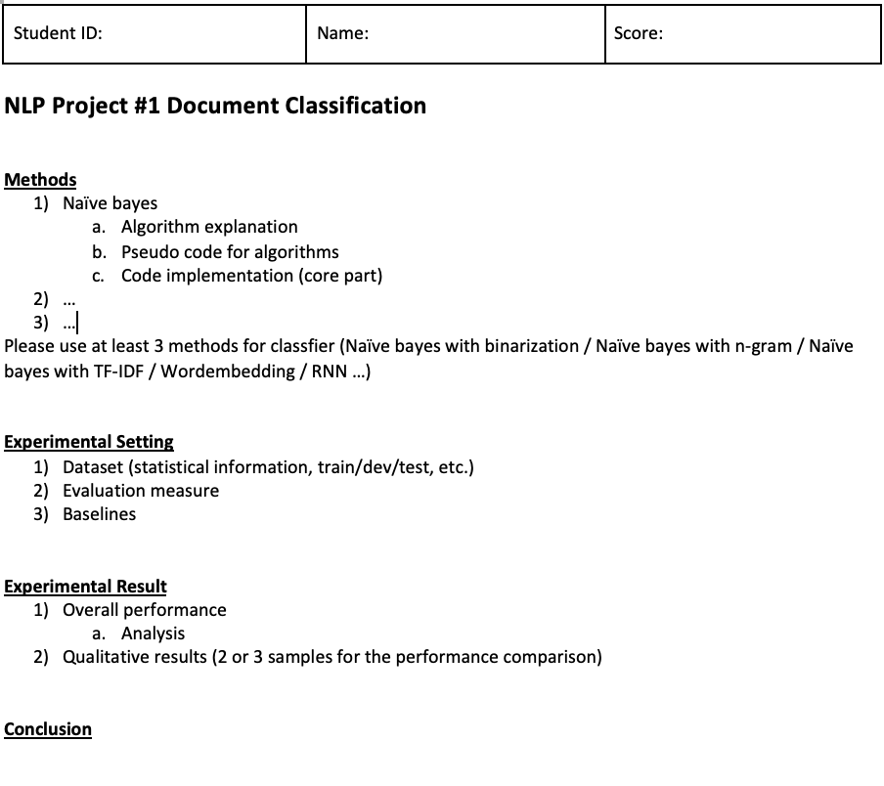
Format

Slide 5
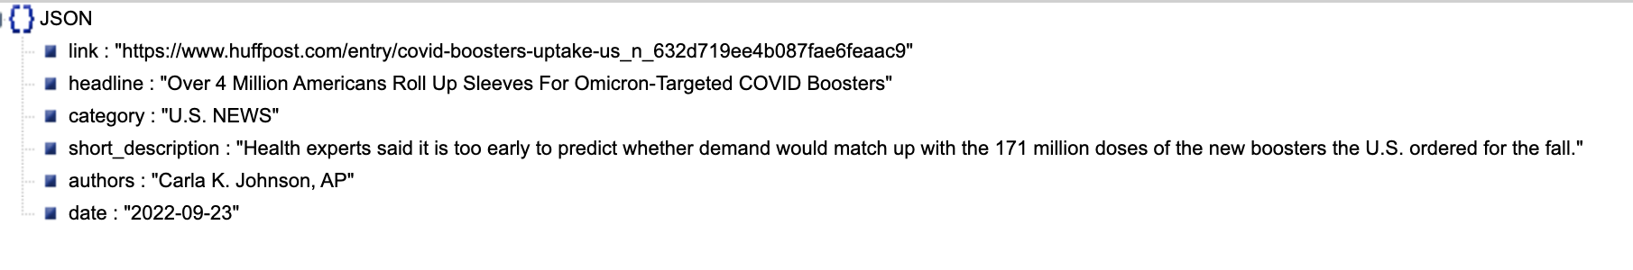
News_Category_Dataset_v3_balanced.json

Slide 6
Q&A
Thank you

