Slide 1
5G NR PDCP CIPHERING
Complete Flow Demonstration
Standards: 3GPP TS 38.323 | TS 33.501 | TS 35.222
Presented by-
58618 - Vinayak Majhi
58620 - Harsh Prasad
58633- Diptendra Maity
58621- Diyanisha Dey
58625 - Keshav Janghala

Slide 2
Project Overview
Project Title
5G NR PDCP Ciphering Implementation using 128-NEA2 (AES-CTR)
Objective
Demonstrate end-to-end encryption flow for secure 5G data transmission between UE and gNB
What This Program Demonstrates
Complete PDCP ciphering workflow in C++ covering all 5 stages from PDU construction to encrypted transmission
Key Features: AES-128 encryption • Counter mode operation • 3GPP compliant • Educational implementation

Slide 3
STAGE 1
INTEGRITY-PROTECTED PDU INPUT
& PARAMETER SETUP

Slide 4
Stage 1: Key Concepts
PDCP Service Data Unit
PDCP Header Construction
Original plaintext message to be encrypted and transmitted over the air interface
2-byte header with sequence number (12-bit SN) for ordering and duplicate detection
COUNT Parameter
Bearer & Direction
32-bit value combining HFN and PDCP SN, ensures unique keystream per PDU
Bearer ID (5-bit, 0-31) and Direction (0=UL, 1=DL) identify the data radio bearer

Slide 5
Stage 1: Technical Implementation
// Step 1: Parse PDCP SDU
string plaintext = "Hello 5G Network!";
// Step 2: PDCP Header (2 bytes)
header[0] = 0x80; // D/C bit + SN[11:8]
header[1] = 0x01; // SN[7:0]
// Step 3: Construct COUNT
uint32_t COUNT = (HFN << 12) | PDCP_SN;
// COUNT = 0x00000001
// Step 4: Set Bearer & Direction
uint8_t BEARER = 5; // 5-bit
uint8_t DIRECTION = 0; // Uplink
COUNT
0x00000001
BEARER
05 (5-bit)
DIRECTION
0 (Uplink)
LENGTH
440 bits

Slide 6
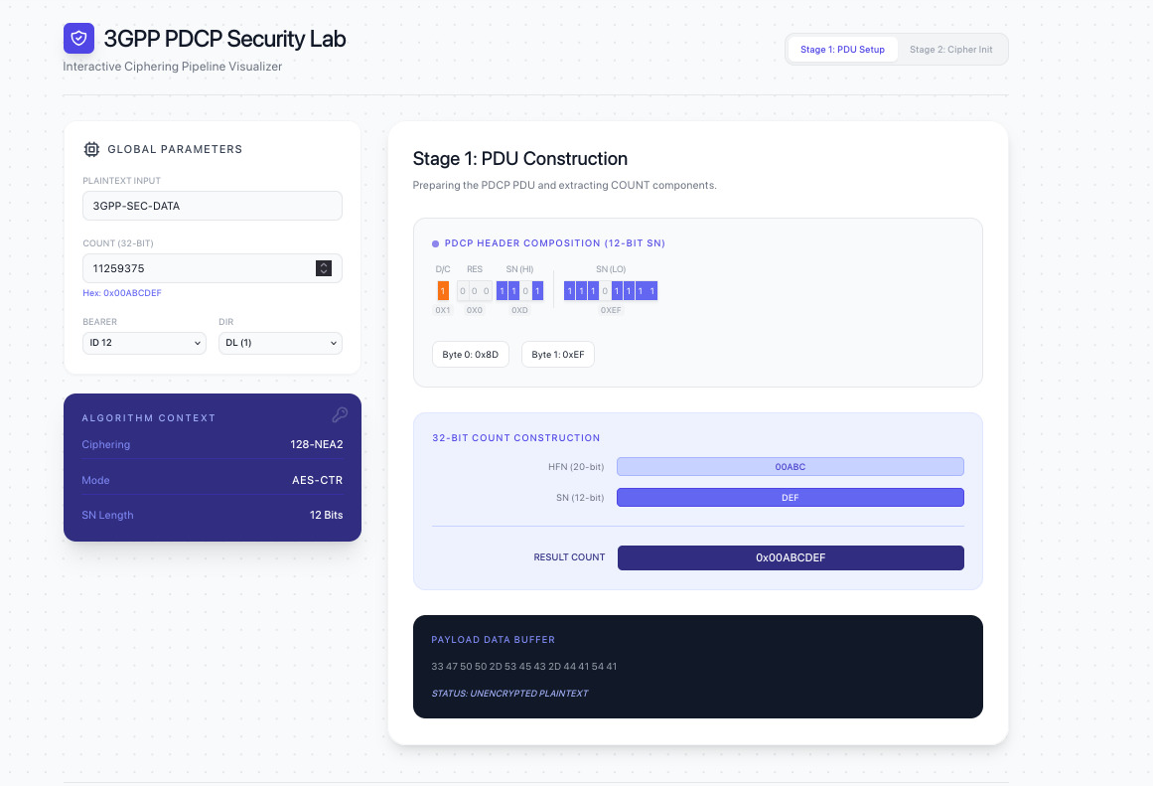
Stage 1: INTEGRITY-PROTECTED PDU INPUT & PARAMETER SETUP

Slide 7
Stage 1: Output Summary
✓
PDU Structure Ready
PDCP header constructed with sequence number and plaintext data prepared for encryption
✓
Security Parameters Configured
COUNT value, Bearer ID, and Direction set according to 3GPP specifications
✓
Ready for Ciphering Algorithm
All input parameters validated and formatted for NEA2 algorithm processing
✓ STAGE 1 COMPLETE: PDU prepared for ciphering

Slide 8
STAGE 2
CIPHER INITIALIZATION
NEA2 - AES-CTR MODE

Slide 9
Stage 2: Cipher Algorithm (128-NEA2)
AES-128 Encryption
Counter (CTR) Mode
128-bit key size, 128-bit block size, industry-standard encryption
Stream cipher mode, parallel processing, no padding required
Counter Block Structure (128 bits)
Counter Block Structure (128 bits)

Slide 10

Stage 2: Counter Block Construction

Slide 11
Stage 2: Output Summary
✓
Cipher Algorithm Selected
128-NEA2 (AES-128 in Counter mode) initialized for secure encryption
✓
Encryption Key Loaded
128-bit cipher key (CK) derived from K_gNB and loaded into AES engine
✓
Counter Block Constructed
128-bit counter block formatted with COUNT, BEARER, DIRECTION per TS 35.222
✓ STAGE 2 COMPLETE: AES-CTR cipher initialized

Slide 12
STAGE 3
KEYSTREAM GENERATION
AES-CTR BLOCK ENCRYPTION

Slide 13
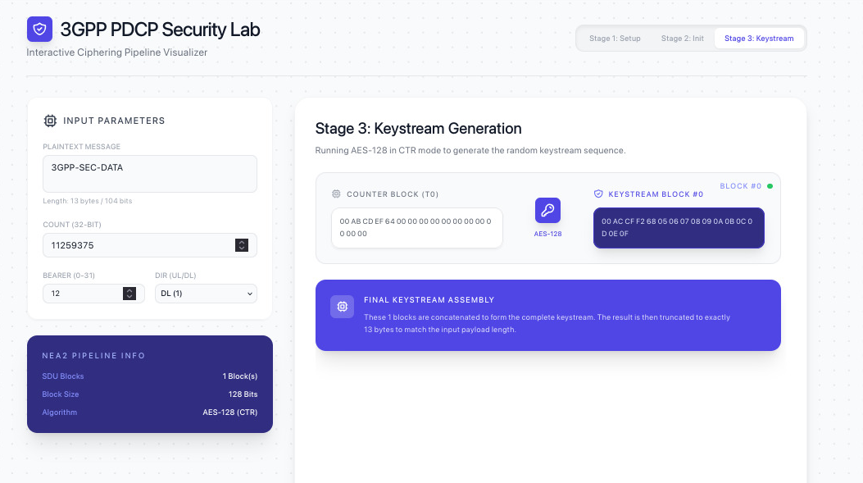
Stage 3: Keystream Generation Process

Slide 14
Stage 3: Output Summary
✓
Keystream Generated
Pseudo-random keystream of exact length matching plaintext created via AES encryption
✓
Deterministic & Reproducible
Same parameters at receiver produce identical keystream for successful decryption
✓
Security Properties
Counter prevents keystream reuse, ensuring each PDU has unique encryption sequence
✓ STAGE 3 COMPLETE: Keystream generation successful

Slide 15
STAGE 4
XOR OPERATION
PLAINTEXT ⊕ KEYSTREAM → CIPHERTEXT

Slide 16
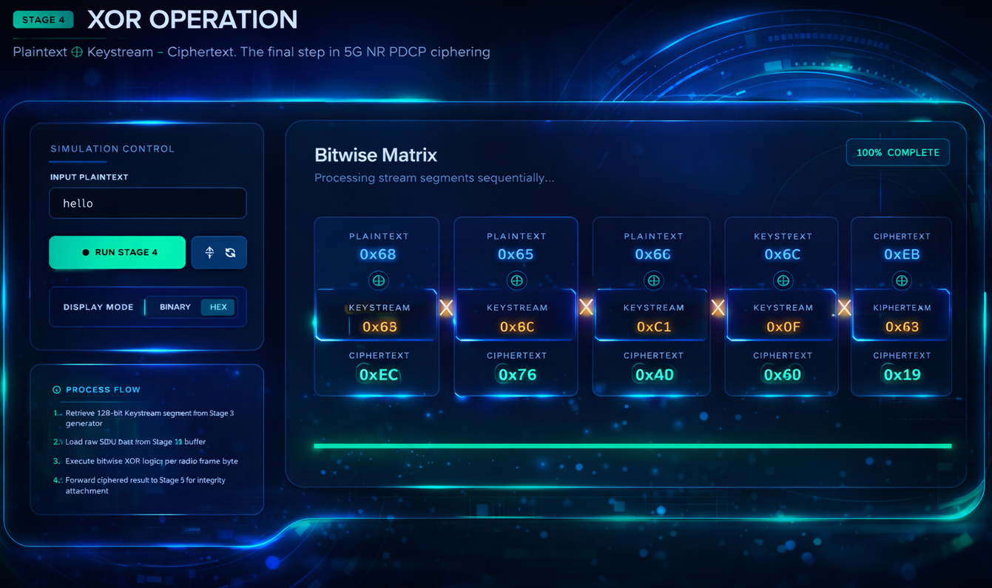
Stage 4: XOR Encryption Principle

Slide 17
Stage 4: Output Summary
✓
Ciphertext Generated
Plaintext successfully encrypted via bitwise XOR with generated keystream
✓
Encryption is Symmetric
Same XOR operation used for both encryption and decryption (stream cipher property)
✓
No Data Expansion
Ciphertext length equals plaintext length - no padding overhead in CTR mode
✓ STAGE 4 COMPLETE: Ciphertext generated via XOR operation

Slide 18
STAGE 5
ENCRYPTED PDU OUTPUT
& TRANSMISSION PREPARATION

Slide 19
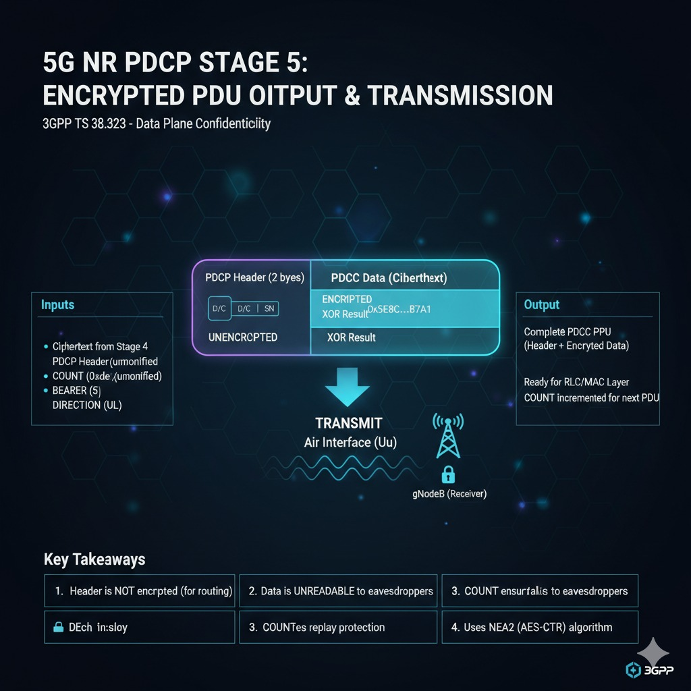
Stage 5: PDCP PDU Structure

Slide 20
Stage 5: Output Summary
✓
PDCP PDU Constructed
Complete PDU with plaintext header and encrypted payload ready for transmission
✓
Transmission Ready
PDU formatted per 3GPP TS 38.323 specifications for over-the-air delivery
✓
Security Context Updated
COUNT incremented for next PDU to ensure unique keystream per transmission
✓ STAGE 5 COMPLETE: Encrypted PDU ready for transmission!

Slide 21
Complete Flow Summary
1
PDU Input
& Setup
2
Cipher Init
(NEA2)
3
Keystream
Generation
4
XOR
Encryption
5
PDU Output
& TX
Key Learnings
• Implemented complete 5G PDCP ciphering workflow per 3GPP standards
• Understood AES-CTR mode operation and counter block construction
• Learned symmetric encryption via XOR operation and keystream generation
• Recognized importance of COUNT management for security

