Slide 1

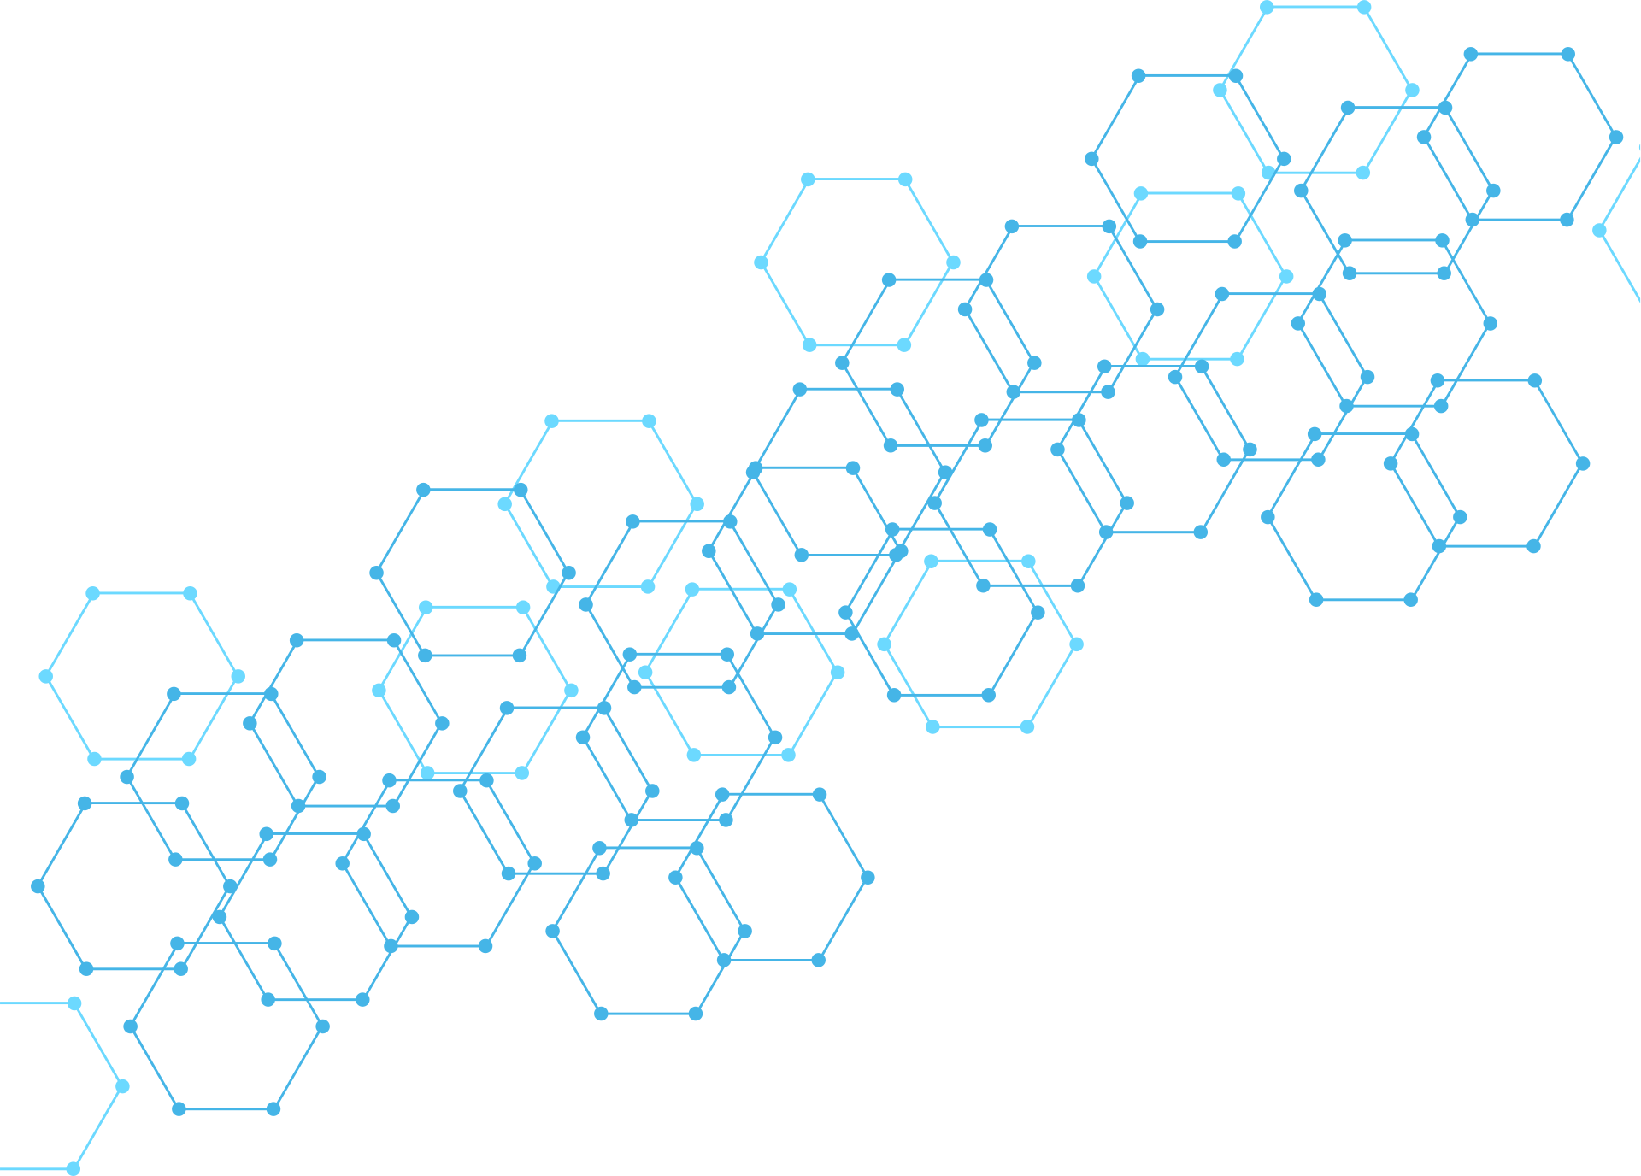
PASSWORD STRENGTH
CHECKER
CYBER SECURITY AND BLOCKCHAIN :

Slide 2

PASSWORD STRENGTH
CHECKER :
Presented By | Under the Supervision
GroupNo:1A | Dr.G.Sudhakar
1. S.Veena Akshaya - 2620090069 | Assoc.Professor
2. A.Sowgandhica-2620080045 | Dept-CSE
3. K.V.N.Brundha Geethika-2620080031 | Subject: DTIE-Projects
4. Lahiri-2620030399

Slide 3
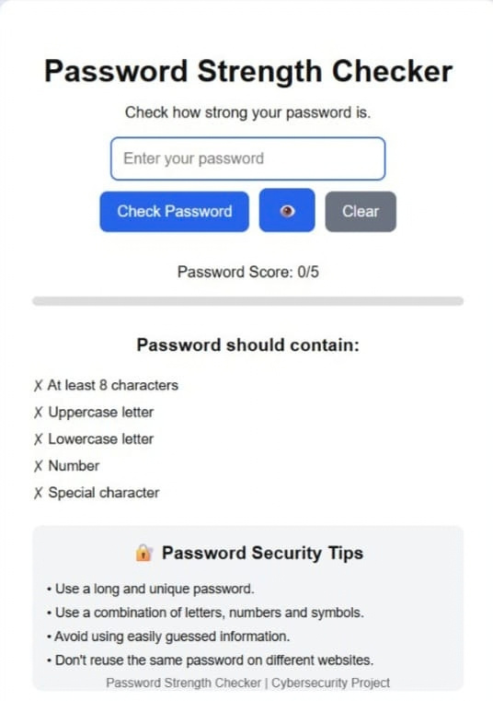
CYBERSECURITY · DESIGN THINKING
Why Password Strength Matters
A clear, local-first way to help people build safer password habits.
Passwords are still the first line of defense for our most personal accounts. This project explores how better feedback can turn “strong” from a vague label into an action people understand and trust.
Notes:
3

Slide 4
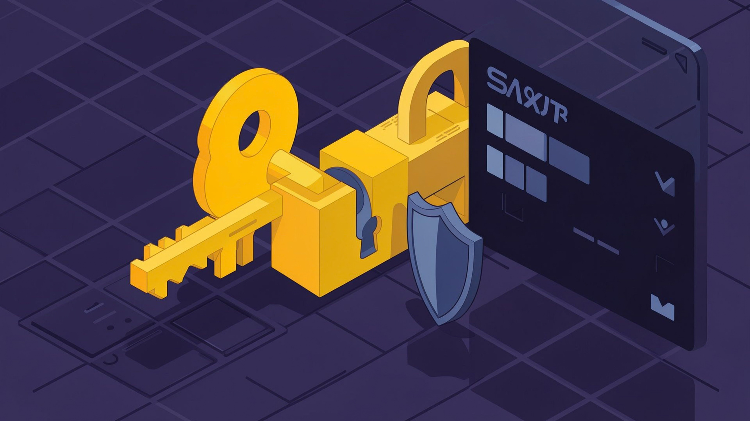
01 · PROBLEM
Weak passwords are easy targets
  People reuse short, predictable passwords because they are easy to remember.
  One exposed password can unlock email, shopping, or work accounts when the same pattern is reused.
  Common patterns—names, birthdays, seasons, and “123”—are easy for attackers to guess or automate.
  A checker should give an instant, understandable answer: weak, medium, or strong.
  Strong-password guidance emphasizes length, randomness, and uniqueness.
password strength checker · design thinking
Notes:
4

Slide 5
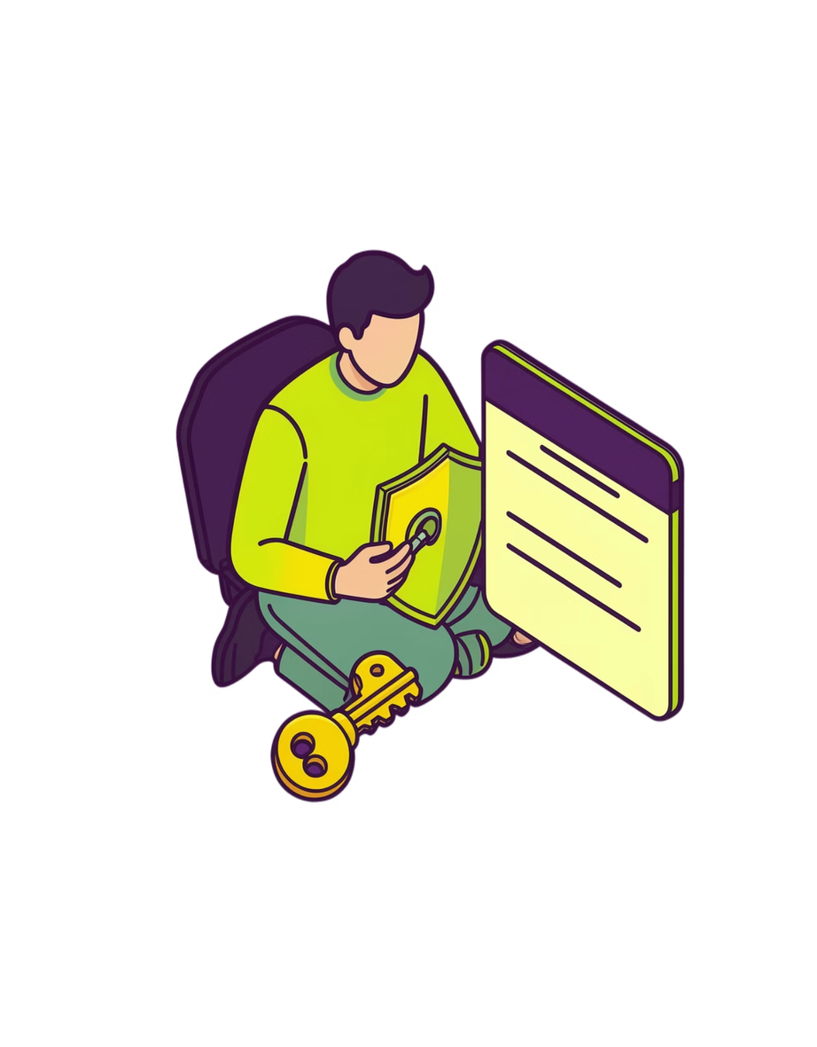
02 · EMPATHY
Security advice must feel usable
People need safety guidance that fits real life, not a lecture in technical language.
01
Make it plain
Use language students, families, and everyday account holders can act on. Say “add a word” instead of “increase entropy,” then show one clear next step.
02
Make it actionable
Explain what to improve, not only that a password is risky. Give a specific cue—lengthen it, make it unique, or stop reusing it—so the next move is obvious.
03
Make it realistic
Many people manage many logins and need help they can remember. Avoid advice that assumes unlimited time, perfect memory, or a password manager already in place.
Notes:
Empathy changes the brief. The checker should respect people who are busy, nontechnical, and already carrying a long list of accounts. The test is not only whether advice is correct; it should reduce confusion, explain the trade-off, and help someone choose a safer option in seconds.
5

Slide 6
03 · DEFINE
Turn “strong” into clear feedback
How might we help a person understand password strength in seconds without exposing the password?
The user needs a decision, not a lecture: show what matters, explain the result, and offer one practical next move.
Inputs
Output
  Password length — more characters usually create more search space
  Character variety — useful when it adds real unpredictability
  Common patterns — names, seasons, sequences, or keyboard runs
  Reuse risk — a password that looks reused or previously exposed
METER
REASONS
NEXT STEP
Weak · medium · strong
What made the score change?
One safer action to try
For example: make it longer, remove a pattern, or use a unique password.
A quick signal, not a promise of perfect safety.
Name the helpful signal and the remaining concern.
Notes:
Define the product around a fast moment of understanding. The checker looks at useful signals locally, then turns them into a meter, reasons, and one next step. Emphasize that “strong” is not a mysterious label: the user should understand what improved, what still looks predictable, and what to try next. A sample explanation might say, “Longer helps; a repeated word pattern still lowers confidence.”
6

Slide 7
04 · IDEA GENERATION
Many ways to make strength visible
Generate several small interventions, compare what each teaches, then combine the clearest signals without overwhelming the user.
01
02
03
04
Color meter
Checklist
Improve this
Passphrase helper
Red, amber, green at a glance. The prototype shifts color as the score improves, giving instant orientation before the user reads the detail.
Long, random, unique, and not based on personal details. Each item flips to a check as it passes, so users see why a password is strong—not just a final label.
Suggestions that never reveal the original password. The prototype offers safe next steps such as adding length or removing a name, while keeping the typed value private.
Several unrelated words that are easier to remember. A “Try a passphrase” action demonstrates a memorable alternative, then lets the user compare its strength before choosing.
Notes:
Keep the ideation broad. Each idea makes strength visible in a different way: color gives speed, a checklist gives reasons, suggestions give direction, and passphrases give people a practical alternative.
7

Slide 8



05 · MULTI VOTING
Choose the most useful combination
Vote for ideas that are easy to understand, safe to implement, and helpful immediately. Compare usefulness, not feature count.
Decision filter
SELECTED CONCEPT
Easy to understand
A first-time user knows what to do next.
Meter + explanation
+ suggestions
Safe to implement
Works locally without exposing the password.
Simple enough for a first-time user to act confidently.
Example vote: keep the meter, explanation, and suggestions; skip extras that add complexity.
Helpful immediately
Turns a result into one practical next step.
Notes:
The vote is not for the most elaborate feature set. It is for the smallest combination that helps someone understand the result and do something safer next.
8

Slide 9

06 · RAPID ESTIMATION & SOLUTION CONCEPT
A lightweight checker, calculated locally
LOCAL CHECKER
Build the first version around four core checks: length, variety, predictability, and uniqueness. Each check maps to a visible suggestion, so the team can test the idea without a scoring black box.
••••••••••••
RESET BUTTON
MEDIUM
Feedback updates live as you type
  Length is improving
  Variety adds coverage
  Predictability needs attention
  Try a longer passphrase, then recheck
PRIVACY BY DESIGN
Never store or send the entered password; calculate the result in the browser.
Feasible for a first prototype: one field, local rules, instant feedback. Phishing and stolen passwords remain separate risks.
Notes:
Rapid estimation keeps the first version focused: one field, one live meter, one feedback panel, and reset. The password never leaves the device. The interface can teach strength while still reminding users that phishing and stolen credentials are separate threats.
9

Slide 10
07 · ROUGH PROTOTYPE
From idea to clickable screen
The prototype turns the concept into one short, clickable interaction: enter fictional input, see feedback change, and choose a safer next step.
01
Enter
Type fictional text in a masked field; keep focus on the input.
CHECK A SAMPLE · LOCAL ONLY
Watch
••••••••••••••
02
See weak, fair, and strong states change as length and variety shift.
No account, upload, or network call.
STRONG
03
Learn
meter changes live · no score overload
Add length. Avoid names and dates. Try several unrelated words. The next action stays visible beside the result.
Read one next action, such as “Add length” or “Avoid names and dates.”
TRY A PASSPHRASE
RESET
04
Try again
Try a neutral passphrase example, then clear the field and start again.
Notes:
Show the interaction as a four-step loop. The prototype does not need every rule. It needs to prove that the user can enter fictional sample text, understand the changing result, and try a safer direction without exposing the original input.
10

Slide 11
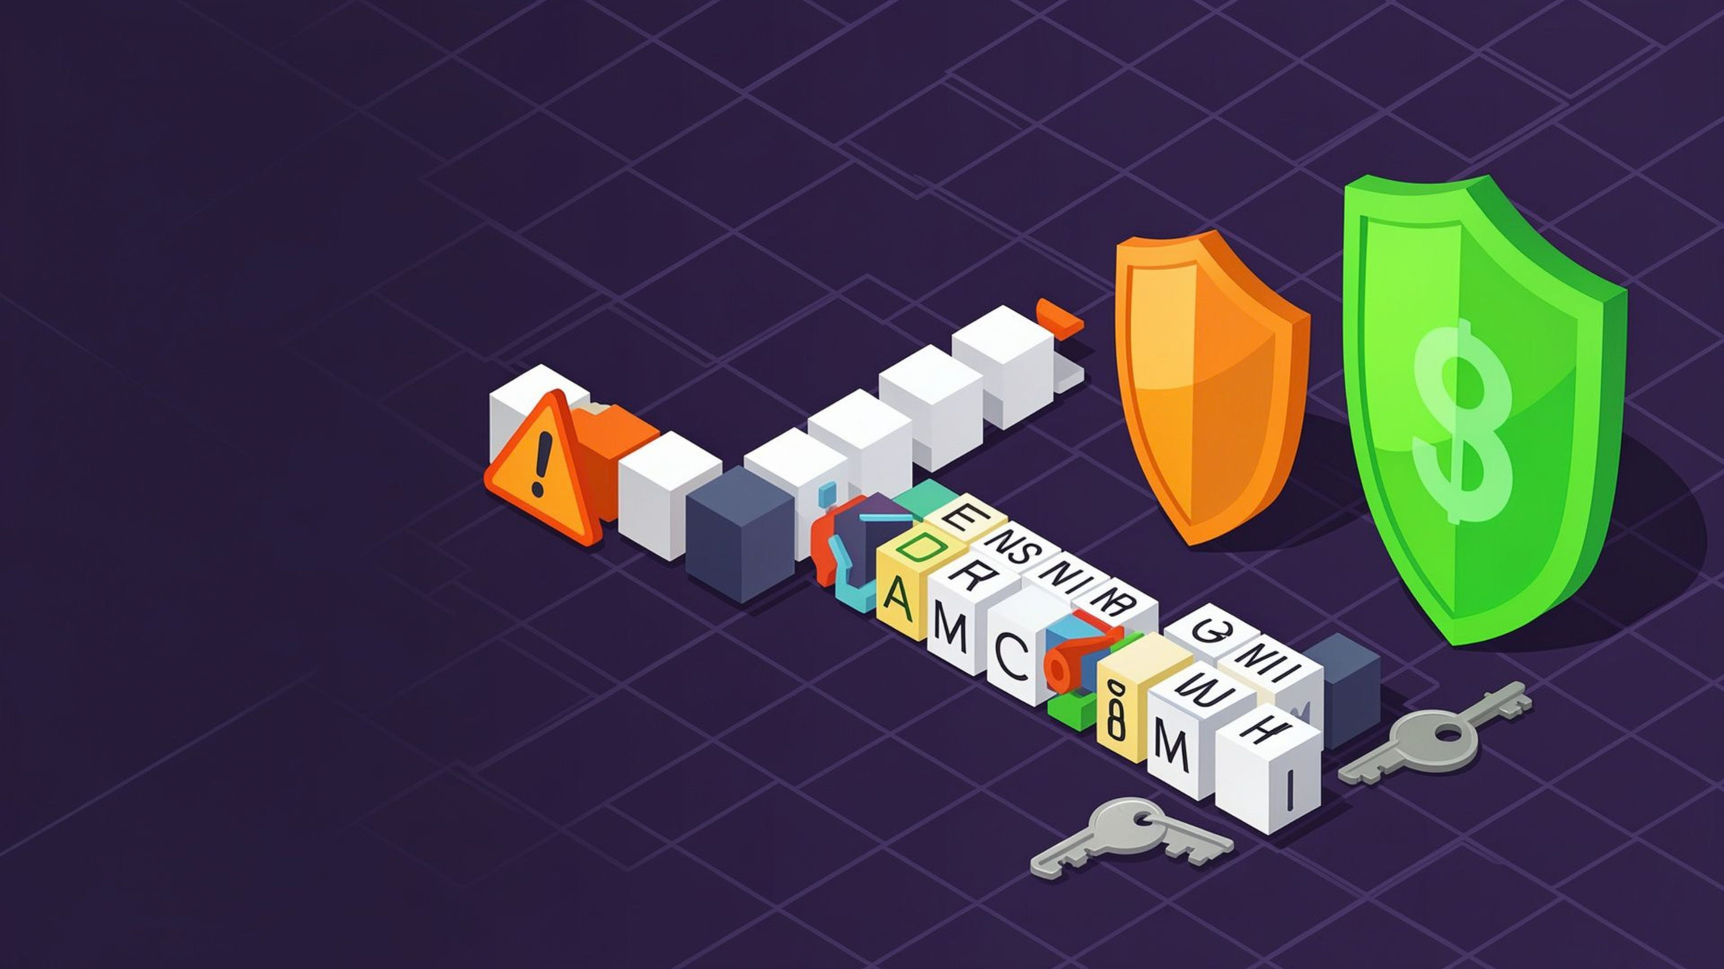
08 · DEMONSTRATION
Test, learn, improve
01
123456
Weak and predictable — the meter should flag it immediately, explain why, and avoid shaming language.
02
Short mixed-case
Looks complex at a glance, but limited length keeps the score moderate; the feedback should make that distinction obvious.
03
Long passphrase
Longer and unique — the prototype should reward length, show a clear next step, and keep the guidance easy to act on.
watch: score change · reason shown · next step clear
Notes:
Close by entering the three fictional examples one at a time and asking what the user expects before the meter responds. Observe whether the score changes quickly, the reason is understandable, and the next action is obvious: the prototype should reward length and uniqueness rather than treating mixed case as proof of strength. Likely iterations include clearer reason labels, a calmer warning state, and a stronger suggestion after each result. Keep the lesson practical beyond the checker: use a password manager, unique passwords, and multifactor authentication.
11

Slide 12

THANK YOU
Thank You
Safer habits start with small, clear choices.
Use a unique password for every account, store them in a trusted password manager, and turn on multifactor authentication wherever it is available.
Make security easier to understand — and easier to practice.
Notes:
12

