Slide 1
MCA Major Project Mid Term Evaluation
ATTENDANCE MANAGEMENT SYSTEM WITH FACE RECOGNITION
Under the guidance of
Dr. Monika Jyotiyana
Department of Computer Applications
Faculty of Science, Technology and Architecture
Manipal University Jaipur
By
PRIYANKA PRADHAN
23FS20MCA00069
2023-25

Slide 2
Outline
Introduction
Motivation
Process Model
Software Requirement Specification (SRS)
Data Flow Diagram (DFD)
ERD
Future Scope

Slide 3
1. INTRODUCTION
Automation and AI have revolutionized attendance management, replacing traditional methods like paper logs and RFID cards, which are time-consuming and error-prone. The Face Attendance System leverages facial recognition to automate attendance tracking, eliminating manual effort and enhancing security. It integrates Django for web management, OpenCV for facial detection, and PyTorch with Facenet-PyTorch for deep learning-based identification. This system provides a secure, efficient, and user-friendly alternative, making it ideal for schools, workplaces, and other environments requiring reliable attendance tracking.

Slide 4
2. MOTIVATION
Traditional attendance systems, such as manual registers and biometric scanners, are time-consuming, error-prone, and inconvenient. Manual methods often lead to proxy attendance, human errors, and inefficiency, while fingerprint scanners require physical contact, which may not be ideal in health-sensitive environments.
With the advancement of AI and facial recognition technology, an automated face-based attendance system provides a contactless, secure, and efficient solution. This project is motivated by the need to:
Eliminate manual errors and proxy attendance.
Provide a fast and contactless way to mark attendance.
Enhance security and accuracy using AI-powered facial recognition.
Reduce administrative workload and improve efficiency.

Slide 5
3. PROCESS MODEL
1. Requirement Analysis & Planning
Identify project goals (automated attendance using face recognition).
Define technical requirements (Python, Django, OpenCV, SQLite).
Research existing solutions and frameworks.
Plan the project architecture, including database design.
Identify hardware needs (camera, server requirements).
2. Data Collection & Preparation
Gather images of users for face recognition.
Store images in a structured format (e.g., media directory).
Preprocess images (resizing, grayscale conversion, noise removal).
Label and annotate images to train the recognition model.
Split data into training and testing sets.

Slide 6
3. PROCESS MODEL
3. Model Development & Fine-Tuning
Implement face detection using OpenCV (Haar cascades, DNN, or MTCNN).
Use a face recognition model (e.g., FaceNet, dlib, or deep learning models).
Train the model on collected data to recognize faces accurately.
Fine-tune model parameters to reduce false positives and improve accuracy.
Store extracted facial features in a database for comparison.
4. Backend Development & API Integration
Set up a Django-based backend.
Develop database models for users and attendance records.
Implement API endpoints for face recognition, attendance marking, and user authentication.
Integrate the trained model with the backend for real-time recognition.
Ensure secure data storage and retrieval.

Slide 7
3. PROCESS MODEL
5. Frontend Development & User Interface
Design an intuitive web-based interface using django.
Implement user registration and login pages.
Develop an admin dashboard for attendance management.
Integrate real-time face recognition feedback.
Ensure a responsive UI for different devices.
6. Deployment & Testing
Deploy the system on a cloud server or local machine.
Test the model with different lighting conditions and angles.
Debug and optimize performance (reduce lag, improve recognition speed).
Perform security testing to prevent unauthorized access.
Ensure cross-browser and cross-device compatibility.

Slide 8
3. PROCESS MODEL
7. Monitoring, Feedback & Continuous Improvement
Monitor system performance and accuracy.
Collect user feedback to improve usability.
Regularly update the model with new data for better recognition.
Optimize database queries and backend processes.
Add new features based on user needs.
8. Maintenance & Scaling
Schedule regular database backups.
Keep dependencies updated for security and efficiency.
Improve scalability (e.g., migrate to cloud-based databases if needed).
Introduce multi-user support and role-based access.
Expand the system to integrate with other platforms (HR software, payroll).

Slide 9
4. Software Requirement Specifications (SRS)
Python: Serves as the core programming language for the system.
Django Framework: Manages the web interface using the Model-View-Template (MVT) pattern.
OpenCV: Captures and processes face images for real-time detection.
PyTorch & Facenet-PyTorch: Extracts facial features and performs identity matching.
SQLite Database: Stores user credentials, facial data, and attendance records.
Web Interface: Allows users and admins to manage attendance and view reports.

Slide 10
5. Data Flow Diagram (DFD)
Level 0 - Context Diagram
This is the highest level of the system showing overall interaction:
Users (Admin & Employee/Student)
Provide face input
View attendance reports
Face Recognition System
Captures and verifies the face
Matches with stored data
Database
Stores user details and attendance records
Sends attendance data for report generation

Slide 11
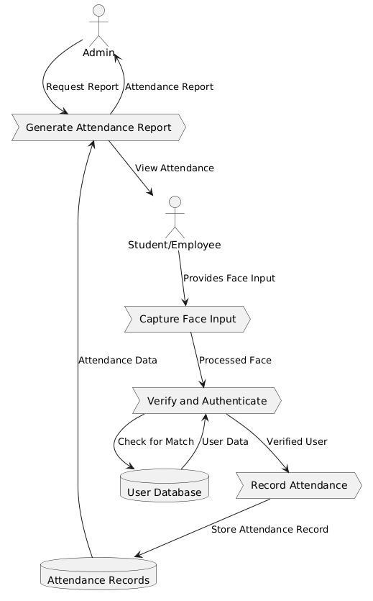
LEVEL 0
I.

Slide 12
5. DFD
2. Level 1 - Process Breakdown
This level details the internal processes:
1. User Module
User logs in/registers using credentials
Uploads a face image for registration
Sends data to Face Recognition Module
2. Face Recognition Module
Captures live face using OpenCV
Preprocesses and compares with database using facenet-pytorch
If matched: Sends data to Attendance Module
If not matched: Prompts the user to try again
3. Attendance Management Module
Stores attendance logs (date, time, user ID)
Generates attendance reports
Admin can view and edit records

Slide 13
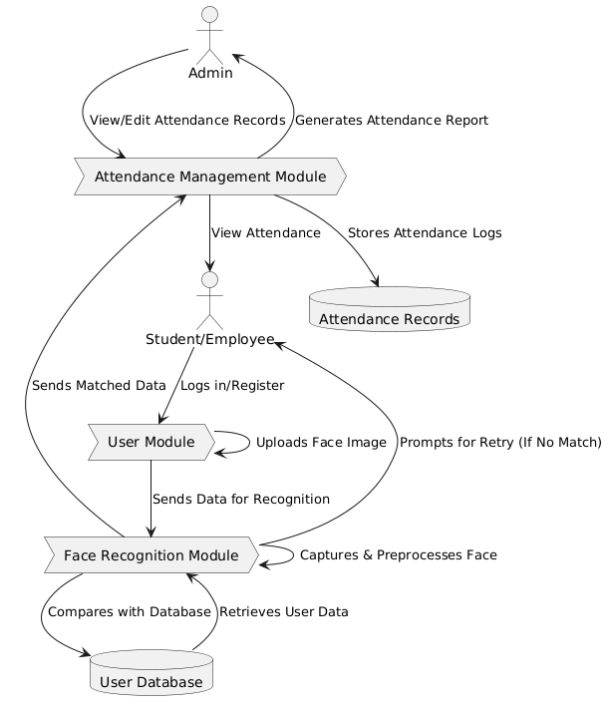
LEVEL 1
I.

Slide 14
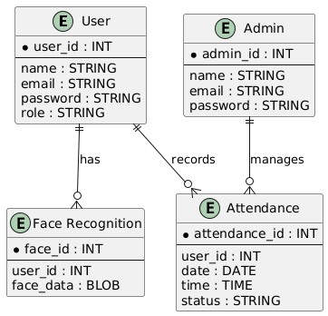
ERD

Slide 15
6. FUTURE SCOPE
Better AI Model – Improve face recognition accuracy and prevent fake face detection.
Cloud & Smart Devices – Store data online and connect with smart cameras for real-time tracking.
Faster & Scalable – Make the system work smoothly for large organizations and process faces faster.
Mobile & Web Apps – Create mobile apps and online platforms for easy access.
More Security – Protect data, follow privacy rules, and use blockchain for secure records.

