Slide 1
Circulation paper figures

Slide 2
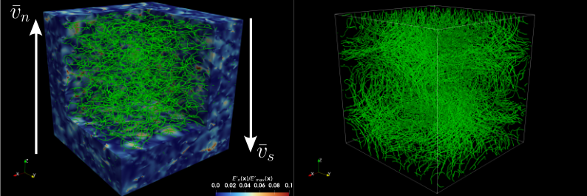
Snapshots

Slide 3
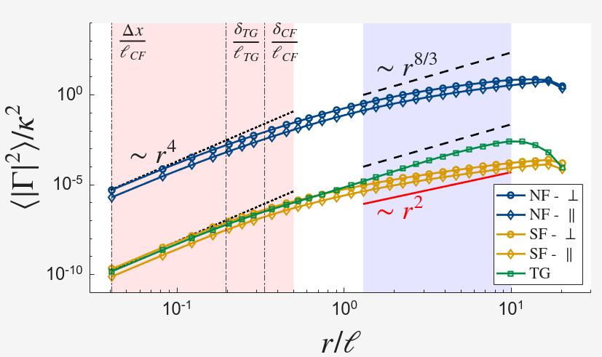
Circulation variance

Slide 4
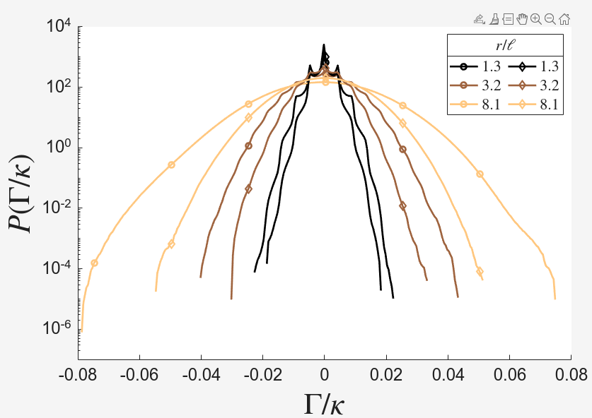
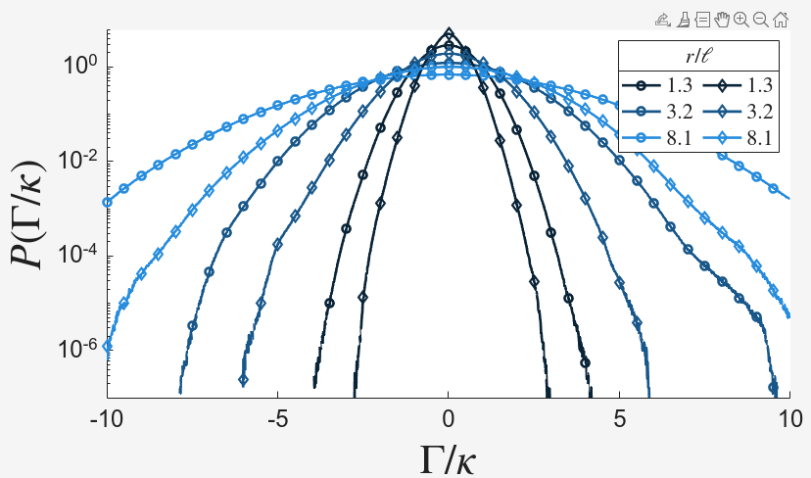
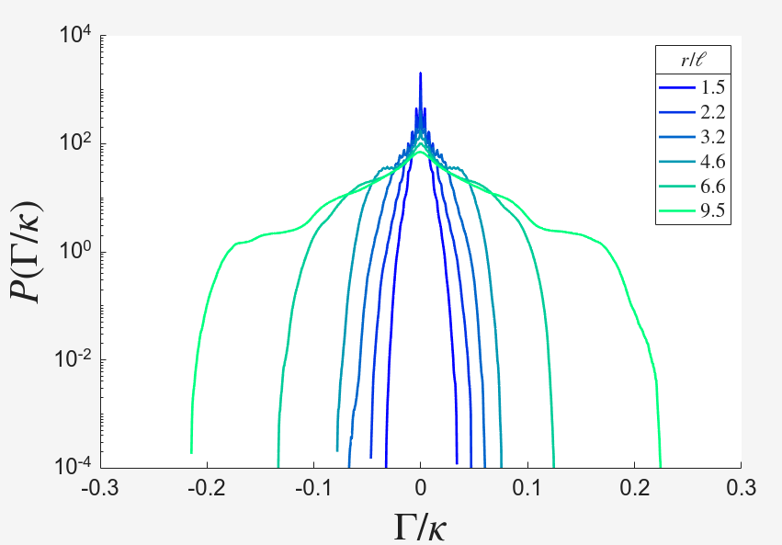
PDFs

Slide 5
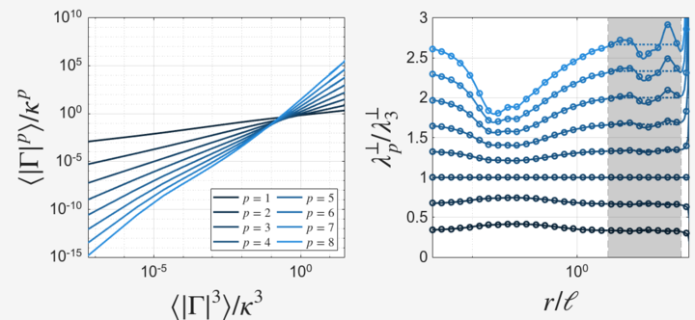
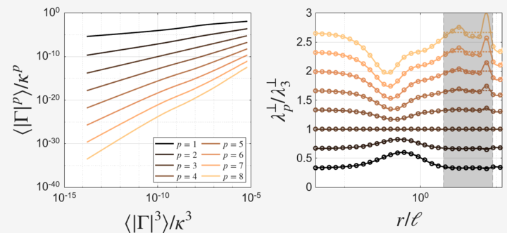
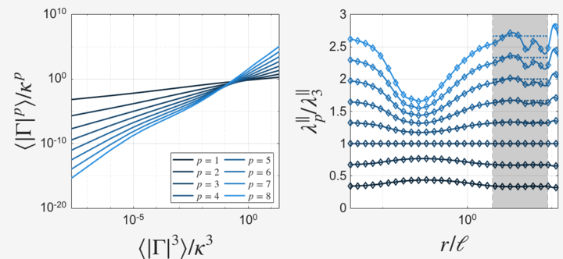
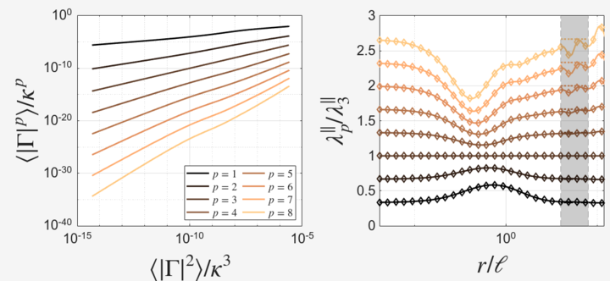
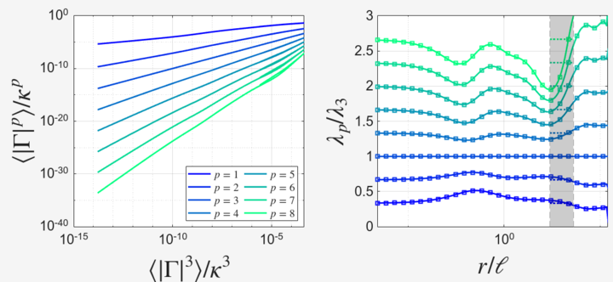
Moments (ESS)

Slide 6
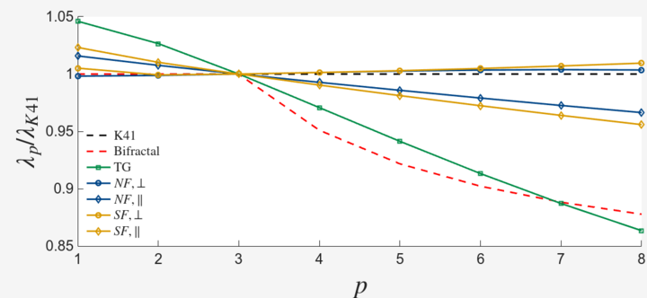
Exponents
Fitting h and D for the parallel in the beta-model:
NF:
h = 0.2856
D = 2.8657
SF:
h = 0.2746
D = 2.8237

Slide 7
Other additional plots

Slide 8
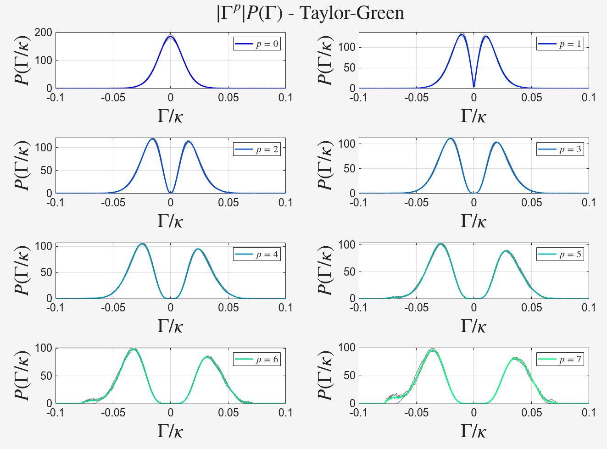
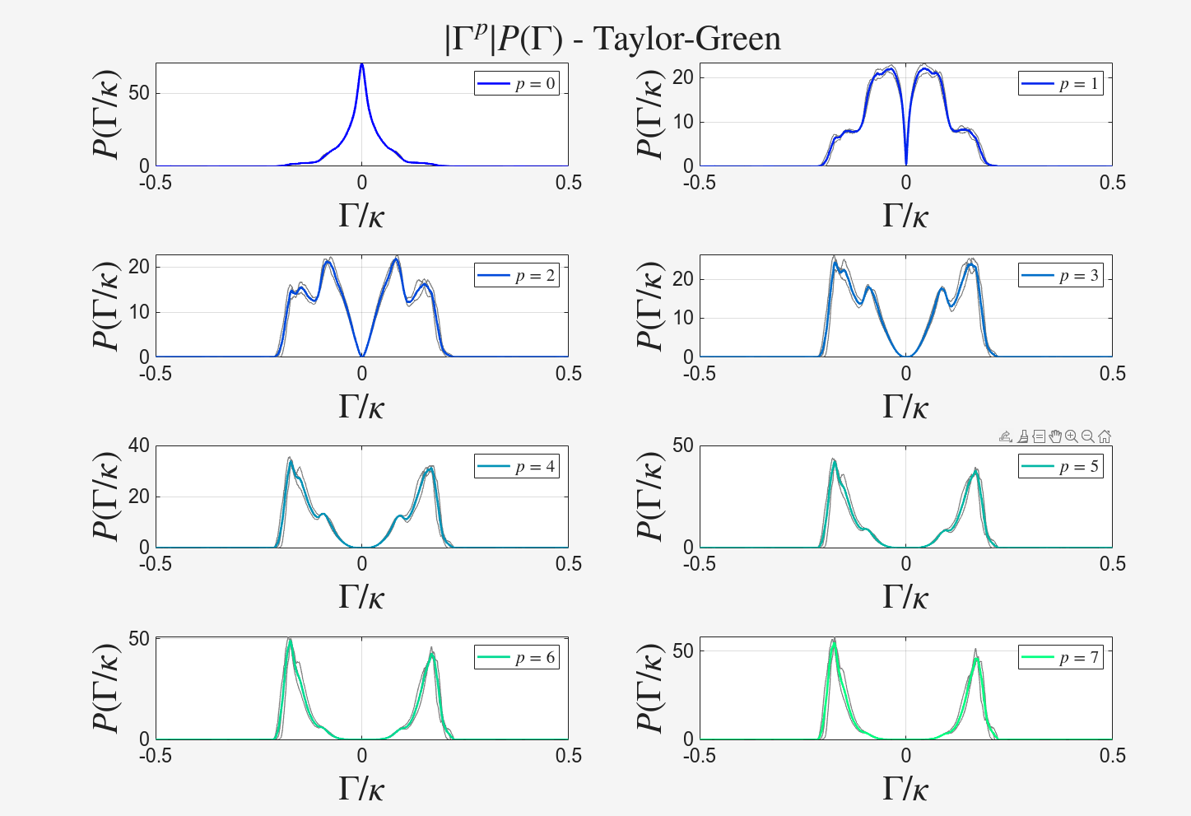
All Normalized PDFs (linear)
r/\ell ~ 9.51
r/\ell ~ 23.6

Slide 9
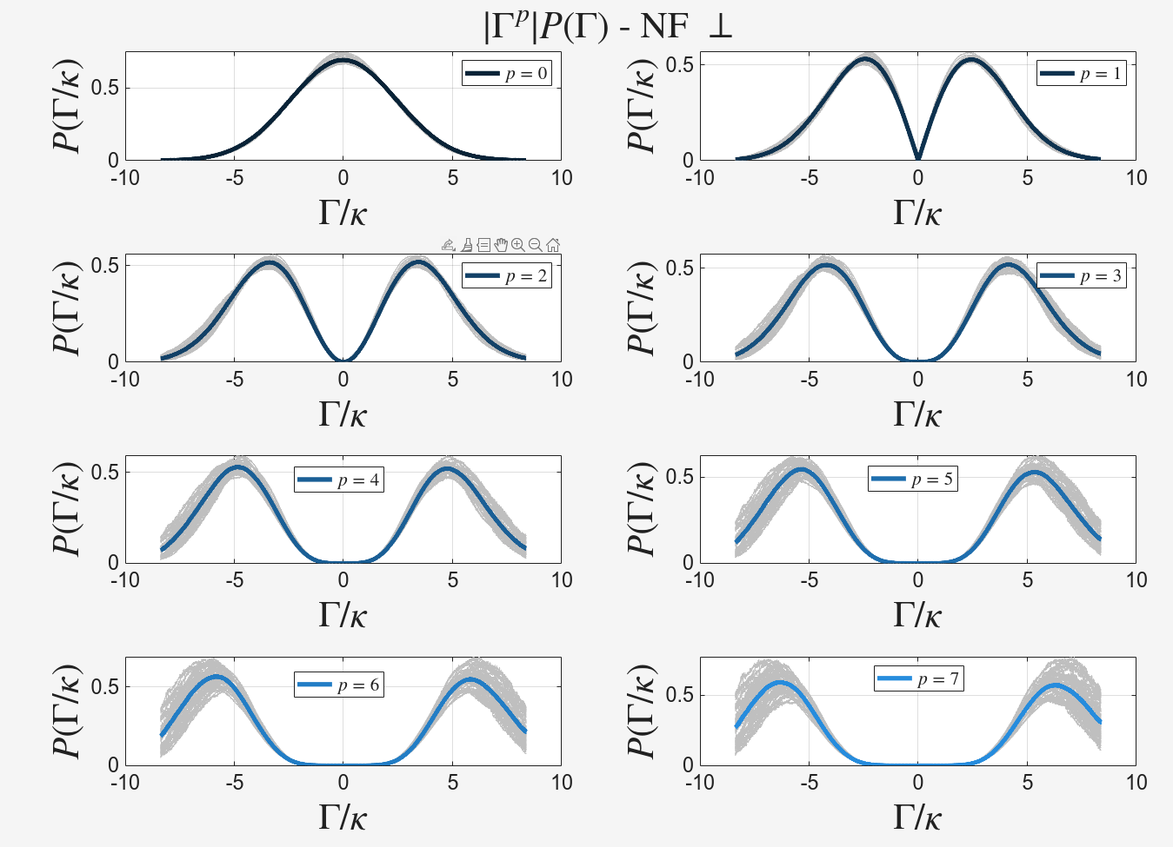
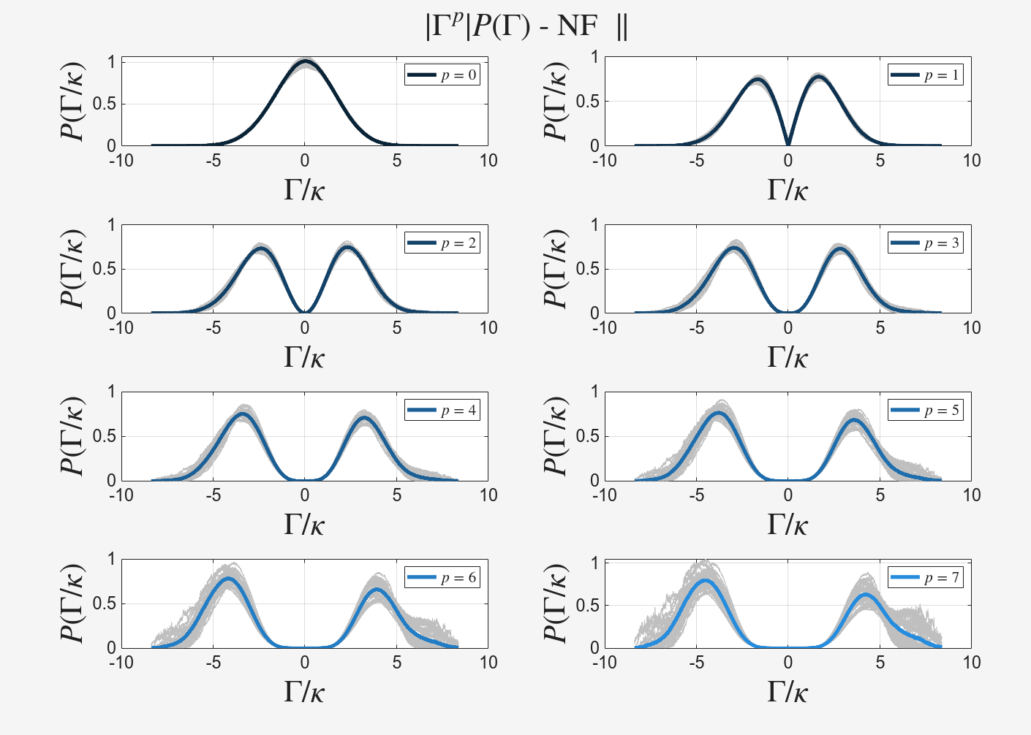
All Normalized PDFs (linear)
r/\ell ~ 8

Slide 10
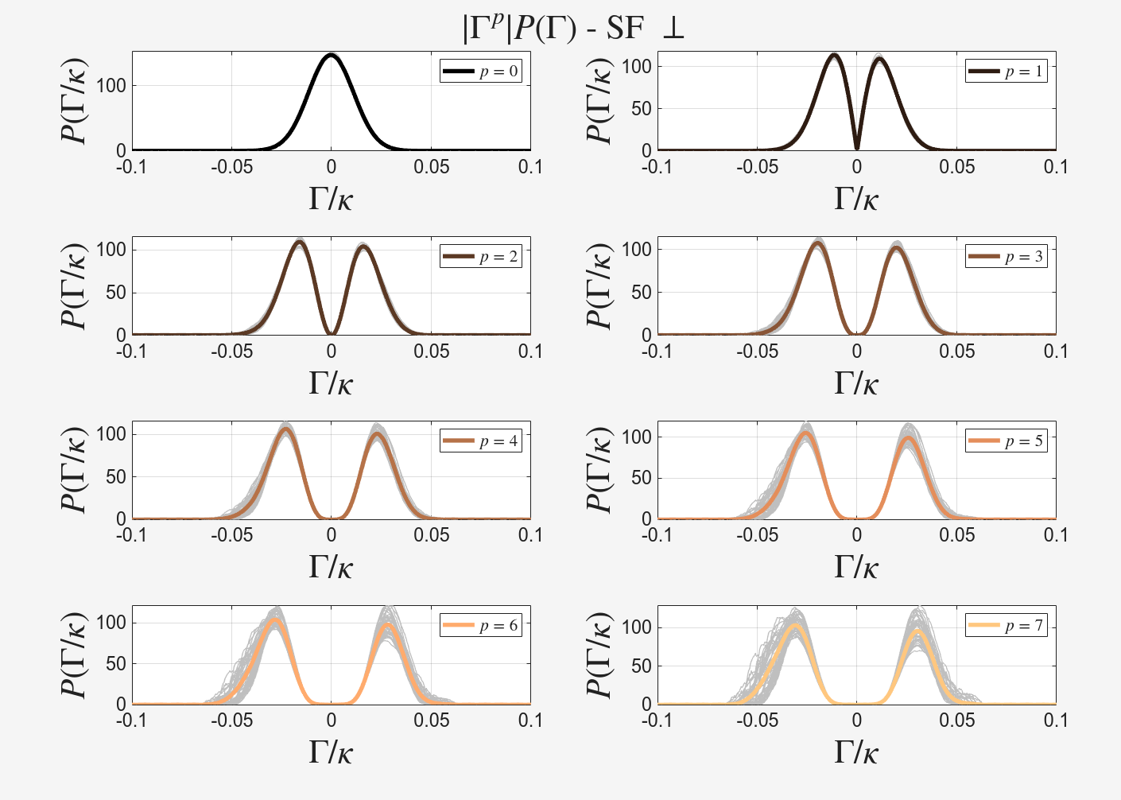
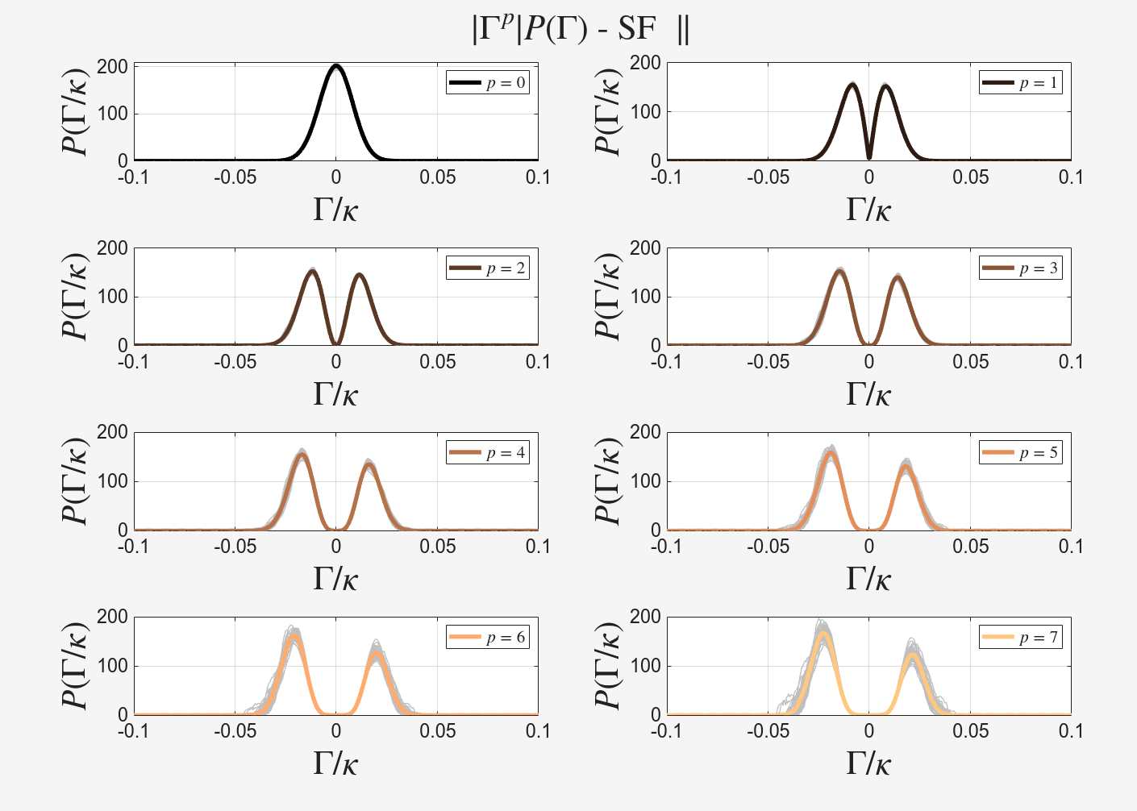
All Normalized PDFs (linear)
r/\ell ~ 8

