Slide 1


BLUEALPHA · CAPSTONE I · PROGRESS UPDATE
Prior Sensitivity in Bayesian MMM
A robustness workflow and prototype dashboard built around Google Meridian
UCSB PSTAT 197 × BlueAlpha AI
Aidan Frazier · Quinlan Wilson · Jimmy Wu · Jasper Luo · Coraline Zhu
Spring 2026

Slide 2

THE PROBLEM
Motivation and Research Question
Bayesian MMM outputs are only as credible as the priors beneath them.
Priors are assumed, not measured.
Channel ROI priors (μ, σ, distribution family) come from analyst judgment. Small prior shifts can cascade into large posterior changes.
Single runs hide uncertainty.
A one-shot Meridian fit gives a point estimate. Stakeholders rarely see how much that estimate would move under reasonable alternative priors.
RESEARCH QUESTION
How sensitive are Bayesian MMM conclusions to reasonable changes in ROI priors, and how can we communicate that uncertainty to decision-makers?
BlueAlpha × UCSB · Capstone I — Work in Progress
2 / 12

Slide 3
OUR CONTRIBUTION
Approach
METHODOLOGICAL POSITION
We do not propose a new MMM estimator. We run the existing Meridian model many times over a structured grid of prior settings, summarize how much the inferred ROI changes, and surface that variation for analyst review.
1
2
3
4
Grid perturbation
Parallel Meridian fits
Sensitivity summaries
Prototype dashboard
μ, σ, and distribution family swept across a structured grid
every grid point refits the full Bayesian model with QC tagging
ROI %-change, $-swing, tornado rankings, stability flags
interactive HTML to support analyst review and discussion
BlueAlpha × UCSB · Capstone I — Work in Progress
3 / 12

Slide 4
WORKFLOW
End-to-End Pipeline
Implemented as a sequence of Python modules; each stage writes versioned outputs the next stage reads.
src/pipeline.py → src/main.py → src/run_meridian_once.py → src/summarize_sensitivity.py → src/reporting/make_dashboard.py
Raw Data
Grid Config
Meridian Fits
QC Gate
Sensitivity Tables
Dashboard
monthly spend + KPI (subs)
μ × σ × dist YAML driven
parallel runs per grid point
PASS / REVIEW / FAIL
tornado & %-change
prototype HTML + JSON
data/output/01_runs/
data/output/02_tables/
data/output/03_reports/
Raw per-channel fits
Merged sensitivity tables + tornado
Prototype dashboard HTML + payload
BlueAlpha × UCSB · Capstone I — Work in Progress
4 / 12

Slide 5
WHERE THE WORKFLOW SURFACES
Prototype Dashboard — Overview
Five panels, one HTML file, designed to support analyst review.
We will look at two in detail; the others are mentioned here as supporting pieces.
1
Decision Card
DETAIL →
Preliminary robustness tier, model health summary, top sensitivity metric.
2
Workbench
DETAIL →
Channel scenario studio: analysts move μ/σ and watch ROI move with them.
3
Tornado
DETAIL →
Channels ranked by %-ROI swing across the grid.
4
Allocation View
Spend vs. estimated contribution, useful for spotting misalignment.
5
Supporting Panels
Meridian's standard plots, heatmaps, scenario drills — embedded inline.
BlueAlpha × UCSB · Capstone I — Work in Progress
5 / 12

Slide 6
DASHBOARD DETAIL · 1 OF 2
Decision Card — Summary of Current Result
• Preliminary tier derived from QC pass rate, sensitivity spread, and guardrail hits. Thresholds are still being calibrated.
• Health card mirrors Meridian's model diagnostics summary (convergence, saturation).
• Top metric + pair answers "what moved and why" in one line so analysts can start there.
• Follow-ups suggested by recommend_next_grid.py; intended as starting points for analyst review, not verdicts.
PRELIMINARY ROBUSTNESS TIER
GREEN tier — on this run
HEALTH
TOP Δ ROI
SENSITIVE PAIR
QC PASS RATE
PASS
+34%
meta × σ
17 / 18
SUGGESTED FOLLOW-UPS (auto-generated)
• Zoom the μ grid on meta; widen σ on google
• Re-fit with LogNormal to cross-check tail behavior
• Flag meta for analyst review before reporting
BlueAlpha × UCSB · Capstone I — Work in Progress
6 / 12

Slide 7
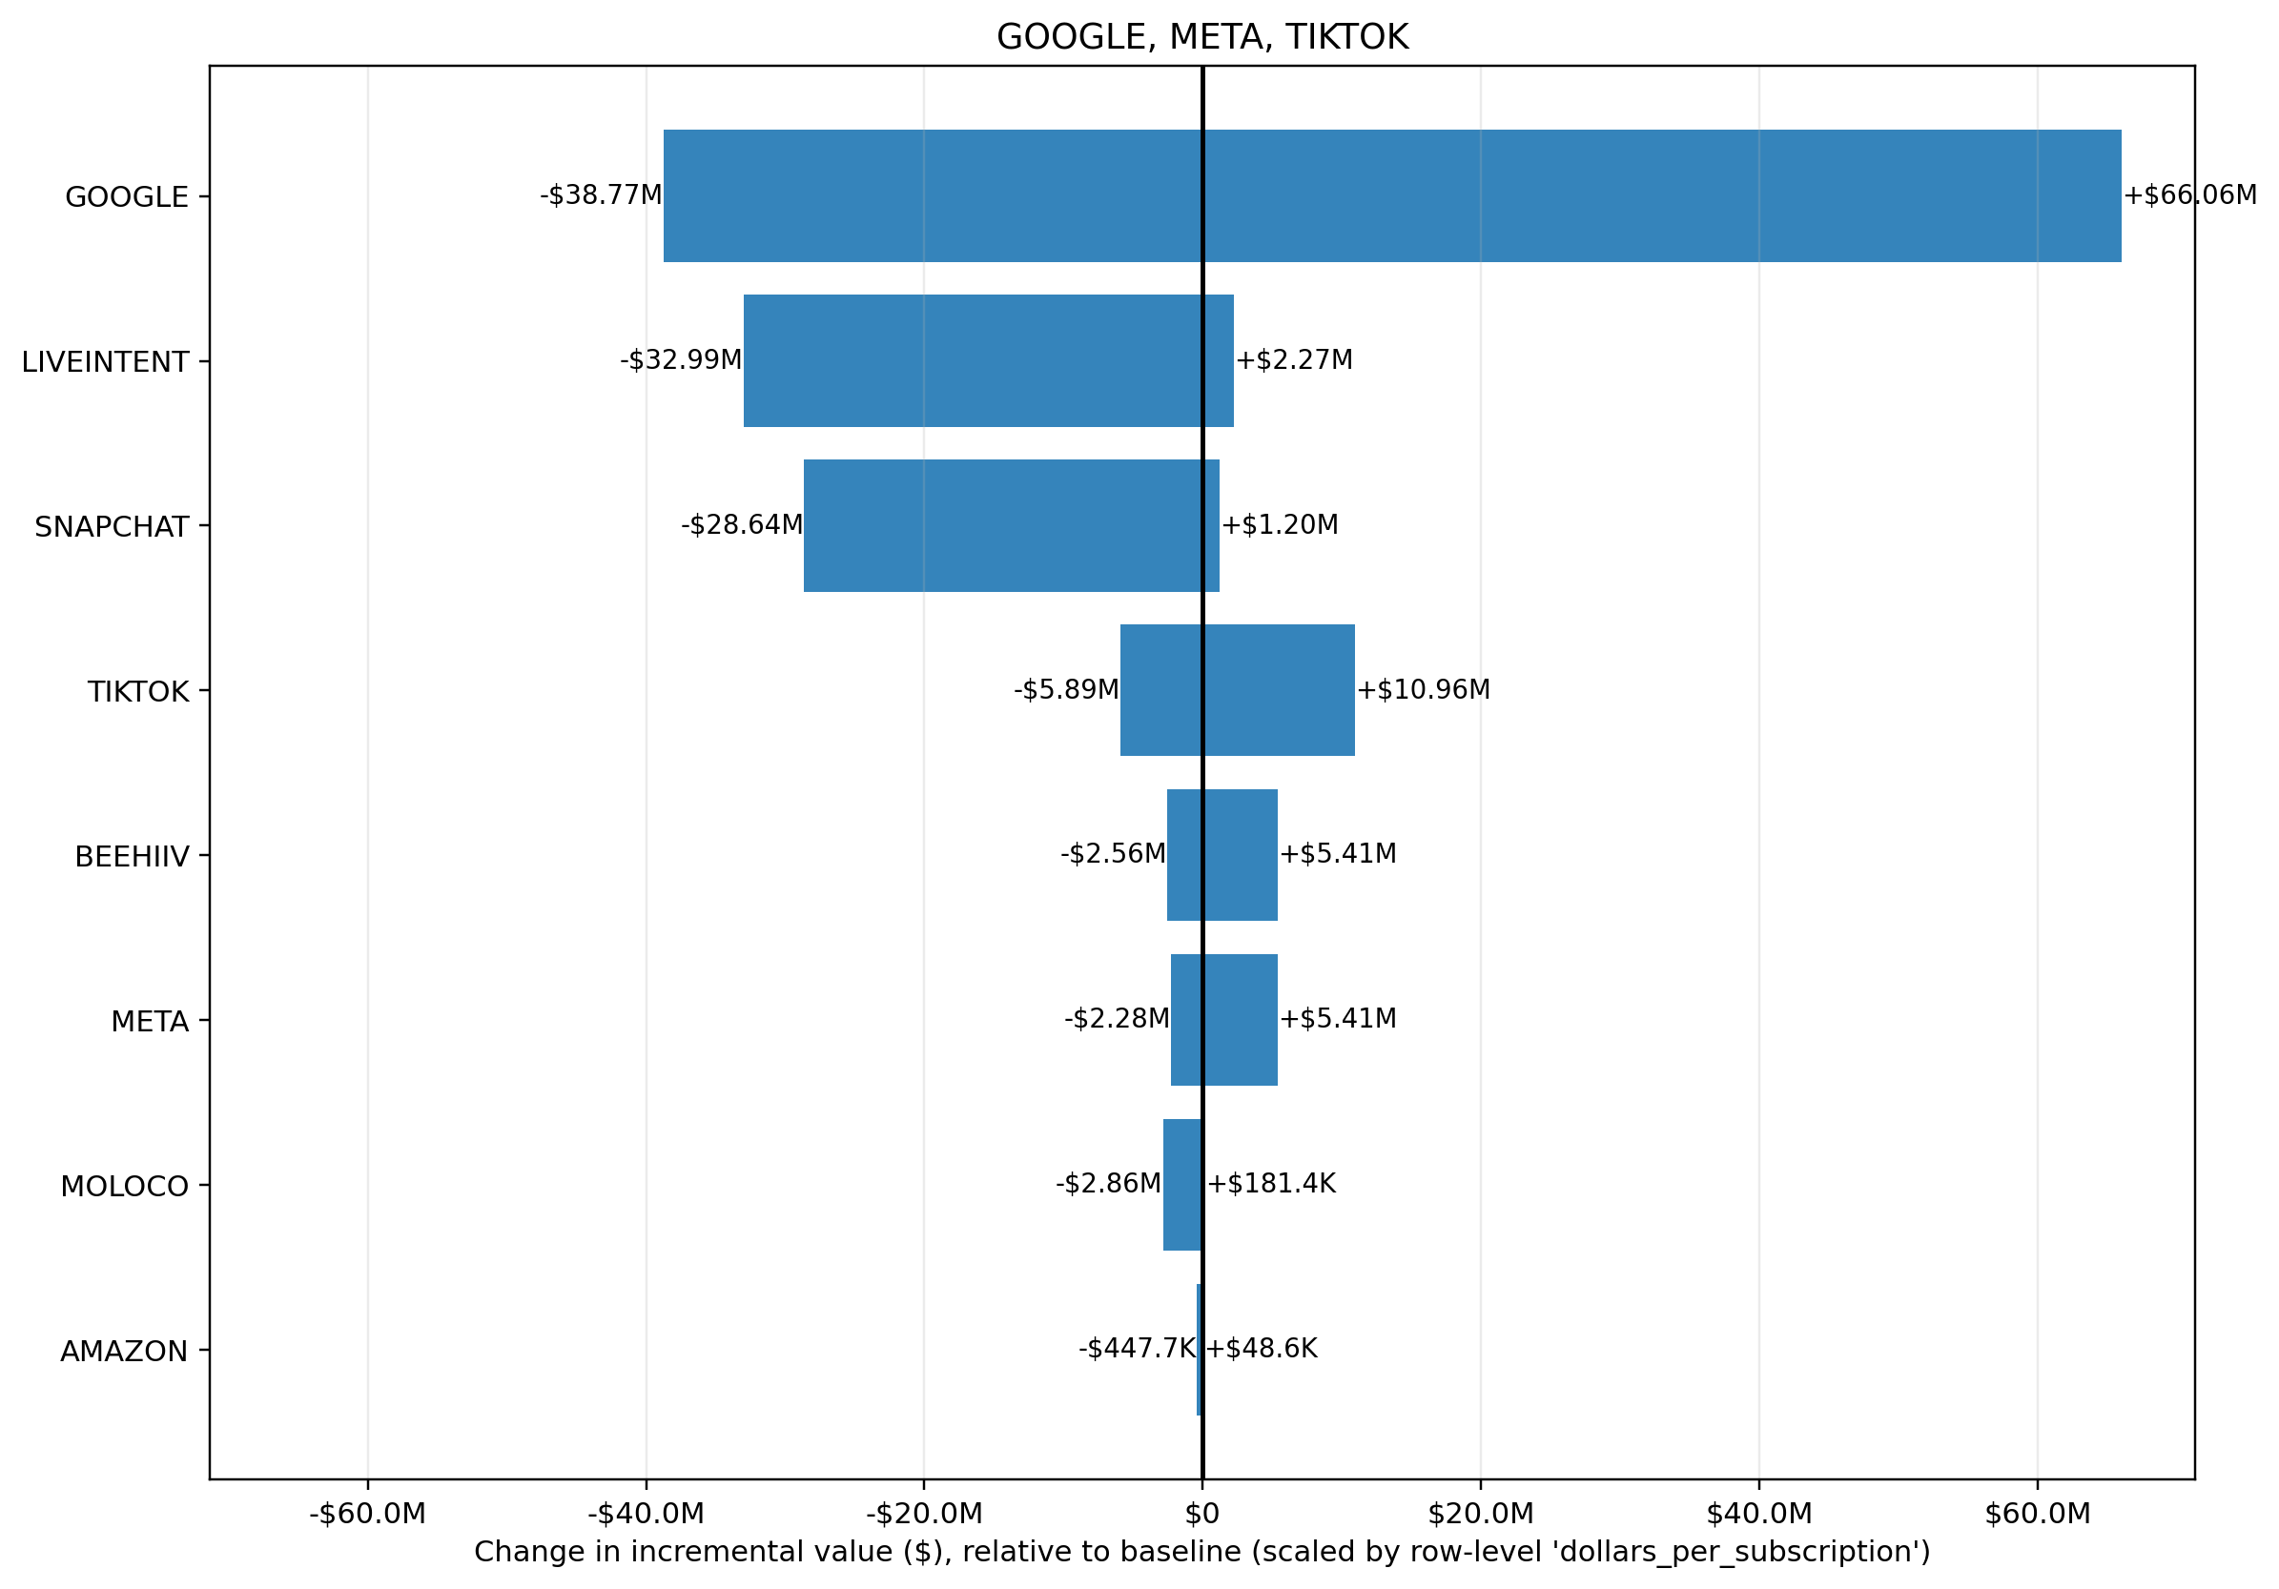
DASHBOARD DETAIL · 2 OF 2
Exploring Sensitivity — Workbench & Tornado
WORKBENCH — CHANNEL = META
μ
σ
SELECTED ROI
Δ VS. BASELINE
CONTRIBUTION
2.14x
+18%
11.4%
Analyst drags μ/σ; ROI recomputes from the pre-fit grid (no re-run needed).
ROI distribution across σ (μ fixed)
Tornado — channels ranked by %-ROI swing across the prior grid (p05–p95).
Workbench builds intuition at the channel level · Tornado gives the portfolio-level rank.
BlueAlpha × UCSB · Capstone I — Work in Progress
7 / 12

Slide 8
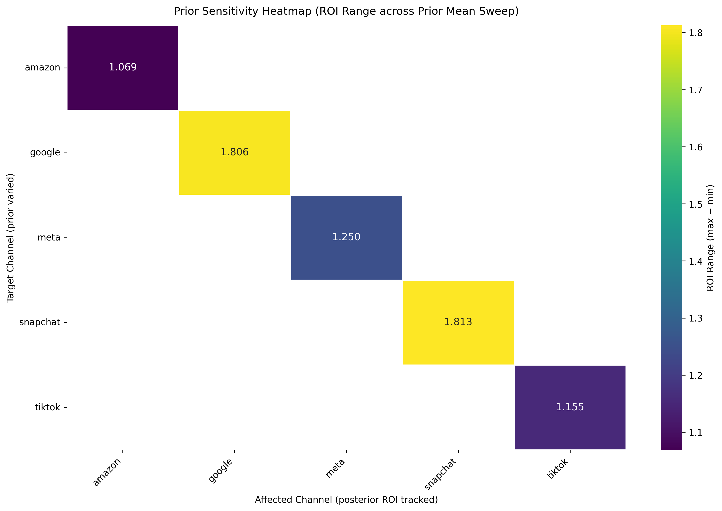
MENTIONED BRIEFLY
Supporting Pieces
These round out the dashboard but are not the focus of today's talk.
• Allocation view spend vs. estimated contribution, sized by ROI. Useful for spotting mis-allocation.
• Meridian official charts embedded inline: ROI by channel, spend vs. contribution, ROI vs. mROI, contribution waterfall, and two more. Analysts see the plots they already know.
• Scenario snapshots grid of top prior combinations, selected by largest absolute %-change.
• Structural & guardrails adstock / saturation curves, prior guardrail checks on P(ROI < 0).
μ × σ heatmap — posterior ROI surface for a focal channel.
BlueAlpha × UCSB · Capstone I — Work in Progress
8 / 12

Slide 9
WHERE WE ARE STILL VALIDATING
What Remains Open
The workflow runs end-to-end, but several methodological choices are not yet settled.
?
Are the sensitivity thresholds well calibrated?
The cutoffs that drive the robustness tier (GREEN / YELLOW / RED) are hand-set. We have not yet shown they generalize beyond the current dataset.
?
Is the tier verdict stable across datasets?
We have run the pipeline on a single client dataset with 73 months and 8 channels. Stability needs to be tested on additional, ideally larger, datasets.
?
Which metrics are actually interpretable for stakeholders?
We surface %-change, $-swing, marginal μ/σ effects, and guardrail checks. It is unclear which of these move analyst decisions and which are just noise on the screen.
?
Are μ/σ perturbations the right unit of sensitivity?
The grid perturbs each channel independently. Cross-channel and distribution-family effects are only partially captured.
BlueAlpha × UCSB · Capstone I — Work in Progress
9 / 12

Slide 10
UNDER THE HOOD
Technology Stack
Modeling
Data & Orchestration
Reporting & Dashboard
• Google Meridian (Bayesian MMM)
• TensorFlow · TF Probability
• QC gates & prior guardrail checks
• Python 3.11 · pandas · numpy
• YAML-driven grid configs (PyYAML)
• Parallel subprocess pipeline
• Jinja2 server-side rendering
• ECharts (interactive charts)
• matplotlib (static figures)
BlueAlpha × UCSB · Capstone I — Work in Progress
10 / 12

Slide 11
REPOSITORY MAP
Where Things Live
BlueAlpha/
config/
sensitivity_*.yaml ← grid definitions
data/
raw/ ← monthly_mocha.csv
output/01_runs/ 02_tables/ 03_reports/
src/
pipeline.py ← one-command entrypoint
main.py run_meridian_once.py ← grid + fits
summarize_sensitivity.py ← merge + tornado
recommend_next_grid.py ← suggested follow-ups
robustness_score.py ← composite scoring (WIP)
reporting/
make_dashboard.py ← orchestrator
metrics.py figures.py render.py
templates/dashboard_template.html + dashboard.css
docs/ theory · slides · interim reports
scripts/ open_demo.ps1
BlueAlpha × UCSB · Capstone I — Work in Progress
11 / 12

Slide 12
NEXT STEPS
Where we go from here
Calibrate thresholds
back the GREEN / YELLOW / RED cutoffs with evidence rather than defaults.
Test on additional datasets
run the workflow on at least one more client dataset to check stability.
Cross-channel perturbation
extend the grid to linked prior shifts and measure spillover effects.
Robustness scoring v2
composite score combining QC pass rate, sensitivity spread, guardrail hits.
Usability study with analysts
observe how analysts actually use the dashboard to identify which panels matter.
Thank you — questions and feedback welcome.
Local demo: scripts/open_demo.ps1 · Dashboard: data/output/03_reports/report/google_meta_tiktok/dashboard.html

