Slide 1
Caterina Massidda
How can we use multispectral analysis in the control loop of a robot?

Slide 2
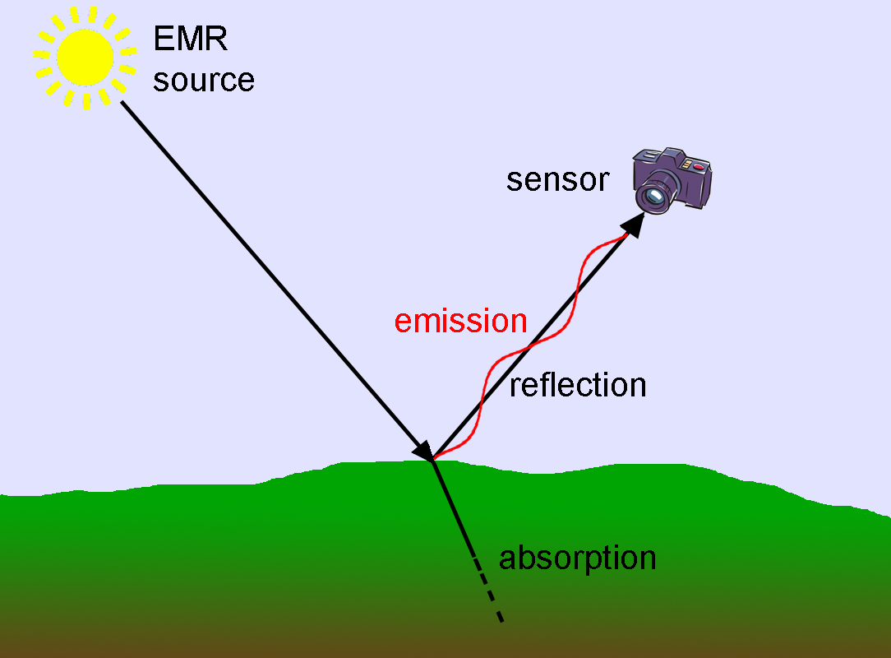
What is spectral analysis
Remote sensing is a technique which measures the ElectroMagnetic (EM) radiation from the sun reflected by the Earth’s surface

Slide 3
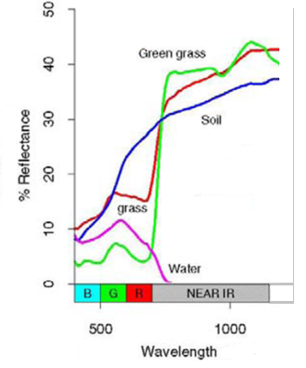
What is spectral analysis
The amount of energy reflected varies in wavelength for each material in a characteristic way, creating a sort of spectral signature

Slide 4
What you can do with spectral analysis
These broad-band multispectral system allows the discrimination of:
different types of vegetation
rocks and soil
water
man made materials

Slide 5
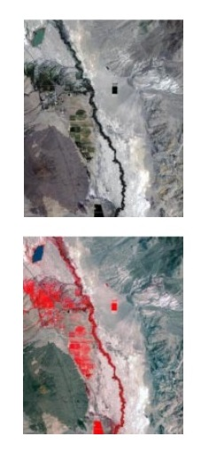
Using the classic RGB combination it seems that the airplane is overflying a river with some vegetation on the right side
Instead, using the combination given by
NIR+R+G
it is easy to understand that the airplane is overflying a strip of vegetation, and that there is a lake.

Slide 6
How we can use it
It is a well known and powerful technique used to discern and classify surfaces, materials, vegetation
We are using this technique from a short distance in a robotic swarm to identify objects in the environment
From a mid-long distance, robots can use it to improve their understanding of the ground (e.g.: to identify safe landing areas)

Slide 7
Thank you

