Slide 1
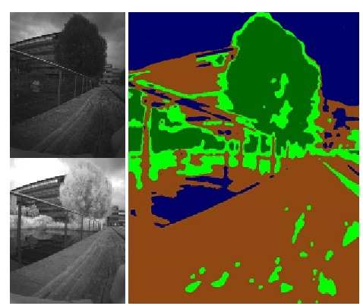
Autonomous Natural Landmarks Identification for Outdoor Navigation
Caterina Massidda¹, Heinrich H. Bülthoff¹,
and Paolo Stegagno¹
¹Max Planck Institute for Biological Cybernetics, Germany
A low-cost low-weight camera-array setup for simultaneous stereo-vision and spectral analysis
Online classification of the environment and extraction of vegetation and water bodies
3D reconstruction of the detected materials

