Slide 1
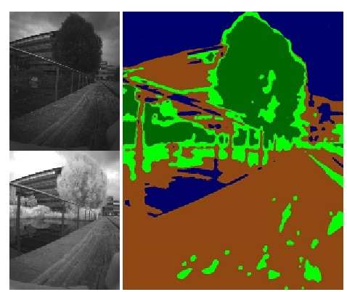
Autonomous Vegetation Identification for Outdoor Aerial Navigation
Caterina Massidda¹, Heinrich H. Bülthoff¹,
and Paolo Stegagno¹
¹Max Planck Institute for Biological Cybernetics, Germany
A low-cost low-weight camera-array setup for simultaneous spectral analysis and stereo-vision
Online classification of the environment and extraction of vegetation and water bodies
3D reconstruction of the detected materials
example of classification

