Slide 1

WG BCM
Business Continuity Management
BACK ON THE FLOOR !

Slide 2
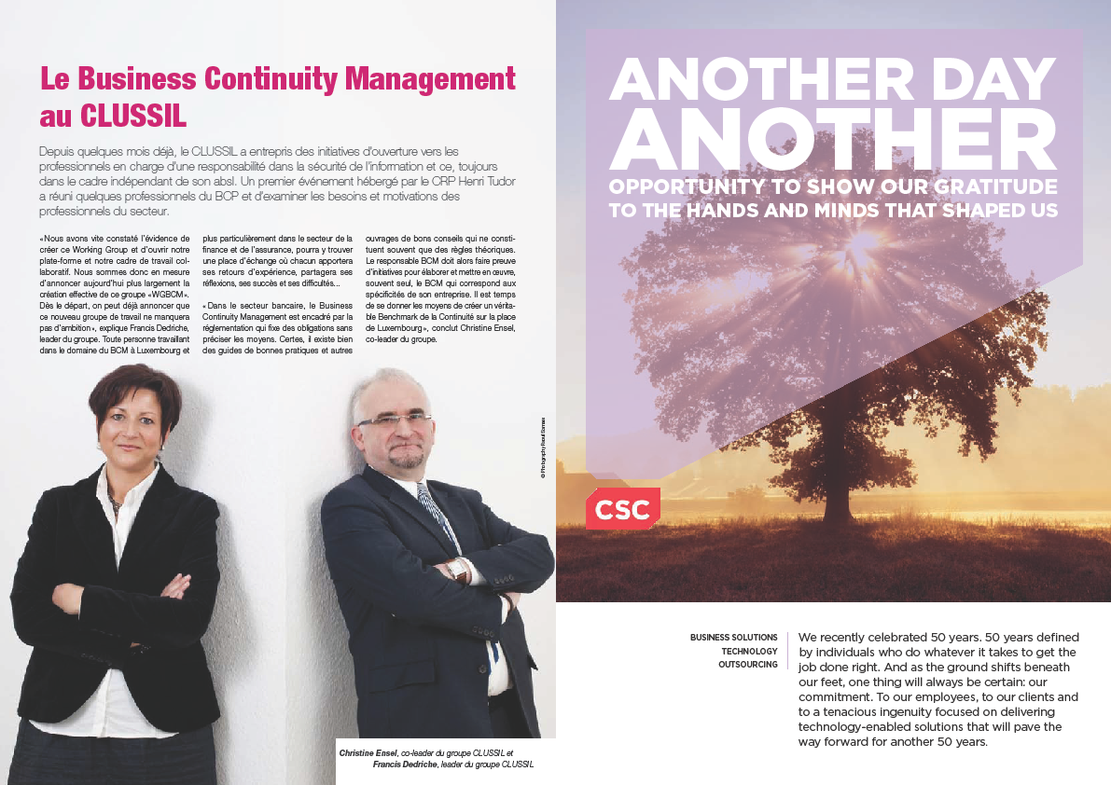
Some history…
Early 2010….
Francis and Christine took the initiative to set up a forum dedicated to Business Continuity Management.
Their initiative has been welcomed by the CLUSSIL and soon a Working Group was created.
Their objectives were:
To share vision about BCM
To improve skills and knowledge
To ensure sustainability of BCM
Thanks to their dedication , their working group could deliver interesting policy statements, recommendations and supporting documents these last years.

Slide 3
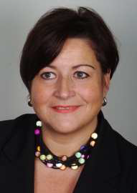
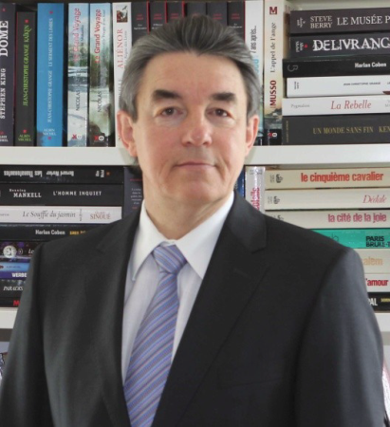
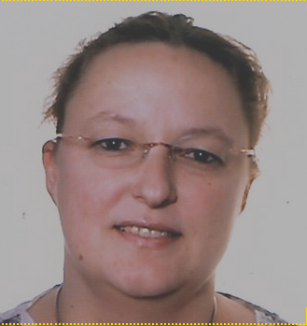
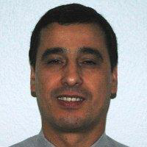
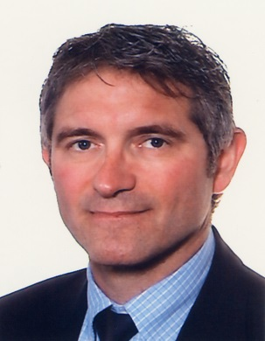
Some history…
Early 2014….
Bérengère, Christine, Ahmed, Thierry and Jean-Marie were suggested by “The BCI” to set up a Business Continuity Management initiative in Luxembourg. Hence our attendance to the Working Group created by Francis and Christine and our willingness to pursue actively the promotion of Continuity and Resilience through the social and economic landscape in Luxembourg.

Slide 4

Achievement in 2014
Cross-Industry seminar on Oct, 16th
….

Slide 5
Achievement in 2014
Feed-back on seminar
> 40 participants
Request to organize 3-4 events / year
Suggested topics to be addressed
  Crisis management
  Crisis communication
  BCM i.r.w. Data Centers and new technologies
  Pandemics in BC planning
  Psychological & Medical care in crisis situations

Slide 6
Targets for 2015
Keep focus on cross-industry seminars
2-4 events / year
Possible major event during 2015
  Promoting continuity in sectors not submitted to BCM regulations
  Raising awareness within SMEs’
  Stress on preservation of critical supply chains
Increase active membership within BCM WG
  Jan 2014: 5
  Nov 2014: 6

Slide 7

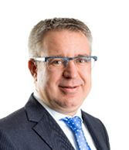

Who’s who

Slide 8
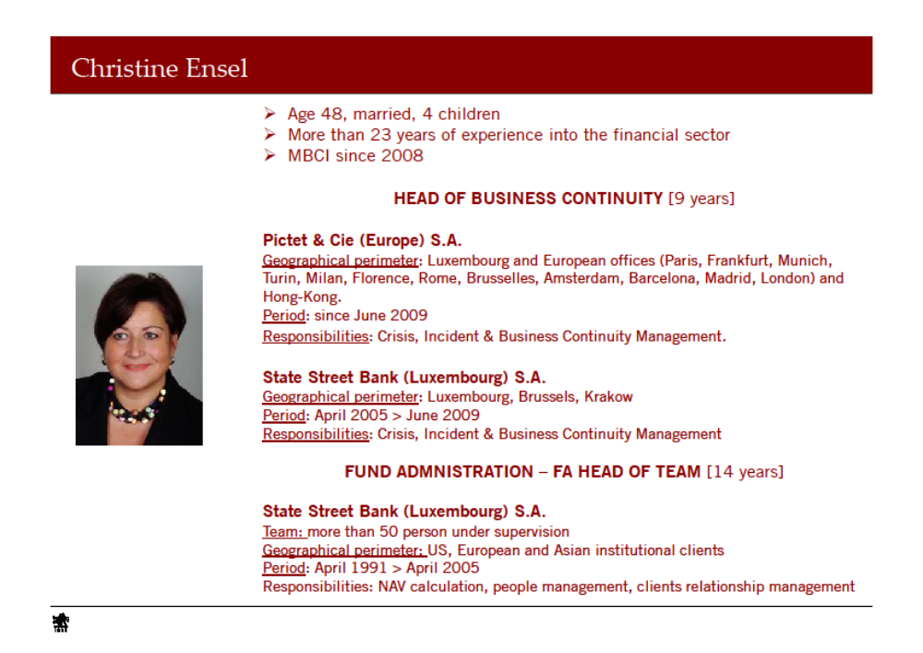

Slide 9
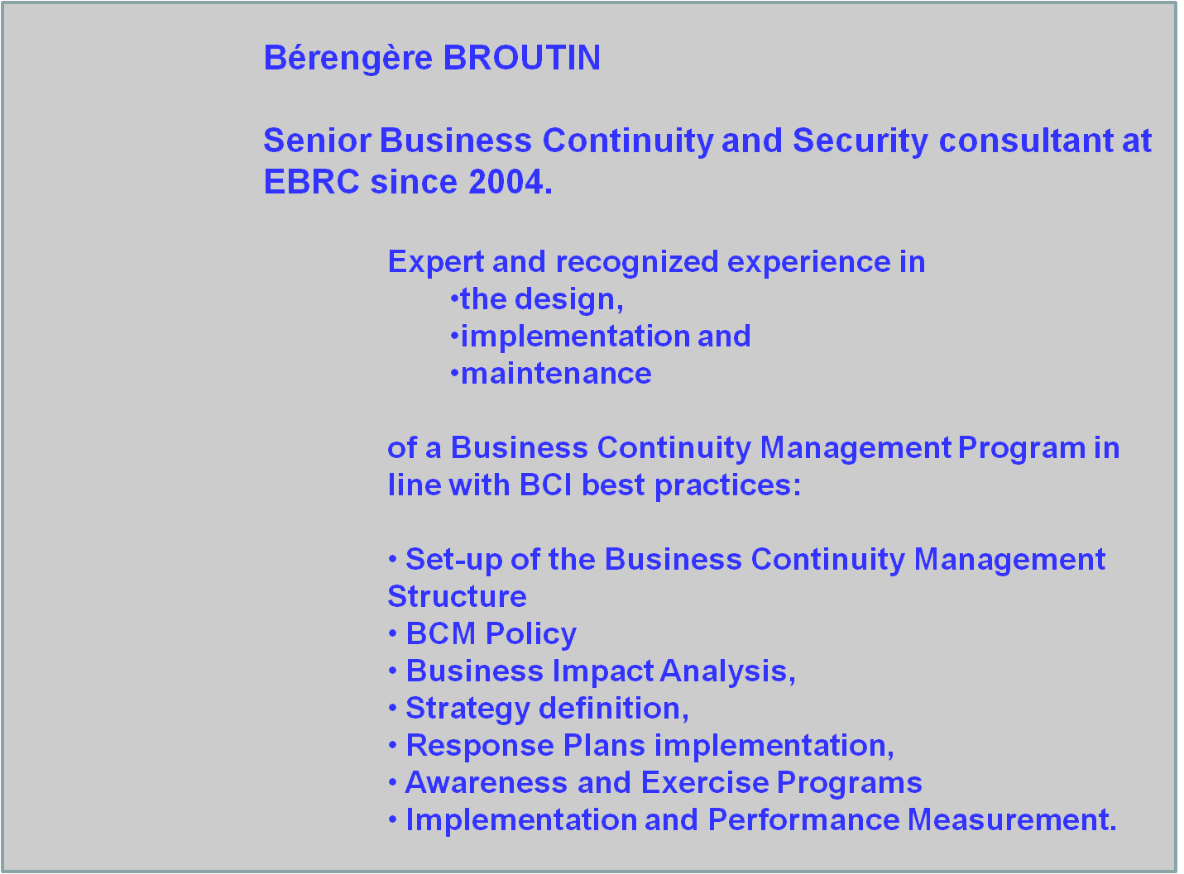

Slide 10
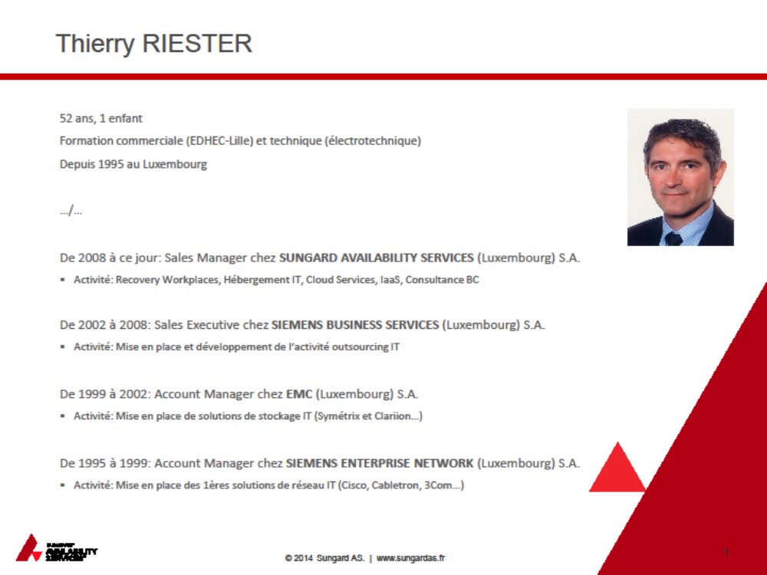

Slide 11
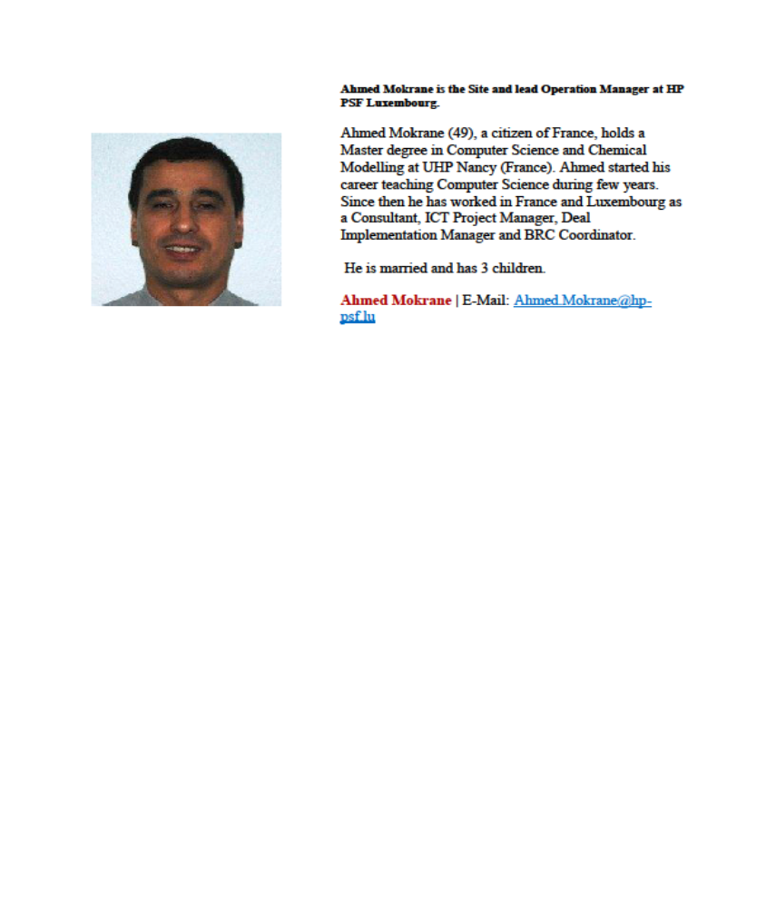

Slide 12
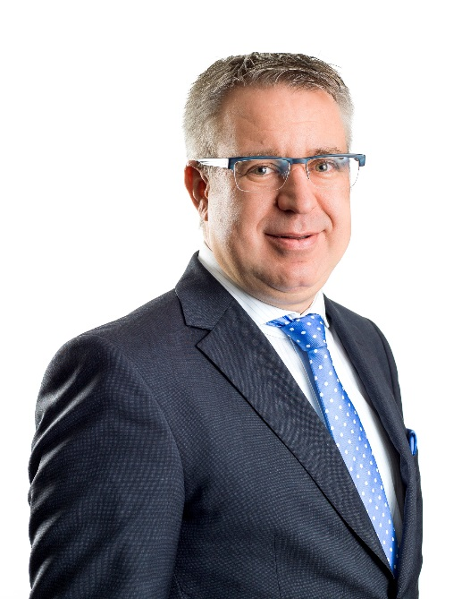
Paul Fohl
51 ans, marié, 3 enfants
Chief Risk Officer du Groupe Foyer
  Depuis 2011 en charge de l’implémentation d’un risk framework dans le contexte Solvency II
  Sponsor du projet BCP pour le Groupe Foyer
  Expérience de plus de 26 ans dans le Groupe
    dont directeur IARD et autres responsabilités opérationnelles
  Administrateur de sociétés
Formation
  Maîtrise en gestion d’entreprise
  INSEAD
Loisirs
  Photographie
  Voyages

Slide 13
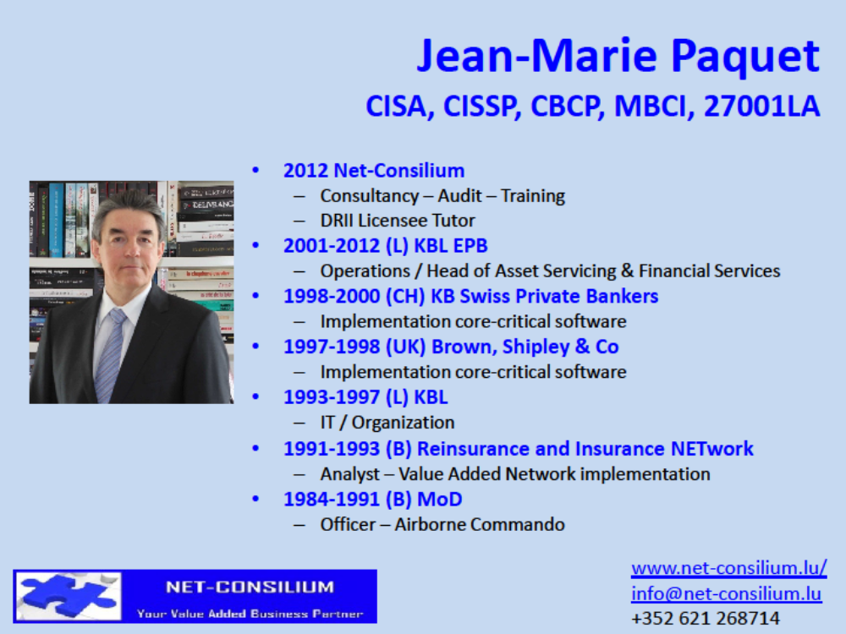

Slide 14
Thank you very much
for your attention !
Contact persons
Bérengère Broutin broutinb@gmail.com
Christine Ensel censel@pictet.com
Paul Fohl paul.fohl@foyer.lu
Ahmed Mokrane Ahmed.Mokrane@hpcds.com
Thierry Riester Thierry.Riester@sungard.com
Jean-Marie Paquet info@net-consilium.lu

