Slide 1

THE FUTURE
OF ISOs
Jean-Christophe LE TOQUIN
Cyril PIERRE-BEAUSSE

Slide 2

THE FUTURE OF INFORMATION SECURITY, LEGAL OUTLOOK
THE RULES TO COME
DRAFT EU DATA PROTECTION REGULATION
STRINGENCY TAKEN TO NEXT LEVEL
improved harmonisation
stricter (not workable?) rules
businesses under pressure
DATA PROTECTION TO BECOME A BOARDROOM ISSUE
approach based on competition rules
huge sanctions

Slide 3
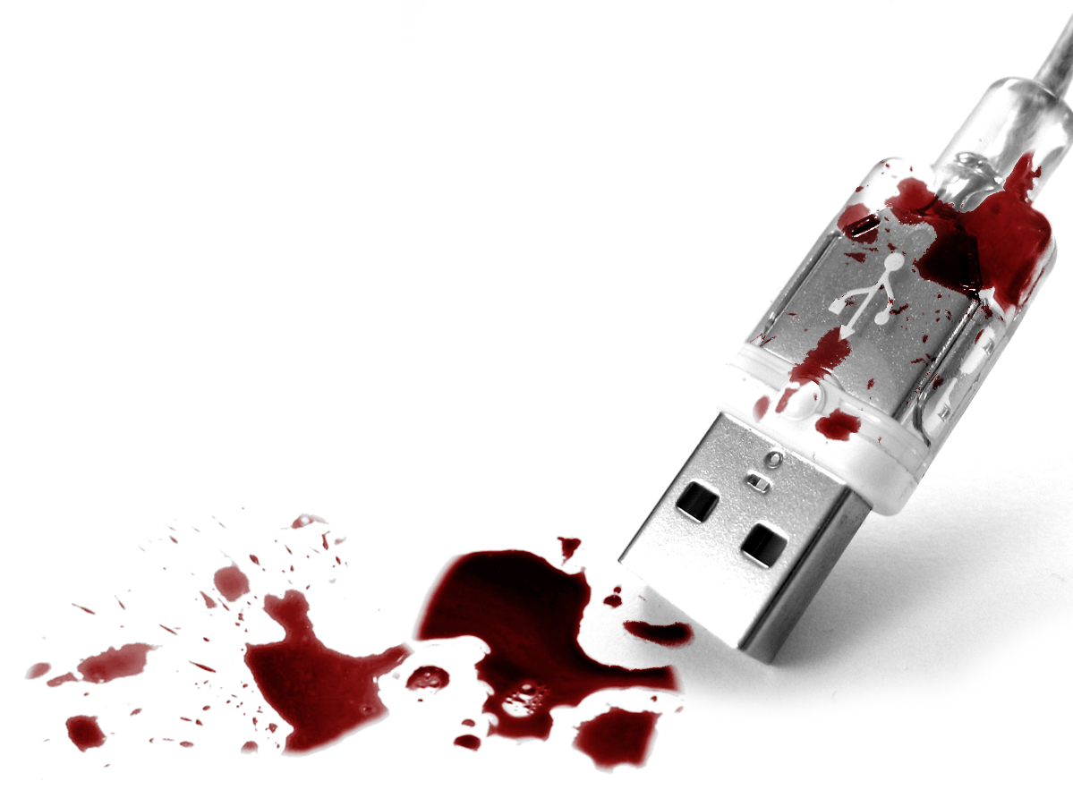
THE FUTURE OF INFORMATION SECURITY, LEGAL OUTLOOK
THE RULES TO COME
DATA BREACHES
TODAY
No notification obligation, criminal sanctions (rarely applied)
TOMORROW
Obligation to inform within 24 (72?) hours:
CNPD
data subjects’ whose privacy is threatened

Slide 4

THE FUTURE OF INFORMATION SECURITY, LEGAL OUTLOOK
THE RULES TO COME
SANCTIONS
TODAY
CNPD warnings
criminal sanctions virtually never applied
TOMORROW
graduated administratives fines
up to 2% of worldwide turnover

Slide 5

OUTLOOK
WHERE ARE WE?
COUNTDOWN
draft published in Jan-2012
intense lobbying
10,000+ amendments at EU Parliament (no precedent)
adoption expected 2014
entry into force: +24 months
= 2016?
NOT TOO SOON TO PREPARE…

Slide 6

THE FUTURE OF INFORMATION SECURITY, LEGAL OUTLOOK
WHAT IMPACT?
HOW DO WE HANDLE THIS?
NO IMPROVISION ALLOWED
reaction must be appropriate, immediate
response to encompass:
technical
legal
commercial/marketing
ISOs CANNOT BE ISOLATED
co-operate with fellow travellers: DPOs!
find your way to the board…

Slide 7
SO WHAT DO WE DO?
BRACE FOR IMPACT…
BOARD
TASK FORCE
BE READY!
A TRAINED TASKFORCE
prepare, revise scenarios
know-your-interlocutors
WHEN IN CRISIS
taskforce to lead response (alone)
unchallenged authority needed
full/immediate co-operation from all
must include a board member to validate decisions and weigh in
RISK MGT DPO
ISO
BUSINESS IT, L/C
MARKETING
BUSINESS
L/C
IT

Slide 8

HELP US HELP YOU…
please voice!
WHAT DO YOU NEED?
training?
coaching?
LET’S DISCUSS!
jcletoquin@socogi.fr
cyril@cpb.lu

