Slide 1




WG ISM
Information Security Management
Activities of Outlook for
http://www.clusil.lu/

Slide 2
Content
WG ISM Organisation
WG ISM Working Sessions 2013
Mobile Security Deliverable
Outlook 2014

Slide 3
WG ISM Organisation > History
WG ISM started beginning 2011 and continued in 2012 with the concept of monthly presentations on hot topics
Cloud Computing
Data Leakage Prevention
Risk Management
Mobile Security
Incident Management
The same approach was kept for 2013
Change in Legal and Regulatory Environment
Business Continuity Management
Notes:
Add and continued in 2012

Slide 4
WG ISM Organisation > Some figures
Since 2011
7 hot topics
17 sessions
20 speakers
315 attendees
18+ attendees per session
Focus on 2013
2 hot topics
6 sessions
8 speakers
159 attendees
26+ attendees per session
Max = 40
77% of registrations are effective attendees
Notes:
Change le <<are effective attendees>>

Slide 5
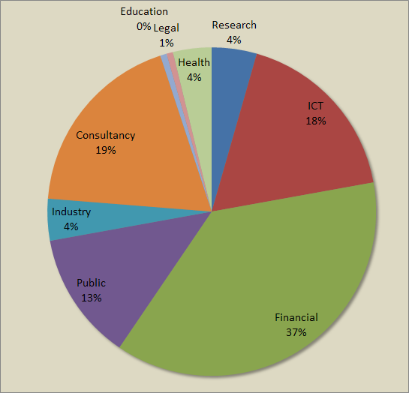
WG ISM Organisation > Some figures (cont.)
Since 2011
315 attendees
9 economic sectors
Notes:
77% of registrations are converted into attendees

Slide 6
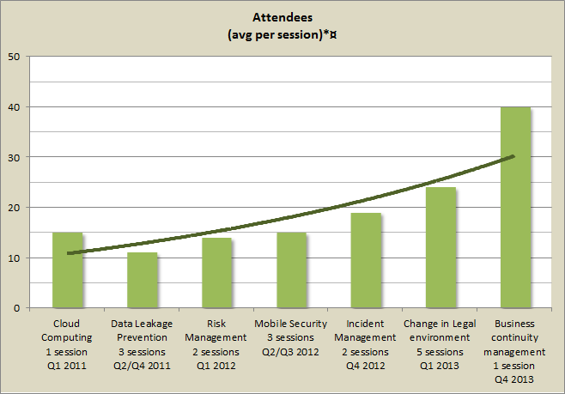


WG ISM Organisation > Some figures (cont.)
Increased success topics after topics since 2011

Slide 7


WG ISM Working Sessions 2013
2 hot topics have been proposed in 2013
Change in Legal and Regulatory Environment
5 sessions
Business Continuity Management
1 session
In 2013, CLUSIL organized 3 sessions jointly with other professional associations in LU
ISACA LU
FEDISA LU

Slide 8
WG ISM Working Sessions 2013
Change in Legal and Regulatory Environment
Sécurité de l'information et protection des données: nouvelles tendances et perspectives
Cyril PIERRE-BEAUSSE, Allen & Overy
Using COBIT 5 for Information Security, simply
Matthieu RINCK, ISACA LU
Change in the ISO/IEC 27000 series of standards - Toward new 27001 and 2002
Cédric MAUNY, SC27 LU
Luxembourg's e-archiving bill
Cyril PIERRE-BEAUSSE, FEDISA LU
Value-chains: an innovative way to face both business constraints and the legal and regulatory requirements
Serge RAUCQ, LEARCH

Slide 9
WG ISM Working Sessions 2013
Business Continuity Management (1 session)
The link between Incident Management & Business Continuity
Pascal STEICHEN, CLUSIL WG-IMP
BCM Lifecycle, The Key Points: The 6 steps of the BCM wheel explained
Christine ENSEL, PICTET
Francis DEDRICHE, ABN AMRO
From current local laws, regulations, standards & frameworks to a structured approach using COBIT5
Michael SIM, ISACA LU

Slide 10

WG ISM Working Sessions 2013
@allSpeakers: Thank you very much for your support

Slide 11
WG ISM Working Sessions 2013
@allAttendees: Thank you for your confidence

Slide 12
Mobile Security Deliverable
How to Use Smartphones and Tablets securely in a Corporate Environment
Current Status
Finalised and at the Board for review and approval
Some delay but high quality deliverable
Initially planned to deliver in 2012 but delayed

Slide 13

Mobile Security Deliverable
How to Use Smartphones and Tablets securely in a Corporate Environment
A lot of working sessions since July
Numerous e-mail exchanged
Authors & Contributors
Werner ANSORGE
Melanie CHEVALIER
Adriana CULTRONE
Myriam DJEROUNI
Philippe HOUGARDY (guest speaker)
Guy ISLER
Serge MARELLI
Cédric MAUNY
Benjamin OBERMEIER
Cyril PIERRE-BEAUSSE
Michael SIM
Selim STITI
Raphael TABAN
Tim van HONSTE
Thank you very much for your support !

Slide 14
Mobile Security Deliverable
How to Use Smartphones and Tablets securely in a Corporate Environment
Content Overview
Mobile Security Overview
Challenges
History & Trends
Security Risks and Threats
Laws and Regulations
EU wide & Local
Private Data vs. Company Owned Data
Best Practise Recommendations
End User
Companies
Company Owned Device (COD)
Company Owned & Personal Enabled (COPE)
Bring Your Own Device (BYOD)

Slide 15
Mobile Security Deliverable
How to Use Smartphones and Tablets securely in a Corporate Environment
Topic
Laws and Regulations
EU wide
Directive 95/46/EC of the European Parliament and of the Council of 24 October 1995 on the protection of individuals with regard to the processing of personal data and on the free movement of such data
Local
Law of 2 August 2002 on the Protection of Persons with regard to the Processing of Personal Data
Luxembourg Labour Code
Private Data vs. Company Owned Data
Definition
Recommendation for a legal document

Slide 16
Mobile Security Deliverable
How to Use Smartphones and Tablets securely in a Corporate Environment
Topic
Best Practise Recommendations
End Users
Basic security configuration
(Bluetooth, WiFi, password, data storage,…)
Basic behaviour
(Lock device, usage of Wi-Fi Hotspots, device OS update, backup,…)
Companies
Company Owned Device (COD)
Company Owned & Personal Enabled (COPE)
Bring Your Own Device (BYOD)
Covers topics like
Security Policy, awareness training, exit strategy, mobile device management tools,

Slide 17
Outlook 2014
Organisation of WG ISM sessions will
slightly change
Back to the basics
WG for working on deliverables
Selection of topic(s)
Monthly meetings
4th Thursday
Objective: to produce a CLUSIL-branded deliverable expressing opinion of the information security professionals in LU
Revival of CLUSIL After-Work sessions
CLUSIL members manifest interest on this concept
Interactive sessions on specific topics to be defined
Every 2 months

Slide 18
Outlook 2014
Back to the basics
Proposal of working-groups
Migrating existing ISMS with new versions of ISO/IEC 27001 and ISO/IEC 27002 issued on October 1st
Commenting and annoting legal texts from security perspectives
To be supported by a dedicated tool currently under development
Benchmark of Information Security in Luxembourg
Questionnaire
Analysis
Report
Any other ideas are welcome
Proposal to meet on January 30th for starting WG in 2014
Notes:
Change to <<Migrating existing ISMS >>

Slide 19
Outlook 2014
Revival of CLUSIL After-Work sessions
Proposal of topics
Hot topics such as international spying affairs (Prism, …)
Practical topics such as how to file a complaint?
Local topics such as the Luxembourg's e-archiving bill
Any other ideas are welcome
Topic of first session still to be defined

Slide 20
Outlook 2014
Schedule of WG-ISM sessions
Date:
Last Thursday of each month (as usual)
January 30th
February 27th
March 27th
April 24th
May 22nd*
July 03rd*
July 31st
September 25th
October 23rd*
November 27th
Place
CRP HT (as usual)
Time
17h30 > 19h (as usual)

Slide 21
Outlook 2014
Schedule of CLUSIL After-Work sessions
Topic
To be announced
Date
To be announced
Place
CRP HT
Time
17h30 > 19h (expected)
Notes:
Change the text in red

Slide 22
Thank you very much for your involvement !
See you in 2014
Contact persons
WG Leaders Werner ANSORGE werneransorge@gmail.com Cédric MAUNY cedric.mauny@telindus.lu
Notes:
22

