Slide 1

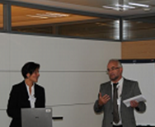
WG BCM
Business Continuity Management
2014 Projection

Slide 2
Some suggestions as a start…
Data center (DRP test, cartographic view, fiber optics, choice of site).
Crisis Management (scenario, communication flow with externals).
How to challenge business needs in regards to critical activities & number of BCP seats.
Local BCM certification programs (DRI, BCI).
From process to resilience.
How to quantify potential financial loss
….

Slide 3

Thank you very much
for your attention !
Contact persons/Leaders:
Francis Dedriche francis.dedriche@lu.abnamro.com
Christine Ensel censel@pictet.com

