Slide 1


CLUSIx symposium
24th and 25th June 2013
http://www.clusil.lu/

Slide 2
History of the CLUSIx
Information security: an ever-increasing subject of interest
Need of best practice sharing and emerging risk awareness is growing
Creation of associations named CLUSIx (CLUb de la Sécurité de l'Information) in several, mainly French speaking countries, such as CLUSIL in Luxembourg
Notes:
Change le <<are effective attendees>>

Slide 3










French-speaking CLUSIx
CLUSIx landscape:
France
Luxembourg
Italy
Tunisia
Burkina Faso
Morocco
Belgium
Switzerland
Ivory coast
Quebec
Notes:
Add and continued in 2012

Slide 4
CLUSIx initiative
By nature, the cyber criminality knows no geographical boundaries
The need for information security and the importance of exchange and collaboration between countries is now distinct
=> In this context, the French speaking CLUSIx, at an international level , decided to come closer
Notes:
Change le <<are effective attendees>>

Slide 5


CLUSIx Symposium | 24th and 25th June 2013
Participants
Luxembourg
France
Belgium
Italia
Tunisia
Notes:
Add and continued in 2012

Slide 6
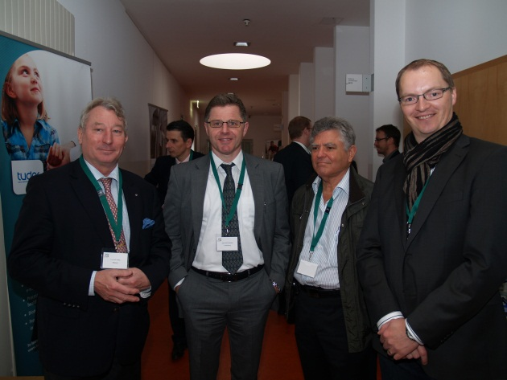
Objectives of the symposium
Day 1
Define and implement the first concrete actions to promote the exchange of knowledge and experiences between members of CLUSIx, still permitting each organization to present its operation, its activities, its difficulties but also its peculiarities and competence centres
Day 2
Public lecture on "Cyber Security Through International Cooperation!"
Notes:
77% of registrations are converted into attendees

Slide 7
Main results of the symposium | Day 1
Implement a strong and lasting partnership through the following mechanisms and tools:
Annual meetings between CLUSIx
Secure Platform for document exchange between CLUSIx
Sharing of deliverables by each CLUSIx
Creation of a working group inter-CLUSIx
Notes:
77% of registrations are converted into attendees

Slide 8
Cyber Security Through International Cooperation! (1)
CLUSIx cyber security panorama
Participating CLUSIx provided an overview of cyber criminality in their respective countries
Some core initiatives of information security at the national Luxembourg level
Records management: a new and innovative regulation in Luxembourg (Catherine di Lorenzo – FEDISA)
my.cases.lu, the new risk management platform for all (François Thill - Ministry of the Economy and Foreign Trade)
Telecom package art13a. setup in Luxembourg (Sébastien Pineau - CRP Henri Tudor)
Notes:
77% of registrations are converted into attendees

Slide 9
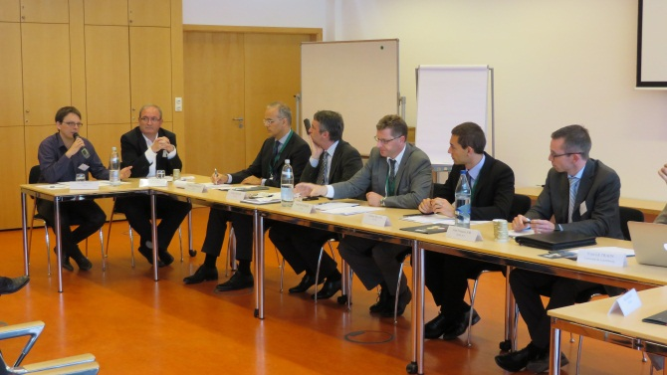
Cyber Security Through International Cooperation! (2)
Roundtable discussion involving representatives of:
CLUSIx (France, Luxembourg)
ENISA (European Network and Information Security Agency)
CERT of the European institutions
FEDIL-ICT (Business Federation Luxembourg - ICT chapter)
Banking sector (Yapital, CETREL)
Research and innovation sector (University of Luxembourg, CRP Henri Tudor)
Slides are still available:
http://clusix.clusil.lu/
Notes:
77% of registrations are converted into attendees

Slide 10
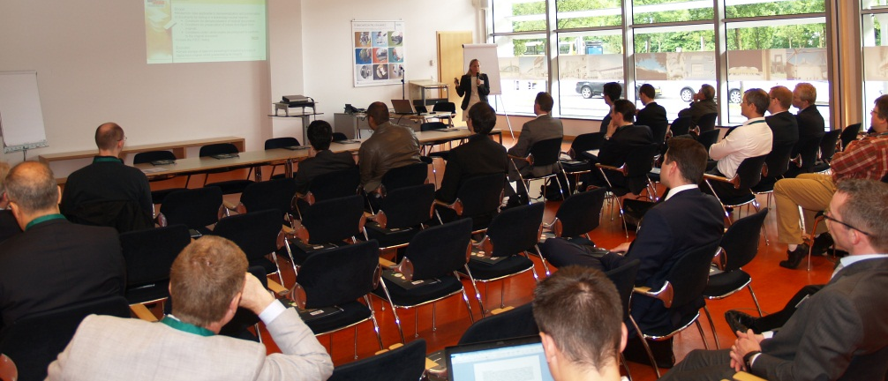
Next steps
clusix.clusil.lu is ready to host documents
Establishment of the list of deliverables to be shared on the platform
The next CLUSIx collaboration meeting is planned for 2014 in Italy
Notes:
77% of registrations are converted into attendees

Slide 11
Thank you for your attention
Notes:
11

