Slide 1

EOY Event
CLUSIL
Jean Goetzinger
Président du Clusil
December 3rd 2014
CLUSIL

Slide 2

SMAC
Social
Mobile
Analytics (Big Data)
Cloud
  Creating a cohesive and comprehensive security strategy is a must !
CLUSIL
3

Slide 3
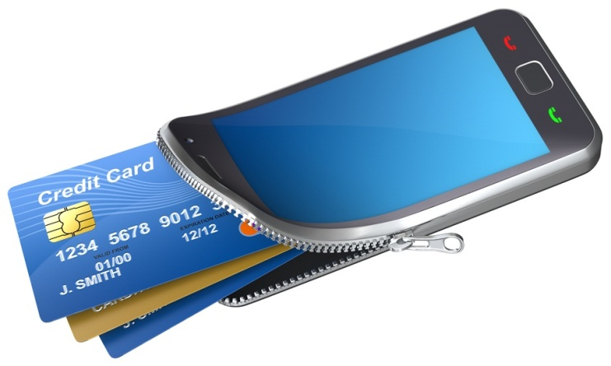




The world is changing
CLUSIL
4

Slide 4
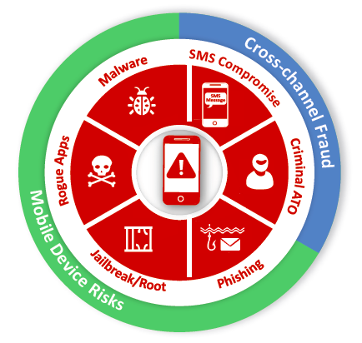

Threat Landscape
CLUSIL
18/12/2008
15

Slide 5
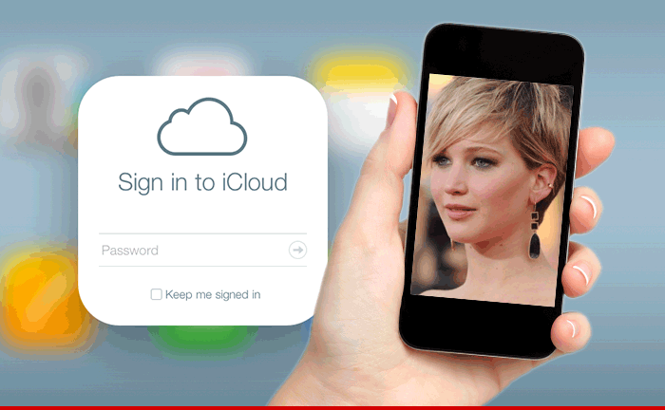
Mobile Threat Landscape
iCloud Hacked: 100+ Celebrities Nude Picture Leaks
CLUSIL
16
18/12/2008

Slide 6
What is CLUSIL?
CLUSIL stands for
CLUb de la Sécurité de l'Information Luxembourg
since 1996
With over 250 member from
different sectors interested in Information security
www.clusil.lu

