Slide 1




WG ISM
Information Security Management
Activities of Outlook for
http://www.clusil.lu/

Slide 2
Content
WG ISM achievements for 2014
Workplan for 2015

Slide 3

WG ISM Working Sessions 2014
2 main achievements for 2014
Publication of the Mobile Security Deliverable
First stones of the Benchmark of Information Security Controls

Slide 4

WG ISM Working Sessions 2014
2 main achievements for 2014
    1. Publication of the Mobile Security Deliverable during the Annual General Meeting of CLUSIL in Q1 2014
      Mobile Security - How to use Smart phones and Tablets securely in a Corporate Environment
        https://intranet.clusil.lu/main/2013
      Thanks to all contributors, reviewers but also readers
      So far the document is only available to CLUSIL Members
        To be publicly released to everybody by the end of 2014
      Security is not a state but a continual process
        Such document needs to be regularly updated
        Call for volonteers to keep this document alive

Slide 5
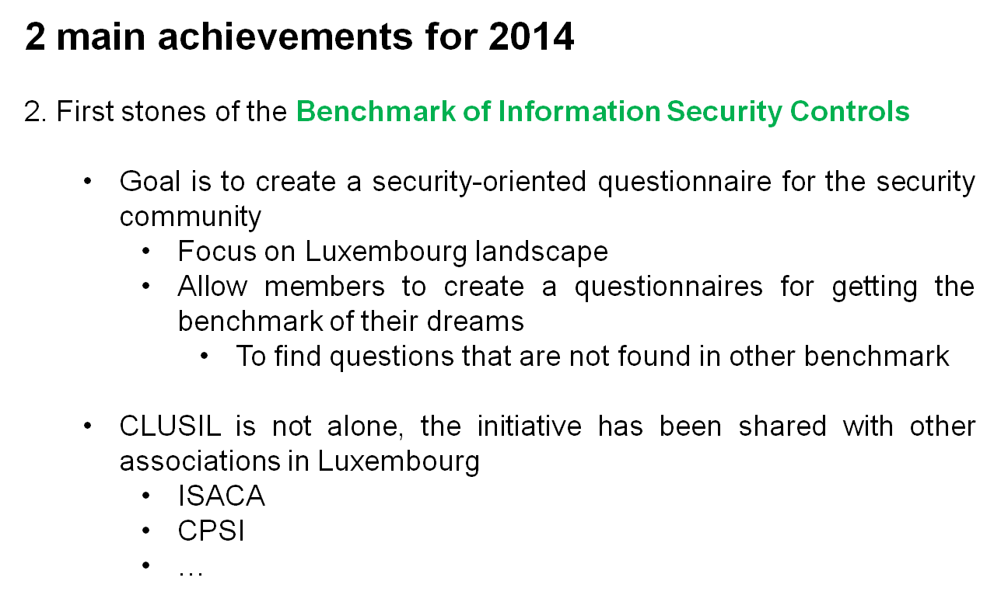


WG ISM Working Sessions 2014

Slide 6

WG ISM Working Sessions 2014
@allContributors @allReviewers: Thank you !

Slide 7
Benchmark of Information Security Controls
Benchmark of Information Security Controls
Draft of first questions elaborated
Let’s test some questions right now!

Slide 8
Benchmark of Information Security Controls
Benchmark of Information Security Controls
How do you consider cybercrime?
Highest priority and risk
One of the highest priority and risk
No specific consideration

Slide 9
Benchmark of Information Security Controls
Benchmark of Information Security Controls
Are you comfortable that detection mechanisms cover all key risks of incidents?
Yes
No
I do not know

Slide 10
Benchmark of Information Security Controls
Benchmark of Information Security Controls
Do you have adequate infrastructure to recover data which has been backed up with previous systems or configurations?
Yes and tested
Yes …
No
I do not know

Slide 11
Benchmark of Information Security Controls
Benchmark of Information Security Controls
Current Status
Qualification of the scope of work
Identification of key areas
Draft of first questions (and proposed answer)

Slide 12

Benchmark of Information Security Controls
Benchmark of Information Security Controls
A dozens of working sessions since January
Numerous e-mail exchanged
Contributors & Reviewers
Christophe AJDONIK
Werner ANSORGE
Olivier ANTOINE
Émelyne BAUDRIER
Jürgen BLUM
Alexandre CASTAING
Yann FAGUER
Daniel MARNACH
Cédric MAUNY
Olivier LEONARD
Olivier MONTEE
Raphaël TABAN
Eric TIERLING
Christophe RUPPERT
Guillaume SCHAFF
Michael SIM
Guy ISLER
Thank you very much for your support !

Slide 13
Benchmark of Information Security Controls
Benchmark of Information Security Controls
Qualification of the scope of work
Privacy and confidentiality of answers to be under control
~30 questions focused on the security controls and measures
  CLUSIL to focus on the security controls and measures and their implementation
  Identification of key areas
  Generic questions to be asked at the end of every benchmark
Collaboration with other associations in LU
  Contacts taken
    ISACA for governance and auditing areas
    CPSI for roles and responsibilities of the Information Security Officer
    Everybody is welcome

Slide 14
Benchmark of Information Security Controls
Benchmark of Information Security Controls
Identified set of key topics and currently 79 questions
Generic questions (13)
Access control (6)
Cybercrime, incident management, response, forensics and Malware analysis (19)
Cloud computing (4)
Physical security (5)
Data classification (5)
Data security and Privacy (6)
DLP (2)
Encryption (9)
Security appliances (5)
DRP and data recovery / Backup & restore management / archiving (5)

Slide 15
Benchmark of Information Security Controls
Benchmark of Information Security Controls
Work to be done in 2015
Synchronisation with other associations
Selection and validation of the set of questions
Dissemination of the questionnaire
Analysis of collected results and report presentation at EoY event 2015

Slide 16



Workplan 2015
Schedule of WG-ISM sessions
Proposal to focus on the Benchmark
Dates
    Last Thursday of each month (as usual)
      January 29th
      Februay 26th
      March 26th
      April 30th
      June 04th
      July 02th
      September 17th
      October 15th
      November 05th
      December 03rd
    Place
    LIST in Kirchberg (as usual)
    Time
    17h30 > 19h (as usual)

Slide 17

Thank you very much
for your involvement !
See you in 2015
Contact persons
WG Leaders
Werner ANSORGE werneransorge@gmail.com
Cédric MAUNY cedric.mauny@telindus.lu

