Slide 1


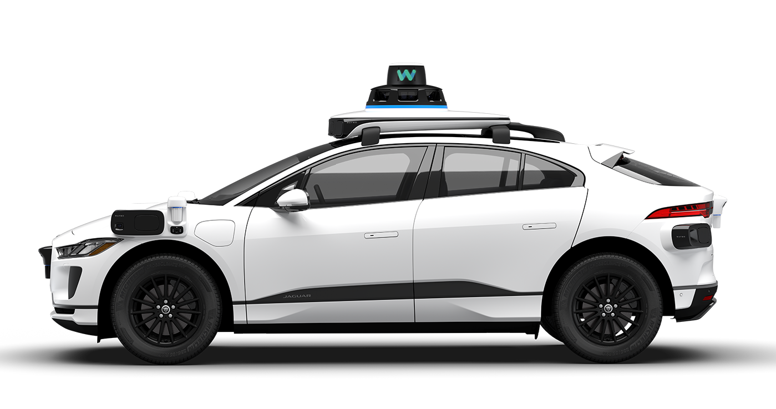
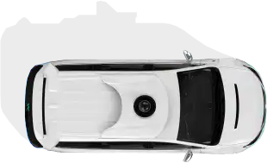
Unsupervised Statistical Learning for Kinematic Anomaly Detection in Autonomous Driving Scenarios
Pavel Stepanov
Ramses Loaces
Justin Cabrera
Department of Computer Science University of Miami
CSC 642 · Spring 2026

Slide 2

Intro

Slide 3
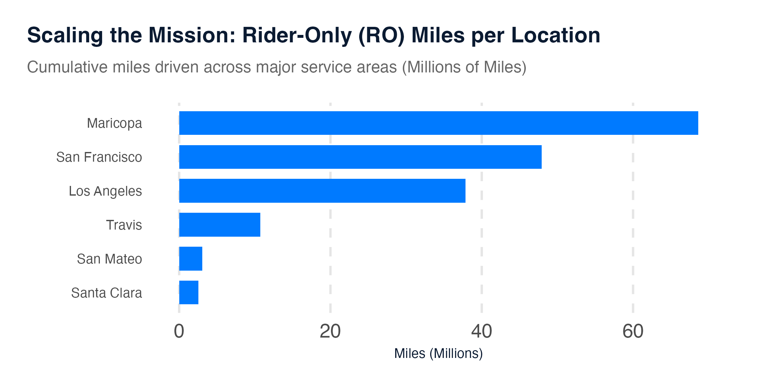
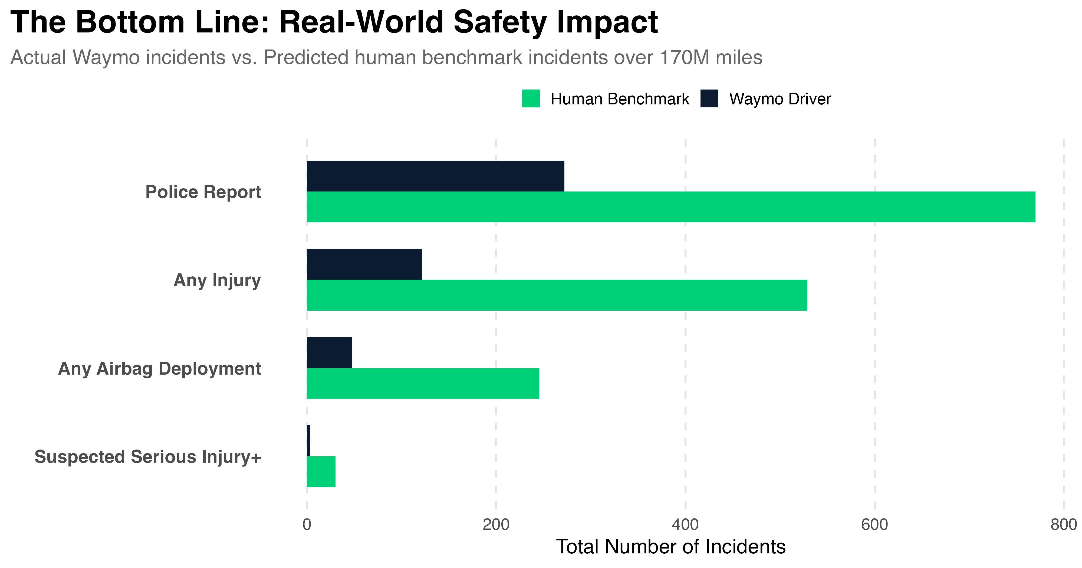
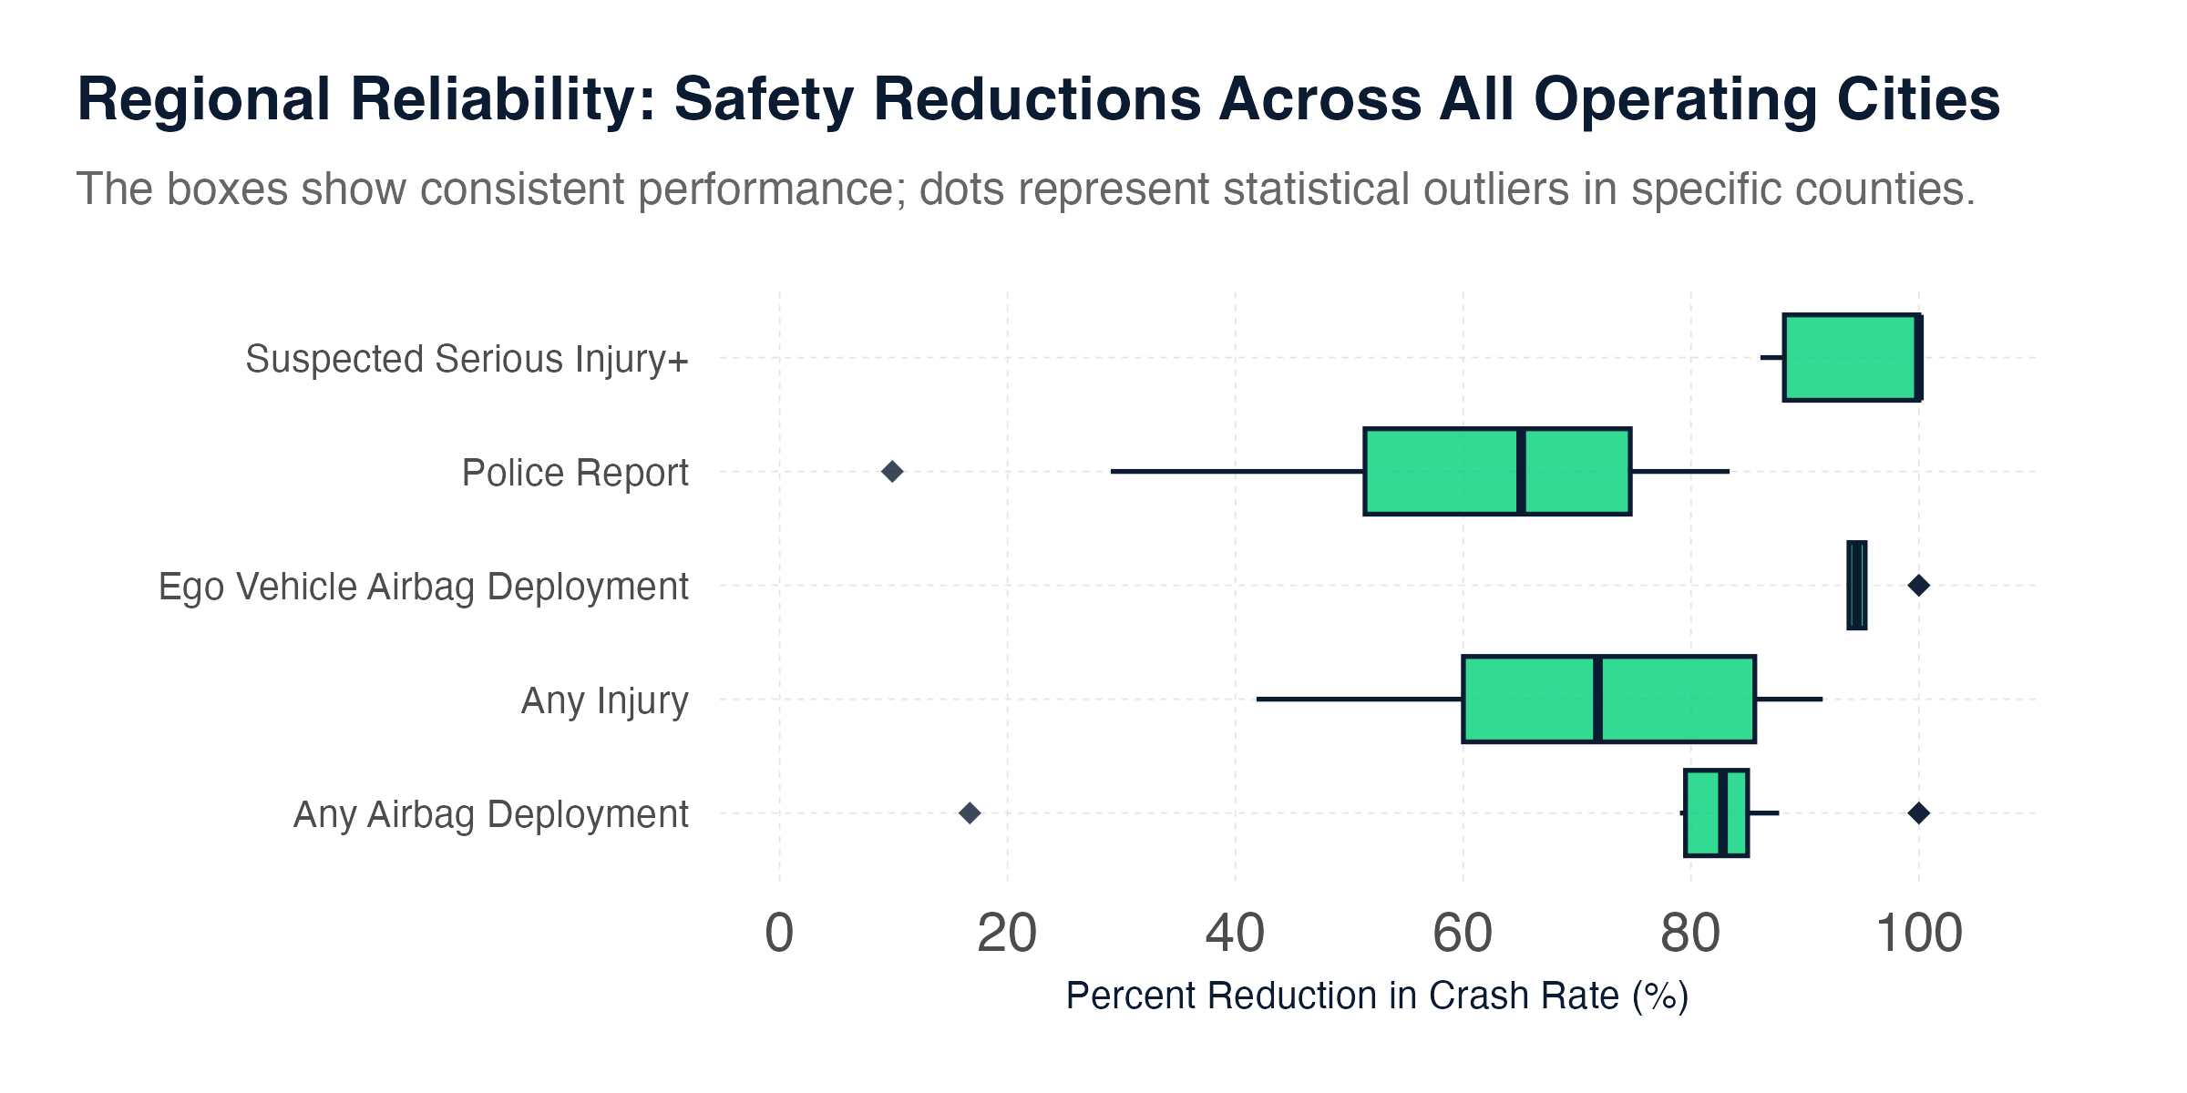
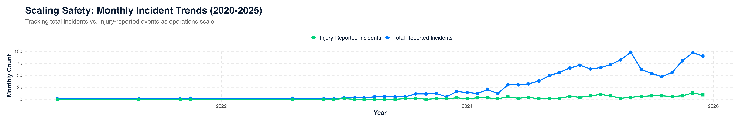
Safety
Waymo has positioned in self as a key technological partner in achieving Vision Zero, the collaborative campaign to help communities reach their goals of eliminating all traffic fatalities and severe injuries while increasing safe, healthy, equitable mobility for all.

Slide 4
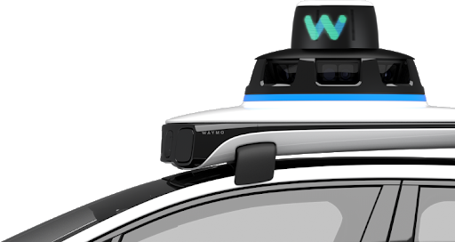
Problem
The Long-Tail Problem in Autonomous Driving
Most driving is routine and predictable.
Safety-critical events are rare but risky:
* Sudden braking or acceleration
* Jaywalking pedestrians
* Near-misses
Anomaly data is scarce, and “danger” depends on context.

Slide 5
Motivation
The Long-Tail Problem in Autonomous Driving
Unsupervised learning lets the data define normal — and flags what falls outside.
Goal 1 | Goal 2
Detect anomalous agents from kinematics alone — no labels | Predict 5-second future displacement from current kinematic state

