Slide 1
How to not use Prometheus and Grafana with Prusa printers
Pavel Strobl

Slide 2

Who am I?
Pavel Strobl
DevOps engineer for Prusa Research
HW wannabe
Car enthusiast
Homebrewer (Sorta)

Slide 3

What is Prometheus exporter?
/metrics
Endpoint for Prometheus Scraper
Instrumenting metrics
TL;DR:
  “Text file” that Prometheus gets and stores

Slide 4

But why?
Multiple printers
Centralisation of metrics
Long preservation of data
Alerting
Freedom
Machine learning?

Slide 5

How it works?
“It just works.”
GoLang
Three Prometheus Handlers
  Legacy (DEPRECATED)
  Buddy
  Einsy
Multi-target
A lot of messy metrics

Slide 6

DemOps!
Hopefully

Slide 7
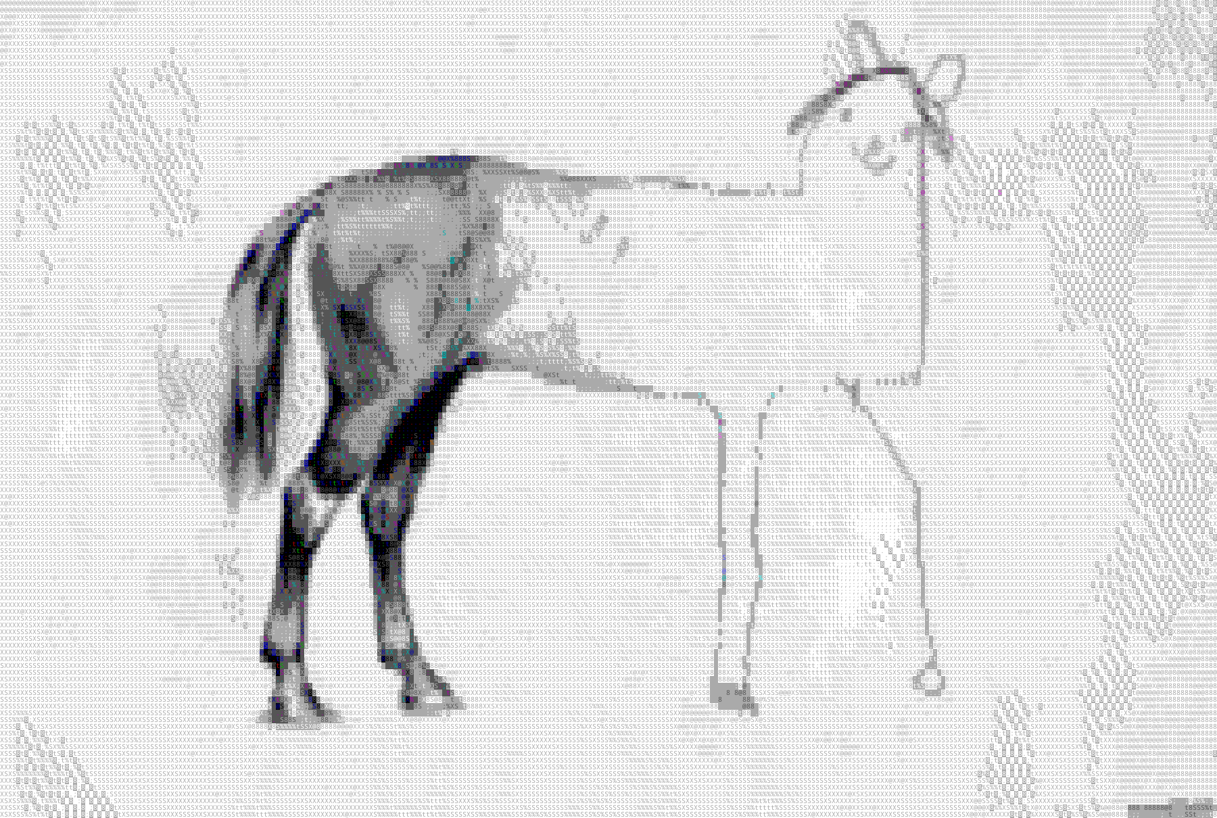
Current status
It works… somehow
WIP - More like PoC
It needs polishing
Logging data from printers to Loki
And much more

Slide 8

Thanks!
See you later…
Alligator

