Slide 1

Never Gonna Give Sentry Down
A Story About Sadness, Eternity, Nuisance and Trying
Pavel Strobl / Prusa Research / pubel.dev / v0.2.3

Slide 2


whoami
Platform Engineer at Prusa Research
Cloud Native Prague co-organizer
Observability and platform
Homebrewer 🍺
Plays with hardware and software
  3D printers
  Cars
  Embedded
Pavel Strobl

Slide 3



cat agenda
Quick reminder what Sentry is
Self-hosted vs. SaaS
  Main difference between them
  Why to self-host
  Why not
Getting started
Running
Takeaways from self-hosting Sentry

Slide 4
What is Love Sentry?

Slide 5
What is Sentry?
Exception handling
APM
  Profiling
  Tracing
Uptime monitoring
Cron monitoring
Session replays
Whew
That’s a lot of stuff

Slide 6
Self-hosted vs. SaaS

Slide 7
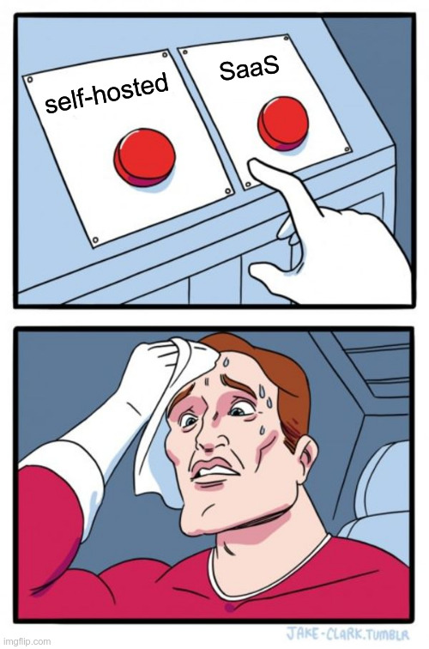
Self-hosted
You don’t send data “to the cloud”
  Yeah, technically
It’s open-source so it is “free”
  Oh sweet summer child
Can run on a single computer
  If you really hate yourself
Can be integrated within your stack
  Docker, K8s you have it all
  …
  Right?

Slide 8
Self-hosted
You don’t send data “to the cloud”
  Only a bit valid reason
It’s open-source so it is “free”
  If you don’t count employees and compute power
Can run on a single computer
  Don’t
Can be integrated within your stack
  Officially only docker-compose
  Unofficially helm chart ❤️
Notes:
Although Sentry libraries does a pretty good job in anonymizing data from apps. NEVER send valuable data to Sentry

Slide 9
SaaS
You can actually use Sentry
  Much less time consumed by just running it
Pretty expensive
  If your usage is enormous
    After that less expensive
Same libraries as for on-premise version
Easy migration from on-premise
version 👏

Slide 10
SaaS
Calculation can be pretty confusing
  Transactions
  Errors
  Session Replays
  Attachments
Easy budgeting per team
  If budget is drained then team is basically blind for the rest of the month

Slide 11
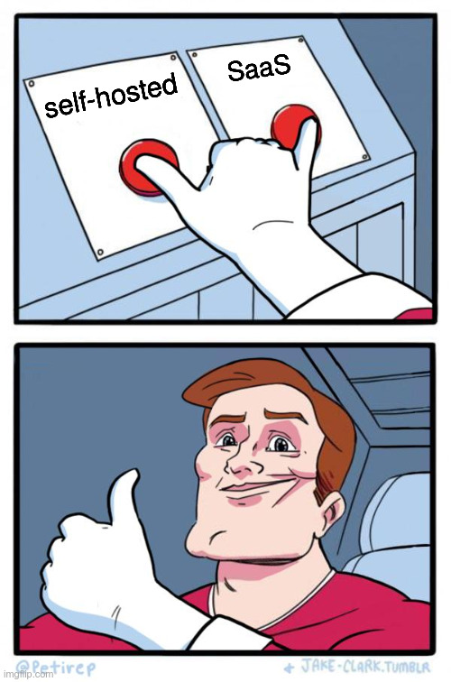
Or both
A project that knows how to behave
  can be leveraged to SaaS
  improve their quality of life for developers
Others
  self-hosted
  millions of errors can be handled locally
    preventing AWS-like invoice

Slide 12
Just deploy it already

Slide 13

Kubernetes it is
Using helm chart
  Easiest way
Not officially supported
  And it’s sometimes like that
Running Sentry
  In Kubernetes
    Is far from ideal
Best option for us
  Bare-metal
  docker-compose

Slide 14
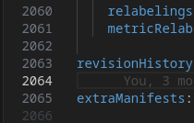
A lot of components
This is going to be long
MemcacheD
PostgreSQL
Clickhouse
Kafka
Redis
Zookeeper
Billing Metrics Consumer
Cron
Generic Metrics Consumer

Slide 15
A lot of components
Ingest Consumer Attachments
Ingest Consumer Events
Ingest Consumer Transactions
Ingest Monitors
Ingest Occurrences
Ingest Profiles
Ingest Replay Recordings
Issue Occurrences Consumer
Metrics Consumer

Slide 16
A lot of components
Post Process Forward Errors
Post Process Forward Issue Platform
Post Process Forward Transactions
Relay
Sessions Consumer
Snuba API
Snuba Consumer
Snuba Generic Metrics Counters Consumer
Snuba Generic Metrics Counters Consumer

Slide 17
A lot of components
Snuba Generic Metrics Sets Consumer
Snuba Group Attributes Consumer
Snuba Metrics Consumer
Snuba Outcomes Billing Consumer
Snuba Outcomes Consumer
Snuba Profiling Functions Consumer
Snuba Profiling Profiles Consumer
Snuba Replacer
Snuba Replays Consumer
Snuba Spans Consumer

Slide 18
A lot of components
Snuba Subscription Consumer Events
Snuba Subscription Consumer Metrics
Snuba Subscription Consumer Transactions
Snuba Transactions Consumer
Subscription Consumer Events
Subscription Consumer Generic Metrics
Subscription Consumer Metrics
Subscription Consumer Transactions
Symbolicator API

Slide 19
A lot of components
Vroom
Web
Worker
Worker Events
Worker Transactions
I forgot RabbitMQ in the beginning
And that’s all folks

Slide 20

A lot of components
As I said - It takes time
Configuration hell
Easy to forget something
Easy to misconfigure something
Upgrading
  gl hf
Issues with Sentry
Issues with Helm chart
  It takes about 40 minutes to deploy

Slide 21

The path to success
After loooooong configuring
  And deploying
It’s online!
SSO runs fine - with one domain*
Projects are being added
Errors flows
Everything seemed nice and cosy
*or more if you know how

Slide 22
The story of how I used to have long hair

Slide 23

The pain
Running it in Kubernetes
  Not so optimized
Even as a code it’s pain
Upgrades
  Just don’t
  Only when needed
Very difficult to cost-optimized
Very expensive

Slide 24

The pain
Heavy load
  Can lead to unforeseen consequences
Up to 1 million transactions per month
  Rookie numbers
Other components started failing
Pressured hard drives
  Yes, we had PV
Noisy neighbor
  Kafka I’m looking at you

Slide 25



The pain
Heavy load
Issue
  Reasoning with developers
    Sending 100% of data is not a good idea
  Sentry is designed for 1 million transactions per month
    We did 1 million per hour
      Very nice and beautiful indeed

Slide 26
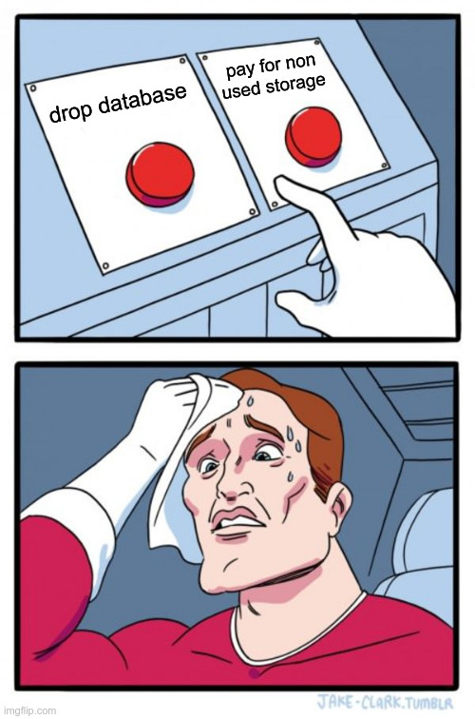
The pain
After heavy load
Sentry PSQL
  2 Ti
Clickhouse
  3x 600 Gi + Broken sharding
Still enormous compute load
  Even when “idling”
Until recently - constantly broken Kafka topics
My missing hair

Slide 27

The definition of insanity
Sentry took almost ⅓ of my time last year
At this moment it’s finally stable
  kinda - occasional OOM is still prevalent
    still issues with topics but they are restarting automatically
Still a lot of transactions into Sentry
Upgrading… upgrading… upgrading… upgrading… upgrading… upgrading… upgrading… upgrading… upgrading… upgrading… upgrading… upgrading… upgrading… upgrading… upgrading… upgrading… upgrading… upgrading…

Slide 28
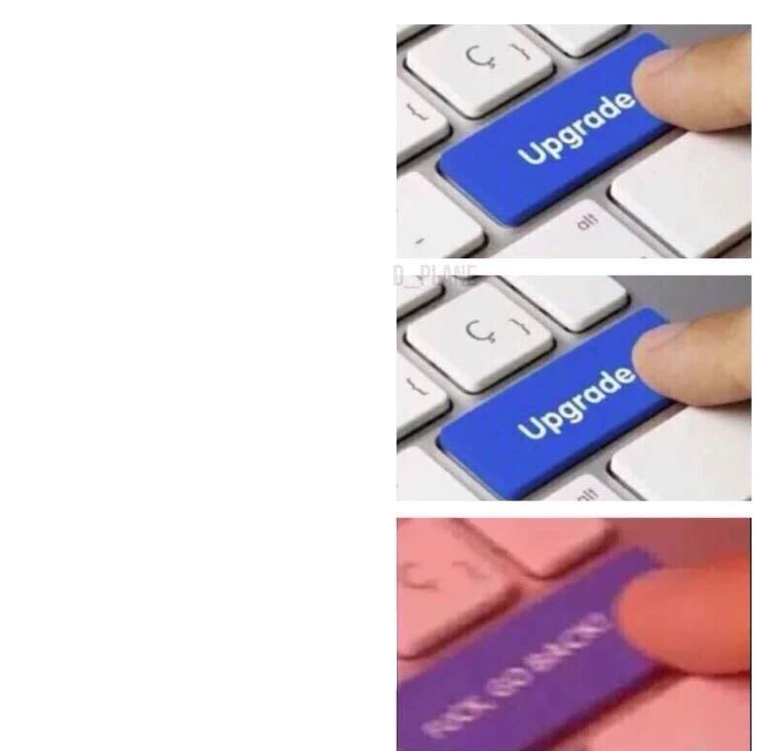
The definition of insanity
Upgrading is hell
  Even Doomguy would retreat
Reverting is almost impossible
Migrations works sometimes
  If clickhouse migration stopped working you are cooked
    More than from Gordon Ramsay
  Errors with no solutions 🤌
Solution?

Slide 29
The definition of insanity
Just not upgrade right?
  Right?
But developers wants more features
  More features almost certainly equals more broken Sentry
So you upgrade Sentry
  It does not work
    So you are working on fix
      And developers complains that Sentry is down
        And you're starting to get PTSD from Slack
          And then you try to

Slide 30
Takeaway

Slide 31

Takeaway
Don’t

Slide 32

Takeaway
Self-hosted when you have extreme load
  So the pricing is unreasonable
You need to allocate up to one person
  Even more if you don’t have
  Mr. Know-It-All
Alternatives?
  GlitchTip…
An experience I never wanted to have

Slide 33
One more thing

Slide 34

We are hiring!
DevOps Engineer
Prometheus
Grafana
OpenTofu
ArgoCD
Gitlab
Kubernetes (GKE)
3D printers
And much much more ❤️

Slide 35
Q & A

Slide 36
The end

