Slide 1
Machine Learning E1 Regression Task
Group 21
Sophie Rain (01425316),
Peter Stroppa (0132xxxx),
Lucas Unterberger (01325438)

Slide 2
General Overview
Used Datasets:
Bikes
Students
Airquality
Energy
Regression Methods:
Regression Tree (min_samples_leaf, max_depth)
Linear Regression (fit_intercept=True)
Lasso Regression (alpha)
kNN (k, weights, algorithm)

Slide 3
General Overview – cont‘d
Preprocessing Methods
OneHotEncoding
OrdinalEncoding
MinMax Scaling
Z-score Scaling
Feature Selection
Evaluation Measures
Rooted mean squared error
Relative mean squared error
Mean absolute error
Relative absolute error
Correlation
No fixed Train-test-split
random sampling in every iteration (80:20)
Preprocessing usefull for every dataset

Slide 4
Comparison Datasets
Bike and Students dataset contain numerical and categorical data
Airquality contains missing values, set to -200 by default
Number of features: 10 (air)-30 (students)
Highest number of samples 9357 (air)
Lowest number of samples 198 (students)

Slide 5
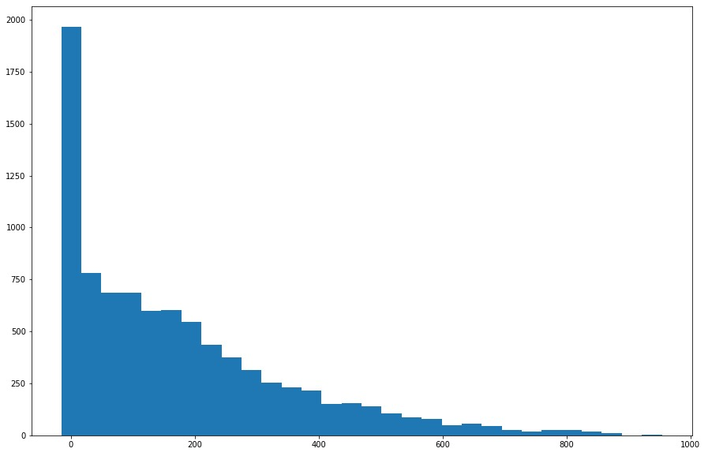
BikeSharing Dataset
15 features
Dteday only string value --> redundant
Id omitted (irrelevant)
Others either float or integer/ordinal valued
Range varies: (Preprocessing!)
Hour: 0-23 <-> weather information: 0-1 <-> holiday: boolean
Target feature: cnt = number of rented bikes
Range about 0-900 (mean: 188, median 142, std: 178)
Missing values? – No
Number of training samples: 8690

Slide 6
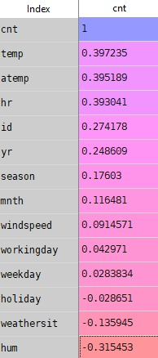
BikeSharing Preprocessing
Correlation Features <-> Target:
No feature with very high correlation
Weekday and holiday low values
Workingday and holiday complementary -> overrepresentation?
Considered 4 different approaches:
No preprocessing (other than dropping both id and dteday)
Z-score scaling on all parameters
Min-max scaling on all parameters
Feature Selection acc. to correlation vector, i.e. drop weekday, holiday
Results
For every method but kNN: Feature selection performed poorly
Other 3 approaches: strong dependence on method

Slide 7
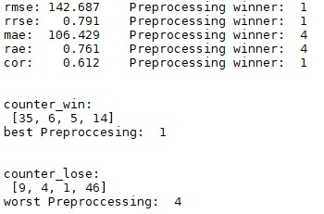
BikeSharing – Linear Regression
Preprocessing:
The raw data approach yields best result
Worst result: Feature Selection
Results-Preprocessing:
20 runs, different train-test splits
Every time evaluation of 5 measures (see graphic), 2 redundant
Saved best and worst preprocessing and counted (3*20 counts )
Measures:
Rooted mean squared error: 143, relative error: 79%
Not good, at least <std

Slide 8
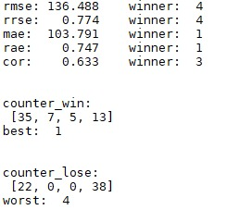
BikeSharing - Lasso Regression
Generally similar to Linear Regression
Preprocessing:
No obvious best, but obvious worst: Feature selection
Parameter:
Very unstable, no clear-cut alpha
Close to 1 and close to 0: performance strongly dependent on train-test split
Middle values: more stable but worse results (average)
Results: (1: alpha=1, 2: alpha=0.5, 3: alpha=0.05, 4: alpha=0.005)
As stated 1 and 4 often winner, often loser
2,3 stable in the middle
Rooted mean squared error slightly better than linear

Slide 9
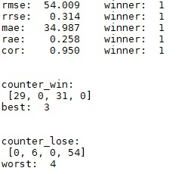
BikeSharing - kNN
Preprocessing
Less features preferred -> Feature Selection outperforms others
Parameter weights:
Weigths: distance by far better
In plot:
K = 5, weights = distance
K = 5, weights = uniform
K = 8, weights = distance
K = 8, weights = uniform
Wins shared amongst weigths=distance

Slide 10
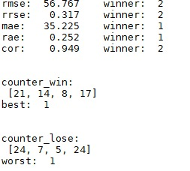
BikeSharing – kNN cont‘d
Parameter k:
Easy to see: behaves badly for k<6, and k>9
Inbetween not too clear
Plot: (weights=uniform, algorithm=ball_tree)
K = 6
K =7
K = 8
K = 9
Results:
RMSE significantly better than for Linear/Lasso Regression

Slide 11

BikeSharing – Regression Tree
Preprocessing:
Feature Selection worst
Others similar
Parameters:
Good values for Min_samples_leaf: 2 or 3
Max_depth: default setting best
Results: for raw data (option 1)
Similar to kNN

Slide 12
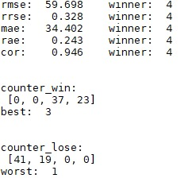
BikeSharing – Method Comparison
Plot:
Linear + raw data
Lasso (alpha = 0.05)+ minmax scaling
kNN (8, distance) + Feature selection
Tree (min_samples_leaf=2)+ raw data
Results:
Knn wins slightly before Tree
Linear and Lasso poor performance
Note: winner is 4 in last iteration
Apparently cnt not linearly dependent on features

Slide 13
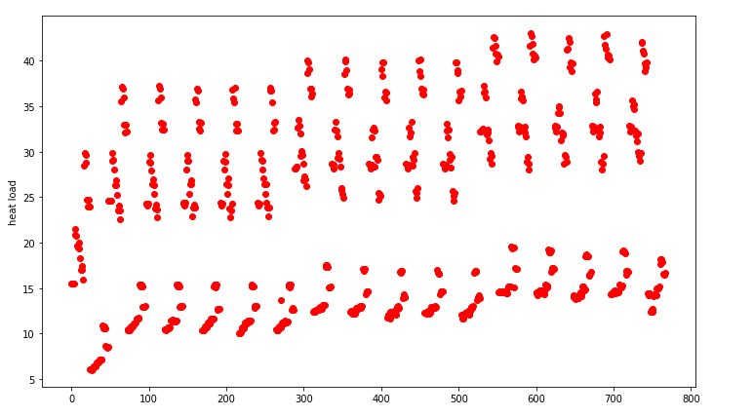
Energy-Dataset
768 samples:
no missing values
simulated dataset
10 features:
2 target values: Y1 and Y2
has only numeric values, X6 being ordinal
performed regression only on Y1 representing heat load
attribute X6 contains int values from 2-6,refering to position
dataset is ‚pregrouped‘ into blocks of 4, differing within a block only by X6
some features have a range from 0-1, others 500-800

Slide 14
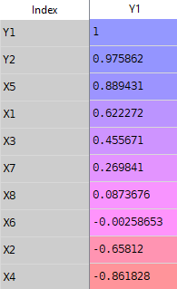
Energy Preprocessing
High correllation to X5 and Y2, which is not used
very low correllation for X6 ↔ feature selection
normalizing, since
Preprocessing options:
raw data
Z-score scaling
minmax scaling
feature selection: dropping X6 and Z-score scaling
Observation:
for every method feature selection proves useful

Slide 15
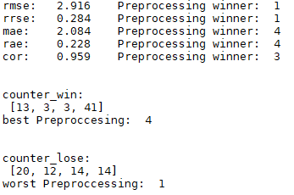
Energy - Linear Regression
Preprocessing:
best option is feature selection
worst option: raw data
Results:
rooted mean squared error = 2.92
rooted relative squared error = 28%
not good, especially compared to the other methods

Slide 16
Energy – Lasso Regression
Preprocessing:

Slide 18
Comparison of Results
Predictions for Energy and Air good
For Bike and Students rather poor
Knn prefers less features, cannot handle many booleans well
Tree prefers more features, stable wrt data type and range
Tree random choice -> same split, different results
Linear and Lasso only good for students (size of dataset?, linear dep?)
Preprocessing almost always usefull

