Slide 1
Machine Learning E1 Regression Task
Group 21
Sophie Rain (01425316),
Peter Stroppa (01326468),
Lucas Unterberger (01325438)

Slide 2
General Overview
Used Datasets:
BikeSharing:
https://inclass.kaggle.com/c/184702-tu-ml-ws-19-bikesharing
Students: https://inclass.kaggle.com/c/184702-tu-ml-ws-19-student-performance
Airquality:
https://archive.ics.uci.edu/ml/datasets/Air+quality
Energy:
https://archive.ics.uci.edu/ml/datasets/energy+efficiency

Slide 3
General Overview
Regression Methods (using sklearn in python):
Regression Tree (min_samples_leaf, max_depth)
Linear Regression (fit_intercept=True)
Lasso Regression (alpha)
kNN (k, weights, algorithm)

Slide 4
General Overview
Preprocessing Methods
OneHotEncoding
OrdinalEncoding
MinMax Scaling
Z-score Scaling
Feature Selection
Evaluation Measures
Rooted mean squared error
Relative mean squared error
Mean absolute error
Relative absolute error
Correlation
No fixed Train-test-split
random sampling in every iteration (80:20)
Preprocessing usefull for every dataset

Slide 5
Comparison of Datasets
Bike and Students datasets contain numerical and categorical data
Airquality and Energy contain numerical values
Airquality contains missing values
set to -200 by default
Number of features: 10 (air) - 30 (students)
Highest number of samples 9357 (air)
Lowest number of samples 198 (students)

Slide 6
BikeSharing Dataset
Number of training samples: 8690
15 features
Dteday only string value --> redundant
Id omitted (irrelevant)
Others either float or integer/ordinal valued
Range varies: (Preprocessing!)
Hour: 0-23 <-> weather information: 0-1 <-> holiday: boolean

Slide 7
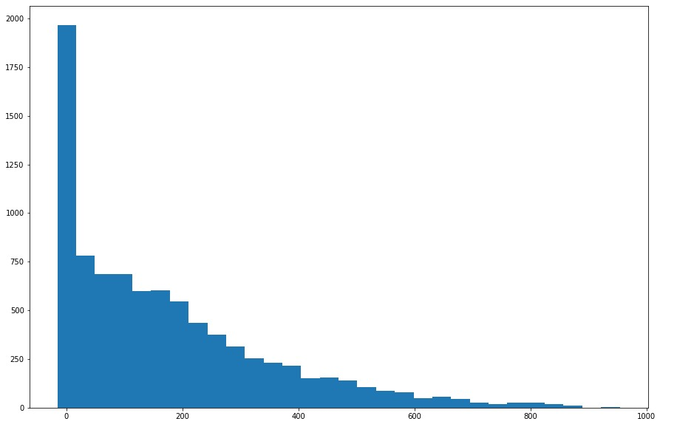
BikeSharing Dataset
Target feature: cnt = number of rented bikes
Range about 0-900 (mean: 188, median 142, std: 178)
Missing values? – No
Frequency in graphic

Slide 8
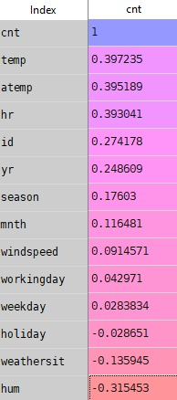
BikeSharing Preprocessing
Correlation Features <-> Target:
No feature with very high correlation
Weekday and holiday low values
Workingday and holiday complementary
→ overrepresentation?

Slide 9
BikeSharing Preprocessing
Considered 4 different approaches:
No preprocessing (other than dropping both id and dteday)
Z-score scaling on all parameters
Min-max scaling on all parameters
Feature Selection acc. to correlation vector, i.e. drop weekday, holiday
Results
For every method but kNN: Feature selection performed poorly
Other 3 approaches: strong dependence on method

Slide 10
BikeSharing - Linear Regression
Preprocessing:
The raw data approach yields best result
Worst result: Feature Selection
Results-Preprocessing:
20 runs, different train-test splits
Every time evaluation of 5 measures (see graphic), 2 redundant
Saved best and worst preprocessing and counted (3*20 counts )

Slide 11
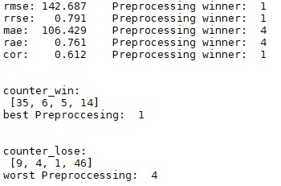
BikeSharing - Linear Regression
Measures:
Rooted mean squared error: 143
relative error: 79%
Not good, at least <std

Slide 12
BikeSharing - Lasso Regression
Generally similar to Linear Regression
Preprocessing:
No obvious best,
but obvious worst: Feature selection
Parameter:
Very unstable, no clear-cut alpha
Close to 1 and close to 0:
performance strongly dependent on train-test split
Middle values: more stable but worse results (average)

Slide 13
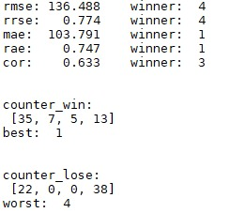
BikeSharing - Lasso Regression
Results: (1: alpha=1, 2: alpha=0.5, 3: alpha=0.05, 4: alpha=0.005)
As stated 1 and 4 often winner, often loser
2,3 stable in the middle
Rooted mean squared error
slightly better than linear

Slide 14
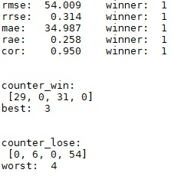
BikeSharing - kNN
Preprocessing
Less features preferred -> Feature Selection outperforms others
Parameter weights:
Weigths: distance by far better
In plot:
K = 5, weights = distance
K = 5, weights = uniform
K = 8, weights = distance
K = 8, weights = uniform
Wins shared amongst weigths=distance

Slide 15
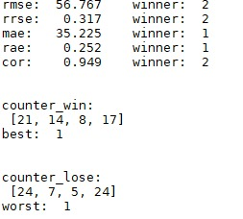
BikeSharing - kNN
Parameter k:
Easy to see: behaves badly for k<6, and k>9
Inbetween not too clear
Plot: (weights=uniform, algorithm=ball_tree)
K = 6
K =7
K = 8
K = 9
Results:
RMSE significantly better than for Linear/Lasso Regression

Slide 16

BikeSharing - Regression Tree
Preprocessing:
Feature Selection worst
Others similar
Parameters:
Good values for Min_samples_leaf: 2 or 3
Max_depth: default setting best
Results: for raw data (option 1)
Similar to kNN

Slide 17
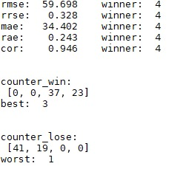
BikeSharing Method Comparison
Plot:
Linear + raw data
Lasso (alpha = 0.05)+ minmax scaling
kNN (8, distance) + Feature selection
Tree (min_samples_leaf=2)+ raw data
Results:
Knn wins slightly before Tree
Linear and Lasso poor performance
Note: winner is 4 in last iteration
Apparently cnt not linearly dependent on features

Slide 18
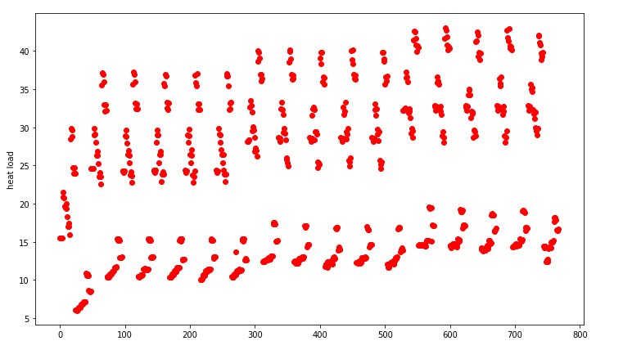
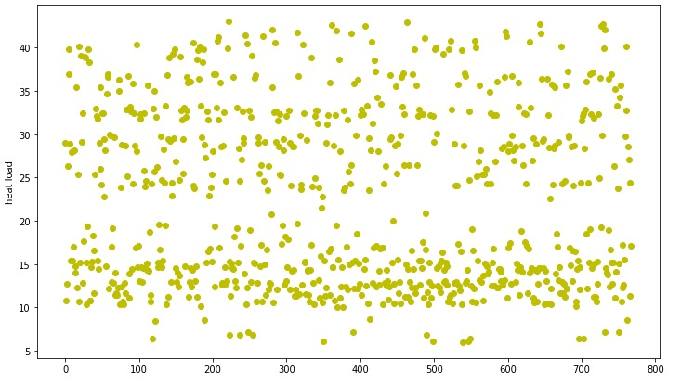
Energy Dataset
768 samples:
no missing values
simulated dataset
10 features:
2 target values: Y1 and Y2
has only numeric values, X6 being ordinal
performed regression only on Y1 representing heat load (mean = 22.3, std = 10)
attribute X6 contains int values from 2-6,refering to position
dataset is ‚pregrouped‘ into blocks of 4, differing within a block only by X6
some features have a range from 0-1, others 500-800

Slide 19
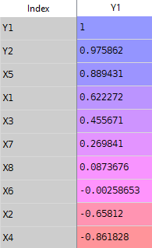
Energy Preprocessing
High correlation to X5 and Y2, which is not used
very low correlation for X6 ↔ feature selection
Normalizing <- due to different ranges
Preprocessing options:
raw data
Z-score scaling
minmax scaling
feature selection: dropping X6 and Z-score scaling
Observation:
for every method Feature Selection is best

Slide 20
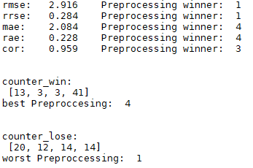
Energy - Linear Regression
Preprocessing:
best option is feature selection
worst option: raw data
Results:
rooted mean squared error = 2.92
rooted relative squared error = 28%
not good, especially compared to the
other methods

Slide 21
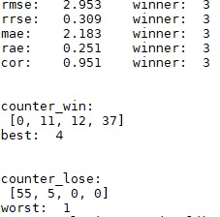
Energy - Lasso Regression
Preprocessing
Best Feature Selection, Z-score scaling
Worst Raw
Parameter
For Feature Selection: small alpha good (~0.005)
For Z-score Scaling: big alpha good (~0.5)
Together: Feature Selection + small alpha better
Result: alpha=0.005 and variable preprocessing
Average: slightly better than linear, still not great

Slide 22
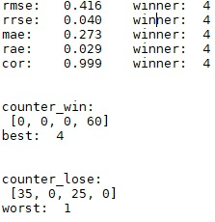
Energy - kNN
Preprocessing
Feature Selection best
Raw and minmax perform poorly
Parameter
Best value for k=3 (4 very similar, 3 intuitive best)
Weights= distance (fits intuition)
Optimal parameter values easy to find
Results
RMSE drastically improved compared to Linear and Lasso
Correlation: 99,9% (!)

Slide 23
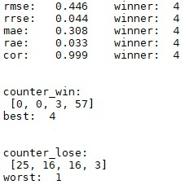
Energy - Regression Tree
Preprocessing
Even here Feature Selection outperforms others
Parameters
Min_samples_leaf=2 to smoothen the model
Max_depth= default more stable
Results min_samples_leaf=2, max_depth=default
Also very good results
Slightly less stable than kNN

Slide 24
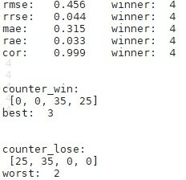
Energy Method Comparison
Graphic
Linear + Feature Selection
Lasso (0.05) + Feature Selection
kNN (k=3, weights=distance) + Feature Selection
Tree (min_samples_leaf=2) + Feature Selection
Results
kNN and Regression Tree share wins
kNN best ->fits intuition:
every datapoint has 3 very close neighbors
Linear and Lasso share losses

Slide 25
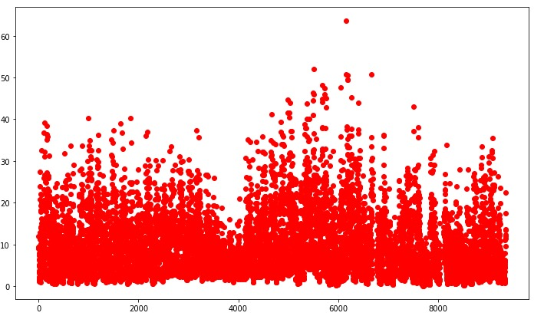
AirQuality Dataset
Features (after cleaning up dataset)
10 float/ordinal values
Converted date and time into ordinal values
Ranges
0-1200 for sensor data, AH between 0-1.2
→ Normalization necessary
Target Value
Benzene value in italian city: 0-50 C6H6
Mean=1.9 (-200 values!) , median=7.9 , std= 41
Missing values – Yes, set to value -200
Size of dataset: 9357 samples

Slide 26
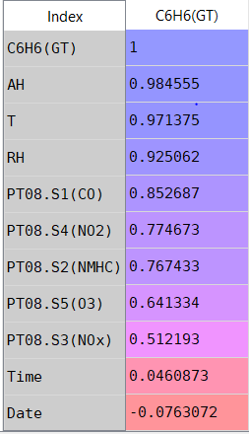
AirQuality Preprocessing
Correlation Features <-> Target
Very high correlation for every chemical info feature
Very low for time and data
→idea: drop them
Missing values
Left as -200
No significant improvement by
treating missing values (mean,median,...)

Slide 27
AirQuality Preprocessing
Preprocessing options
Raw data
Z-score scaling
Minmax scaling
Feature Selection: drop time and date
+ z-score scaling
Surprisingly Feature Selection often worst Preprocessing approach

Slide 28
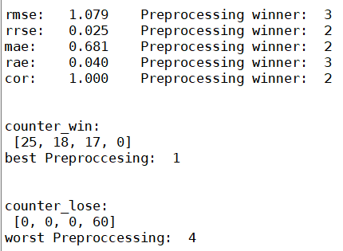
AirQuality - Linear Regression
Preprocessing
Raw data performs best
Feature selection worst by far
Scaling doesn‘t change much
Results
Actually RMSE not bad, but
other methods better
RMSE=1.1
Relative RMSE 2.5%

Slide 29
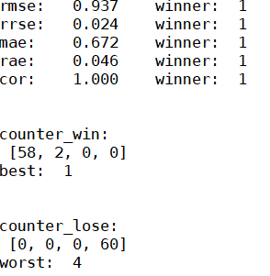
AirQuality - Lasso Regression
Preprocessing
Very clear: best is raw data, worst is Feature Selection
Other two similar
Parameter
The smaller the alpha the better
Graphics (alpha=0.005, alpha=0.05, alpha=0.25, alpha=0.5):
obviously smaller alpha better
Results
Performs slightly better than linear Regression
RMSE 0.94
Relative error again about 2.4%

Slide 30
AirQuality - kNN
Preprocessing
Both Raw data and Feature Selection good
Worst by far: Minmax -> strong outliers
Interestingly also worst when replacing -200 by mean
Reason?
Values vary drastically
shrinking down to [0,1] leads to insignificant distance
Too small distance, even though values far from each other
Parameter weights Raw data
Weights=distance always outperformed uniform

Slide 31
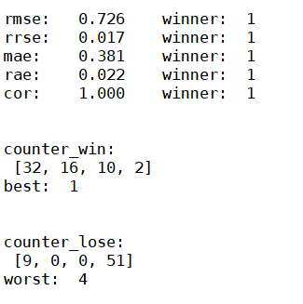
AirQuality - kNN cont‘d
Parameter k Raw data
k: values from 4-6 good,
4 instable, often best, sometimes worst
Plot Raw data, weigths=distance
K=4
K=5
K=6
K=7
Results
Very satisfying results!
Relative error of 1.7%
Correlation very close to 1

Slide 32
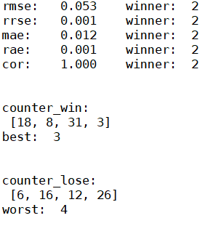
AirQuality - RegressionTree
Preprocessing
As for kNN: minmax performs very poorly
Best one is Feature Selection
Parameter
Min_samples_leaf = 2 yields good results,
considering 4: samples may be grouped,
that are not similar
Max_depth a little more stable using 12
Results 1: (2,12), 2: (4,12), 3: (2,13), 4: (4,13)
Both 1 and 3 good, 3 more unstable
Excellent results! Relative error of 0.1%

Slide 33
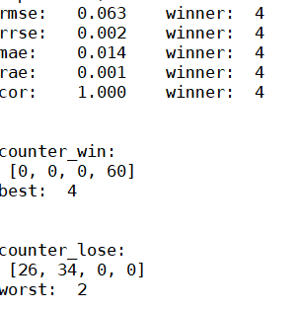
AirQuality Method Comparison
Graphic:
Linear + Raw data
Lasso (alpha=0.005) + Raw data
kNN (k=5, distance) + Raw data
Tree (min_samples_leaf=2, max_depth=12)
+ Feature Selection
Results
Very clear results: Tree by far the best
kNN second
Linear and Lasso last
Altogether very nice error rates

Slide 34
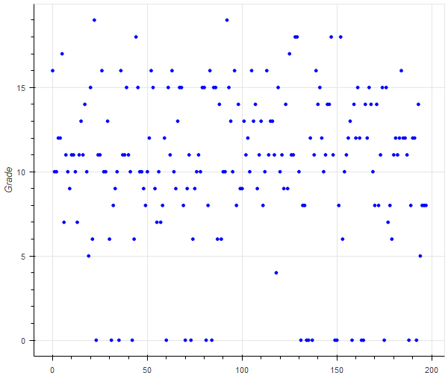
Students Dataset
198 samples:
no missing values
30 features:
Several Boolean & ordinal features, no numeric
Lots of booleans -> bad performance of scaling
Many features with low correlation to target value
Target value: school grades
Value 0-20
Mean=10,3 , median=11, std=4,6
Unrestricted

Slide 35
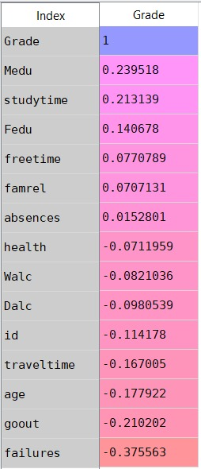
Students Preprocessing
Low correlation for most features
Extremely low for: absences, health, Walc, Dalc
No correlation for categorical data
Used our ordinal encoding
Preprocessing options:
OneHotEncoding, others left raw
OneHotEncoding + z-score scaling
oneHotEncoding + minmax scaling
Handwritten ordinal encoding (intuitive order)
z-score scaling
Feature Selection (dropping of every feature with correlation <0.01)
4th Approach for every method the best

Slide 36
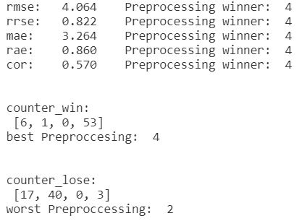
Students - Linear Regression
Preprocessing
Handmade ordinal encoding is best by far
(human intuition is taken into account)
Raw data and MinMax similarly bad
Results
Rooted mean squared error = 4.1
Rooted relative squared error 82%
Linear is quite good compared to other methods

Slide 37
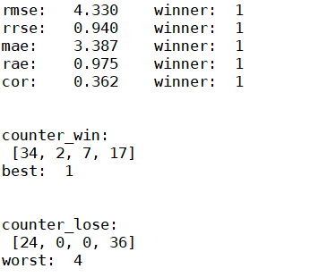
Students - Lasso Regression
Preprocessing
Similar to Linear Regression
Parameters
Alpha between 0.15 and 0.3 best
In plot: 1: alpha=0.15, 2: alpha=0.2, 3:alpha=0.25, 4: alpha=0.3
0.15 and 0.3 quite instable though
Fix alpha=0.25 for further uses
Results
Rooted mean square error = 4.3
Rooted relative square error = 0.94
Lasso also quite good / same level as linear

Slide 38
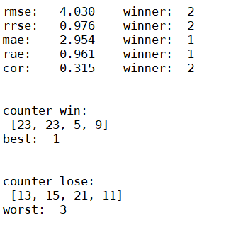
Students - kNN
Preprocessing: see Linear and Lasso
Parameter weights
Quite clear: uniform outperforms distance
Fits intuition: many dimensions, distance may not be significant
In graphic: 1 and 2 uniform (k=20,30), 3 and 4 distance (k=20,30)
Parameter k
No definite result
There is no best k
Every value from 24-40 okay
Results
In this graphic a little better than Linear and Lasso
In average slightly worse

Slide 39
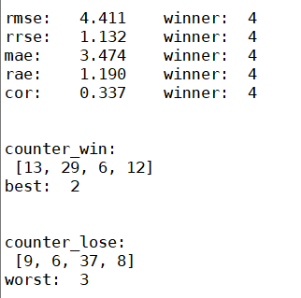
Students - Regression Tree
Preprocessing
OrdinalEncoding wins
Raw data the worst
MinMax and z-score scaling similar
Parameters
Surprisinlgy, decreasing max_depth to 6
increases performance
Even though a small dataset
Also min_samples_leaf = 3 is quite definite the best
Results 1: (2,6), 2: (3,6), 3: (2,default), 4: (3,default)
RMSE of 4.4 is worse than all the other methods
Small datasets not suitable for RegressionTrees

Slide 40
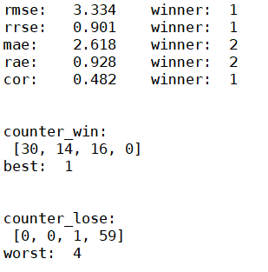
Students Methode Comparison
Plot
Linear + Ordinal
Lasso (0.25)+ Ordinal
Knn (28, uniform)+ Ordinal
Tree (3,6) + Ordinal
Results
Best performance: Linear Regression!
Worst by far: Regression Tree
Unfortunately still a relative error of 90%
Conclusio: kNN and Regression Tree cannot handle very small datasets well

Slide 41
Comparison of Results
Predictions for Energy and Air good
For Bike and Students rather poor
Knn prefers less features, cannot handle many booleans well
Tree prefers more features, stable wrt data type and range
Tree uses random choice -> same split, different results
Linear and Lasso only good for students (size of dataset?, linear dep?)
Preprocessing almost always usefull
kNN and Regression tree can handle clustered data well
kNN and Regression tree cannot handle small datasets well

