Slide 1
ASSIGNMENT 2
Group 20
Sophie RAIN (01425316),
Lucas UNTERBERGER (01325438),
Peter STROPPA (01326468).

Slide 2
datasets
ConGress
Amazon
Wine
Mushrooms

Slide 3
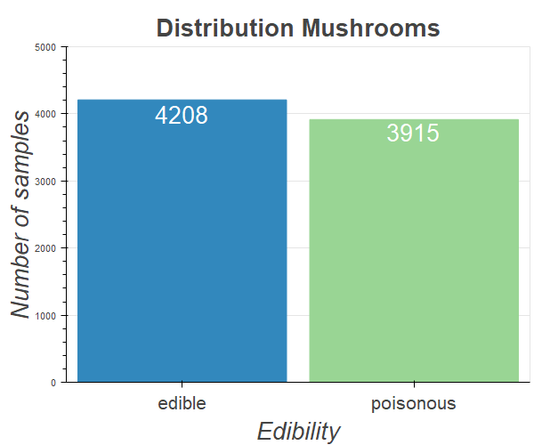
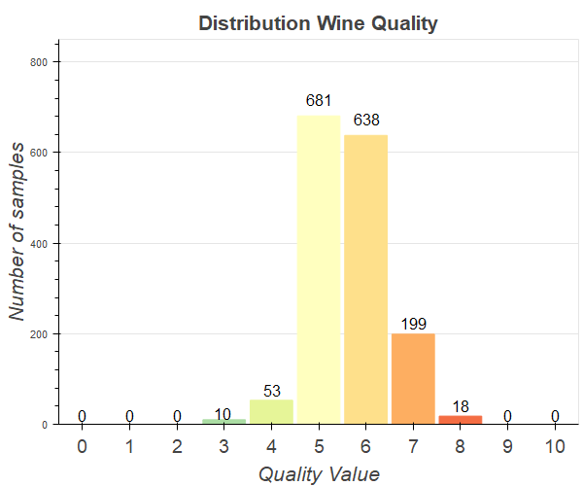
distribution of classes

Slide 4
datasets overview
Dataset | # samples | # attributes | Missing values? | # classes | classes eq. important? | Types of attributes
Amazon | 750 | 10 000 | no | 50 | yes | ordinal
Congress | 217 | 18 | yes (unknown) | 2 | yes | categorical (2 values)
Wine | 1599 | 11 | no | 11 | no | numeric
Mushrooms | 8124 | 22 | yes | 2 | no | categorical (2-10)

Slide 5
methods
K-Nearest-Neighbors
Support Vector Machines
Random Forest
Notes:
WHY: Chose this three because, two rely on distance, RF doesn‘t, SVM interessting most possibilites, K-NN because text analysis
PARAM

Slide 6
pre-processing
scaling and selection
encoding
Min-Max-Scaling
Z-Score-Scaling
Feature Selection
Custom weighted scaling
Ordinal Encoding
One Hot Encoding
TF-IDF

Slide 7
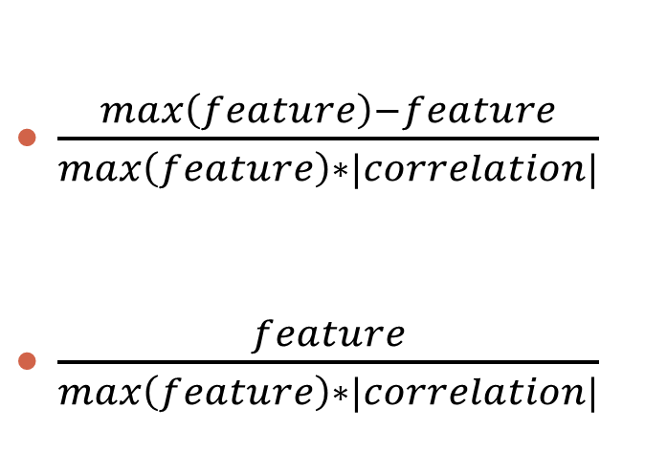
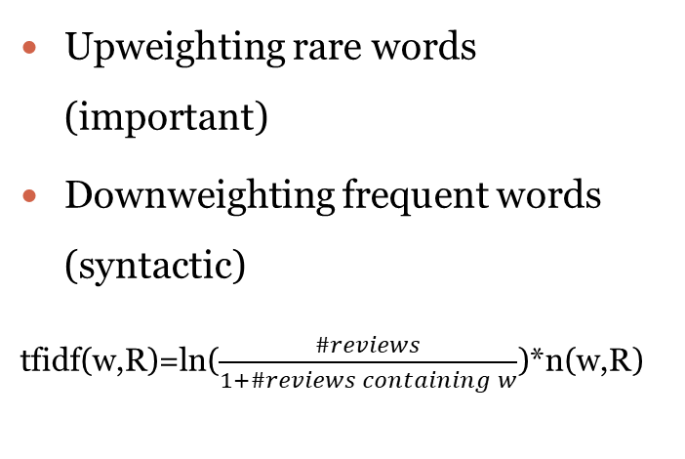
pre-processing
Weighted scaling
TF-IDF (text frequency - inverse document frequency)
$\frac{max\left(feature\right)−feature}{max\left(feature\right)∗|correlation|}$
$\frac{feature}{max\left(feature\right)∗|correlation|}$
Upweighting rare words (important)
Downweighting frequent words (syntactic)
tfidf(w,R)=ln($\frac{\#reviews}{1+\#reviews containing w}$)*n(w,R)
If correlation < 0:
If correlation > 0:

Slide 8
results
Best result | kNN | Random Forest | SVM
Wine |  | perfectly | perfectly
Congress |  |  | 97% accuracy
Mushroom | perfectly | perfectly | perfectly
Amazon |  | 67% accuracy
Notes:
Congress SVM: Poly, Coeff0 = 10, gamma = auto
Wine weighted scaling: RF max_features=6, n_estimator=100, SVM: kernel=poly, degree=4
Mushroom, kNN k=1,

Slide 9
conclusion
different datasets
Different methods
kNN disappointing
high hopes kNN + TF-IDF
SVM highly dependent on kernel
Don‘t forget human intuition
SVM & RF outperformed
kNN troubles with many classes
only RF can handle heterogeneous data

