Slide 1
ASSIGNMENT 2
Group 21
Sophie RAIN (01425316),
Lucas UNTERBERGER (01325438),
Peter STROPPA (01326468).

Slide 2
datasets
Wine
Mushrooms
ConGress
Amazon

Slide 3
datasets overview
Dataset | # samples | # attributes | Missing values? | # classes | classes eq. important? | Types of attributes
Amazon | 750 | 10 000 | no | 50 | yes | ordinal
Congress | 217 | 18 | yes (unknown) | 2 | yes | categorical (2 values)
Wine | 1599 | 11 | no | 11 | no | numeric
Mushrooms | 8124 | 22 | yes | 2 | no | categorical (2-10)

Slide 4
methods
K-Nearest-Neighbors
Support Vector Machines
Random Forest

Slide 5
pre-processing
scaling and selection
encoding
Min-Max-Scaling
Z-Score-Scaling
Feature Selection
Handmade weighted scaling
Ordinal Encoding
One Hot Encoding
TF-IDF

Slide 6
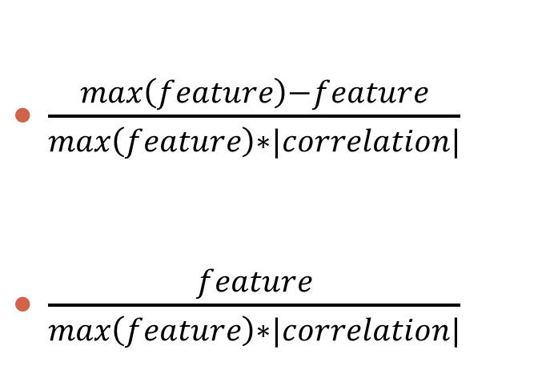
pre-processing
Weighted scaling
TF-IDF
$\frac{max\left(feature\right)−feature}{max\left(feature\right)∗|correlation|}$
$\frac{feature}{max\left(feature\right)∗|correlation|}$
If correlation < 0:
If correlation > 0:

Slide 7
results
Best result | kNN | Random Forest | SVM
Wine |  | perfectly | perfectly
Congress |  |  | 97% accuracy
Mushroom | perfectly | perfectly | perfectly
Amazon |  | 67% accuracy

Slide 8
conclusion
diffrent datasets
Diffrent methods
kNN really good for clustered data
SVM highly depend on kernel
Don‘t forget human intuition
SVM & RF outperformed
kNN troubles with many classes
RF profits of heterogeneous data

