Slide 1
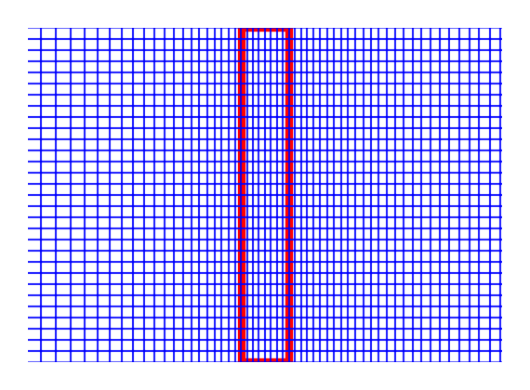
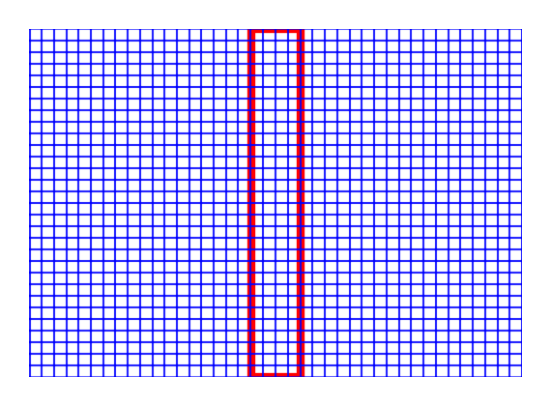

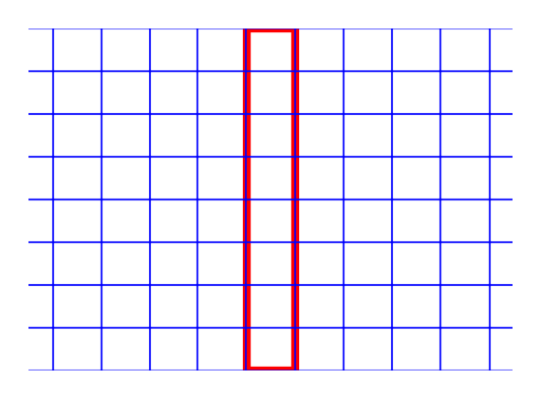
Mesh 1
Mesh 2
Mesh 3
Mesh 4
Zoom-in view around LWD
Mesh 1
Mesh 2
Mesh 3
Mesh 4

Slide 2
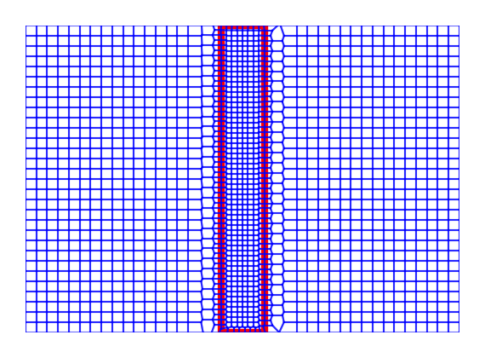
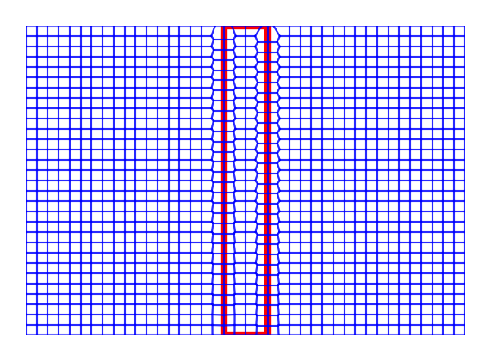
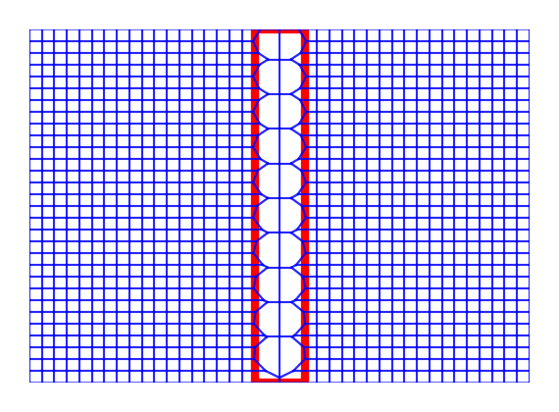
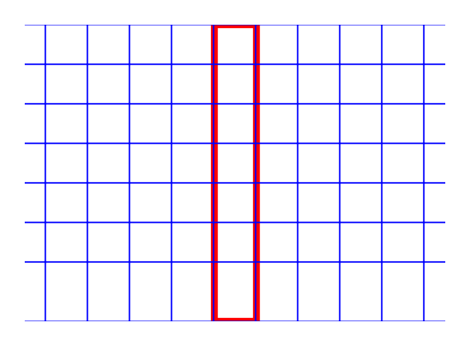
Mesh 1
Mesh 2
Mesh 3
Mesh 4
Zoom-in view around LWD
Mesh 1
Mesh 2
Mesh 3
Mesh 4

