Slide 2
A Single Document Lifecycle
Data1.csv
Data2.csv
Data3.csv
Data3.csv

Slide 3
A Multi-Researcher Document Lifecycle
What do we merge with what?
How do we merge it?
There is likely more than one document to handle.
This “workflow” is often repeated at most stages of the project lifecycle.
How are documents shared?
Data0-ro.csv
Data1-ro.csv
Data2-ro.csv
Data2-jd.csv
Data2-cu.csv
Data2.1-cu.csv
Data2.2-cu.csv
Data3.jd.csv
Data3-rc.csv
Data3-ro.csv
Data4-ro.csv
Data4-ro.csv

Slide 4
Transaction Anomaly
User 1
Storage
Use 2
This is a ubiquitous problem
Transaction locks
Relational Databases
MS Sharepoint
…
Locks are annoying
Projects often deal with hundreds to hundreds of thousands of files
Document1
Document1
Document1
Document2
Document2
Document3
Document3

Slide 5
Collaborations are bigger and wider
Same project
Different location
Must share Information
Between people
Across location
Over time
Direct communication is not always possible
Often faster not to do it
Provenance is important
Different project
Different location?
Same project
Same location

Slide 6


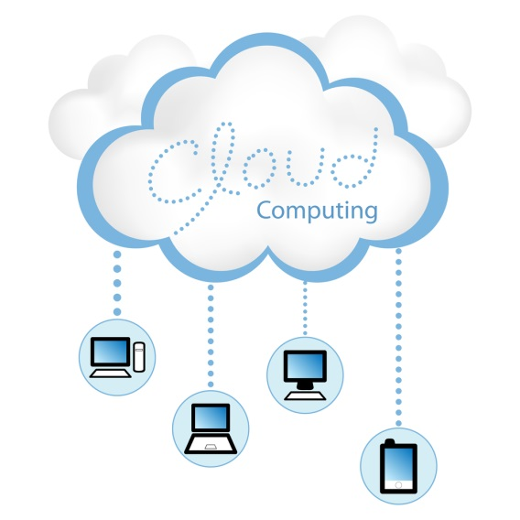
Sharing Solutions
Email
Doesn’t solve many of the issues
Google Docs
Great for small number of documents
Allows real time collaboration
Limited types of documents
Versioning
Shared Server
Very customizable
Requires someone to maintain it
Requires skills
Not scalable
Cloud Storage (DropBox, Amazon S3)
Rely on services provided/allowed by provider
They have your data
Usually scalable
Usually cost effective
They maintain it for you.
Might have versioning

Slide 7
Versioning Repositories
CVS
+ Considered mature technology
- Moving or renaming files does not include a version update
- Security risks from symbolic links to files
- No atomic operation support, leading to source corruption
- Branch operations are expensive as it is not designed for long-term branching
Subversion
Newer system based on CVS
+ Includes atomic operations
+ Cheaper branch operations
+ Wide variety of plug-ins for IDEs
+/- Does not use peer-to-peer model
- Still contains bugs relating to renaming files and directories
- Insufficient repository management commands
- Slower comparative speed

Slide 8
Versioning Repositories
Git
+ Dramatic increase in operation speed
+ Cheap branch operations
+ Full history tree available offline
+/- Distributed, peer-to-peer model
- Learning curve for those used to SVN
Mercurial
+ Easier to learn than Git
+/- Distributed model
- No merging of two parents
- Extension-based rather than scriptability
- Less out of the box power

Slide 9
Distributed vs Centralized
Client – Server
Distributed
Coordinated
Rules established via convention, culture or software
Github
Peer to peer
Anyone can talk to anyone
Git, Mercurial
Rules established via convention, culture or software
SVN, CVS

Slide 10
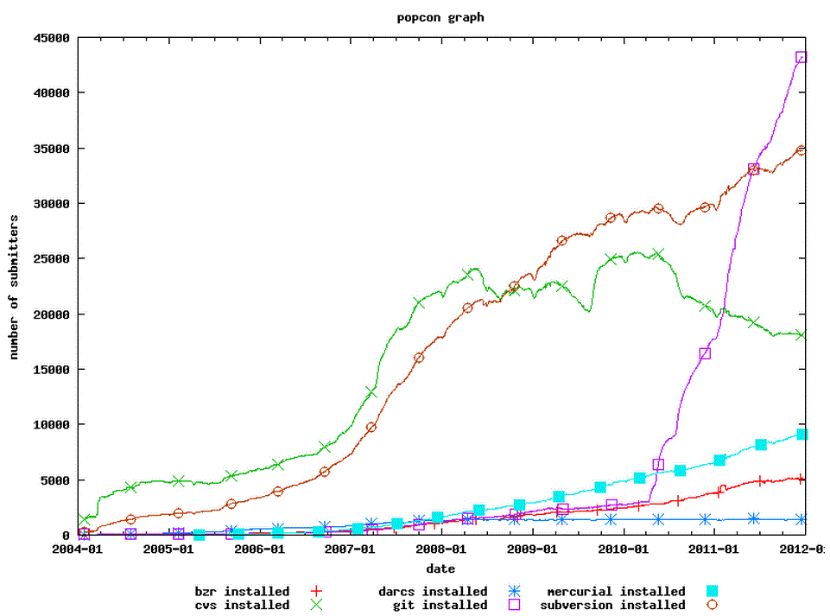
We’ll be focusing on Git and Github
Its getting really popular
Widely used by open source developers
It has the best web based support.
It is being used more by researchers and even taught in data science courses…

Slide 11
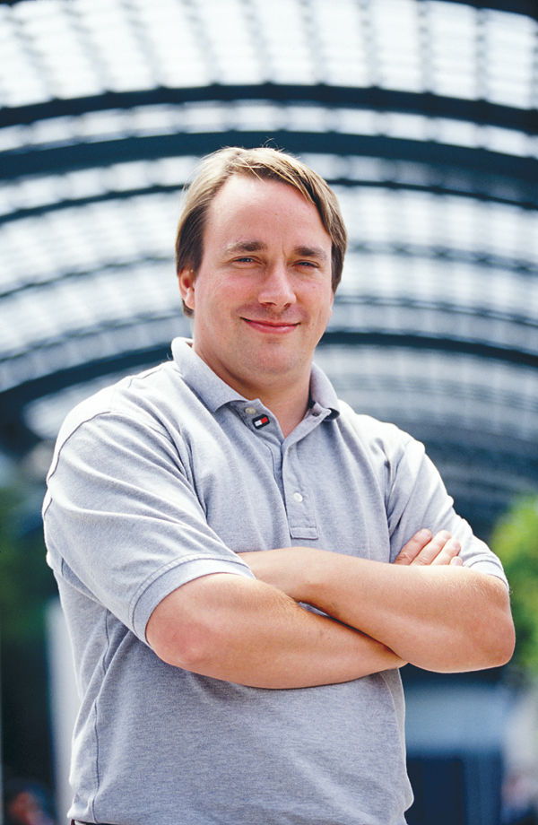
A Brief History of Git
Created by Linus Torvalds in 2005
Was previously using BitKeeper
BitKeeper was not open source
BitKeeper Started charging Linux
Addressed his needs for Linux Kernel development
Speed
Simple design
Non linear development
Fully Distributed
Can handle large projects
Is currently the most installed versioning software

Slide 12
Basic Versioning - Commits
Commits save versions.
You can roll back to any commit.
You can reference any commit.
Commits have commit messages that describe the changes
Commits can be names (tagged)
The naming is handled automatically
ec0b4f….
54563f…
59395c…
Nature-2014
6b3c45…
Tags are created by the user.
Data1.csv
Data2.csv
Data3.csv
Data3.csv

Slide 13
Basic Branching
Failed branches can be deleted. Doesn’t affect project
Merge branches when working
Usually smooth, not always
Branches allow independent development / work

Slide 14
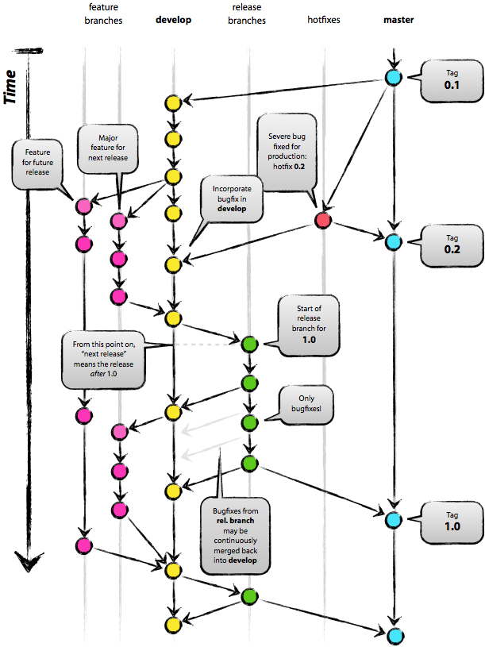
Git Solves A Number of Data Problems
Versions
Merging multiple branches (often)
Reduces transaction anomalies
URIs to different versions

Slide 15
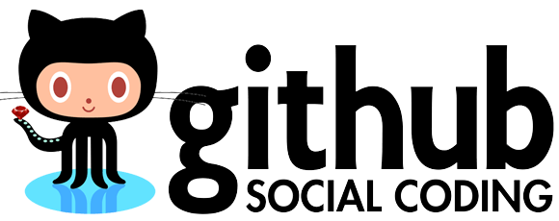
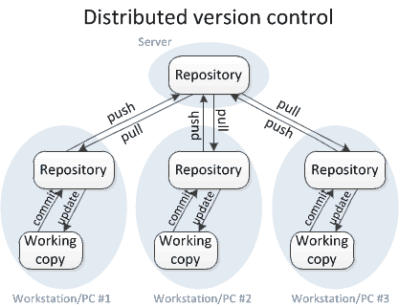
Github History and Overview
Launched in 2008
Tom Preston-Warner
Chris Wanstrath
PJ Hyett
A web service built around Git
Quickly became a favorite of open source software
Ruby on Rails and Ruby Gems
Drupal
Hydra
Blacklight
…

Slide 16

And Then There is Gitlab
Launched in 2008
Dmitriy Zaporozhets
Sytse Sijbrandij
A slightly less shiny, open source Github
Gitlab at LANL (git.lanl.gov)
193 Projects
166 Users
18 Groups
Free
Grassroots
Limited Storage

Slide 17

…and it doesn’t need to be software
Finnish Math Book
Wrote it in a week
Journal Articles
Presentations
Works best with text and images
Sort of versions binaries No diffs

