Slide 1
Foundations of Social, Cognitive, and Affective Neuroscience
PSY 511 Spr 2024

Slide 2
Overview

Slide 3
Prelude

Slide 4
https://www.youtube.com/embed/JB7jSFeVz1U
(melodysheep, 2011)

Slide 5
“If understanding everything we need to know about the brain is a mile, how far have we walked?”
(National Geographic, 2014)

Slide 6
https://www.youtube.com/embed/nvXuq9jRWKE
(National Geographic, 2014)

Slide 7
Gilmore bio

Slide 8
Hiking, camping/backpacking, cycling, paddling
Music, theatre
Activism
Amateur radio (W3TM), computing

Slide 9
Today’s topics
Why neuroscience is harder than physics
Course overview
Does neuroscience need behavior? Does behavioral science need the brain?

Slide 10
Why neuroscience is harder than physics

Slide 11
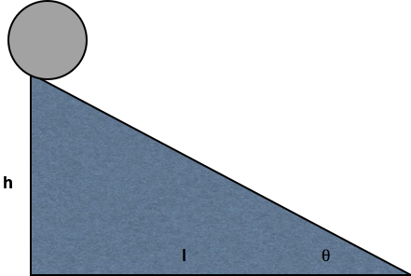

Slide 12
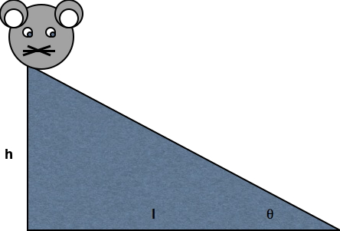

Slide 13
What do we need to know to answer the question?
What is the state…
Of the world ($W$)
Of the organism
Body ($B$)
Nervous system ($N$)
Mind ($M$)

Slide 14
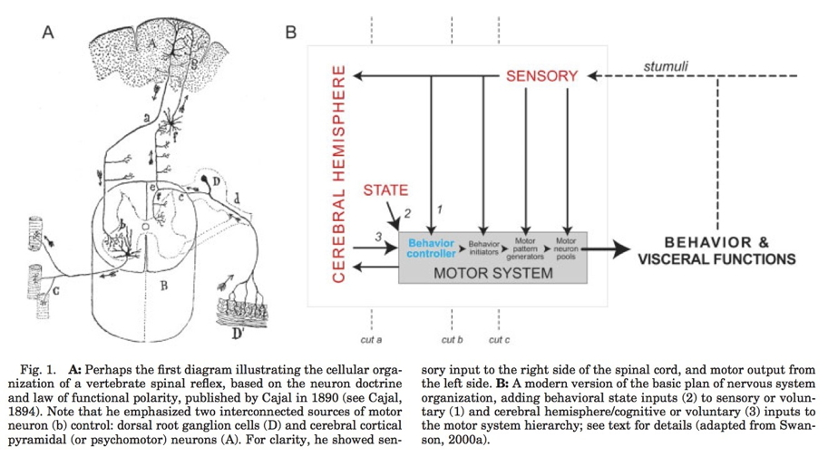
(Swanson, 2005, fig. 1)

Slide 15
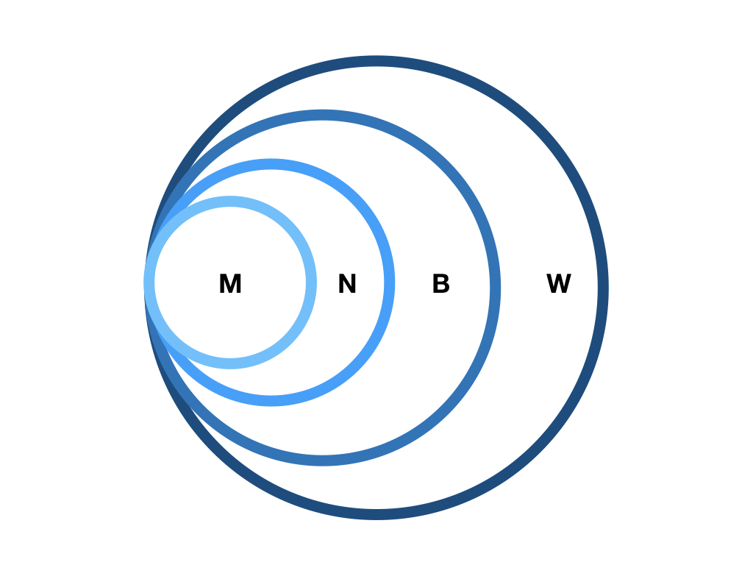

Slide 16
Some states are more easily measured than others
$W$, $B$, $N$ (more or less) directly

Slide 17
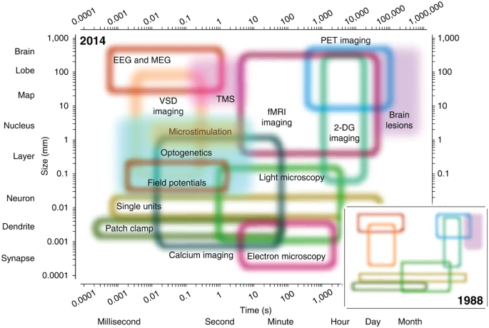
(Sejnowski et al., 2014, fig. 1)

Slide 18
Mental states ($M$)
Measured indirectly
Via $N$, $B$, $W$ (+ prior beliefs/knowledge)
Examples?

Slide 19
What are essential components/dimensions of $W$?

Slide 20
What are essential components/dimensions of $B$?

Slide 21
Brain & behavior are complex, dynamic systems with
Components
Interactions
Forces/influences
Boundaries
Inputs/outputs/processes

Slide 22
Systems…
“Behave” or change state across time
Return to starting state
Appear to be regulated, controlled, influenced by feedback loops
$B\left(t+1\right)=f\left(W\left(t\right),B\left(t\right),N\left(t\right),M\left(t\right)\right)$

Slide 23
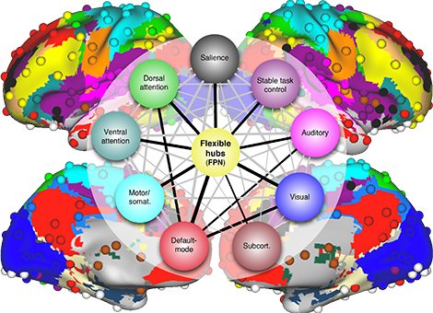
May be thought of as networks
From https://source.wustl.edu/2013/08/brain-flexible-hub-network-helps-humans-adapt/

Slide 24
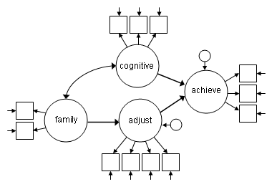
At multiple levels of organization…

Slide 25
(Swanson & Lichtman, 2016, fig. 3)

Slide 26
Studying systems is hard because…
Computation is (often) distributed
Single parts -> multiple functions
Single functions -> multiple parts

Slide 27
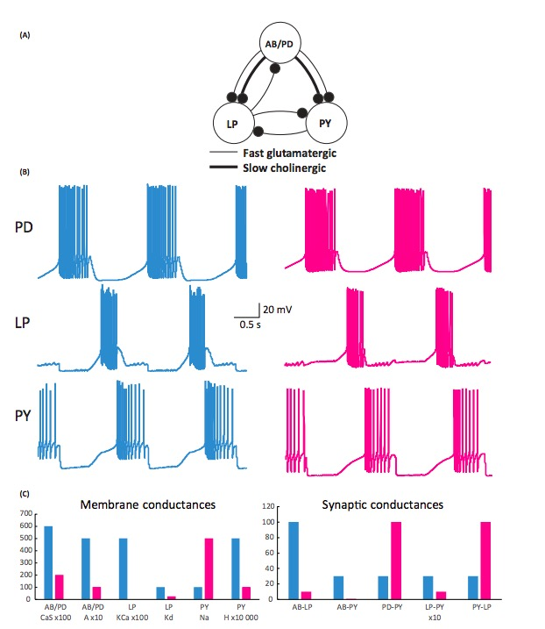
e.g., “equifinality” in micro-circuits
(Calabrese, 2018)

Slide 28
Studying systems is hard because…
Change structure/function over time
Biological systems not “designed” like human-engineered ones
Hard to measure what is being exchanged, what is being controlled

Slide 29
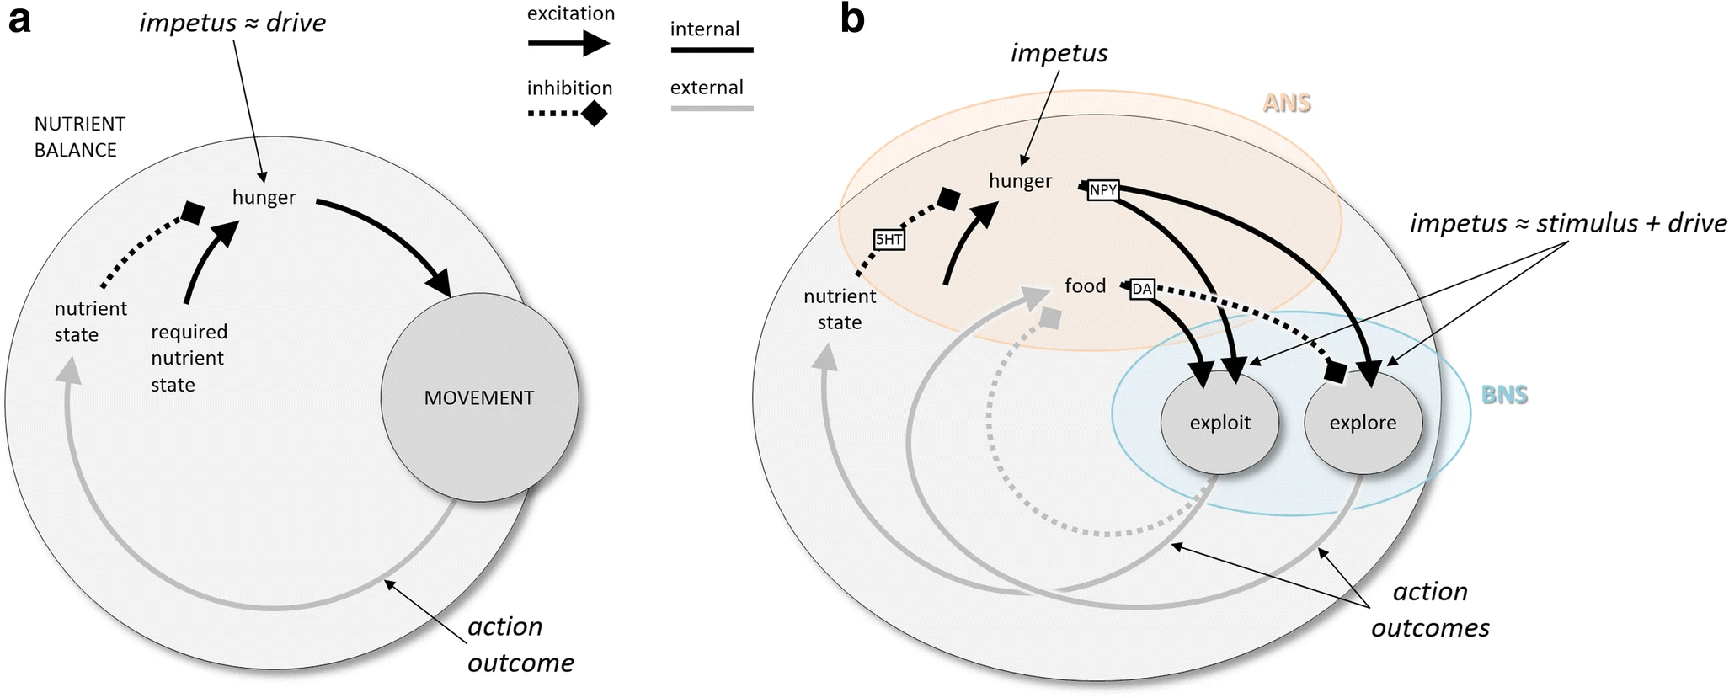
(Cisek, 2019, fig. 3). Schematic behavioral control systems. (A) When the current nutrient state deviates from a desired state, locomotion is initiated, ultimately bringing the animal to a more desirable state. (B) Elaboration of nutrient state control into a high-level controller (ANS) and a lower-level controller (BNS) capable of two modes of locomotion, local exploitation, and long-range exploration. 5HT, serotonin; ANS/BNS, apical/blastoporal nervous system; DA, dopamine; NPY, neuropeptide Y

Slide 30
Course overview

Slide 31
Goals
Master fundamentals of neuroscientific concepts and facts
Prepare to read primary source literature in social, behavioral, cognitive, affective, and clinical neuroscience

Slide 32
Structure
https://psu-psychology.github.io/psy-511-scan-fdns-2024-spring/

Slide 33
Questions
What is the basic organizational plan of the nervous system?
How do neurons work?
How do neurons connected in networks achieve behavioral goals?
How does the nervous system develop? How has it evolved?
How do disorders of the mind reveal themselves in the nervous system?

Slide 34
Approach
Brain architecture (neuroanatomy)
Brain function (neurophysiology)
Brain communication (neurochemistry)
Changes over evolutionary and developmental time

Slide 35
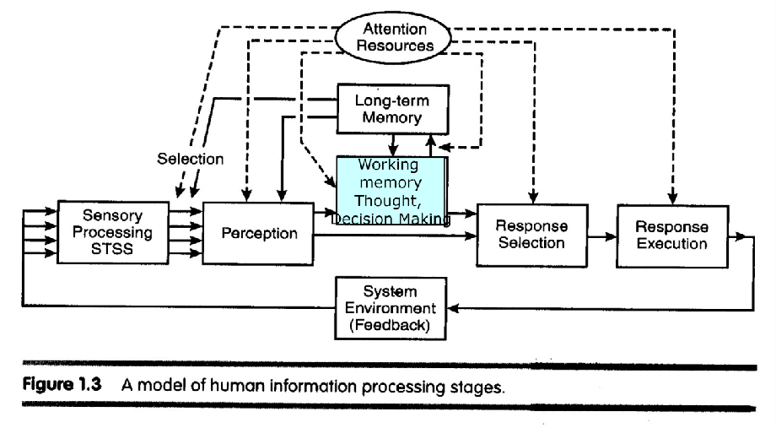
Approach
The nervous system as an information processing system

Slide 36
Inputs
From environment, body, brain

Slide 37
Processing
Current inputs + brain state + body state + possible future states…
Stored information
Physiological & behavioral goals

Slide 38
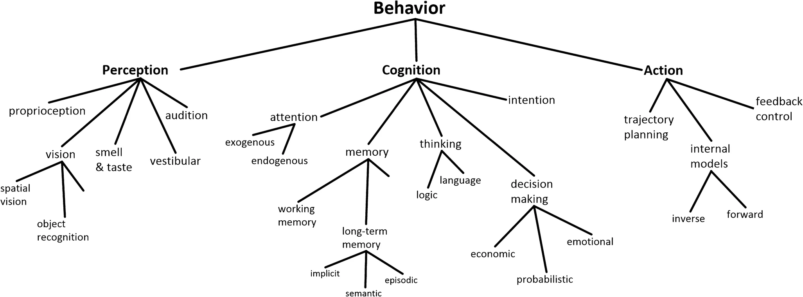
(Cisek, 2019, fig. 1)

Slide 39
Outputs
To brain, body, environment

Slide 40
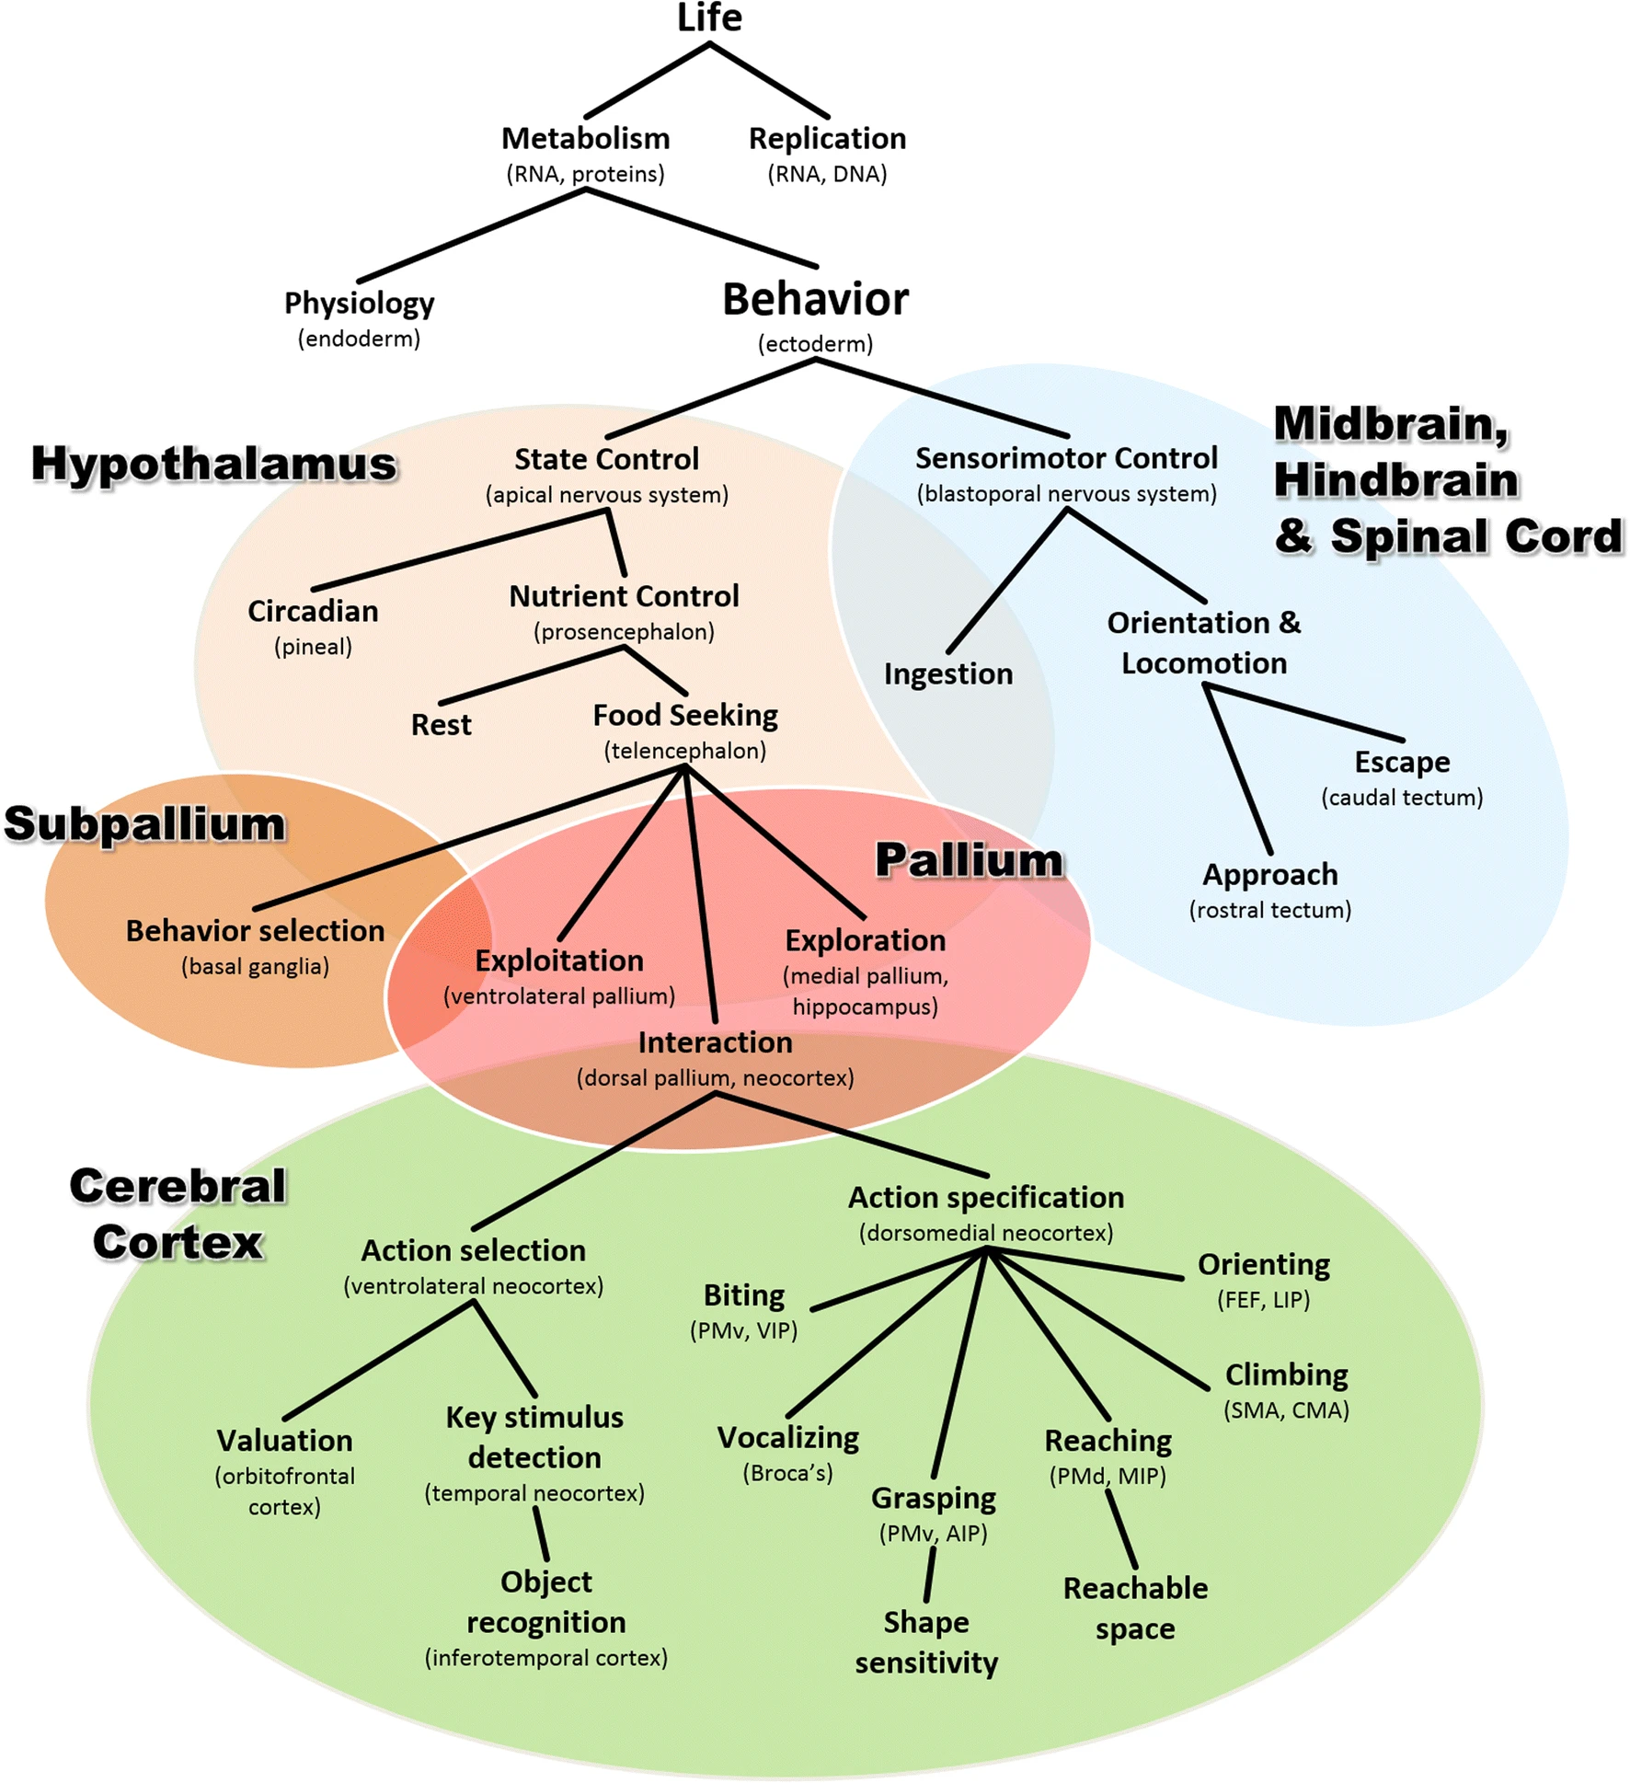
Mapping structures to functions…
(Cisek, 2019, fig. 8)

Slide 41
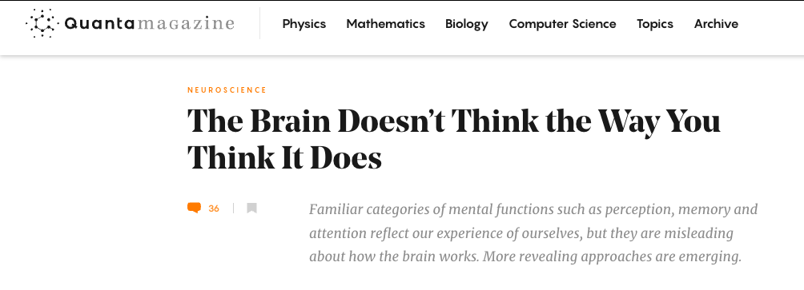
And vice versa?
[Cepelewicz2021-hq]

Slide 42
“The brainwide representation of behavioral variables suggests that information encoded nearly anywhere in the forebrain is combined with behavioral state variables into a mixed representation…Our data indicate that it happens as early as primary sensory cortex.”
(Stringer et al., 2019)

Slide 43
And do we have the right “psychological” structures?
“Psychological sciences have identified a wealth of cognitive processes and behavioral phenomena, yet struggle to produce cumulative knowledge. Progress is hamstrung by siloed scientific traditions and a focus on explanation over prediction, two issues that are particularly damaging…

Slide 44
…for the study of multifaceted constructs like self-regulation…We conclude that self-regulation lacks coherence as a construct…”
(Eisenberg et al., 2019)

Slide 45
“Behavioural biologists don’t agree on what constitutes behaviour”
Behavioural biology is a major discipline within biology, centred on the key concept of ‘behaviour’. But how is ‘behaviour’ defined, and how should it be defined? We outline what characteristics we believe a scientific definition should have, and why we think it is important

Slide 46
…that a definition have these traits. We then examine the range of available published definitions for behaviour.
(Levitis, Lidicker, & Freund, 2009)

Slide 47
Finding no consensus, we present survey responses from 174 members of three behaviour-focused scientific societies as to their understanding of the term. Here again, we find surprisingly widespread disagreement as to what qualifies as behaviour. Respondents contradict themselves…

Slide 48
…each other, and published definitions, indicating that they are using individually variable intuitive, rather than codified, meanings of `behaviour.’
(Levitis et al., 2009)

Slide 49
We offer a new definition, based largely on survey responses: “Behaviour is the internally coordinated responses (actions or inactions) of whole living organisms (individuals or groups) to internal and/or external stimuli, excluding responses more easily understood as developmental changes.”
(Levitis et al., 2009)

Slide 50
Sciences of complexity
(Favela, 2020, fig. 1)

Slide 51
Levels of analysis
(Sejnowski et al., 2014, fig. 1)

Slide 52


David Marr (1945-1980)
David Marr
(Marr, 1980)

Slide 53
Marr’s Three Levels
(Favela, 2020, fig. 3)

Slide 54
What must be computed to carry out task X?
What algorithm is used to carry out the computation?
What hardware implements the algorithm?

Slide 55
Break

Slide 56
Your turn

Slide 57
Does neuroscience need behavior?
Krakauer, J. W., Ghazanfar, A. A., Gomez-Marin, A., MacIver, M. A., & Poeppel, D. (2017). Neuroscience needs behavior: Correcting a reductionist bias. Neuron, 93(3), 480–490. https://dx.doi.org/10.1016/j.neuron.2016.12.041.
Parada, F. J. & Rossi, A. (2018). If neuroscience needs behavior, what does psychology need? Frontiers in Psychology, 9, 433. https://doi.org/10.3389/fpsyg.2018.00433.

Slide 58
Key points
Questions ‘often tacit…belief in the reductionist program for understanding the link between brain and behavior’
Behavior -> understanding; neural interventions -> causality
Marr’s 3 levels (computation; algorithm; implementation)

Slide 59
But what is behavior?

Slide 60
“Behavioural biologists don’t agree on what constitutes behaviour”
…“Behaviour is the internally coordinated responses (actions or inactions) of whole living organisms (individuals or groups) to internal and/or external stimuli, excluding responses more easily understood as developmental changes.”
(Levitis et al., 2009)

Slide 61
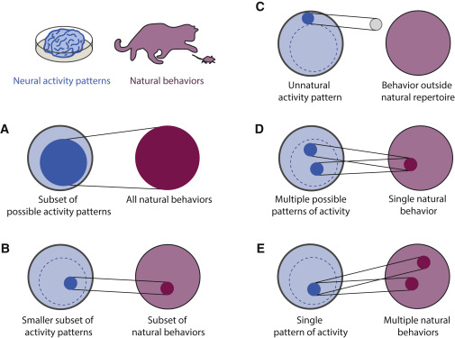
(Krakauer et al., 2017, fig. 1)

Slide 62
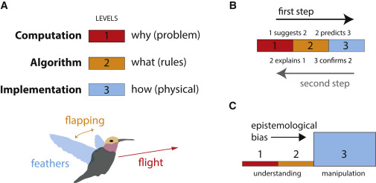
(Krakauer et al., 2017, fig. 2)

Slide 63
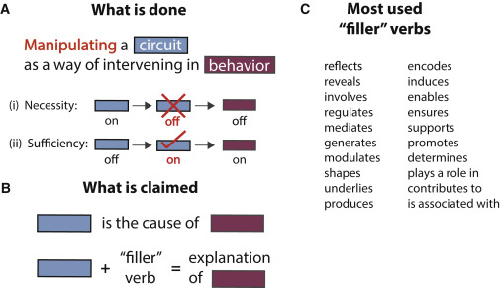
(Krakauer et al., 2017, fig. 3)

Slide 64
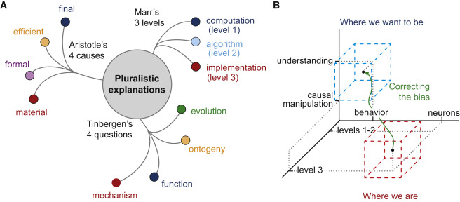
(Krakauer et al., 2017, fig. 4)

Slide 65
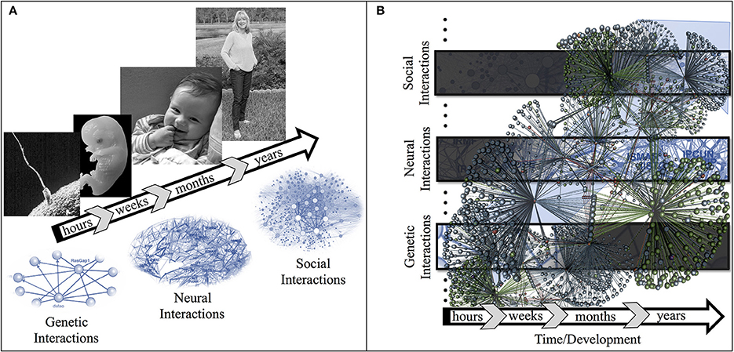
(Parada & Rossi, 2018, fig. 1)

Slide 66
Exercise 01
Due next Wednesday

Slide 67
Main points
Psychology is harder than physics
Neuroscience needs behavior

Slide 68
Next time…
Neuroanatomy lab
Read/study
Neuroanatomy notes
Bring to class a copy of Exercise 02

Slide 69
Resources

Slide 70
References
Calabrese, R. L. (2018). Inconvenient truth to principle of neuroscience. Trends in Neurosciences, 41(8), 488–491. https://doi.org/10.1016/j.tins.2018.05.006
Cisek, P. (2019). Resynthesizing behavior through phylogenetic refinement. Attention, Perception & Psychophysics. https://doi.org/10.3758/s13414-019-01760-1
Eisenberg, I. W., Bissett, P. G., Zeynep Enkavi, A., Li, J., MacKinnon, D. P., Marsch, L. A., & Poldrack, R. A. (2019). Uncovering the structure of self-regulation through data-driven ontology discovery. Nature Communications, 10(1), 2319. https://doi.org/10.1038/s41467-019-10301-1
Favela, L. H. (2020). Cognitive science as complexity science. Wiley Interdisciplinary Reviews. Cognitive Science, 11(4), e1525. https://doi.org/10.1002/wcs.1525
Krakauer, J. W., Ghazanfar, A. A., Gomez-Marin, A., MacIver, M. A., & Poeppel, D. (2017). Neuroscience needs behavior: Correcting a reductionist bias. Neuron, 93(3), 480–490. https://doi.org/10.1016/j.neuron.2016.12.041
Levitis, D. A., Lidicker, W. Z., & Freund, G. (2009). Behavioural biologists don’t agree on what constitutes behaviour. Animal Behaviour, 78(1), 103–110. https://doi.org/10.1016/j.anbehav.2009.03.018
Marr, D. (1980). Vision. Retrieved from https://mitpress.mit.edu/books/vision
melodysheep. (2011, March). Ode to the brain! By symphony of science. Youtube. Retrieved from https://www.youtube.com/watch?v=JB7jSFeVz1U
National Geographic. (2014, January). Beautiful 3-D brain scans show every synapse | national geographic. YouTube. Retrieved from https://www.youtube.com/watch?v=nvXuq9jRWKE
Parada, F. J., & Rossi, A. (2018). If neuroscience needs behavior, what does psychology need? Frontiers in Psychology, 9, 433. https://doi.org/10.3389/fpsyg.2018.00433
Sejnowski, T. J., Churchland, P. S., & Movshon, J. A. (2014). Putting big data to good use in neuroscience. Nat. Neurosci., 17(11), 1440–1441. https://doi.org/10.1038/nn.3839
Stringer, C., Pachitariu, M., Steinmetz, N., Reddy, C. B., Carandini, M., & Harris, K. D. (2019). Spontaneous behaviors drive multidimensional, brainwide activity. Science, 364(6437), 255. https://doi.org/10.1126/science.aav7893
Swanson, L. W. (2005). Anatomy of the soul as reflected in the cerebral hemispheres: Neural circuits underlying voluntary control of basic motivated behaviors. Journal of Comparative Neurology, 493(1), 122–131. https://doi.org/10.1002/cne.20733
Swanson, L. W., & Lichtman, J. W. (2016). From cajal to connectome and beyond. Annual Review of Neuroscience, 39, 197–216. https://doi.org/10.1146/annurev-neuro-071714-033954

