Slide 1
Cellular Neuroscience II
PSY 511.003

Slide 2
Prelude

Slide 3
https://www.youtube.com/embed/nvXuq9jRWKE

Slide 4
Announcements
Exercise 04 assigned
Next Wednesday, February 7, Exercise 03 write-up due.

Slide 5
Last time…

Slide 6
What maintains the ion concentration gradients in the neuron (and other cells)?

Slide 7
What do gradients enable?

Slide 8
What direction does information typically flow in a neuron?

Slide 9
What type of glial cell creates myelin around axons in the central nervous system?

Slide 10
Today’s topics
Resting potential review
Cellular neuroscience II
Action potential
Synaptic transmission

Slide 11
Resting potential

Slide 12
Potential means…
Electrical potential (voltage)
Current flows (ions move)
More current can flow if…
Conductance changes (ion channels open)

Slide 13
Why we care
Fast signalling (faster than diffusion)
From one part of body to another

Slide 14
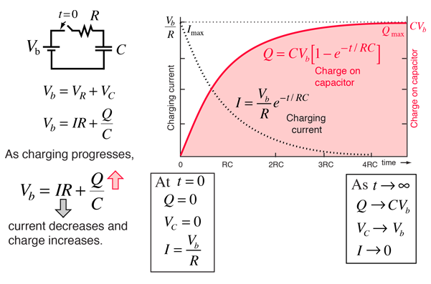
Outward $\left[K^{+}\right]$ flow
Down concentration gradient
Charges membrane like a capacitor
How capacitors work

Slide 15
Small $\left[Na^{+}\right]$ flow
Channels for $Na^{+}$ not especially permeable
$Na^{+}$ flows ___________ (Why?)
Makes total voltage across (membrane potential) more [positive/negative] (Why?)
Membrane potential = $Σ$ of all ion effects

Slide 16

Goldman-Hodgkin-Katz equation

Slide 17
Party metaphor
Annie ($A^{−}$) was having a party.
Used to date Nate ($Na^{+}$), but now sees Karl ($K^{+}$)
Hired bouncers called
“The Channels”
Let Karl and friends in or out, keep Nate out

Slide 18
Annie’s friends ($A^{−}$) and Karl’s ($K^{+}$) mostly inside
Nate and friends ($Na^{+}$) mostly outside
Claude/Claudia ($Cl^{−}$) tagging along

Slide 19
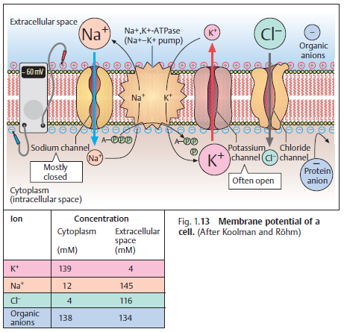

Slide 20
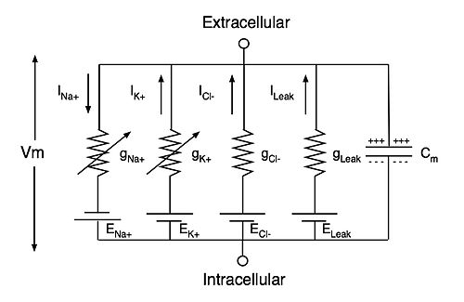
Wikipedia

Slide 21
Action potential

Slide 22
Link to resources/cells

Slide 23
Synaptic transmission

Slide 24
Link to resources/cells

Slide 25
Main points
Resting potential
Equilibrium point (e.g., attractor state)
Balance of forces (diffusion/voltage)
Combined effects on multiple ions

Slide 26
Action potential
Short (in time), discrete message
Can propagate quickly
Triggers neurotransmitter release

Slide 27
Next time…
Neurochemistry
Neurotransmitters
Hormones
Neurocomputing

Slide 28
Resources

Slide 29
References

