Slide 1
Evolution of nervous systems
PSY 511.003

Slide 2
Prelude

Slide 3
Announcements
Exercise 05 write-up due yesterday.
Exercise 06 write-up due next Wednesday.
Final project/paper proposal due Thursday, February 29

Slide 4
Last time…
Methods in neuroscience

Slide 5
When and why would you choose EEG/ERP over fMRI?

Slide 6
Why do single unit recordings have the finest spatial and temporal resolution among neuroscience methods?

Slide 7
Today’s topics
Evolution of nervous systems

Slide 8
Evolution

Slide 9
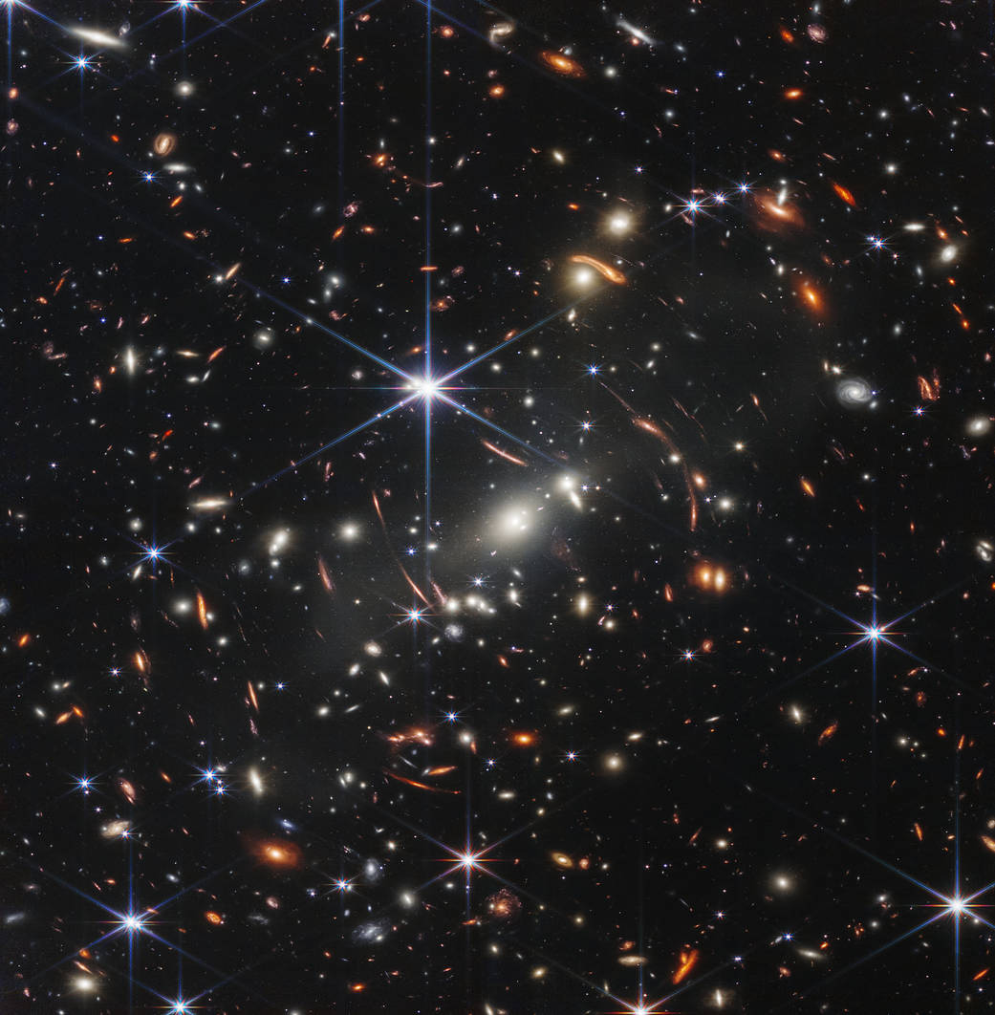
In the beginning…
Near IR deep field (12.5 hr exposure) from JWST

Slide 10
resources/evolution

Slide 11
Main points
Our solar system has a history ~1/3 as long as the Universe
Multi-cellular animals with nervous systems have a history ~1/7 as long as life on Earth
Substantial similarities in vertebrate nervous systems
Brain mass/body mass scaling
(& subtypes) of cerebral cortical neurons distinguish human from other primate brains

Slide 12
Next time…
Development of the human brain

Slide 13
Resources

Slide 14
References

