Slide 1
Disorders of affect
PSY 511.003

Slide 2
Prelude

Slide 3
https://www.youtube.com/embed/lioWzrpCtGQ?si=_ZsKsfOkJrXhDSgm

Slide 4
Last time…
Schizophrenia

Slide 5
What dopamine system is implicated in schizophrenia?

Slide 6
What neurotransmitter system has replaced DA as a target for research?

Slide 7
Today’s topics
Disorders of affect
Link to resources/affective-disorders

Slide 8
Main points
Major depressive disorder a major public health problem.
Major pharmacological treatments influence monoamines, especially 5-HT, but no evidence for 5-HT pathology
Bipolar disorder more similar to schizophrenia, despite affective dimension of some symptoms

Slide 9
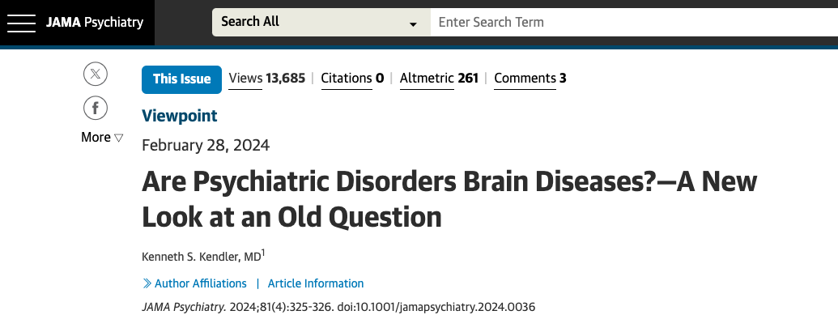
Kendler (2024)

Slide 10
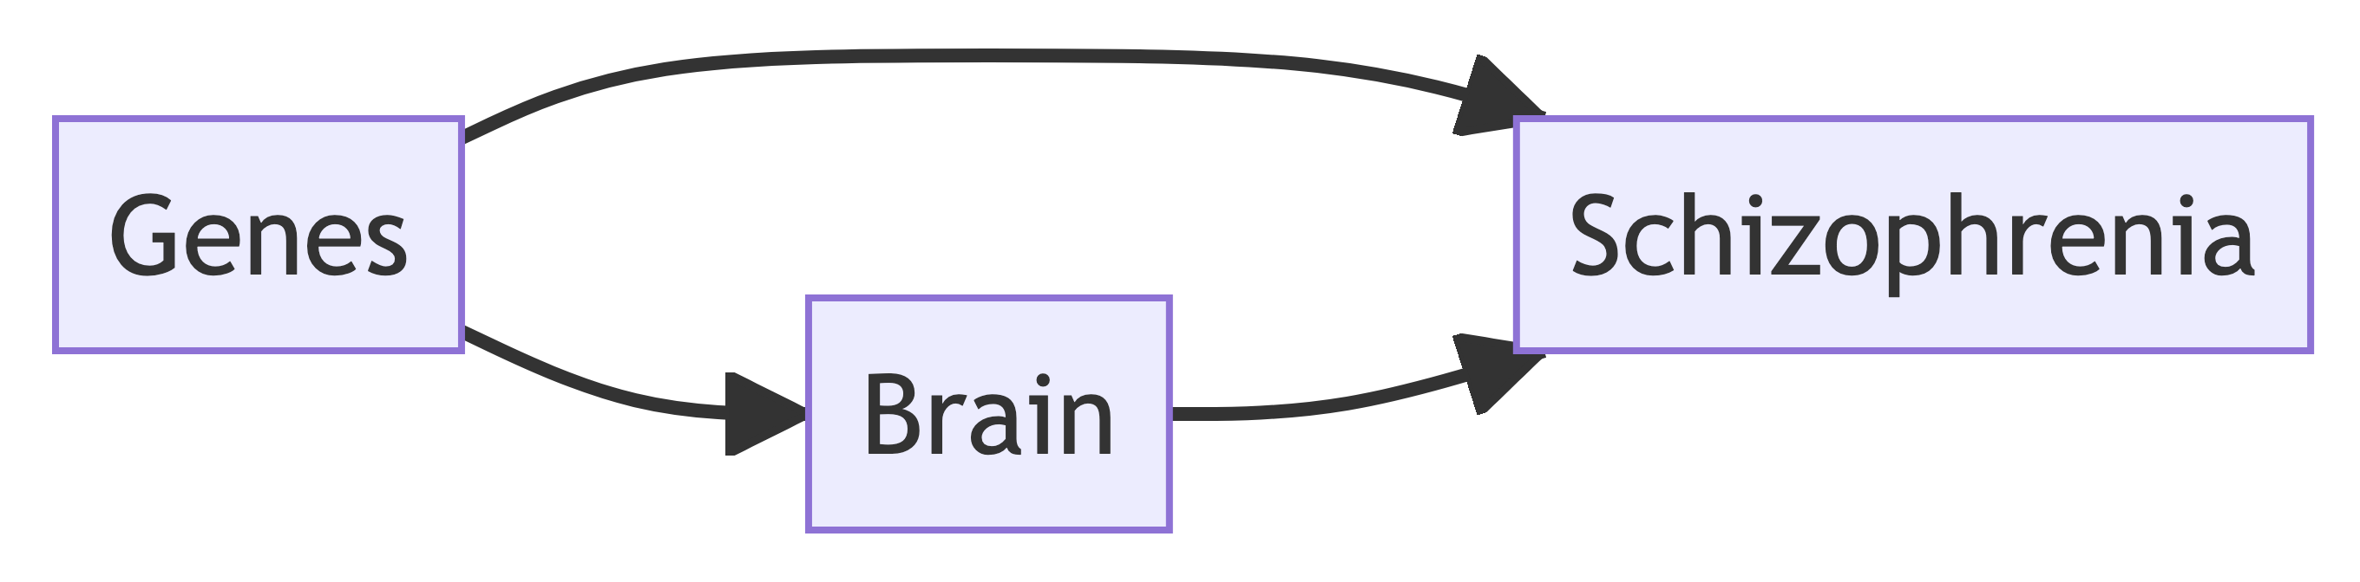
Can we show that critical causal pathways to psychiatric illness occur in the brain? (Kendler, 2024)
In other words…

Slide 11
…we report common variant associations at 287 distinct genomic loci. Associations were concentrated in genes that are expressed in excitatory and inhibitory neurons of the central nervous system, but not in other tissues or cell types. (Trubetskoy et al., 2022)
Our way forward is to convert this question into a scientifically tractable form, which I try to do here by asking where in the human body genetic risk factors for our disorders are expressed. A tentative answer, at least for schizophrenia…“it is entirely in the brain.” (Kendler, 2024)

Slide 12
Next time
Fear, stress, pleasure, & reward

Slide 13
Kendler, K. S. (2024). Are psychiatric disorders brain Diseases?-A new look at an old question. JAMA Psychiatry, 81(4), 325–326. https://doi.org/10.1001/jamapsychiatry.2024.0036
Trubetskoy, V., Pardiñas, A. F., Qi, T., Panagiotaropoulou, G., Awasthi, S., Bigdeli, T. B., … Schizophrenia Working Group of the Psychiatric Genomics Consortium. (2022). Mapping genomic loci implicates genes and synaptic biology in schizophrenia. Nature, 604(7906), 502–508. https://doi.org/10.1038/s41586-022-04434-5

