Slide 1
Biological approaches to emotion
PSY 511 Spr 2024

Slide 2
Prelude

Slide 3
https://www.youtube.com/embed/yRUAzGQ3nSY
(Pixar, 2014)

Slide 4
https://www.youtube.com/embed/7qWbcosJdtU
(Rlzee, 2010)

Slide 5
Announcements
Final Projects due next Thursday, May 2, by 5:00 pm.
  Canvas link

Slide 6
Last time…
Affective disorders

Slide 7
What are some key features of the biology of major depressive disorder?

Slide 8
Reduced volume of peri-ventricular areas/larger cerebral ventricles
Altered reactivity (+/-)
Altered connectivity, esp between frontal cortex and rest of brain

Slide 9
What is the monoamine hypothesis of depression?

Slide 10
Why has it been abandoned?

Slide 11
What distinguishes bipolar disorder from depression?

Slide 12
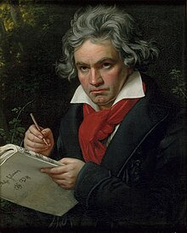
Today’s topics
The biology of emotion
  Fear & stress
  Pleasure & reward
The Cerebral Symphony

Slide 13
The Cerebral Symphony

Slide 14
https://www.youtube.com/embed/ljGMhDSSGFU
(smalin, 2011)

Slide 15
Pixar. (2014, December). Inside out - official US trailer. Youtube. Retrieved from https://www.youtube.com/watch?v=yRUAzGQ3nSY
Rlzee. (2010, October). Immortal beloved ode to joy scene. Youtube. Retrieved from https://www.youtube.com/watch?v=7qWbcosJdtU
smalin. (2011, December). Beethoven, symphony 9, 4th movement (complete) ode to joy, presto, philharmonia baroque. Youtube. Retrieved from https://www.youtube.com/watch?v=ljGMhDSSGFU

