Slide 1
Neuroanatomy
PSY 511.003

Slide 2
Prelude

Slide 3
(ctdalilah, 2006)

Slide 4
(Kids Learning Tube, 2015)

Slide 5
Announcements
Exercise 02 due next Wednesday, January 24, 2024.

Slide 6
Last time…
Levels of analysis

Slide 7
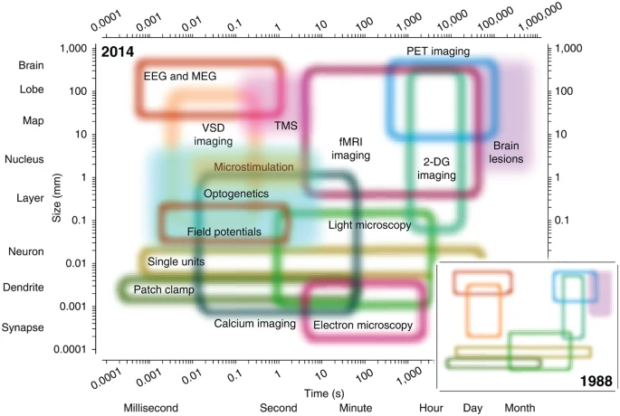
Spatial & temporal levels
(Sejnowski et al., 2014, fig. 1)

Slide 8
≠ Marr’s levels
(Favela, 2020, fig. 3)

Slide 9
Computational level
What has to be computed?
What is the shape/form of that unknown object?
What did that person just say?
Is that unknown object a threat to me?

Slide 10
Algorithmic level
What’s the ‘recipe’ for…
computing shape
perceiving speech
recognizing threats

Slide 11
Implementation level
How do…
neurons
areas
networks
implement the recipe?

Slide 12
Causality in neuroscience
(Siddiqi, Kording, Parvizi, & Fox, 2022).
Stimulation & lesion studies needed for inferring causation.
Bradford-Hill criteria (Hill, 2015)

Slide 13
Today’s topics
Neuroanatomy
Brief overview
In-class lab
Exercise 02

Slide 14
Neuroanatomy

Slide 15
Why study?
Master basic vocabulary for reading literature

Slide 16
Brain anatomy through dance
Your browser does not support the audio tag.
https://psu-psychology.github.io/psych-260-2023-spring-notes/neuroanatomy.html#brain-anatomy-through-dance

Slide 17
Directional terms
Anterior/Posterior
Medial/Lateral
Superior/Inferior
Dorsal/Ventral
Rostral/Caudal

Slide 18
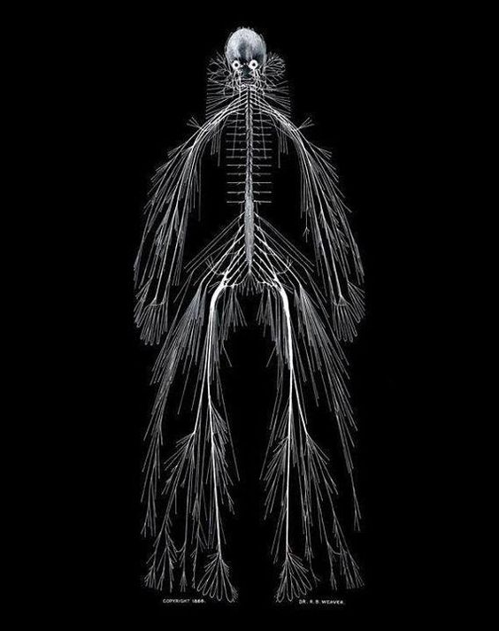
Central vs. Peripheral Nervous System
Nervous system of Harriet Cole from https://www.pastmedicalhistory.co.uk/the-nervous-system-of-harriet-cole/

Slide 19
Organization of the CNS
Major division | Ventricular Landmark | Embryonic Division | Structure
Forebrain | Lateral | Telencephalon | Cerebral cortex
 |  |  | Basal ganglia
 |  |  | Hippocampus, amygdala

Slide 20
Major division | Ventricular Landmark | Embryonic Division | Structure
 | Third | Diencephalon | Thalamus
 |  |  | Hypothalamus

Slide 21
Major division | Ventricular Landmark | Embryonic Division | Structure
Midbrain | Cerebral Aqueduct | Mesencephalon | Tectum, tegmentum

Slide 22
Major division | Ventricular Landmark | Embryonic Division | Structure
Hindbrain | 4th | Metencephalon | Cerebellum, pons
 | – | Mylencephalon | Medulla oblongata

Slide 23
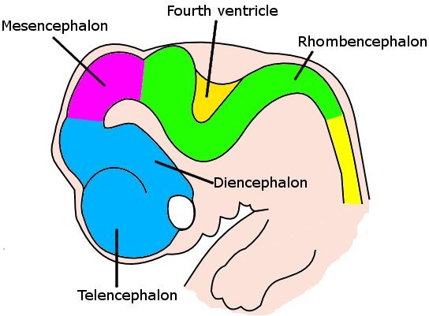
Forebrain, midbrain, hindbrain terminology derives from embryonic stages in CNS development.
Embryonic human brain from Wikipedia

Slide 24
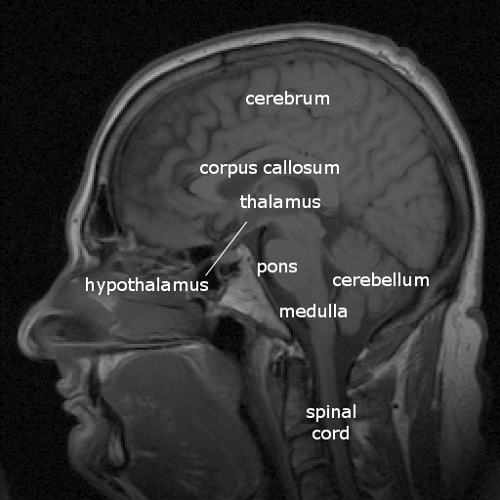
Cerebrum
(Cerebral) cortex
Subcortical structures
Labelled MRI including thalamus and hypothalamus

Slide 25
(Cerebral) cortex
Lobes, marked by sulci/fissures, adjacency to bones of skull
Functional areas marked by gyri & sulci
Brodmann Areas
Microstructural (cellular composition) features

Slide 26
Most lobes have host primary sensory or motor area
Frontal: Motor cortex
Temporal: Auditory cortex
Parietal: Somatosensory cortex
Occipital: Visual cortex
Insula: Gustatory

Slide 27
Input/output
Via cranial nerves (in CNS)
Via spinal nerves (in PNS)

Slide 28
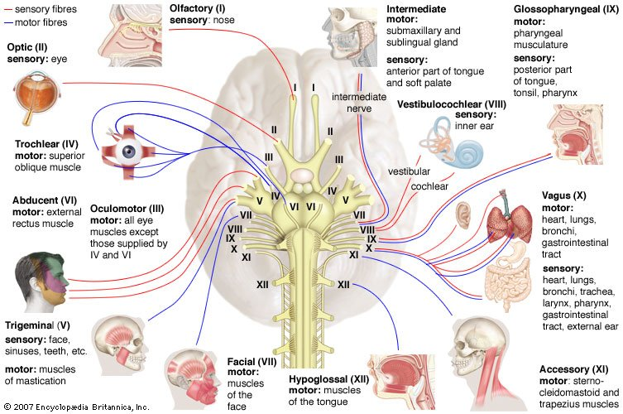
Cranial nerves from https://www.britannica.com/science/cranial-nerve#/media/1/141797/46720

Slide 30
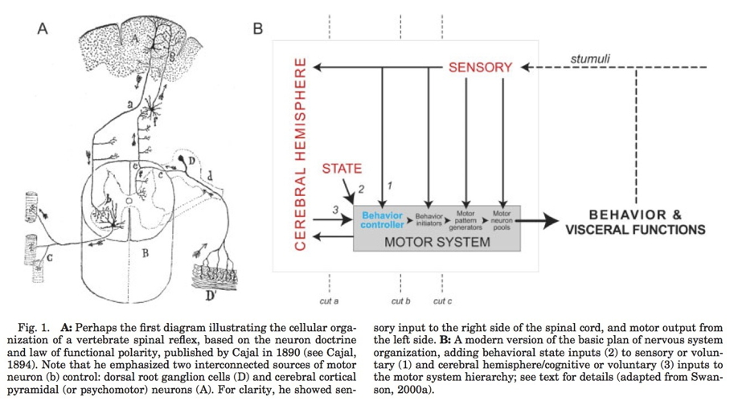
Multiple hierarchies
(Swanson, 2005, fig. 1)

Slide 31
Maps
Sensory & motor systems often use maps

Slide 33
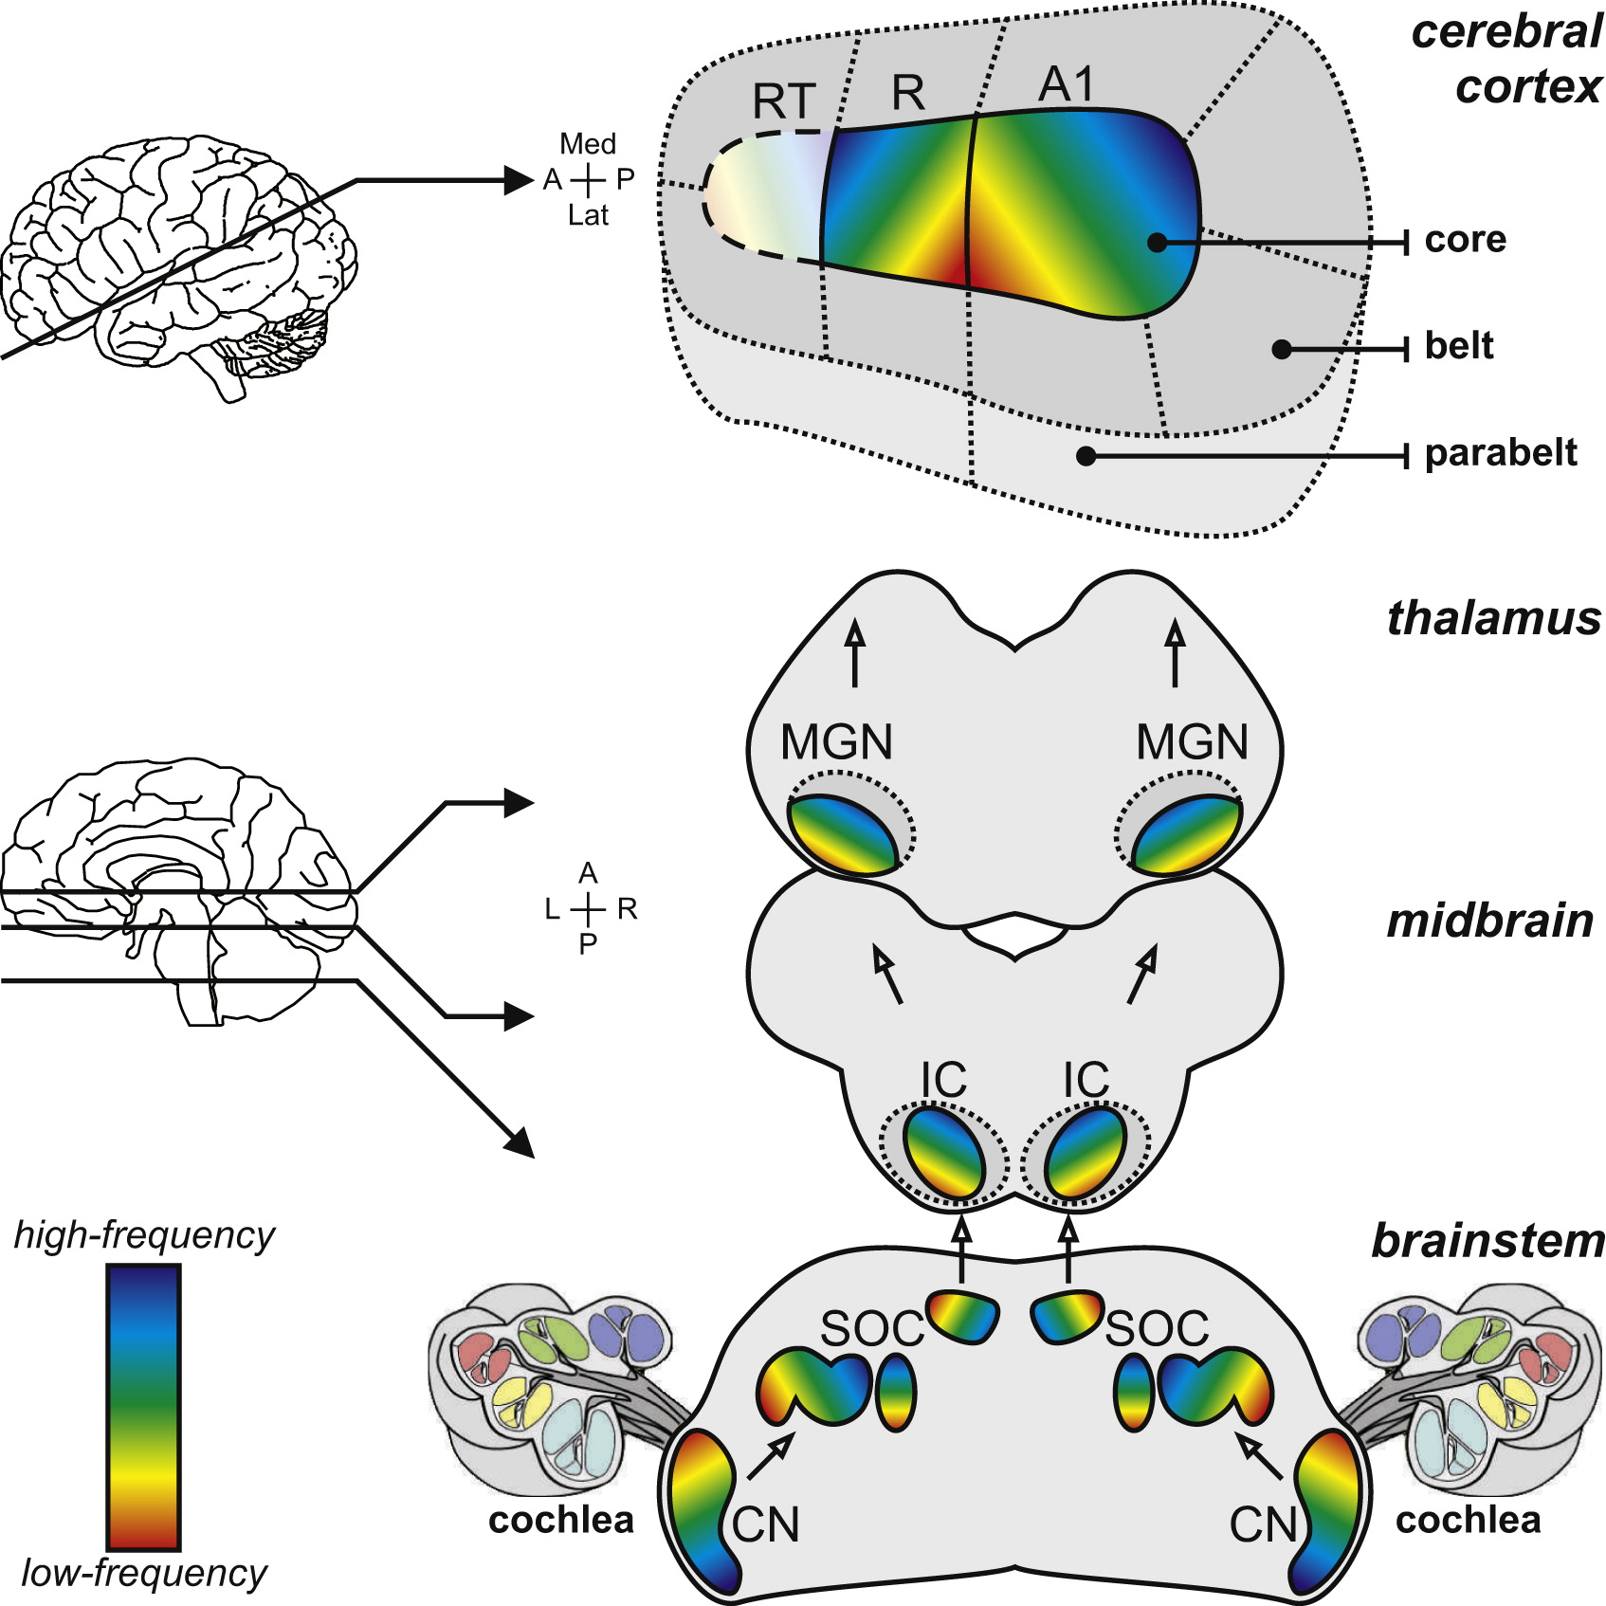
[Figure 1 from@Saenz2014-ao]

Slide 34
Wikipedia

Slide 35
Geometric issues central for perceptual/motor behavior
Do other systems “map” function to structure?

Slide 36
Neuroanatomy lab

Slide 37
Overview
3 groups
Rotate among stations
Identify as many structures as possible

Slide 38
Wrap-up

Slide 39
Main points
Directional terms
What is it
Where is it
Relative to other things
CNS/PNS
Forebrain/midbrain/hindbrain

Slide 40
Cerebral cortex and its subparts
Grey matter vs. white matter

Slide 41
Next time…
Cellular neuroscience I

Slide 42
Resources

Slide 43
References
ctdalilah. (2006, October). Pinky and the brain-brainstem. Youtube. Retrieved from https://www.youtube.com/watch?v=snO68aJTOpM
Favela, L. H. (2020). Cognitive science as complexity science. Wiley Interdisciplinary Reviews. Cognitive Science, 11(4), e1525. https://doi.org/10.1002/wcs.1525
Hill, A. B. (2015). The environment and disease: Association or causation? 1965. Journal of the Royal Society of Medicine, 108(1), 32–37. https://doi.org/10.1177/0141076814562718
Kids Learning Tube. (2015, October). Human body for Kids/Brain Song/Human body systems. Youtube. Retrieved from https://www.youtube.com/watch?v=Qw8E9WnZTQk
Sejnowski, T. J., Churchland, P. S., & Movshon, J. A. (2014). Putting big data to good use in neuroscience. Nat. Neurosci., 17(11), 1440–1441. https://doi.org/10.1038/nn.3839
Siddiqi, S. H., Kording, K. P., Parvizi, J., & Fox, M. D. (2022). Causal mapping of human brain function. Nature Reviews. Neuroscience, 23(6), 361–375. https://doi.org/10.1038/s41583-022-00583-8
Swanson, L. W. (2005). Anatomy of the soul as reflected in the cerebral hemispheres: Neural circuits underlying voluntary control of basic motivated behaviors. Journal of Comparative Neurology, 493(1), 122–131. https://doi.org/10.1002/cne.20733

