Slide 1
Cellular neuroscience I
PSY 511.003

Slide 2
Prelude
http://www.gregadunn.com/

Slide 3
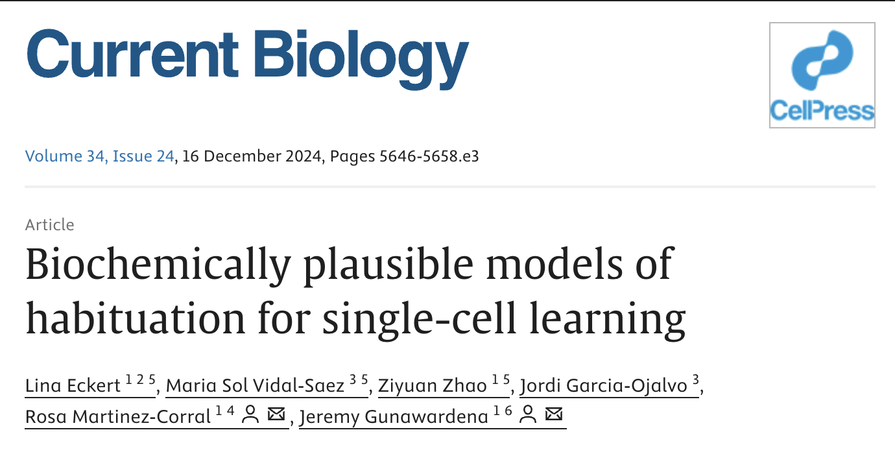
https://www.youtube.com/embed/nvXuq9jRWKE
National Geographic (2014)
In the news…
Eckert et al. (2024)

Slide 4
Our results suggest that individual cells may exhibit habituation behavior as rich as that which has been codified in multi-cellular animals with central nervous systems and that the relative simplicity of the biomolecular level may enhance our understanding of the mechanisms of learning.
Eckert et al. (2024)

Slide 5
I contain multitudes…
Whitman (2019)
Announcements
Exercise 01
Scores
Themes
Implications
Exercise 03 distributed.
due in two weeks on Wednesday, February 7
Last time…
Neuroanatomy

Slide 6
Where is the cerebellum found?

Slide 7
In what lobe would one find primary somatosensory cortex?

Slide 8
What structure in the diencephalon controls the endocrine system and both branches of the autonomic nervous sytem?
Today’s topics
Cellular neuroscience
Neurons
Glia
Resting potential

Slide 9
Break
Work on Exercise 03
Visit Exercise 03
Main points
Cells of nervous system specialized
Convey, process, store information
Nervous systems enable complex external (behavior) and internal states
Complex behavior/internal states not reducible to, but inseparable from nervous system states
Electrical + chemical information flows
Next time…
The action potential

Slide 10
Resources
References
Eckert, L., Vidal-Saez, M. S., Zhao, Z., Garcia-Ojalvo, J., Martinez-Corral, R., & Gunawardena, J. (2024). Biochemically plausible models of habituation for single-cell learning. Current Biology: CB, 34, 5646–5658.e3. https://doi.org/10.1016/j.cub.2024.10.041
National Geographic. (2014, January). Beautiful 3-D brain scans show every synapse | national geographic. YouTube. Retrieved from https://www.youtube.com/watch?v=nvXuq9jRWKE
Whitman, W. (2019, February 13). Song of myself, 51. Retrieved January 30, 2025, from https://poets.org/poem/song-myself-51

