Slide 1
Neuroanatomy
PSY 511.003 Spr 2025

Slide 2
Prelude

Slide 3
Announcements
Exercise 02 due next Wednesday, January 29, 2025.

Slide 4
Today’s topics
Neuroanatomy
Brief overview
In-class lab
Exercise 02

Slide 5
Neuroanatomy

Slide 6
Why study?
Master basic vocabulary for reading literature

Slide 7
Information processing perspective
Inputs from
World
Body
Brain¹

Slide 8
Outputs to
World
Body
Brain
What computations occur where

Slide 9
Functional anatomy perspective
Located where
Connected to
Involved in

Slide 10
Brain anatomy through dance
Your browser does not support the audio tag.

Slide 11
Directional terms
Anterior/Posterior
Medial/Lateral
Superior/Inferior
Dorsal/Ventral
Rostral/Caudal

Slide 12
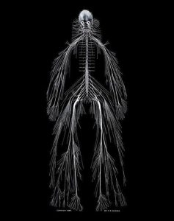
Central vs. Peripheral Nervous System
Nervous system of Harriet Cole, see McNaughton (2018)

Slide 13
Organization of the CNS
Major division | Ventricular Landmark | Embryonic Division | Structure
Forebrain | Lateral | Telencephalon | Cerebral cortex
 |  |  | Basal ganglia
 |  |  | Hippocampus, amygdala

Slide 14
Major division | Ventricular Landmark | Embryonic Division | Structure
 | Third | Diencephalon | Thalamus
 |  |  | Hypothalamus

Slide 15
Major division | Ventricular Landmark | Embryonic Division | Structure
Midbrain | Cerebral Aqueduct | Mesencephalon | Tectum, tegmentum

Slide 16
Major division | Ventricular Landmark | Embryonic Division | Structure
Hindbrain | 4th | Metencephalon | Cerebellum, pons
 | – | Mylencephalon | Medulla oblongata

Slide 17
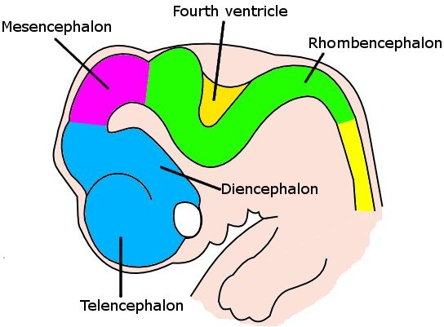
Forebrain, midbrain, hindbrain terminology derives from embryonic stages in CNS development.
Embryonic human brain from Wikipedia

Slide 18
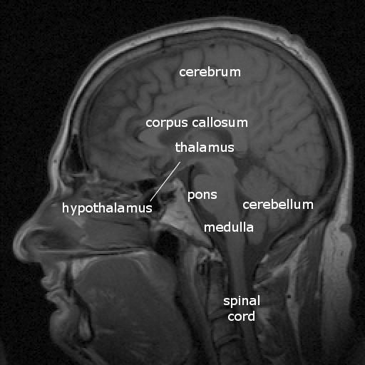
Cerebrum
(Cerebral) cortex
Subcortical (below the cortex) structures
Labelled MRI including thalamus and hypothalamus

Slide 19
(Cerebral) cortex
Lobes, marked by sulci/fissures, adjacency to bones of skull
Functional areas marked by gyri & sulci
Brodmann Areas
Microstructural (cellular composition) features

Slide 20
Most lobes host primary sensory or motor area
Frontal: Motor cortex
Temporal: Auditory cortex
Parietal: Somatosensory cortex
Occipital: Visual cortex
Insula: Gustatory

Slide 21
Input/output
Via cranial nerves (in CNS)
Via spinal nerves (in PNS)

Slide 22
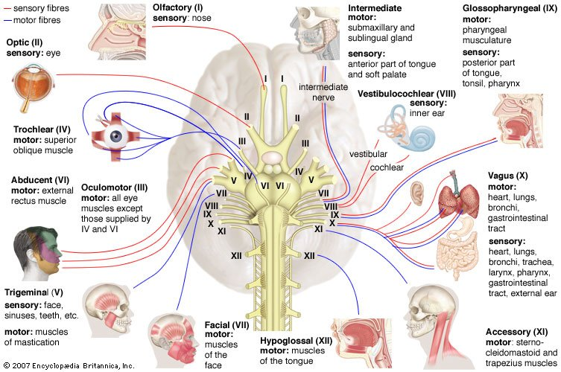
Cranial nerves from https://www.britannica.com/science/cranial-nerve#/media/1/141797/46720

Slide 23
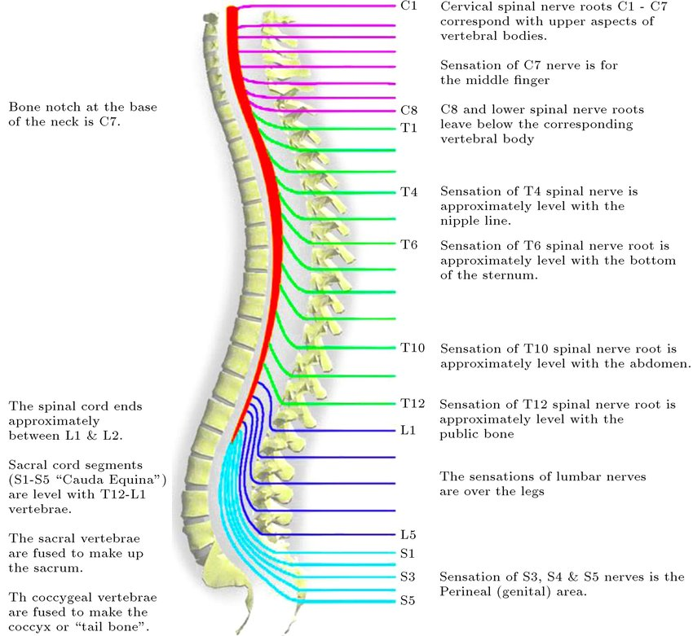
https://www.researchgate.net/profile/Saeede-Rahimi-Damirchi-Darasi/publication/324683974/figure/fig10/AS:753484697726976@1556656159277/Diagram-showing-the-relationship-between-spinal-nerve-roots-and-vertebrae-27.jp

Slide 24
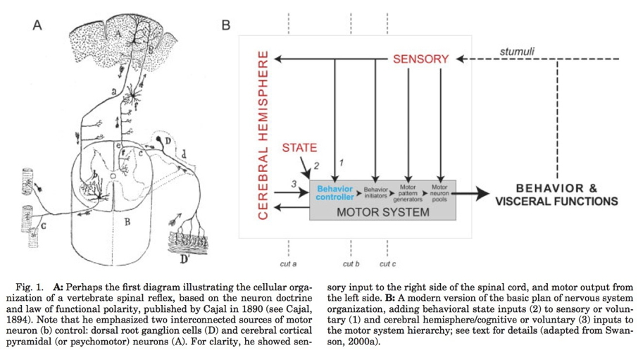
Multiple hierarchies
(Swanson, 2005, fig. 1)

Slide 25
Maps
Sensory & motor systems often use maps

Slide 26
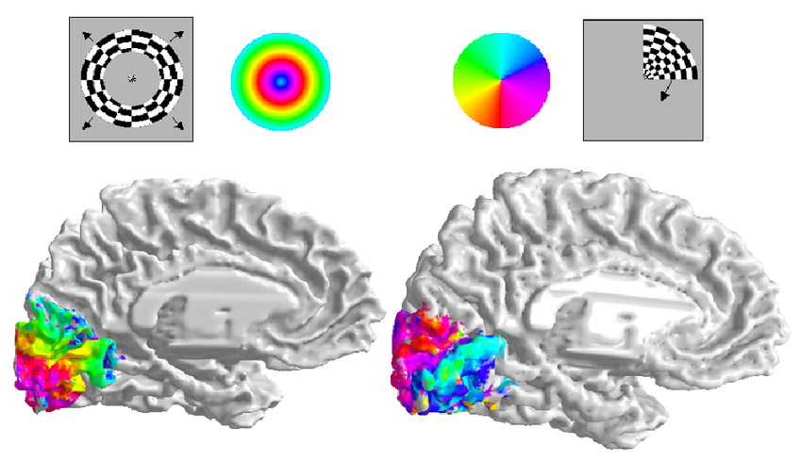
https://www.researchgate.net/profile/Brian-Wandell/publication/8988812/figure/fig1/AS:280067633631238@1443784735289/The-Retinotopy-paradigm-Two-stimuli-are-used-to-measure-the-retinotopic-maps-in-cortex.png

Slide 27
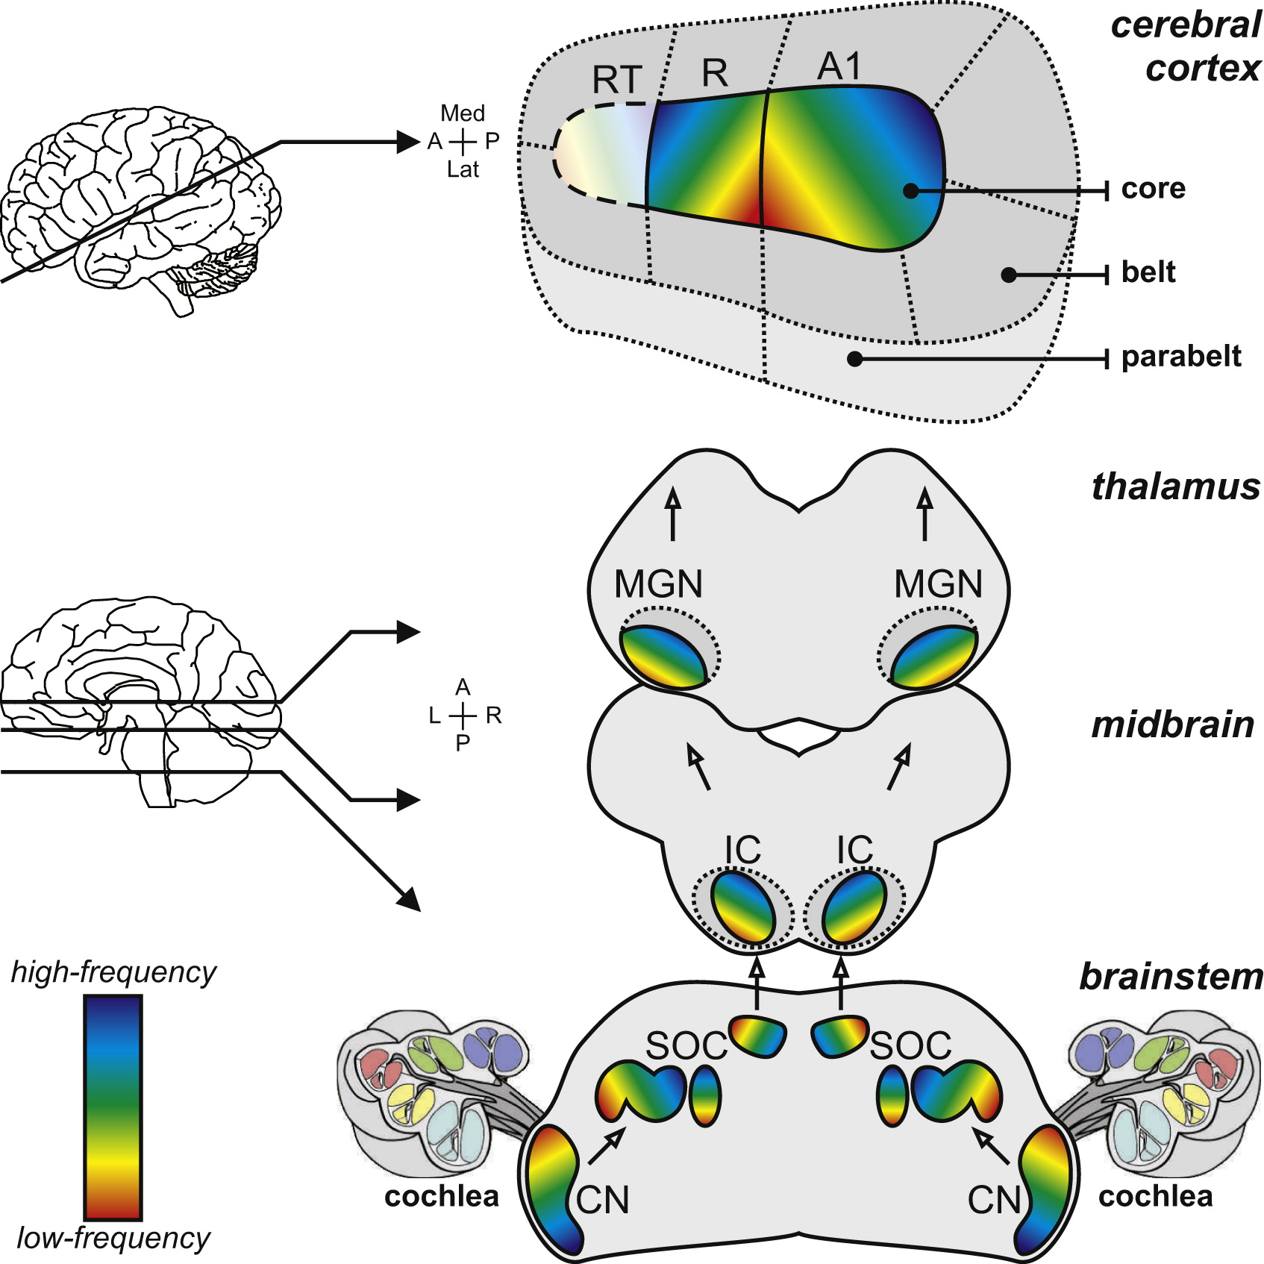
Figure 1 from Saenz & Langers (2014)

Slide 28
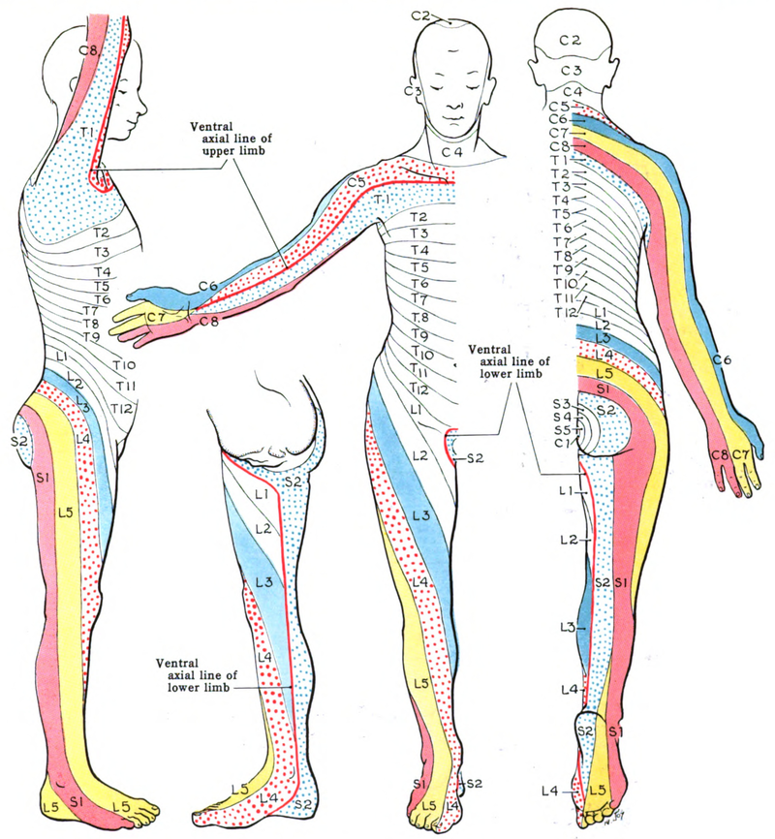
Wikipedia

Slide 29
Geometric issues central for perceptual/motor behavior
Do other systems “map” function to structure?

Slide 30
Neuroanatomy lab

Slide 31
Overview
3 groups
Rotate among stations every ~25 min
Identify as many structures as possible

Slide 32
Wrap-up

Slide 33
Main points
Directional terms
What is it
Where is it
Relative to other things
CNS/PNS
Forebrain/midbrain/hindbrain

Slide 34
Cerebral cortex and its subparts
Grey matter vs. white matter

Slide 35
Next time…
Cellular neuroscience I

Slide 36
Resources

Slide 37
References
McNaughton, A. (2018, November 20). Dissecting harriet cole: Uncovering women’s history in the archives. Retrieved January 8, 2025, from https://drexel.edu/legacy-center/blog/overview/2018/november/dissecting-harriet-cole-uncovering-womens-history-in-the-archives/
Saenz, M., & Langers, D. R. M. (2014). Tonotopic mapping of human auditory cortex. Hearing Research, 307, 42–52. https://doi.org/10.1016/j.heares.2013.07.016
Swanson, L. W. (2005). Anatomy of the soul as reflected in the cerebral hemispheres: Neural circuits underlying voluntary control of basic motivated behaviors. Journal of Comparative Neurology, 493(1), 122–131. https://doi.org/10.1002/cne.20733

Slide 38
Notes
1. shorthand for nervous system

