Slide 1
Action
PSY 511.001 Spr 2026

Slide 2
Overview

Slide 3
Prelude
https://www.youtube.com/watch?v=hdcTmpvDO0I
– Reviews (2012)

Slide 4
Announcements
Exercise ANAT due today.
Canvas dropbox

Slide 5
Today’s topics
On action
How muscles work
Controlling muscles
Illustrative motor systems

Slide 6
Warm-up

Slide 7
The amygadala is found deep within which lobe of the cerebral cortex?
A. The occipital lobe
B. The frontal lobe
C. The insula
D. The temporal lobe

Slide 8
The amygadala is found deep within which lobe of the cerebral cortex?
A. The occipital lobe
B. The frontal lobe
C. The insula
D. The temporal lobe

Slide 9
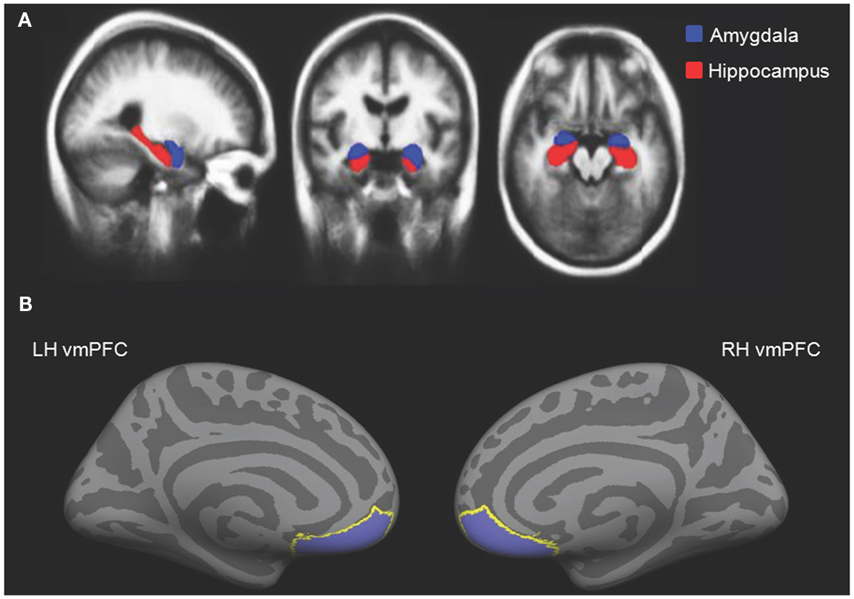
Cassidy2012-ue Figure 2

Slide 10
The middle image in A in the figure at right depicts what plane of section?
A. Sagittal
B. Dorsal
C. Coronal
D. Horizontal
Cassidy & Gutchess (2012) Figure 2

Slide 11
The middle image in A in the figure at right depicts what plane of section?
A. Sagittal
B. Dorsal
C. Coronal
D. Horizontal
Cassidy & Gutchess (2012) Figure 2

Slide 12
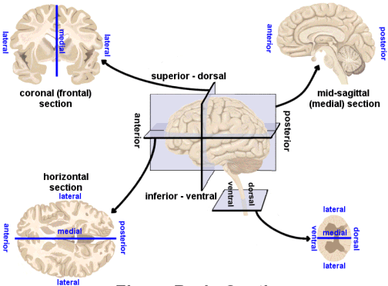
Planes of section from http://www.scienceteacherprogram.org/

Slide 13
Which division of the peripheral nervous system (PNS) ennervates the gastrointestinal tract?
A. Enteric
B. Cerebellum
C. Sympathetic
D. Parasympathetic

Slide 14
Which division of the peripheral nervous system (PNS) ennervates the gastrointestinal tract?
A. Enteric
B. Cerebellum
C. Sympathetic
D. Parasympathetic

Slide 15
On action

Slide 16
Why action?
The way to do is to be.
– Laozi (老子), Chinese philosopher

Slide 17
The way to be is to do.
– Dale Carnegie
“Quote origin” (n.d.)

Slide 18
Do be, do be, do.
– Frank Sinatra

Slide 19
“Quote origin” (n.d.)

Slide 20
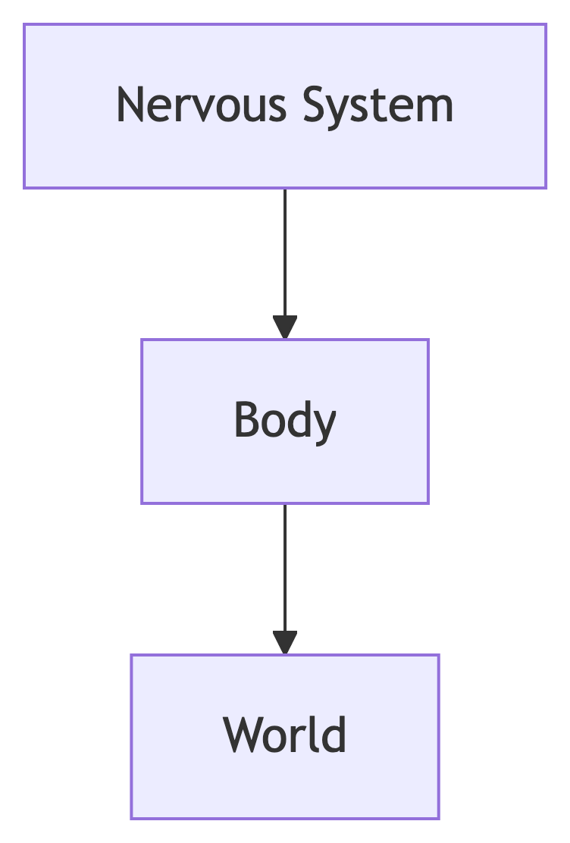
Animals are animate
Actions influence
Their own bodies, $B$
The external world, $W$
The nervous system controls the body and its effects on the world

Slide 21
Animal movement lawful
Physics
Biology
Psychology
Your turn
Can you name a physical law that applies to movement? A biological law? A psychological law?

Slide 22
Movement one class of nervous system output
Nervous system outputs
Autonomic
Endocrine
Somatic
Three classes of outputs from the nervous system.

Slide 23
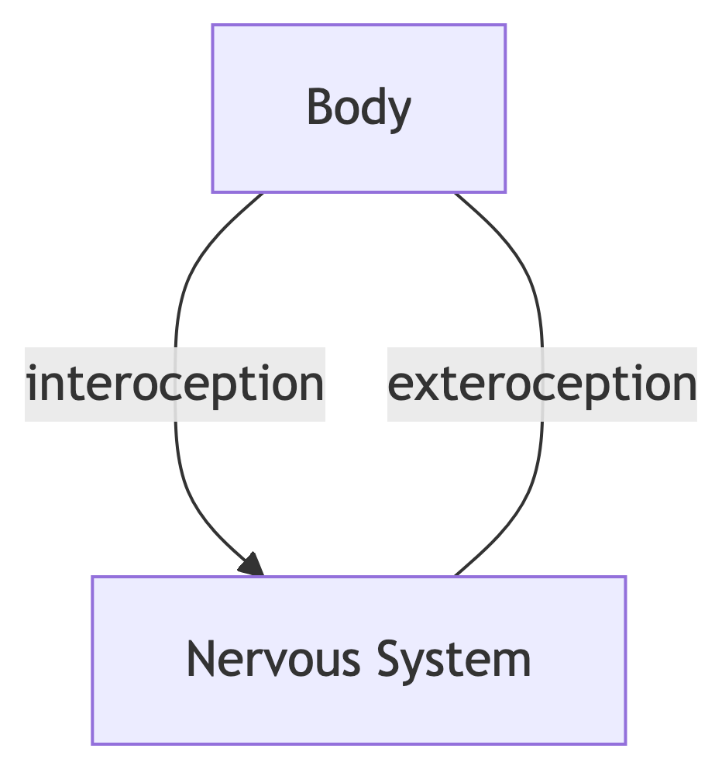
Nervous system inputs fall into two broad classes
Exteroceptive (outside the body)
Interoceptive

Slide 24

Schematic of input and output flows

Slide 25
Schematic of information flows into and out of the nervous system. Note: This figure ignores flows specifically related to metabolism.

Slide 26
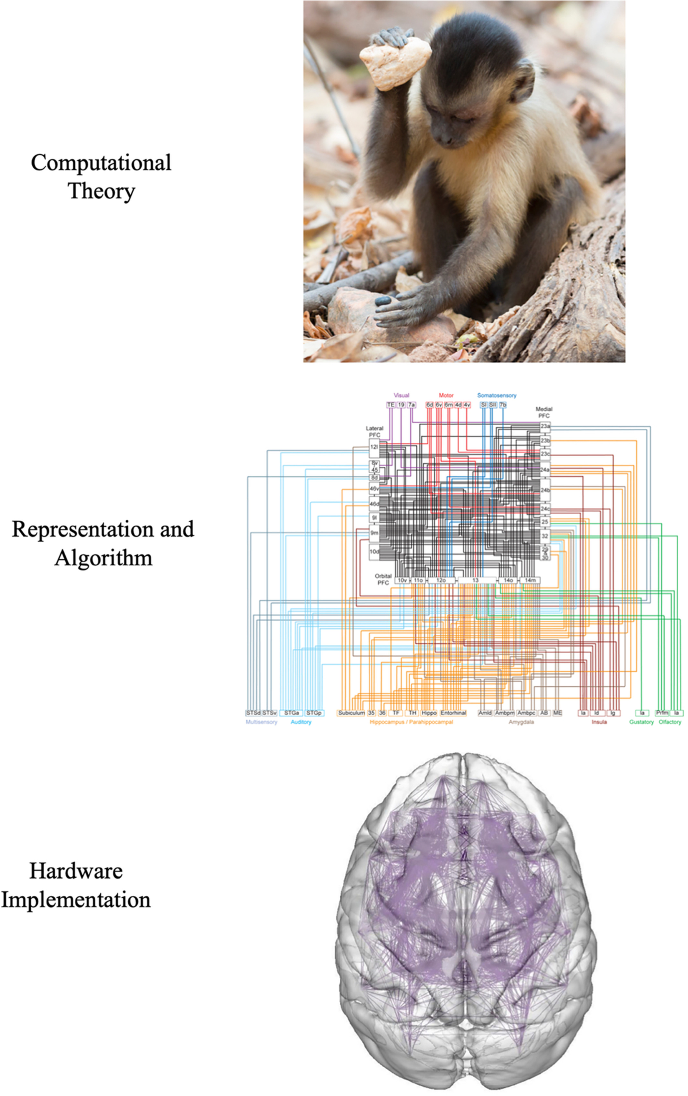
Computational perspective
Favela (2020) Figure 3

Slide 27
Evolutionary perspective
What actions must animals perform?
Live long enough to reproduce

Slide 28
Live long enough…
Avoid injury & predation
Secure sustenance
Maintain health
Reproduce…
Find a mate
Mate
Ensure the well-being of offspring
In other words…behave

Slide 29
Movement is the real reason for brains
https://www.youtube.com/watch?v=7s0CpRfyYp8
– Wolpert (2011)

Slide 30
Classes of behavior
Orienting, info gathering
Maintaining balance
Reaching, grasping, & manipulation
Locomotion
Communication
Mating & caregiving
Ingestion & elimination

Slide 31
Your turn
Does this miss any major classes of behavior?

Slide 32
Muscles: Engines of animal motion
By CFCF - Own work, CC BY-SA 4.0, https://commons.wikimedia.org/w/index.php?curid=37700550

Slide 33
How muscles work

Slide 34
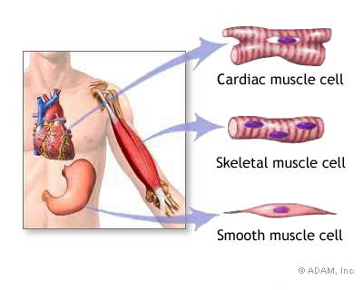
Muscles are machines that
Generate force…in one direction
Involuntary
Cardiac & smooth
Voluntary
Striated
Skeletal

Slide 35
Functional classes
Axial
Trunk, neck, hips
Proximal
Shoulder/elbow, pelvis/knee
Distal
Hands/fingers, feet/toes

Slide 36
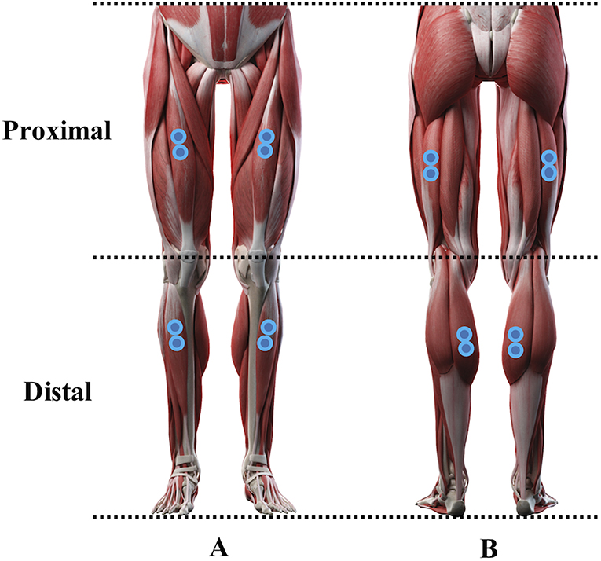
(Cantú et al., 2019)

Slide 37
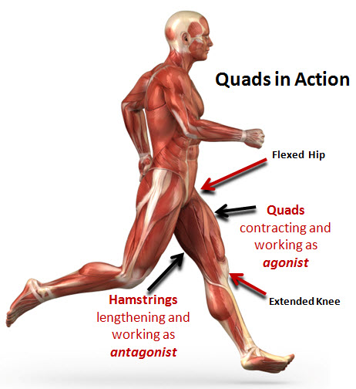
Agonist/antagonist pairs

Slide 38
How skeletal muscles contract
Motor neurons (cell bodies located in ventral horn of spinal cord)
Project to muscle fiber(s)
Motor unit == Motor neuron + muscle fibers
Form neuromuscular junction
Synapse between motor neuron and muscle fiber
Release acetylcholine (ACh)

Slide 39
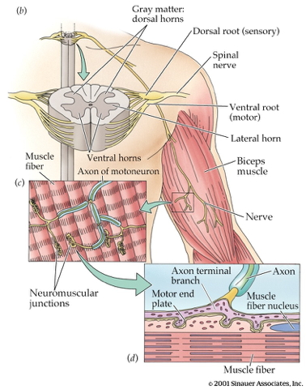
Biological Psychology 4th ed.

Slide 40
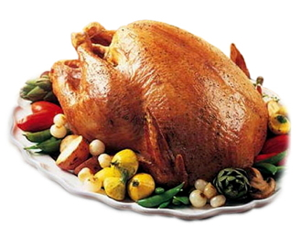
Skeletal muscle fiber types
Fast twitch/fatiguing
Type II
White meat
Slow twitch/fatiguing
Type I
Red meat

Slide 41
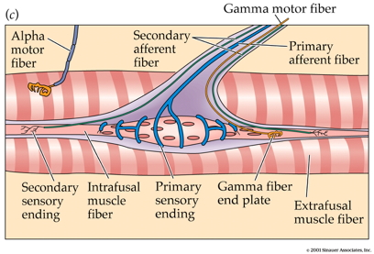
Muscles are sensory organs, too!
Extrafusal fibers
Generate force
Intrafusal fibers
Contain stretch receptors
Sense muscle length/tension

Slide 42
Intrafusal fibers
Sense muscle length and $δl$, e.g. “stretch”
Provide muscle proprioception (perception about the self)
Proprioception a form of interoception

Slide 43
Intrafusal fibers
Stretch receptors (also called muscle spindles)
Ennervated by by primary Ia afferents (sensory output from muscle to CNS)
Secondary Type II fibers
Force-producing motor fiber
Ennervated by gamma ($γ$) motor neurons (motor input)

Slide 44
Extrafusal fibers
Generate force
Ennervated by alpha ($α$) motor neurons

Slide 45
Circuit

Slide 46
Monosynaptic stretch (myotatic) reflex
Muscle stretched (length increases)
Muscle spindle in intrafusal fiber activates
Ia afferent $→$ spinal cord
Activates alpha ($α$) motor neuron
1 synapse $→$ monosynaptic
$α$ motor neuron activates extrafusal fiber
Muscle contracts, shortens length

Slide 47
Gamma ($γ$) motor neuron fires to take up ‘slack’ in intrafusal fiber
Source: Wikipedia

Slide 48
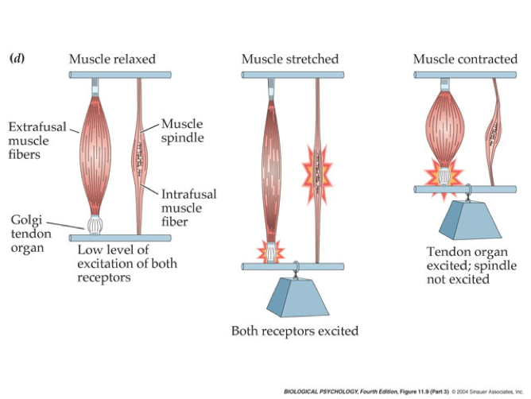

Slide 49
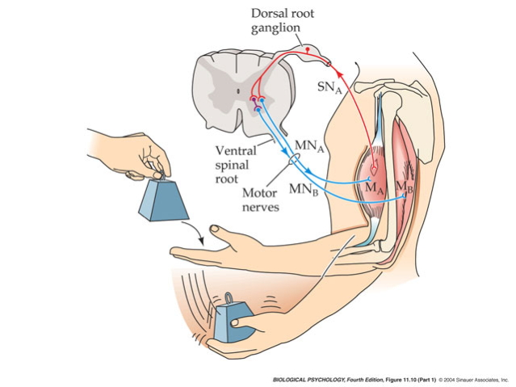

Slide 50
Note
This is a bit like the role of a belayer in rock climbing.

Slide 51
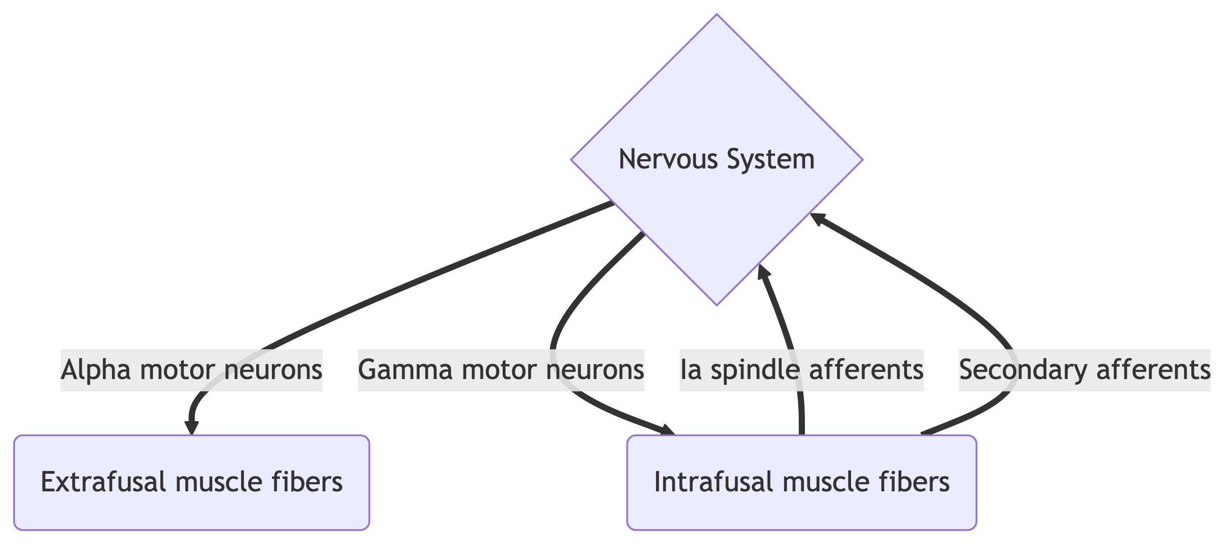

Slide 52
CNS activation of skeletal muscle fibers.

Slide 53
Why doesn’t antagonist muscle respond?
Contract bicep $→$ stretch tricep
Polysynaptic inhibition of antagonist muscle
Prevents/dampens tremor

Slide 54
Example: Patellar reflex
https://www.youtube.com/watch?v=DJLmVSeZ5-c
– 牛津基礎生物學 (2021)

Slide 55
“Tuning” proprioceptive feedback
Developmental orgins
How does the motor system “learn” the sensory consequences of muscle fiber contraction? Could spontaneous “twitches” be involved (Blumberg & Adolph, 2023)?
That is, higher levels of the nervous system might learn the relationship between motor neuron output and spindle feedback from “random” activity.

Slide 56
Conduction speed
$α$ motor neuron ~ 50-60 m/s
Ia afferents ~ 80-120 m/s
Brain to toe or toe to brain: 15-30 ms
Wikipedia contributors (2025a)
Wikipedia contributors (2025a)

Slide 57
How muscles work: Interim summary
Voluntary movements involve motor units causing contraction of agonist or antagonist pairs of skeletal muscles
Skeletal muscles have embedded sensors that detect length/tension
CNS gets rapid feedback about muscle length/tension (proprioception)
Monosynaptic stretch (myotatic) reflexes maintain position stability

Slide 58
Controlling muscles

Slide 59
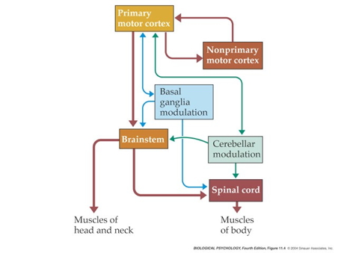
Biological Psychology 4th ed

Slide 60
Key nodes
Primary motor cortex (M1)
Anterior to central sulcus
Frontal lobe

Slide 61
M1. Wikipedia: https://en.wikipedia.org/wiki/Primary_motor_cortex

Slide 62
Topgraphic organization
Motor homunculus. Wikipedia

Slide 63
Key nodes
Non-primary motor cortex
Supplemental motor area (SMA)
Premotor cortex (PMC)
Frontal eye fields (FEF)
Basal ganglia
Brain stem
Cerebellum
Spinal cord

Slide 64
Projection pathways
Pyramidal tracts/system
Extrapyramidal system

Slide 65
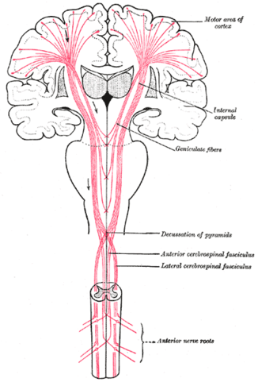
Pyramidal tracts/system
Source: Wikipedia

Slide 66
Pyramidal tracts/system
Pyramidal cells
Cerebral Cortex Layer 5 in primary motor cortex (M1)
Corticobulbar (cortex -> brainstem) tract
Corticospinal (cortex -> spinal cord) tract
Crossover (decussate) in medulla
L side of brain ennervates R side of body

Slide 67
Note
Anatomically separate ascending (afferent) and descending (efferent) pathways in the spinal cord.
Ascending (generally) more dorsal; descending more ventral.
White matter on exterior (unlike cerebral cortex).
Source: Wikipedia

Slide 68
Extrapyramidal system
Tectospinal tract
Lateral Vestibulospinal tract
Reticulospinal tract
Rubrospinal tract
Involuntary movements
Posture, balance, arousal

Slide 69
Direct cortical control
Over some motor neurons
In humans; prevalence uncertain in other animals
For individuated (“fractionated”) movements of fingers, toes, lips, but other muscles, too.

Slide 70
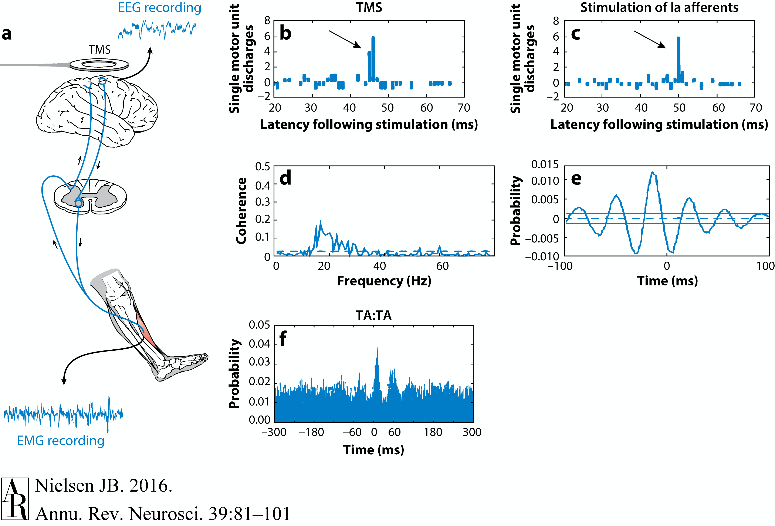
Nielsen (2016) Figure 1. Evidence of corticomotoneuronal connections in human subjects. Indirect, noninvasive evidence of the existence of monosynaptic connections between corticospinal neurons and spinal motoneurons may be obtained in awake human subjects by transcranial magnetic stimulation (TMS) (b,c) and coherence analysis of either cortical [electroencephalogram (EEG)] and muscular activity [electromyogram (EMG)] (d,e) or two separate recordings of muscular activity (f). (b,c) Corticospinal neurons can be excited by a brief magnetic pulse applied by a magnetic coil placed over the appropriate part of the motor cortex in awake human subjects. If the intensity of the magnetic pulse is adjusted appropriately, the evoked descending volley in the corticospinal tract may elicit a subthreshold excitatory postsynaptic potential (EPSP) in the relevant spinal motoneurons. This EPSP may be demonstrated as a change in the discharge probability of a single motor unit recorded from the muscle (b). In the illustrated example, the subject was asked to voluntarily activate the tibialis anterior (TA) muscle, and the discharges of a single motor unit were recorded by a needle electrode inserted into the muscle. TMS elicited a short-lasting (2-ms) increase of discharge probability at a latency of 45 ms (b). The short duration of this peak is consistent with the short rise time of a monosynaptic EPSP. This interpretation is further supported by the observation that stimulation of Ia afferents with known monosynaptic connections to the motoneurons elicits a peak with a similar short duration (c). Data in panels b and c modified with permission from Nielsen & Petersen (1994). (d,e) EEG recorded from the motor cortex and EMG recorded from a voluntarily activated muscle (TA in the illustrated example) show rhythmic modulation of the recorded activity at a frequency of 15–35 Hz. As shown from a coherence analysis of the two signals in panel d, some of this activity is common for the two sites, suggesting a close link between cortical and muscular activity. Panel e shows the EEG and EMG activities are not always synchronous but may show a time lag, which is in the range expected for a fast-conducting direct pathway to the motoneurons. Data in panels d and e modified with permission from Hansen et al. (2002). (f) A monosynaptic origin of corticomuscular coherence is further supported by the observation of short-term synchrony between the discharges of pairs of TA motor units, which may be related to the coherence in the 15–35-Hz frequency band. The subject was asked to voluntarily activate the TA muscle, and the discharges of two different TA motor units were recorded with needle electrodes. The short duration of the central peak of synchronization suggests that the motor unit activities are modulated by a common (monosynaptic) input from collaterals of last-order neurons, which are in all likelihood identical to corticomotoneuronal cells. The secondary peaks at lags of approximately 50–60 ms on either side of the central peak suggest that this last-order input modulates the discharge of the motor units at a frequency of about 20–30 Hz, i.e., corresponding to the coherence observed in the paired EEG-EMG recordings in panels b and c. Data in panel f modified with permission from Nielsen & Kagamihara (1994).

Slide 71
Illustrative motor systems

Slide 72
Behavioral repertoires
Looking
Locomotion
Reaching & grasping
Speaking

Slide 73
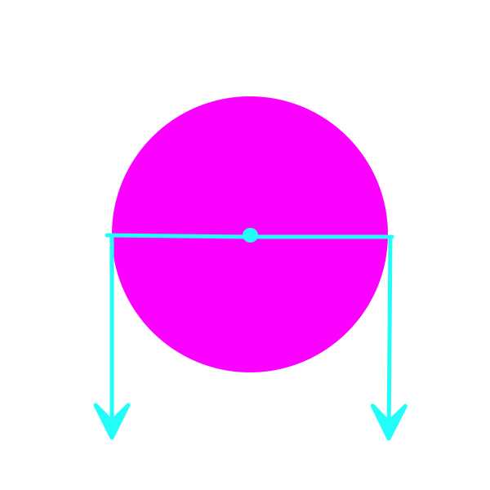
Approach
Computation
Algorithm
Hardware
Physics

Slide 74
Looking
Behavioral goals
Direct gaze (eyes + head + body) toward goal-relevant targets
Direct gaze toward emergent targets
Track/pursue targets across observer/target motion
Maximize quality of visual information about targets

Slide 75
By Rhcastilhos. And Jmarchn. - Schematic_diagram_of_the_human_eye_with_English_annotations.svg, CC BY-SA 3.0, https://commons.wikimedia.org/w/index.php?curid=1597930

Slide 76
By Vanessa Ezekowitz - Hand-drawn based on File:AcuityHumanEye.jpg by Hans-Werner Hunziker, CC BY-SA 3.0, https://commons.wikimedia.org/w/index.php?curid=7327065

Slide 77
Eye movement types
Voluntary
Saccades
Smooth pursuit
Vergence
Involuntary
Vestibulo-occular reflex (VOR)
Optokinetic nystagmus
Accommodation

Slide 78
Saccades
Rapid, ballistic (no online feedback)
~2-3/s
~200 ms to initiate
Amplitudes >20 deg $→$ saccade + head movement
https://upload.wikimedia.org/wikipedia/commons/e/e9/This_shows_a_recording_of_the_eye_movements_of_a_participant_looking_freely_at_a_picture.webm

Slide 79
– Wikipedia contributors (2025b)

Slide 80
https://www.tobii.com/resource-center/learn-articles/types-of-eye-movements

Slide 81
Smooth pursuit
Farnsworth (2019)

Slide 82
Vergence
Eyes move disjointly
Fixate on comparable locations
Binocular vision $→$ 3D depth
Farnsworth (2019)

Slide 83
Vestibulo-occular reflex (VOR)
Steady eyes when head moves
Fast: response < 10 ms
Disturbed in vertigo
By .Koen - Own work based on: Simple vestibulo-ocular reflex.PNG and Image:ThreeNeuronArc.png, CC BY-SA 4.0, https://commons.wikimedia.org/w/index.php?curid=4130081

Slide 84
Optokinetic nystagmus (OKN)
Also called optokinetic response
Fast tracking of whole field visual motion, then reset
https://www.youtube.com/watch?v=CG5n516PCXM
– Stanton (2015)
By Student BSMU, CC BY-SA 3.0, https://commons.wikimedia.org/w/index.php?curid=3004633
By Student BSMU, CC BY-SA 3.0, https://commons.wikimedia.org/w/index.php?curid=3004633

Slide 85
Pupil constriction/dilation
Bright light $→$ constriction
Also by parasympathetic activation
Dim light $→$ dilation
Also by sympathetic activation
By Greyson Orlando - Own work, Public Domain, https://commons.wikimedia.org/w/index.php?curid=1451923

Slide 86
Eye muscles
By OpenStax College - Anatomy & Physiology, Connexions Web site. http://cnx.org/content/col11496/1.6/, Jun 19, 2013., CC BY 3.0, https://commons.wikimedia.org/w/index.php?curid=30147999

Slide 87
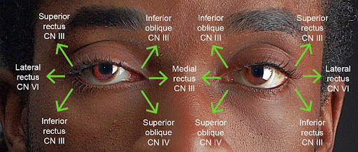
Eye muscles

Slide 88
Nerve | Eye Muscle
CN III Oculomotor | Superior rectus
 | Inferior rectus
 | Medial rectus
 | Inferior oblique
 | Iris (pupillary) sphincter
CN IV Trochlear | Superior oblique
CN VI Abducens | Lateral rectus
ANS sympathetic | Iris (pupillary) dilator

Slide 89
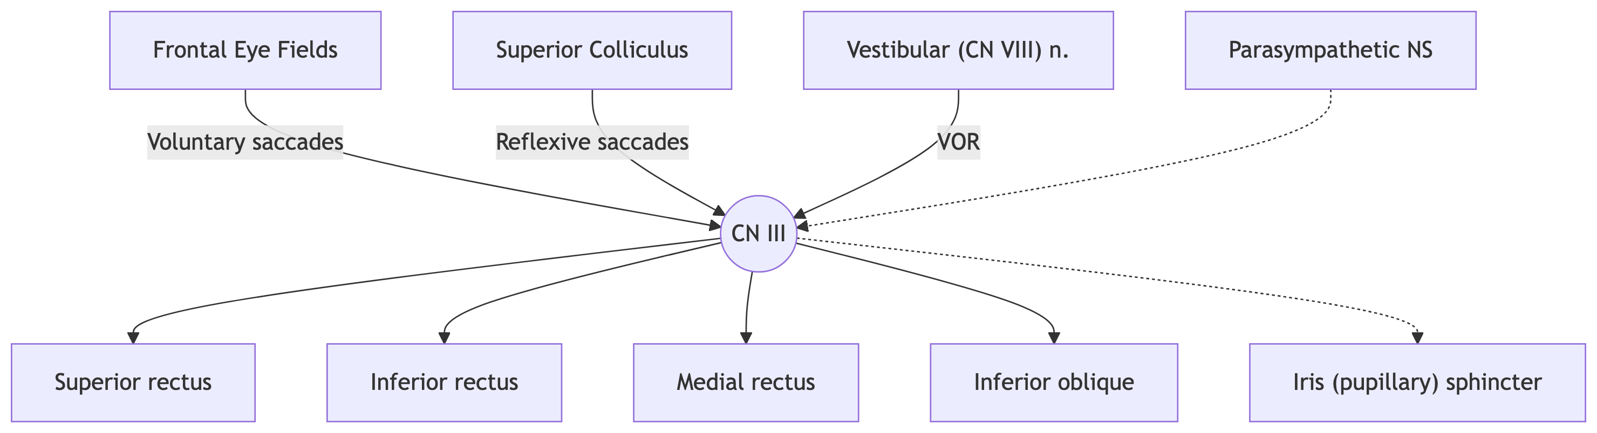
Inputs to CN III

Slide 90
Inputs to CN III.

Slide 91
Considerations
Sensory feedback
Move eyes $→$ shift visual field
Change vergence or lens thickness $→$ change image focus
Eye muscles (probably) have proprioceptors analogous to spindles in skeletal muscles

Slide 92
Considerations
Relatively simple physics:
Limited influence of gravity, friction
Small # of muscles $→$ “model” motor system?
DEMO: Illustration of “forward”/generative model/unconscious inference?
Predicting future/interpreting current sensory states
Converging inputs: voluntary and involuntary control

Slide 93
Locomotion: Goals
Keep balance
Control speed
Steer
Toward
Away
https://www.youtube.com/shorts/pxWIauT1WaM

Slide 94
Physics of balance
Body ~ inverted pendulum
Inherently unstable
Requires control
https://www.youtube.com/watch?v=Rh7JuL3PRSY
– Lab. (2022)

Slide 95
Keep Center of Mass (COM) within base of support
https://www.youtube.com/watch?v=5s1gEi5wfLg&t=11s
– Motion (2024)

Slide 96
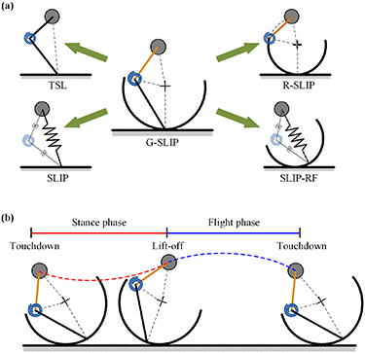
Locomotion: Physics
Rhythmic/periodic movement of limbs
Sequence of left/right leg flexions/extensions
arm swing
hips/trunk/neck movements
Legs, hips can be modeled as generalized spring-loaded inverted pendulum (G-SLIP)
Lu & Lin (2024)

Slide 97
Locomotion: Neural signalling
Central pattern generators (CPG) in spinal cord?
https://www.youtube.com/shorts/pxWIauT1WaM

Slide 98
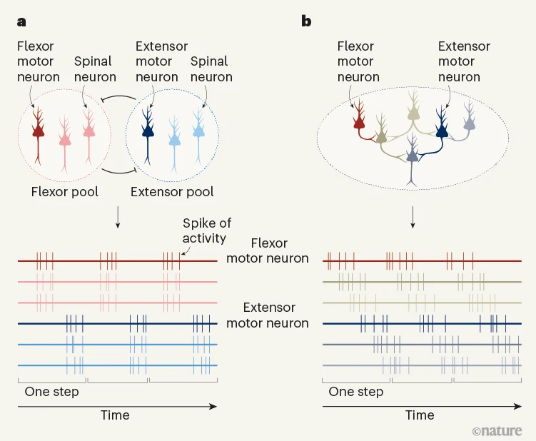
Or “rotational” patterns…
Bagnall (2022)

Slide 99
Reaching: Goals
Move hand (foot/mouth) to contact target
Avoid obstacles
Content

Slide 100
Speech: Goals
Involuntary vs. voluntary
Vocalizations types
Linguistic
Paralinguistic
Pitch, tone, rhythm, tempo, etc.
Non-linguistic

Slide 101
Components
Lips, tongue, mouth
Pharynx
Larynx
Lungs

Slide 102
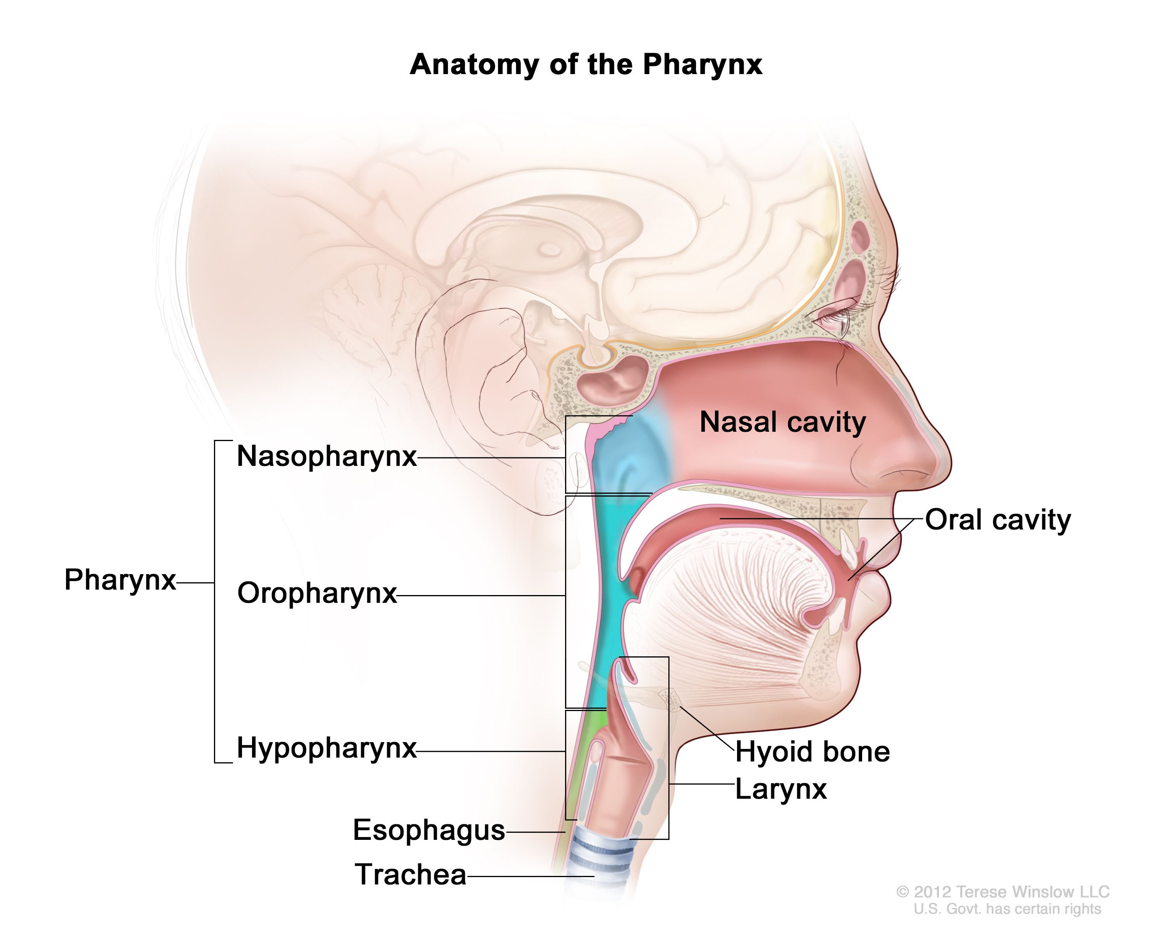
https://www.cancer.gov/publications/dictionaries/cancer-terms/def/pharynx

Slide 103
https://en.wikipedia.org/wiki/File:Real-time_MRI_-_Speaking_(English).ogv
– Wikipedia contributors (2026)

Slide 104
Consonants
Place and manner of articulation
Voicing
“B” vs. “P”
“D” vs. “T”
“G” vs. “K”
“Z” vs. “S”

Slide 105
By created by User:ish shwar (original .png deleted), .svg by Rohieb - sagittal section image based on Minifie et al. (1973:); articulation places are from Catford (1977), CC BY-SA 3.0, https://commons.wikimedia.org/w/index.php?curid=1771968

Slide 106
Simonyan et al. (2016) Figure 1

Slide 107
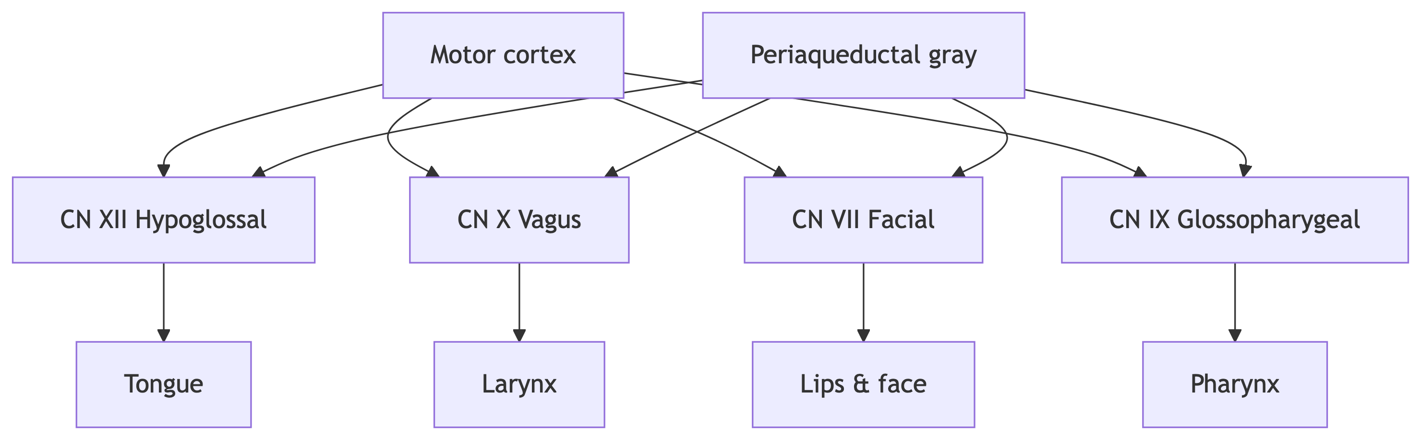

Slide 108
Inputs to cranial nerve nuclei involved in speech from cortex and midbrain.

Slide 109
Example
https://www.youtube.com/watch?v=4X4Fy8YqysY
– VideoCollectables (2014)

Slide 110
Considerations
Hierarchical, parallel control
Sensory feedback
Vocal muscle stretch receptors
Auditory
Vocal muscles like fingers
Large area of M1
Individuated control over

Slide 111
Simonyan et al. (2016) Figure 2

Slide 112
Illustrative motor systems: Interim summary
Many (most?) behaviors involve sequences of
looking/orienting + locomotion + reaching/manipulation + vocalization
Parallel, coordinated, sequential outputs to multiple motor systems
Direct (cerebral) cortical control over muscles of eyes, fingers, vocal apparatus
Feedback critical, often multisensory
NS exploits physics of body
By The original uploader was Davigoli at English Wikipedia. - Transferred from en.wikipedia to Commons., https://at.or.at/hans/solitude/, GPLv2, https://commons.wikimedia.org/w/index.php?curid=3939703
By The original uploader was Davigoli at English Wikipedia. - Transferred from en.wikipedia to Commons., https://at.or.at/hans/solitude/, GPLv2, https://commons.wikimedia.org/w/index.php?curid=3939703

Slide 113
Wrap-up

Slide 114
Main points

Slide 115
Next time
Perception

Slide 116
Resources

Slide 117
About
This talk was produced using Quarto, using the RStudio Integrated Development Environment (IDE), version 2026.1.0.392.
The source files are in R and R Markdown, then rendered to HTML using the revealJS framework. The HTML slides are hosted in a GitHub repo and served by GitHub pages: https://psu-psychology.github.io/psy-511-scan-fdns-2026-spring/

Slide 118
References
Bagnall, M. W. (2022). Neurons that control walking go round in circles. Nature, 610, 453–454. https://doi.org/10.1038/d41586-022-02238-1
Blumberg, M. S., & Adolph, K. E. (2023). Infant action and cognition: What’s at stake? Trends in Cognitive Sciences, 27(8), 696–698. https://doi.org/10.1016/j.tics.2023.05.008
Cantú, H., Nantel, J., Millán, M., Paquette, C., & Côté, J. N. (2019). Abnormal muscle activity and variability before, during, and after the occurrence of freezing in parkinson’s disease. Frontiers in Neurology, 10, 951. https://doi.org/10.3389/fneur.2019.00951
Cassidy, B. S., & Gutchess, A. H. (2012). Structural variation within the amygdala and ventromedial prefrontal cortex predicts memory for impressions in older adults. Frontiers in Psychology, 3, 319. https://doi.org/10.3389/fpsyg.2012.00319
Farnsworth, B. (2019, January 8). Eye movements explained: Understanding saccades, smooth pursuits, and fixations. Retrieved January 16, 2026, from https://imotions.com/blog/learning/best-practice/types-of-eye-movements/
Favela, L. H. (2020). Cognitive science as complexity science. Wiley Interdisciplinary Reviews. Cognitive Science, 11(4), e1525. https://doi.org/10.1002/wcs.1525
Lab., E. C. (2022). Triple inverted pendulum (transition control). YouTube. Retrieved from https://www.youtube.com/watch?v=Rh7JuL3PRSY
Lu, W.-C., & Lin, P.-C. (2024). The generalized spring-loaded inverted pendulum model for analysis of various planar reduced-order models and for optimal robot leg design. Bioinspiration & Biomimetics, 19, 026017. https://doi.org/10.1088/1748-3190/ad2869
Motion, M. A. (2024). Mastering balance: The science of center of gravity and base of support. Youtube. Retrieved from https://www.youtube.com/watch?v=5s1gEi5wfLg&t=11s
Nielsen, J. B. (2016). Human spinal motor control. Annual Review of Neuroscience, 39, 81–101. https://doi.org/10.1146/annurev-neuro-070815-013913
Quote origin: “To be is to do” “to do is to be” “do be do be do.” (n.d.). Retrieved January 12, 2026, from https://quoteinvestigator.com/2013/09/16/do-be-do/
Reviews, B. &. T. (2012). I like to move it (original video) madagascar HD. YouTube. Retrieved from https://www.youtube.com/watch?v=hdcTmpvDO0I
Simonyan, K., Ackermann, H., Chang, E. F., & Greenlee, J. D. (2016). New developments in understanding the complexity of human speech production. The Journal of Neuroscience: The Official Journal of the Society for Neuroscience, 36, 11440–11448. https://doi.org/10.1523/JNEUROSCI.2424-16.2016
Stanton, J. (2015). Optokinetic to the right for projection. YouTube. Retrieved from https://www.youtube.com/watch?v=CG5n516PCXM
VideoCollectables. (2014). World’s fastest talking man sings michael jackson’s BAD in 20 seconds @VideoScrapbookOfOurTimes. Youtube. Retrieved from https://www.youtube.com/watch?v=4X4Fy8YqysY
Wikipedia contributors. (2025a, August 30). Nerve conduction velocity. Retrieved from https://en.wikipedia.org/wiki/Nerve_conduction_velocity
Wikipedia contributors. (2025b, December 19). Saccade. Retrieved from https://en.wikipedia.org/wiki/Saccade
Wikipedia contributors. (2026, January 11). Articulatory phonetics. Retrieved from https://en.wikipedia.org/wiki/Articulatory_phonetics
Wolpert, D. (2011). Daniel wolpert: The real reason for brains. YouTube. Retrieved from https://www.youtube.com/watch?v=7s0CpRfyYp8
牛津基礎生物學O. M. B. (2021). Animation 16.3 knee jerk reflex. Youtube. Retrieved from https://www.youtube.com/watch?v=DJLmVSeZ5-c

