Slide 1
Foundations of Social, Cognitive, and Affective Neuroscience
PSY 511.001 Spr 2026

Slide 2
Overview

Slide 3
Prelude
https://www.youtube.com/embed/JB7jSFeVz1U
– melodysheep (2011)

Slide 4
If understanding everything we need to know about the brain is a mile, how far have we walked?
– National Geographic (2014)

Slide 5
Today’s topics
Why neuroscience psychology is harder than physics
Course overview
Does neuroscience need behavior? Does behavioral science need the brain?

Slide 6
Why psychology is harder than physics

Slide 7
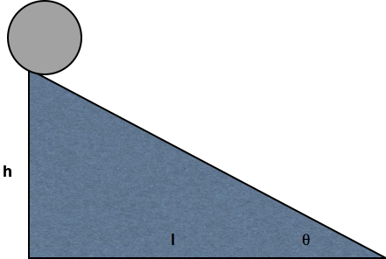

Slide 8
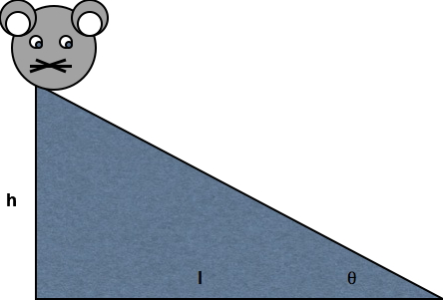

Slide 9
Physics perspective
Simplifying assumptions
Universal laws
Macro phenomena
Low dimensional state space

Slide 10
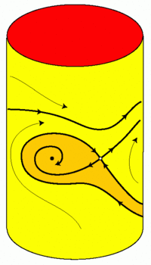
On state spaces…
State space is the set of all possible states of a dynamical system; each state of the system corresponds to a unique point in the state space. For example, the state of an idealized pendulum is uniquely defined by its angle and angular velocity…
– Terman & Izhikevich (2008)
Figure 1 from Terman & Izhikevich (2008)

Slide 11
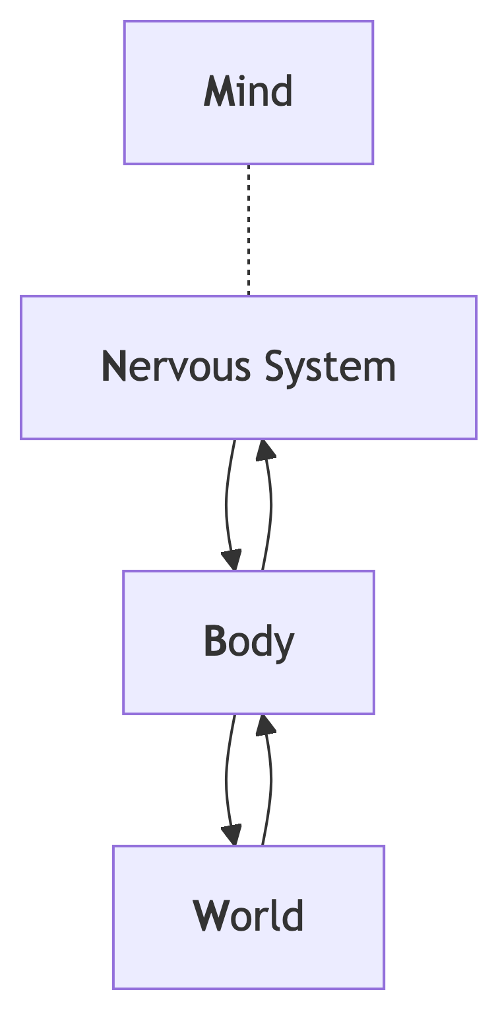
Psychological perspective
What is the state…
Of the world ($W$)?
Of the organism?
Body ($B$)
Nervous system ($N$)
Mind ($M$)
How do these states change over time?
What causes the changes?

Slide 12
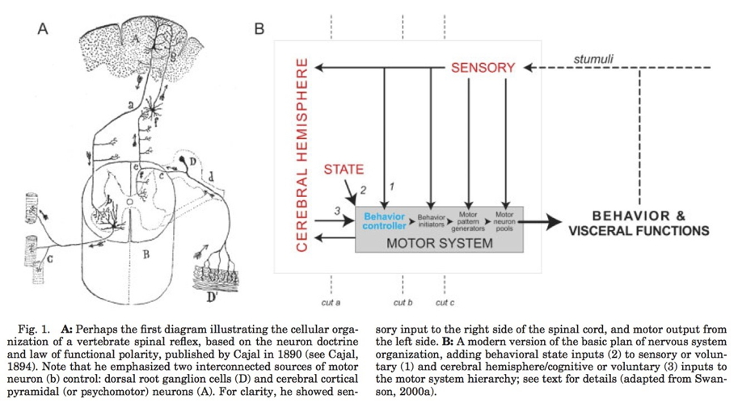
Swanson (2005) Figure 1

Slide 13
States high dimensional
~86 billion neurons
~100 trillion - 1 quadrillion synapses
?? # of motor units
600+ skeletal muscles; 300+ joints

Slide 14
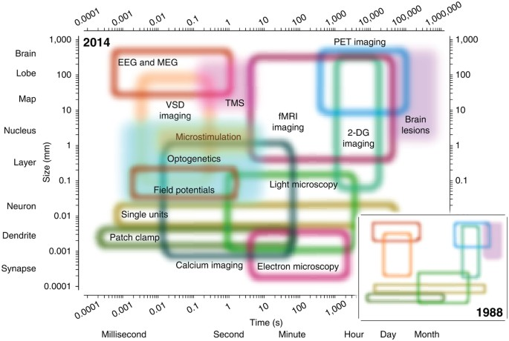
Sejnowski et al. (2014) Figure 1

Slide 15
Direct vs. indirect measurement
$W$, $B$, $N$ (more or less) directly
vs. $M$, measured indirectly
Via $N$, $B$, $W$
Your turn
Do you agree or disagree?
Does it matter?

Slide 16
Hard to simplify
Consider a spherical cow
Computation (and memory) often distributed
Single functions -> multiple parts
By Keenan Crane; (The source material is licensed under CC0), CC BY-SA 4.0

Slide 17
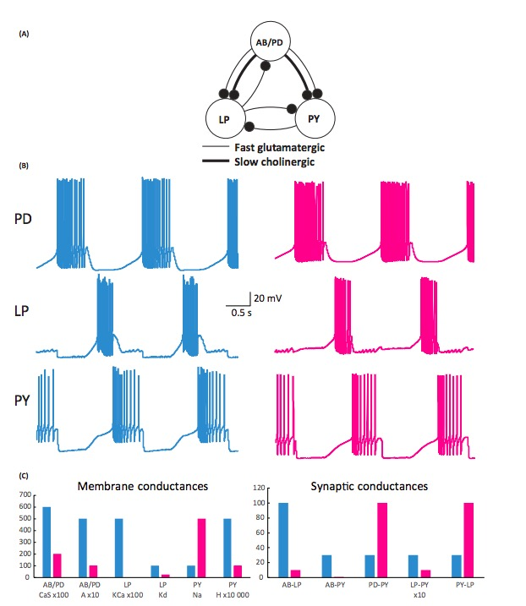
Single parts -> multiple functions
Many circuit wiring patterns yield similar dynamics
Wiring diagram (i.e., connectome) important, but not definitive
Calabrese (2018)

Slide 18
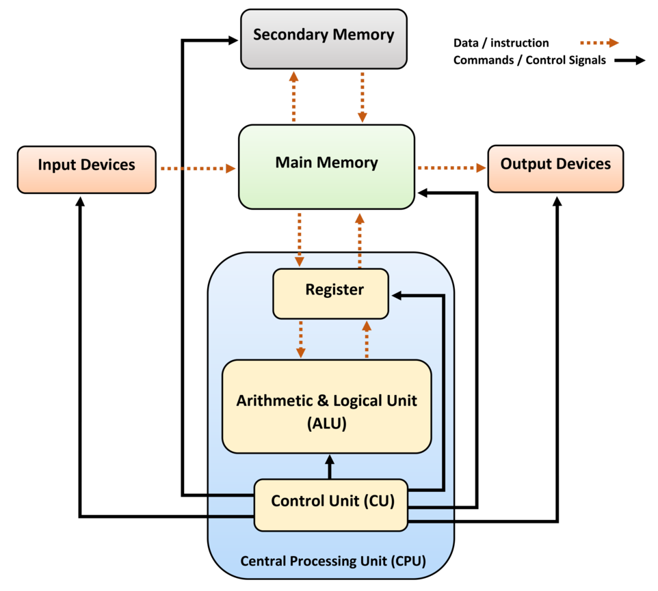
Biological systems not “designed”
…like human-engineered ones
https://en.wikipedia.org/wiki/Computer_architecture

Slide 19
Studying such systems is hard because…
Change structure/function over time
Hard to measure what is being exchanged, what is being controlled

Slide 20
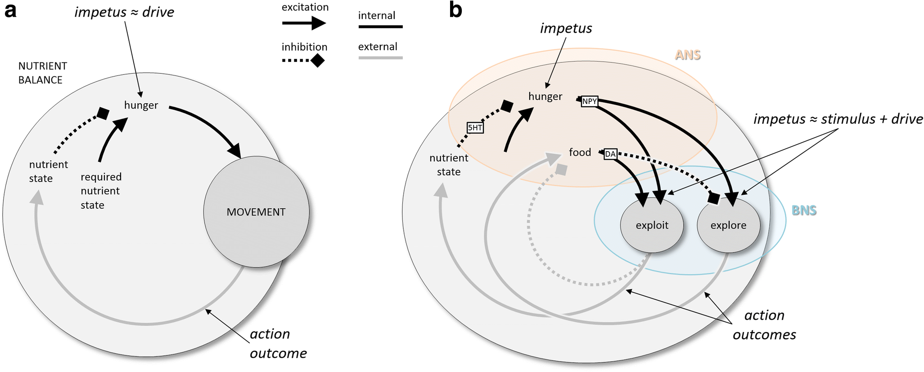
(Cisek, 2019, fig. 3). Schematic behavioral control systems. (A) When the current nutrient state deviates from a desired state, locomotion is initiated, ultimately bringing the animal to a more desirable state. (B) Elaboration of nutrient state control into a high-level controller (ANS) and a lower-level controller (BNS) capable of two modes of locomotion, local exploitation, and long-range exploration. 5HT, serotonin; ANS/BNS, apical/blastoporal nervous system; DA, dopamine; NPY, neuropeptide Y

Slide 21
Course overview

Slide 22
Goals
Master fundamentals of neuroscientific concepts and facts
Prepare to read primary source literature in social, behavioral, cognitive, affective, and clinical neuroscience

Slide 23
Structure
https://psu-psychology.github.io/psy-511-scan-fdns-2026-spring/

Slide 24
Questions
What is the basic organizational plan of the nervous system?
How does the nervous system undergird…
action
perception
emotion
learning & memory

Slide 25
Questions
What happens to the brain during sleep?
How does the nervous system develop? How has it evolved?
How do neurons work? How do they communicate?
How do disorders of the mind reveal themselves in the nervous system?

Slide 26
Approach
Biologically essential behaviors
Brain architecture (neuroanatomy)
Brain function (neurophysiology)
Brain communication (neurochemistry)
Changes over evolutionary and developmental time

Slide 27
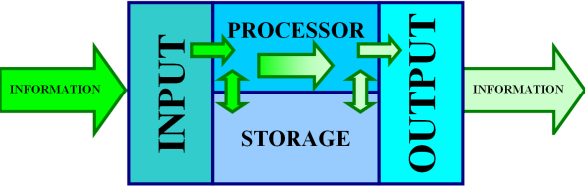
Approach
The nervous system as a mechanism
Specifically, an information processing system
Wikipedia

Slide 28
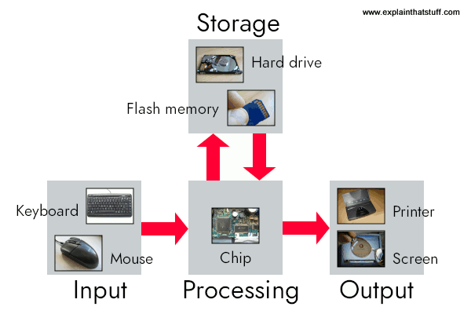
Mindful of limitations in brain/computer metaphors
https://www.explainthatstuff.com/howcomputerswork.html

Slide 29
Inputs
From environment, body, brain

Slide 30
Processing
Current inputs + brain state + body state + possible future states…
Stored information
Physiological & behavioral goals

Slide 31
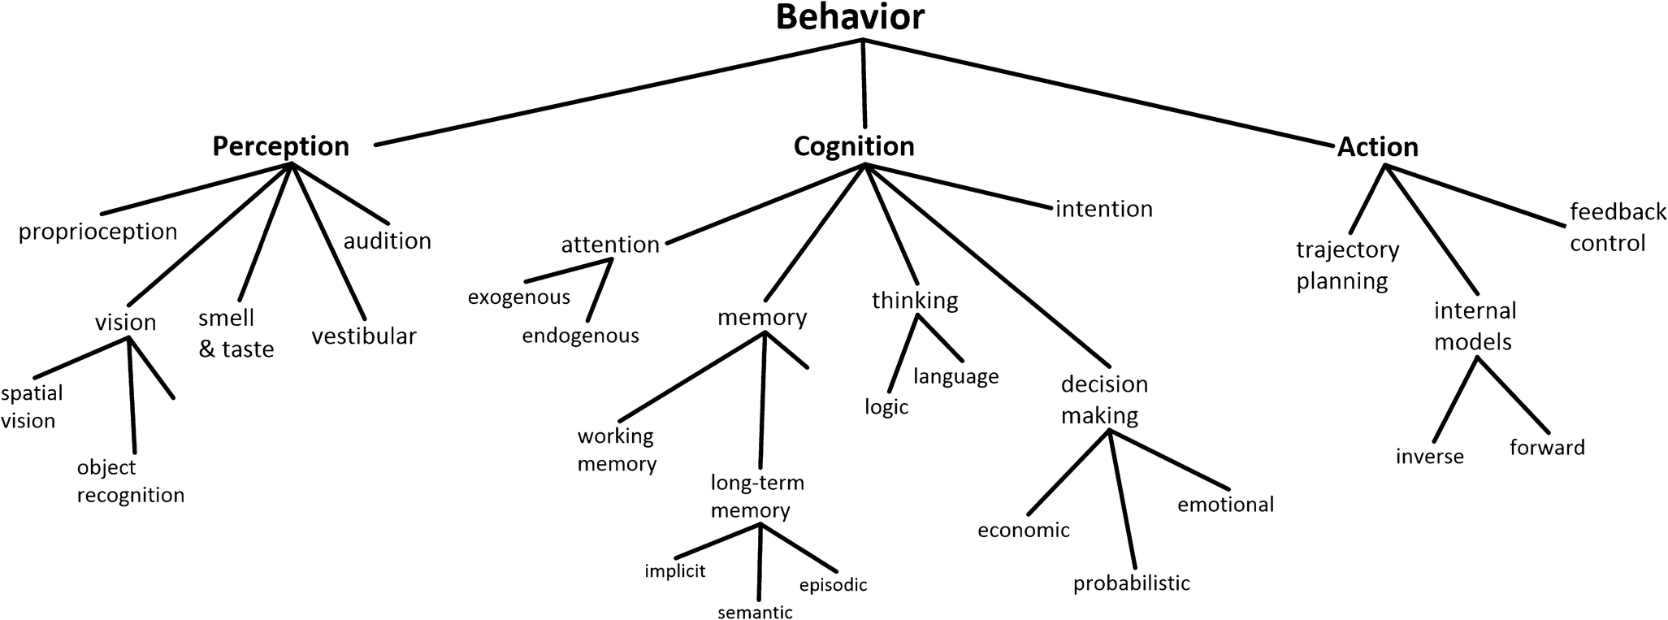
Cisek (2019) Figure 1

Slide 32
Outputs
To brain, body, environment

Slide 33
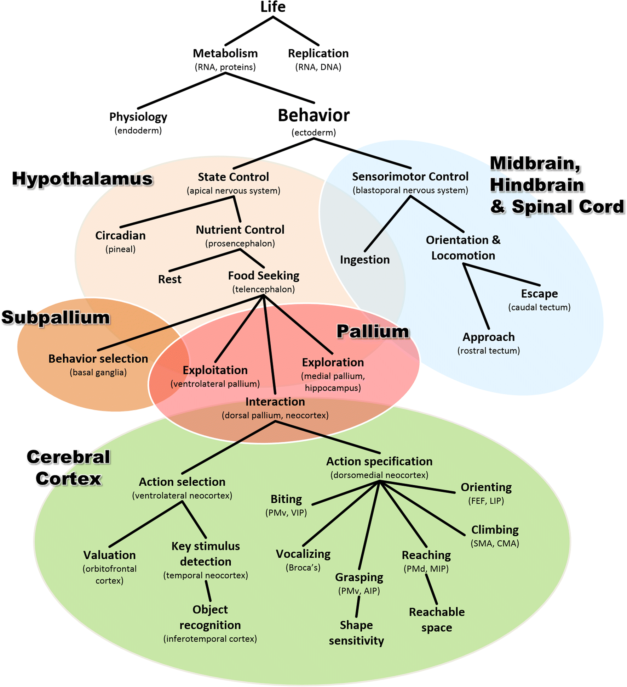
Mapping structures to functions…
Cisek (2019) Figure 8

Slide 34
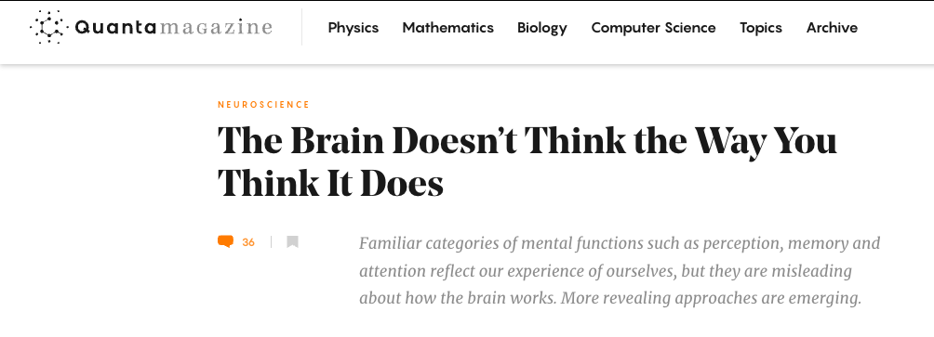
And vice versa?
Cepelewicz (2021)

Slide 35
The brainwide representation of behavioral variables suggests that information encoded nearly anywhere in the forebrain is combined with behavioral state variables into a mixed representation…Our data indicate that it happens as early as primary sensory cortex.
– Stringer et al. (2019)

Slide 36
Do we have the right “psychological” structures?
Psychological sciences have identified a wealth of cognitive processes and behavioral phenomena, yet struggle to produce cumulative knowledge…
– Eisenberg et al. (2019)

Slide 37
Progress is hamstrung by siloed scientific traditions and a focus on explanation over prediction…two issues that are particularly damaging for the study of multifaceted constructs like self-regulation…We conclude that self-regulation lacks coherence as a construct…
– Eisenberg et al. (2019)

Slide 38
How should behavior be defined?

Slide 39
How is behaviour defined?
Behavioural biology is a major discipline within biology, centred on the key concept of ‘behaviour’. But how is ‘behaviour’ defined, and how should it be defined? …
– Levitis, Lidicker, & Freund (2009)

Slide 40
We outline what characteristics we believe a scientific definition should have, and why we think it is important that a definition have these traits. We then examine the range of available published definitions for behaviour.
– Levitis et al. (2009)

Slide 41
Finding no consensus, we present survey responses from 174 members of three behaviour-focused scientific societies as to their understanding of the term. Here again, we find surprisingly widespread disagreement as to what qualifies as behaviour…
– Levitis et al. (2009)

Slide 42
Respondents contradict themselves, each other, and published definitions, indicating that they are using individually variable intuitive, rather than codified, meanings of `behaviour.’
– Levitis et al. (2009)

Slide 43
We offer a new definition, based largely on survey responses: “Behaviour is the internally coordinated responses (actions or inactions) of whole living organisms (individuals or groups) to internal and/or external stimuli, excluding responses more easily understood as developmental changes.”
– Levitis et al. (2009)

Slide 44
Levels of analysis
Sejnowski et al. (2014) Figure 1

Slide 45
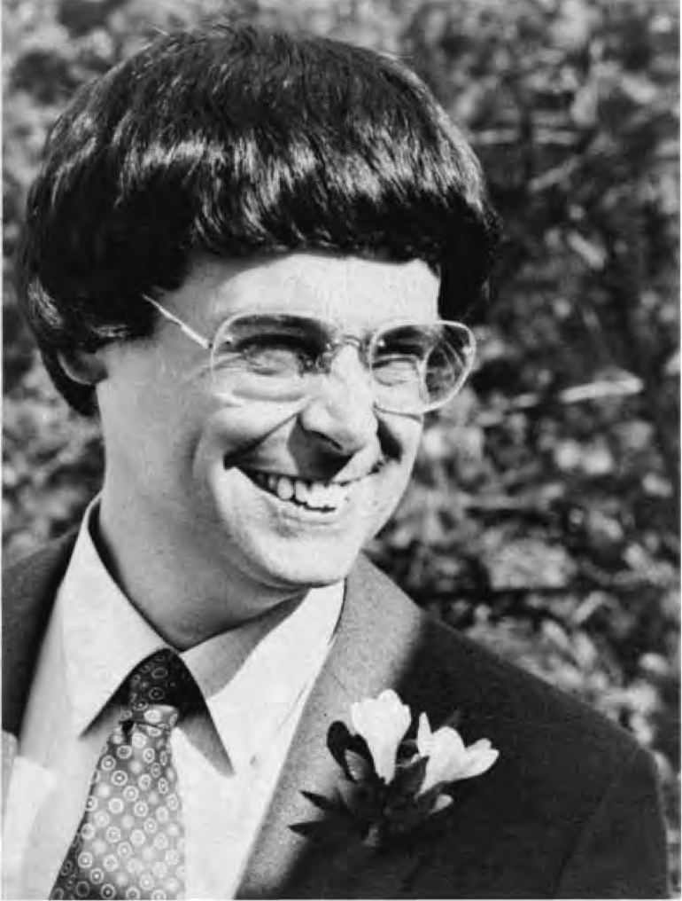

David Marr (1945-1980)
David Marr
Marr (1980)

Slide 46
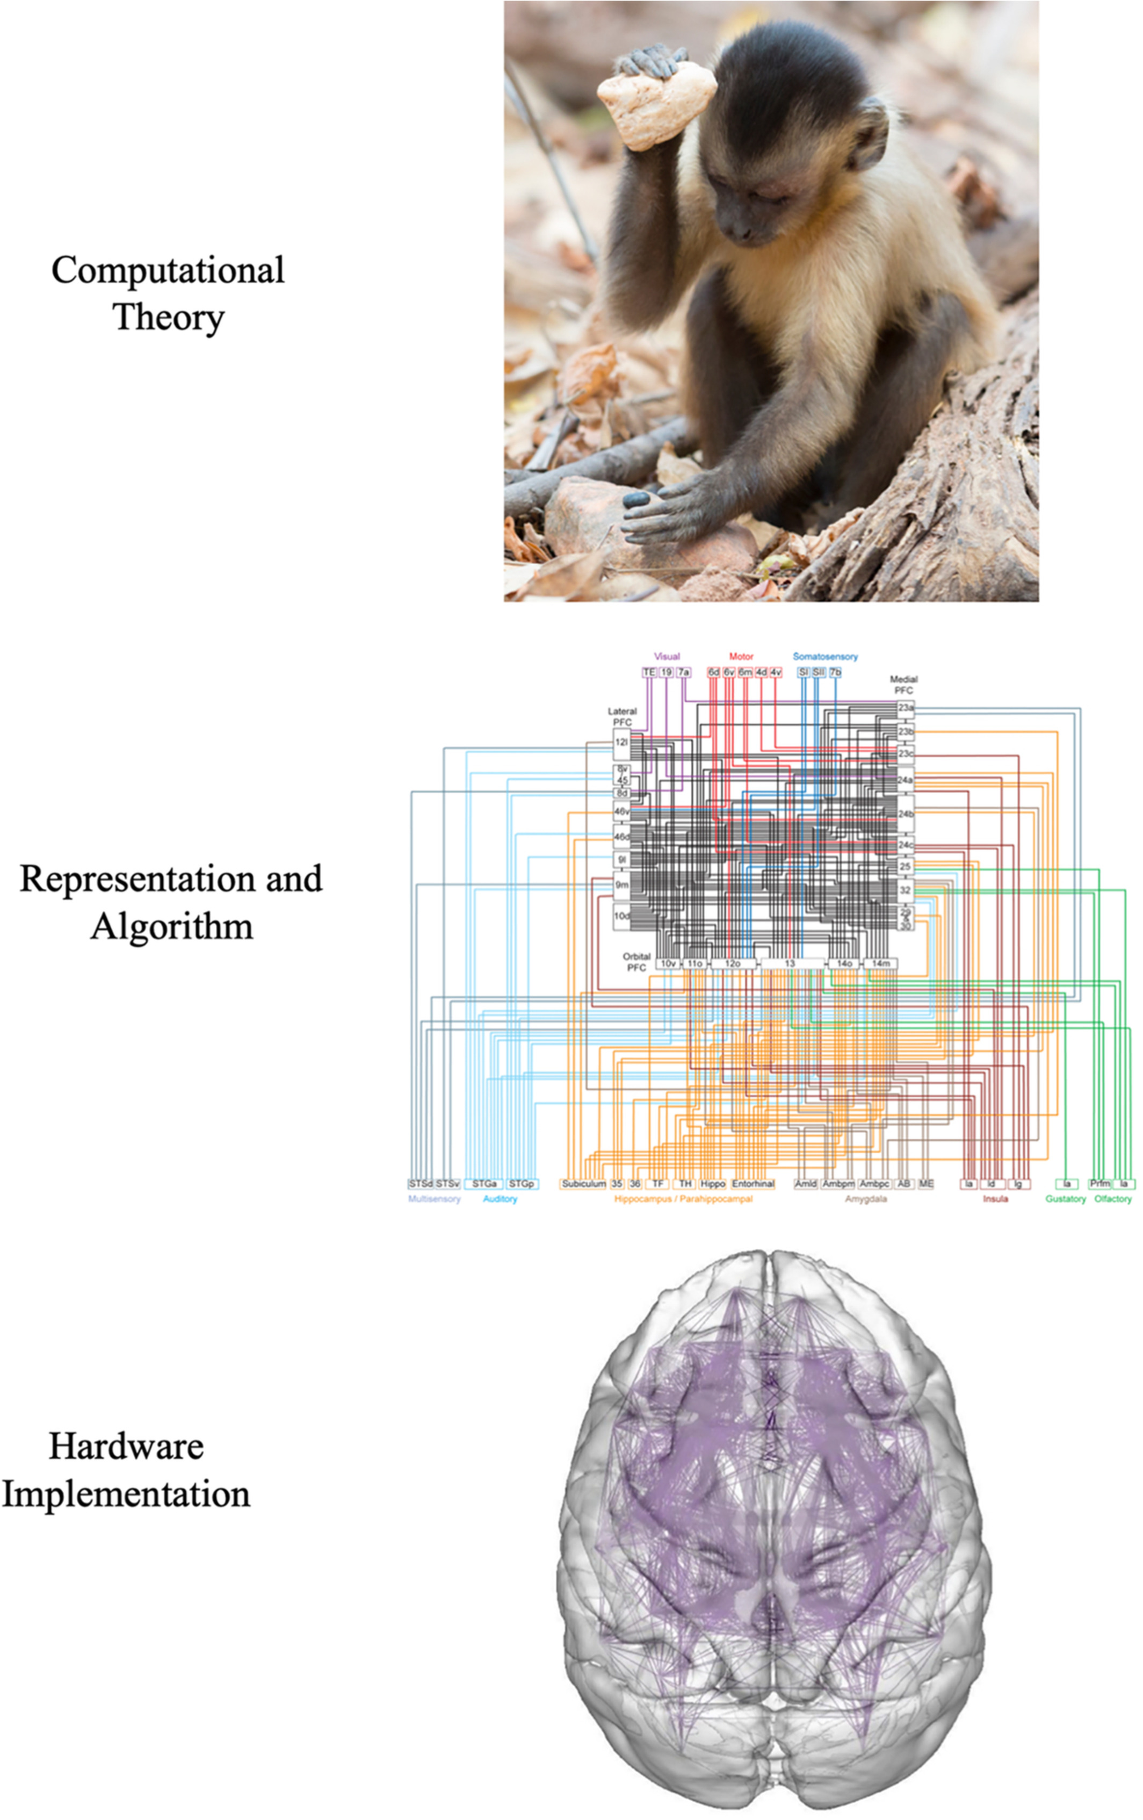
Marr’s Three Levels
Favela (2020) Figure 3

Slide 47
What must be computed to carry out task X?
What algorithm is used to carry out the computation?
What hardware implements the algorithm?

Slide 48
Computational level
What has to be computed?
What is the shape/form of that unknown object?
What did that person just say?
Is that unknown object a threat to me?

Slide 49
Algorithmic level
What’s the ‘recipe’ or sequence of operations for…
computing shape
perceiving speech
recognizing threats

Slide 50
Implementation level
How do…
neurons
areas
networks
implement the recipe?

Slide 51
Causality in neuroscience
Siddiqi, Kording, Parvizi, & Fox (2022)
Stimulation & lesion studies needed for inferring causation.
Bradford-Hill criteria (Hill, 2015)

Slide 52
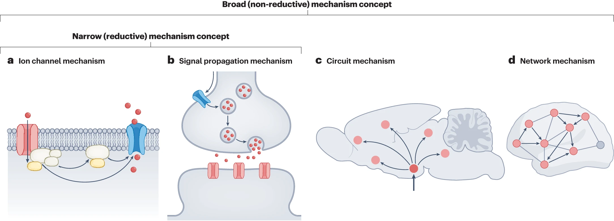
Varied notions of mechanism
Fig. 1: The narrow and broad notions of mechanism from Ross & Bassett (2024)

Slide 53
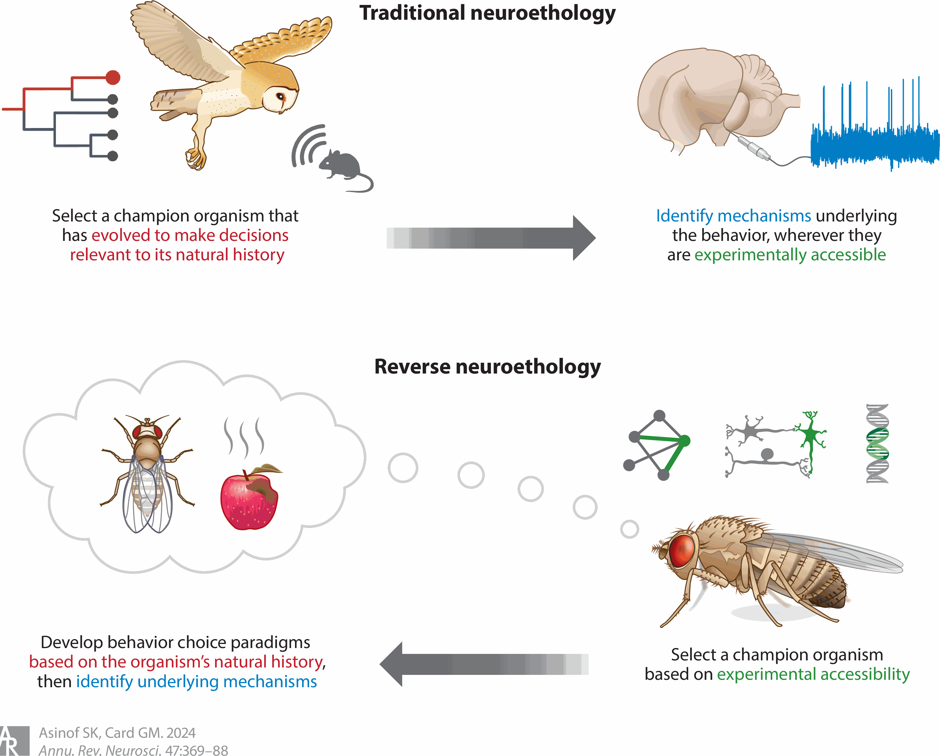
Toward reverse neuroethology
Figure 1 from Asinof & Card (2024)

Slide 54
…when faced with a difficult question, we often answer an easier one instead, usually without noticing the substitution.
– Kahneman (2013), p. 12 quoted in Krakauer, Ghazanfar, Gomez-Marin, MacIver, & Poeppel (2017)

Slide 55
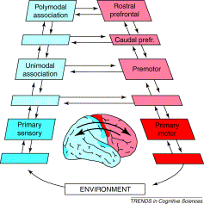
There and back again
The perception action-cycle
Fuster (2004) Figure 2

Slide 56
Another example…

Slide 57
From computer screen to cortex.
Pathways to move the finger.
Feedback from finger muscle.

Slide 58
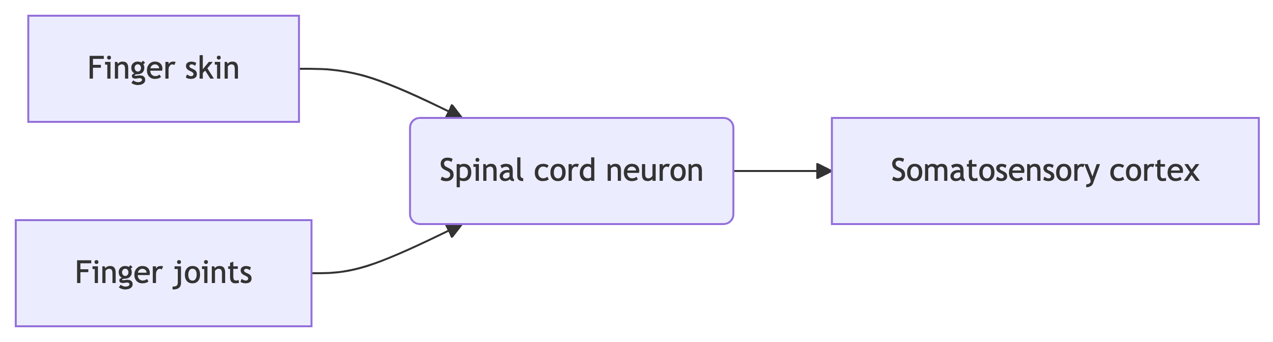

Slide 59
Other sources of sensory information from the finger.

Slide 60
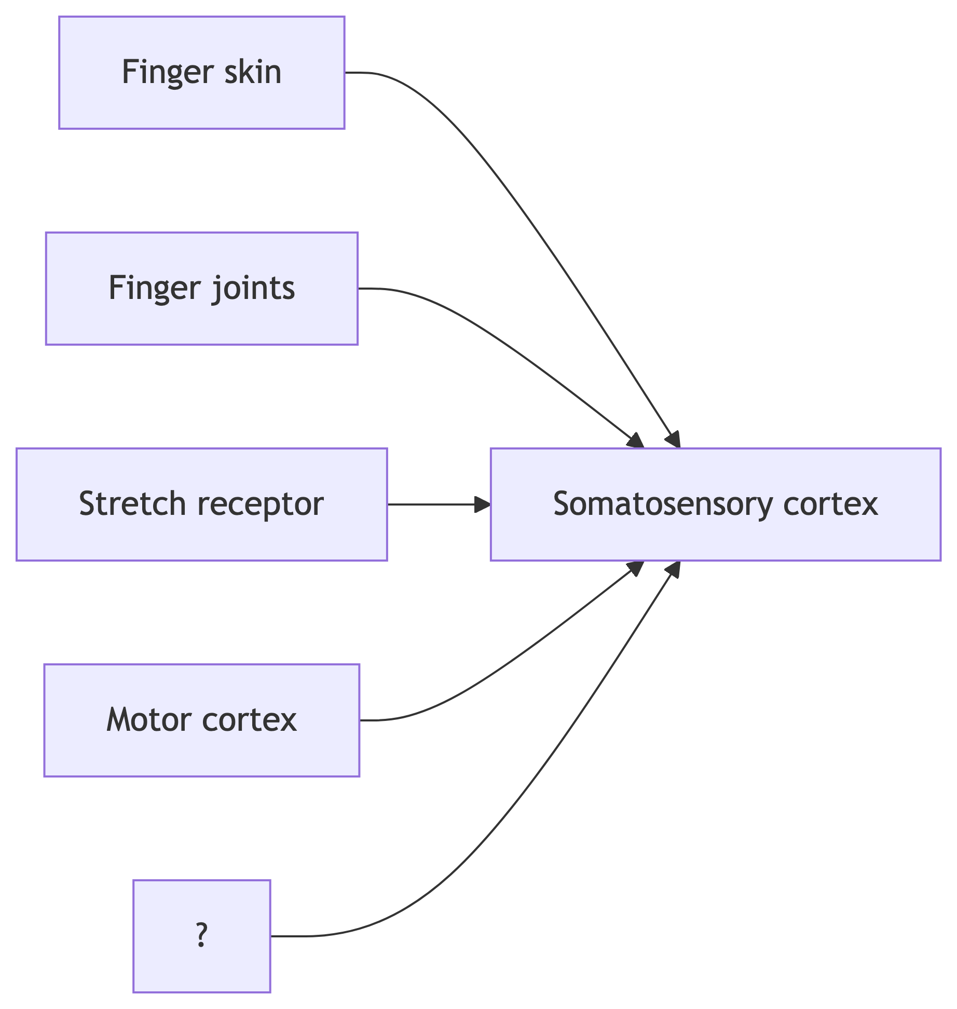

Slide 61
Inputs to primary somatosensory cortex.

Slide 62
Break

Slide 63
Your turn

Slide 64
Does neuroscience need behavior?
Krakauer, J. W., Ghazanfar, A. A., Gomez-Marin, A., MacIver, M. A., & Poeppel, D. (2017). Neuroscience needs behavior: Correcting a reductionist bias. Neuron, 93(3), 480–490. https://dx.doi.org/10.1016/j.neuron.2016.12.041.
Parada, F. J. & Rossi, A. (2018). If neuroscience needs behavior, what does psychology need? Frontiers in Psychology, 9, 433. https://doi.org/10.3389/fpsyg.2018.00433.

Slide 65
Newcombe, N. (2017). If neuroscience needs behavior, what does behavioral science need? APS Observer, 31(1). https://www.psychologicalscience.org/observer/if-neuroscience-needs-behavior-what-does-behavioral-science-need

Slide 66
Key points
Questions ‘often tacit…belief in the reductionist program for understanding the link between brain and behavior’
Behavior -> understanding; neural interventions -> causality
Marr’s 3 levels (computation; algorithm; implementation)

Slide 67
But what is behavior?

Slide 68
“Behavioural biologists don’t agree on what constitutes behaviour”
Behaviour is the internally coordinated responses (actions or inactions) of whole living organisms (individuals or groups) to internal and/or external stimuli, excluding responses more easily understood as developmental changes.
– Levitis et al. (2009)

Slide 69
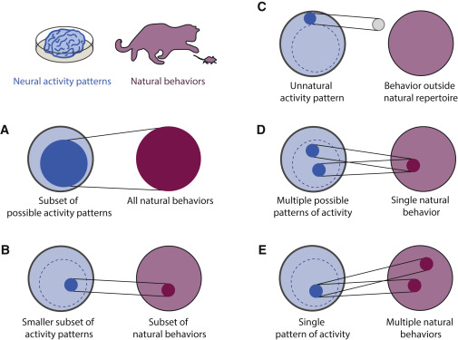
Krakauer et al. (2017) Figure 1

Slide 70
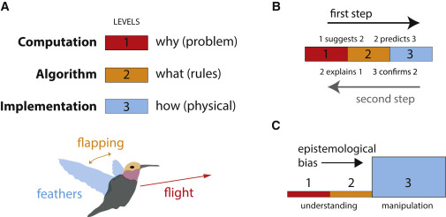
Krakauer et al. (2017) Figure 2

Slide 71
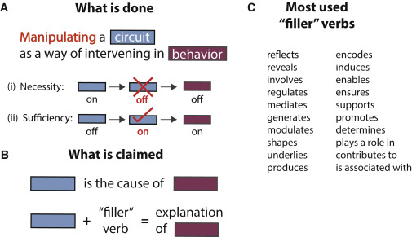
Krakauer et al. (2017) Figure 3

Slide 72
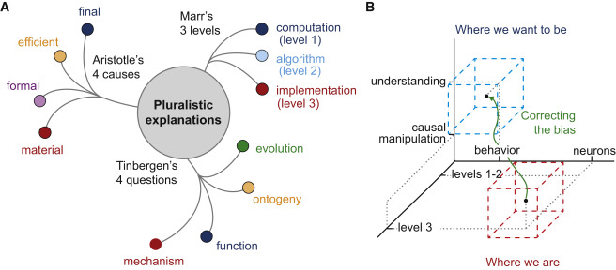
Krakauer et al. (2017) Figure 4

Slide 73
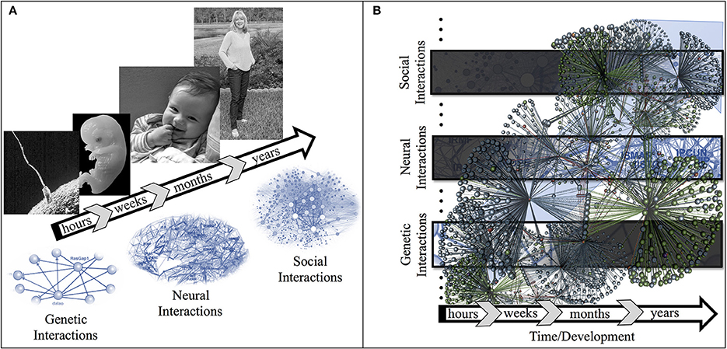
Parada & Rossi (2018) Figure 1

Slide 74
Exercise LVL
Due next Thursday

Slide 75
Main points
Psychology is harder than physics
Neuroscience needs behavior
Psychology needs behavior + mental states + measures of environment

Slide 76
Next time…
Neuroanatomy lab
Read/study
Neuroanatomy notes
Bring to class a copy of Exercise ANAT | docx | pdf |

Slide 77
Resources

Slide 78
References
Asinof, S. K., & Card, G. M. (2024). Neural control of naturalistic behavior choices. Annual Review of Neuroscience, 47, 369–388. https://doi.org/10.1146/annurev-neuro-111020-094019
Calabrese, R. L. (2018). Inconvenient truth to principle of neuroscience. Trends in Neurosciences, 41(8), 488–491. https://doi.org/10.1016/j.tins.2018.05.006
Cepelewicz, J. (2021, August). Mental phenomena don’t map into the brain as expected. https://www.quantamagazine.org/mental-phenomena-dont-map-into-the-brain-as-expected-20210824/. Retrieved from https://www.quantamagazine.org/mental-phenomena-dont-map-into-the-brain-as-expected-20210824/
Cisek, P. (2019). Resynthesizing behavior through phylogenetic refinement. Attention, Perception & Psychophysics. https://doi.org/10.3758/s13414-019-01760-1
Eisenberg, I. W., Bissett, P. G., Zeynep Enkavi, A., Li, J., MacKinnon, D. P., Marsch, L. A., & Poldrack, R. A. (2019). Uncovering the structure of self-regulation through data-driven ontology discovery. Nature Communications, 10(1), 2319. https://doi.org/10.1038/s41467-019-10301-1
Favela, L. H. (2020). Cognitive science as complexity science. Wiley Interdisciplinary Reviews. Cognitive Science, 11(4), e1525. https://doi.org/10.1002/wcs.1525
Fuster, J. M. (2004). Upper processing stages of the perception-action cycle. Trends in Cognitive Sciences, 8, 143–145. https://doi.org/10.1016/j.tics.2004.02.004
Hill, A. B. (2015). The environment and disease: Association or causation? 1965. Journal of the Royal Society of Medicine, 108(1), 32–37. https://doi.org/10.1177/0141076814562718
Kahneman, D. (2013). Thinking, fast and slow (1st edition). Farrar, Straus; Giroux. Retrieved from https://www.amazon.com/Thinking-Fast-Slow-Daniel-Kahneman/dp/0374533555
Krakauer, J. W., Ghazanfar, A. A., Gomez-Marin, A., MacIver, M. A., & Poeppel, D. (2017). Neuroscience needs behavior: Correcting a reductionist bias. Neuron, 93(3), 480–490. https://doi.org/10.1016/j.neuron.2016.12.041
Levitis, D. A., Lidicker, W. Z., & Freund, G. (2009). Behavioural biologists don’t agree on what constitutes behaviour. Animal Behaviour, 78(1), 103–110. https://doi.org/10.1016/j.anbehav.2009.03.018
Marr, D. (1980). Vision. Retrieved from https://mitpress.mit.edu/books/vision
melodysheep. (2011, March). Ode to the brain! By symphony of science. Youtube. Retrieved from https://www.youtube.com/watch?v=JB7jSFeVz1U
National Geographic. (2014, January). Beautiful 3-D brain scans show every synapse | national geographic. YouTube. Retrieved from https://www.youtube.com/watch?v=nvXuq9jRWKE
Parada, F. J., & Rossi, A. (2018). If neuroscience needs behavior, what does psychology need? Frontiers in Psychology, 9, 433. https://doi.org/10.3389/fpsyg.2018.00433
Ross, L. N., & Bassett, D. S. (2024). Causation in neuroscience: Keeping mechanism meaningful. Nature Reviews. Neuroscience. https://doi.org/10.1038/s41583-023-00778-7
Sejnowski, T. J., Churchland, P. S., & Movshon, J. A. (2014). Putting big data to good use in neuroscience. Nat. Neurosci., 17(11), 1440–1441. https://doi.org/10.1038/nn.3839
Siddiqi, S. H., Kording, K. P., Parvizi, J., & Fox, M. D. (2022). Causal mapping of human brain function. Nature Reviews Neuroscience, 23(6), 361–375. https://doi.org/10.1038/s41583-022-00583-8
Stringer, C., Pachitariu, M., Steinmetz, N., Reddy, C. B., Carandini, M., & Harris, K. D. (2019). Spontaneous behaviors drive multidimensional, brainwide activity. Science, 364(6437), 255. https://doi.org/10.1126/science.aav7893
Swanson, L. W. (2005). Anatomy of the soul as reflected in the cerebral hemispheres: Neural circuits underlying voluntary control of basic motivated behaviors. Journal of Comparative Neurology, 493(1), 122–131. https://doi.org/10.1002/cne.20733
Terman, D., & Izhikevich, E. (2008). State space. Scholarpedia Journal, 3, 1924. https://doi.org/10.4249/scholarpedia.1924

