Slide 1
Neuroanatomy
PSY 511.001 Spr 2026

Slide 2
Prelude

Slide 3
https://www.youtube.com/embed/snO68aJTOpM
– ctdalilah (2006)

Slide 4
https://www.youtube.com/embed/Qw8E9WnZTQk
– Kids Learning Tube (2015)

Slide 5
Announcements
Exercise LVL due today.
Canvas dropbox
Exercise ANAT due next Thursday, January 29, 2026.
Canvas dropbox

Slide 6
Today’s topics
Neuroanatomy
In-class lab
Exercise ANAT

Slide 7
Neuroanatomy

Slide 8
Why study?
Master basic vocabulary for reading literature

Slide 9
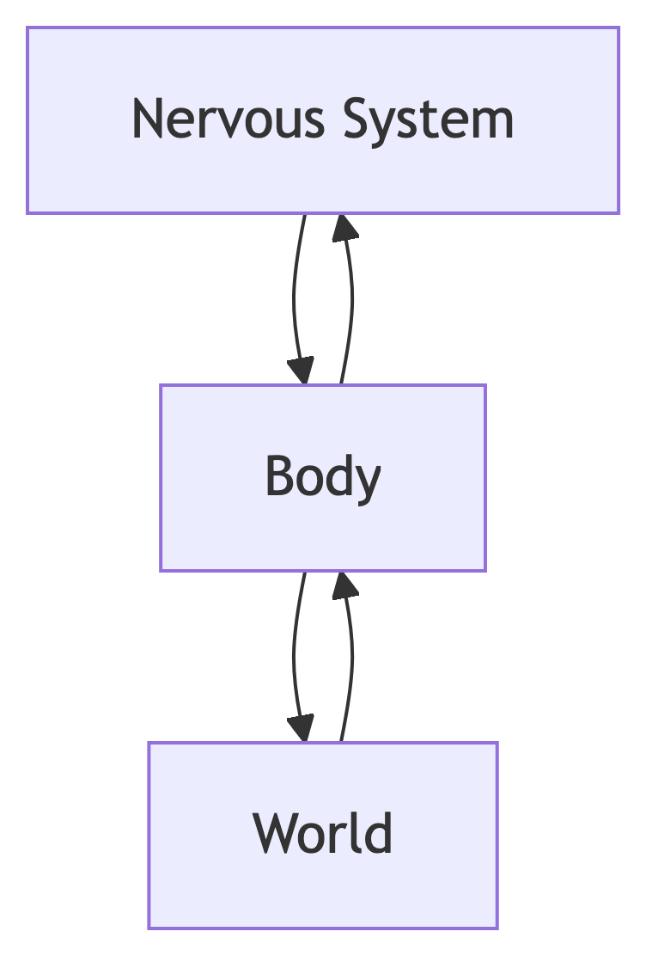
Computational perspective
Inputs from
World
Body
Nervous system

Slide 10
What computations occur where?

Slide 11
Functional anatomy perspective
Located where
Connected to
Involved in

Slide 12
Brain anatomy through dance
Your browser does not support the audio tag.

Slide 13
Terms
Anterior/Posterior
Medial/Lateral
Superior/Inferior
Dorsal/Ventral
Rostral/Caudal

Slide 14
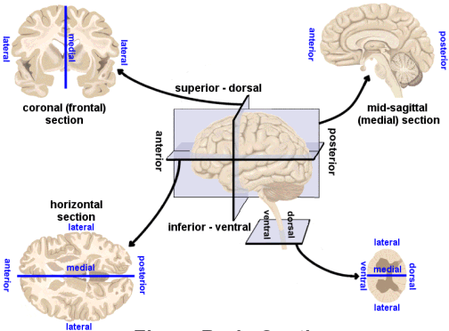
Planes of section
Planes of section from http://www.scienceteacherprogram.org/

Slide 15
Nervous system
Central Nervous System (CNS)
Encased in bone
Brain
Spinal cord
Peripheral Nervous System (PNS)

Slide 16
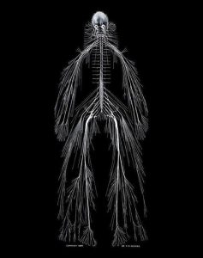
Nervous system of Harriet Cole, see McNaughton (2018)
By Own work, CC BY 3.0, https://commons.wikimedia.org/w/index.php?curid=10187018

Slide 17
CNS Organization
Major division | Ventricular Landmark | Embryonic Division | Structure
Forebrain | Lateral | Telencephalon | Cerebral cortex
 |  |  | Basal ganglia
 |  |  | Hippocampus, amygdala

Slide 18
Major division | Ventricular Landmark | Embryonic Division | Structure
 | Third | Diencephalon | Thalamus
 |  |  | Hypothalamus

Slide 19
Major division | Ventricular Landmark | Embryonic Division | Structure
Midbrain | Cerebral Aqueduct | Mesencephalon | Tectum, tegmentum

Slide 20
Major division | Ventricular Landmark | Embryonic Division | Structure
Hindbrain | 4th | Metencephalon | Cerebellum, pons
 | – | Mylencephalon | Medulla oblongata

Slide 21
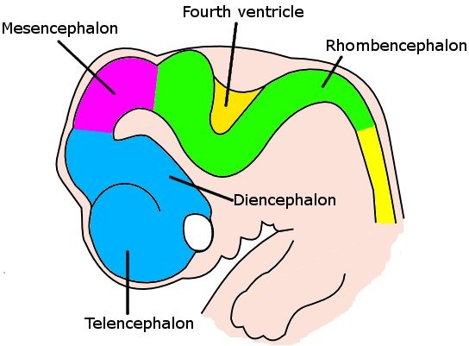
Embryonic human brain from Wikipedia
Cross section of embryonic brain from Wikipedia

Slide 22
Forebrain, midbrain, hindbrain terminology derives from embryonic stages in CNS development.

Slide 23
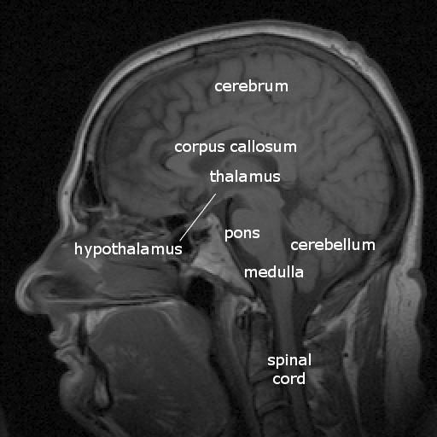
Cerebrum
(Cerebral) cortex
Subcortical (below the cortex) structures
Labelled MRI including thalamus and hypothalamus

Slide 24
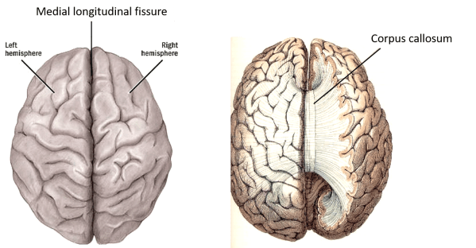
Cerebral Cortex: Landmarks
Cerebral hemispheres
Bumps
Gyrus or gyri
Grooves
Sulcus or sulci: shallow
Fissure: deep
Medial longitudinal fissure
Corpus callosum
From www.anatomyqa.com

Slide 25
Cerebral cortex: Lobes
Lateral (sagittal) view
Lobes
Frontal
Temporal
Parietal
Occipital
By Sebastian023, CC BY-SA 3.0, https://commons.wikimedia.org/w/index.php?curid=21020857

Slide 26
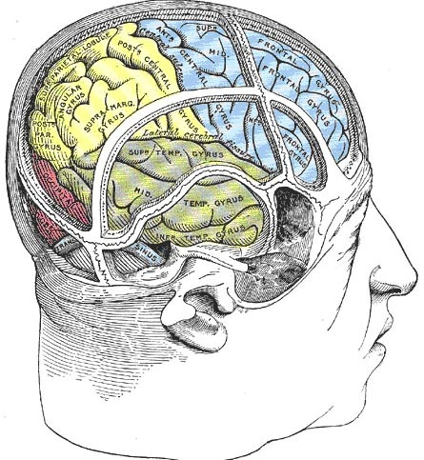
Cerebral cortex: Lobes
Bones of the skull from Wikipedia
Alternative view of the relationship between bones of the skull and lobes of the cerebral cortex

Slide 27
Cerebral cortex: Lobes
Frontal: Motor cortex (M1)
Temporal: Auditory cortex (A1)
Parietal: Somatosensory cortex (S1)
Occipital: Visual cortex (V1)
Insula: Gustatory
By Sebastian023, CC BY-SA 3.0, https://commons.wikimedia.org/w/index.php?curid=21020857

Slide 28
Cerebral cortex: M1
By Cortex sensorimoteur1.jpg: Pancratderivative work: Iamozy - Own work, This file was derived from: Cortex sensorimoteur1.jpg:, CC BY-SA 3.0, https://commons.wikimedia.org/w/index.php?curid=33981076

Slide 29
Cerebral cortex: A1
By Chittka L, Brockmann - Perception Space—The Final Frontier, A PLoS Biology Vol. 3, No. 4, e137 doi:10.1371/journal.pbio.0030137 ([1]/[2]), vectorised by Inductiveload, CC BY-SA 2.5, https://commons.wikimedia.org/w/index.php?curid=5958918

Slide 30
Cerebral cortex: S1
By Jimhutchins (talk) - The original image was uploaded on en.wikipedia as en:Image:Postcentral_gyrus.png, CC BY-SA 3.0, https://commons.wikimedia.org/w/index.php?curid=4481990

Slide 31
Cerebral cortex: V1
By Brodmann - File:Brodmann_Cytoarchitectonics.PNG, Public Domain, https://commons.wikimedia.org/w/index.php?curid=8221432

Slide 32
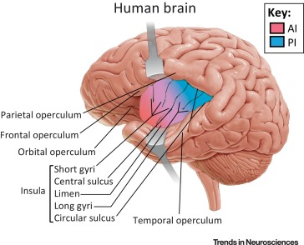
Cerebral cortex: Insula
Primary gustatory cortex
Self-awareness, interpersonal experiences, motor control, interoception
Namkung et al. (2017) Figure 1

Slide 33
Cerebral cortex: Brodmann areas
Korbinian Brodmann
Cytoarchitecture
Examples
BA 41 & 42: audition; BA 44 & 45: Broca’s area
BA 17, 18: vision
Brodmann areas

Slide 34
Cerebrum: Subcortical
Basal ganglia
Hippocampus
Amygdala

Slide 35
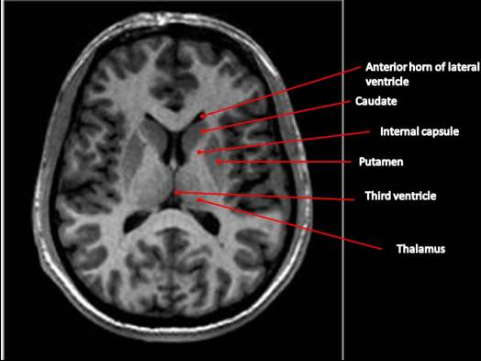
Basal ganglia
Striatum
Caudate nucleus
Putamen
Globus pallidus
Subthalamic nucleus
Substantia nigra (tegmentum)
MRI of the basal ganglia

Slide 36
Basal ganglia
https://upload.wikimedia.org/wikipedia/commons/8/8c/Cortical_surface_with_an_overlay_of_the_basal_ganglia_and_thalamus.jpg

Slide 37
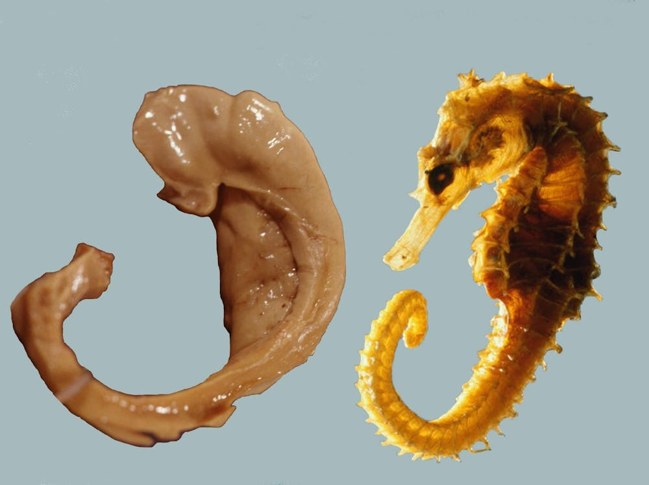
Hippocampus
Hippocampus means “sea horse”
Fornix (axon fiber bundle) projects to (mammillary bodies of) hypothalamus
Hippocampus and Sea Horse

Slide 38
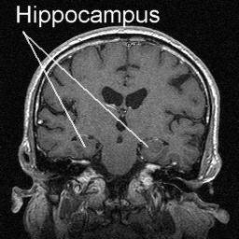
Hippocampus
Initial storage of memories for specific facts (semantic memory) or events (episodic memory)
Place memory in non-human animals (& humans?)
MRI of hippocampus

Slide 39
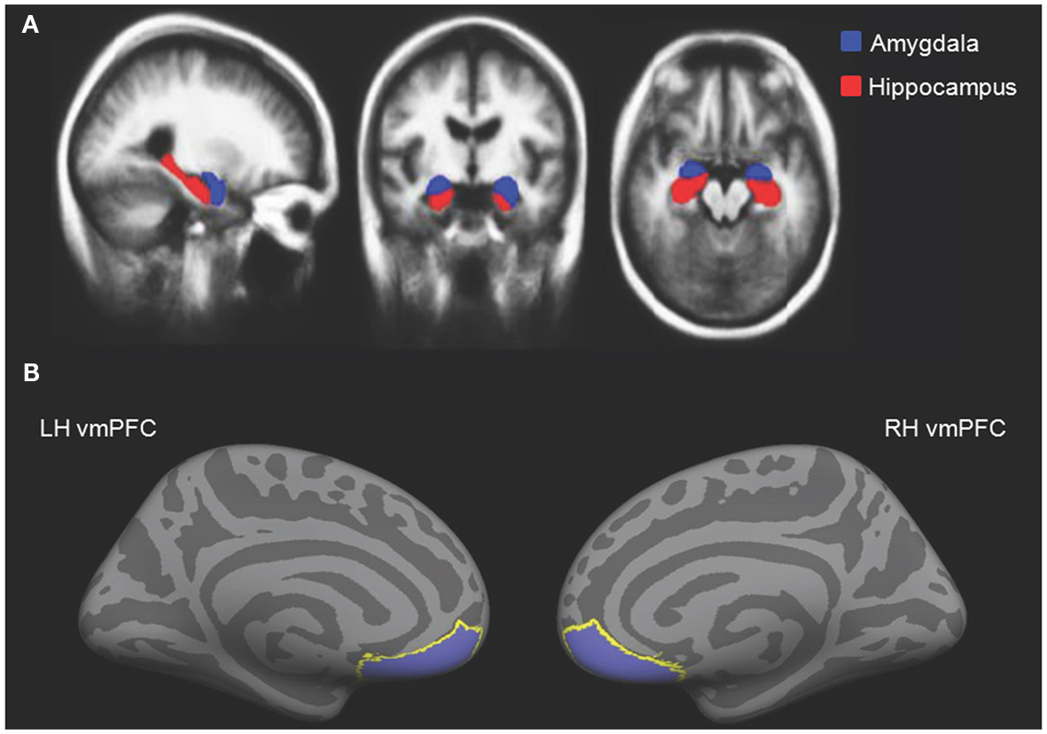
Amygdala
Physiological state, behavioral readiness, affect
NOT the fear center! (LeDoux, 2015).
Projection to hypothalamus
Cassidy2012-ue Figure 2

Slide 40
Major division | Ventricular Landmark | Embryonic Division | Structure
 | Third | Diencephalon | Thalamus
 |  |  | Hypothalamus

Slide 41
Diencephalon
Thalamus
Hypothalamus
Diencephalon from Wikipedia

Slide 42
Thalamus
Input to cortex
Functionally distinct nuclei
Lateral geniculate nucleus (LGN), vision
Medial geniculate nucleus (MGN), audition
Pulvinar, attention?
Nuclei of the thalamus

Slide 43
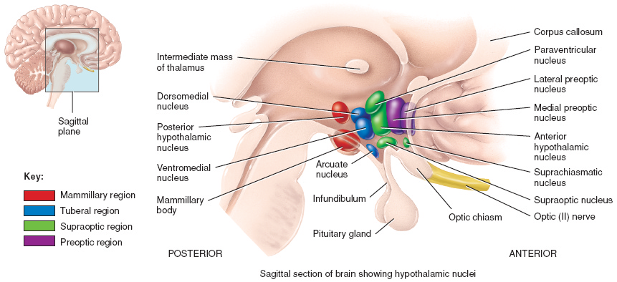
Hypothalamus
Nuclei of the hypothalamus

Slide 44
Hypothalamus
Five Fs:
Fighting/fleeing/freezing
Feeding
Reproduction

Slide 45
Hypothalamus
Controls pituitary gland (“master” gland)
Anterior pituitary (indirect release of hormones)
e.g., Corticotropin Releasing Hormone (CRH) -> release of cortisol from Adrenal Cortex (adjacent to kidney)
Posterior pituitary (direct release of hormones)
Oxytocin
Vasopressin (aka, Arginine Vasopressin – AVP; Anti-diuretic Hormone – ADH)

Slide 46
Major division | Ventricular Landmark | Embryonic Division | Structure
Midbrain | Cerebral Aqueduct | Mesencephalon | Tectum, tegmentum
Hindbrain | 4th | Metencephalon | Cerebellum, pons
 | – | Mylencephalon | Medulla oblongata

Slide 47
Midbrain
Tectum (roof), dorsal
Tegmentum (floor), ventral

Slide 48
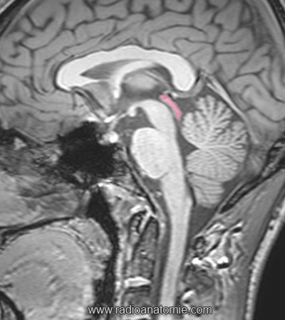
Tectum
“Roof” of the midbrain
Superior and inferior colliculus (colliculi is plural for ‘little hill’)
Labeled MRI of Tectum

Slide 49
Tectum: Components
Superior colliculus (colliculi)
Reflexive orienting of eyes, head, ears (superior colliculi)
Inferior colliculus
Auditory processing (from brainstem to auditory thalamus)
Labeled locations of Inferior and Superior Colliculi of the dorsal midbrain or Tectum from Wikipedia

Slide 50
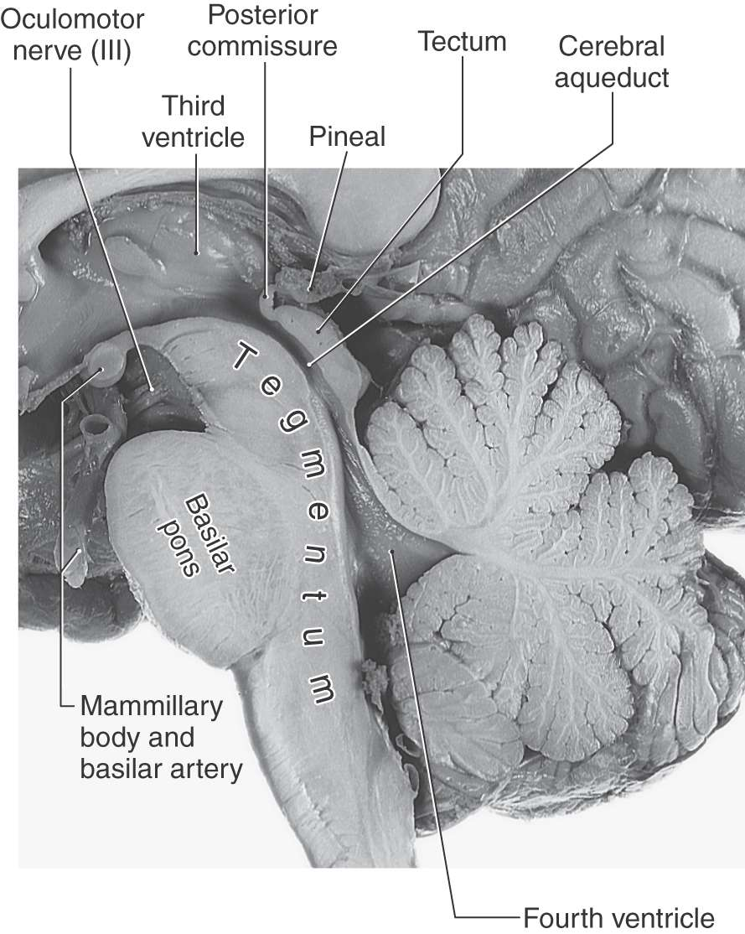
Tegmentum
“Floor” of the midbrain
Species-typical movement sequences
Neuromodulatory nuclei release NTs
Norepinephrine (NE)
Serotonin (5-HT)
Dopamine (DA) – from ventral tegmental area (VTA)
https://neupsykey.com/the-midbrain/

Slide 51
Hindbrain
Structures adjacent (or caudal to) 4th ventricle
Components
Pons
Cerebellum
Medulla oblongata
Lateral view of brainstem from Wikipedia

Slide 52
Pons
Bulge on ventral brain stem
Relay to cerebellum
Illustration of brainstem from Wikipedia

Slide 53
Cerebellum
“Little brain”, but most neurons in CNS
Dorsal to pons
Movement coordination, simple learning (classical conditioning)
Animated GIF of cerebellum from Wikipedia

Slide 54
Medulla oblongata
Cardiovascular regulation
Muscle tone
Fibers of passage
Ascending fibers (from body), a.k.a. afferents
Descending fibers (exiting brain), a.k.a., efferents
Illustration of brainstem from Wikipedia

Slide 55
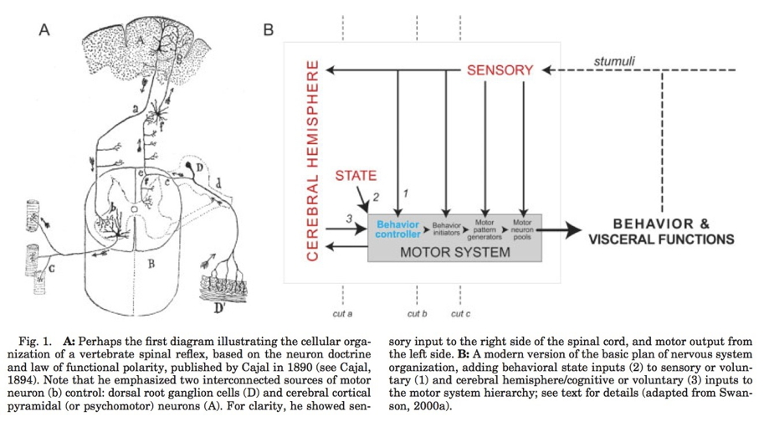
Input/output
Via cranial nerves (in CNS)
Via spinal nerves (in PNS)
Hierarchical organization
Substantial interconnection
Swanson (2005) Figure 1

Slide 56
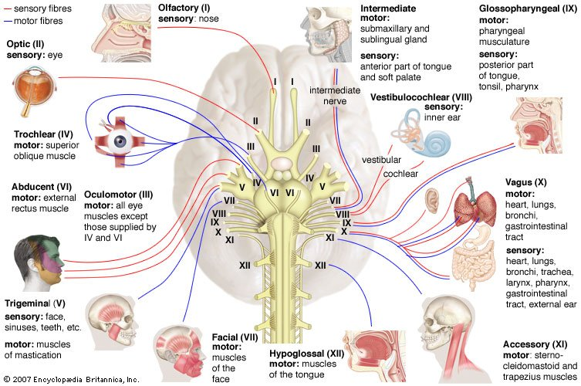
Cranial nerves
Cranial nerves from https://www.britannica.com/science/cranial-nerve#/media/1/141797/46720

Slide 57
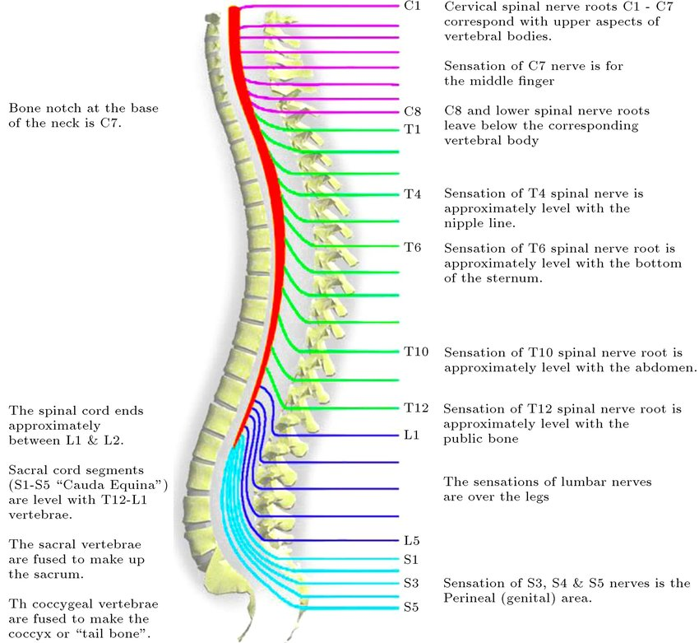
Spinal nerves
https://www.researchgate.net/profile/Saeede-Rahimi-Damirchi-Darasi/publication/324683974/figure/fig10/AS:753484697726976@1556656159277/Diagram-showing-the-relationship-between-spinal-nerve-roots-and-vertebrae-27.jp

Slide 58
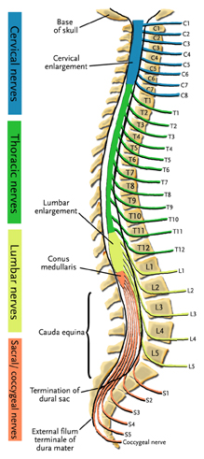
Spinal cord
Spinal column w/ vertebrae
Segments
Cervical (8), thoracic (12), lumbar (5), sacral (5), coccygeal (1)
31 (anterior & posterior) nerve pairs
Cauda equina
https://www.physio-pedia.com/Cauda_Equina

Slide 59
Spinal cord: Axial
Anterior and posterior roots of spinal cord
Axial view of spinal cord anterior and posterior roots

Slide 60
PNS Organization
Somatic nervous system
Autonomic nervous system (ANS)
Sympathetic
Parasympathetic
Enteric (gut, intestinal tract)
By Own work, CC BY 3.0, https://commons.wikimedia.org/w/index.php?curid=10187018

Slide 61
Somatic nervous system
SimplyPsychology

Slide 62
Autonomic nervous system
Controls “vegetative functions”
Limited voluntary control
Sympathetic
Prepares body for action
“Fight, flee, or fight”
Parasympathetic (around the sympathetic)
Restorative function
“Rest & digest”

Slide 63
Autonomic nervous system
By OpenStax College - Anatomy & Physiology, Connexions Web site. http://cnx.org/content/col11496/1.6/, Jun 19, 2013., CC BY 3.0, https://commons.wikimedia.org/w/index.php?curid=30148020
By Henry Vandyke Carter - Henry Gray (1918) Anatomy of the Human Body (See “Book” section below)Bartleby.com: Gray’s Anatomy, Plate 839, Public Domain, https://commons.wikimedia.org/w/index.php?curid=792179

Slide 64
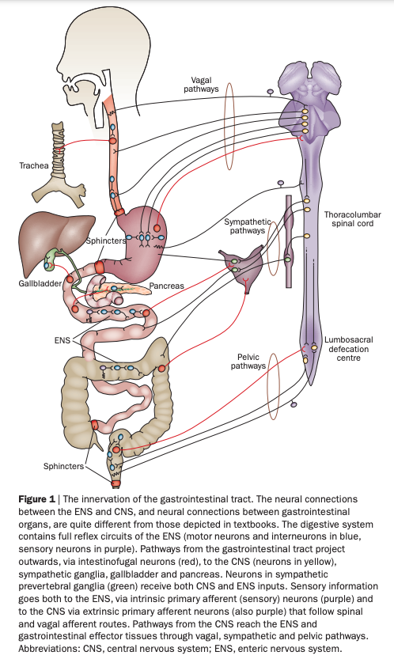
Autonomic nervous system: Enteric
Furness (2012) Figure 1

Slide 65
Neuroanatomy lab

Slide 66
Overview
3 groups
Rotate among stations every ~25 min
Identify as many structures as possible

Slide 67
Wrap-up

Slide 68
Main points
Directional terms
What is it
Where is it
Relative to other things
CNS/PNS
Forebrain/midbrain/hindbrain

Slide 69
Cerebral cortex and its subparts
Grey matter vs. white matter

Slide 70
Next time…
Action
Due: Exercise ANAT • Neuroanatomy
Canvas dropbox

Slide 71
Resources

Slide 72
References
ctdalilah. (2006, October). Pinky and the brain-brainstem. Youtube. Retrieved from https://www.youtube.com/watch?v=snO68aJTOpM
Furness, J. B. (2012). The enteric nervous system and neurogastroenterology. Nature Reviews. Gastroenterology & Hepatology, 9(5), 286–294. https://doi.org/10.1038/nrgastro.2012.32
Kids Learning Tube. (2015, October). Human body for Kids/Brain Song/Human body systems. Youtube. Retrieved from https://www.youtube.com/watch?v=Qw8E9WnZTQk
LeDoux, J. (2015, August 10). The Amygdala Is NOT the Brain’s Fear Center. Psychology Today. Retrieved from https://www.psychologytoday.com/blog/i-got-mind-tell-you/201508/the-amygdala-is-not-the-brains-fear-center
McNaughton, A. (2018, November 20). Dissecting Harriet Cole: Uncovering women’s history in the archives. Retrieved January 8, 2025, from https://drexel.edu/legacy-center/blog/overview/2018/november/dissecting-harriet-cole-uncovering-womens-history-in-the-archives/
Namkung, H., Kim, S.-H., & Sawa, A. (2017). The insula: An underestimated brain area in clinical neuroscience, psychiatry, and neurology. Trends in Neurosciences, 40(4), 200–207. https://doi.org/10.1016/j.tins.2017.02.002
Swanson, L. W. (2005). Anatomy of the soul as reflected in the cerebral hemispheres: Neural circuits underlying voluntary control of basic motivated behaviors. Journal of Comparative Neurology, 493(1), 122–131. https://doi.org/10.1002/cne.20733

