Slide 1
Perception
PSY 511.001 Spr 2026

Slide 2
Overview

Slide 3
Prelude

Slide 4
Announcements

Slide 5
Today’s topics
The big picture
Sensory processing
Vision
Somatosensation

Slide 6
Warm-up

Slide 7
The big picture

Slide 8
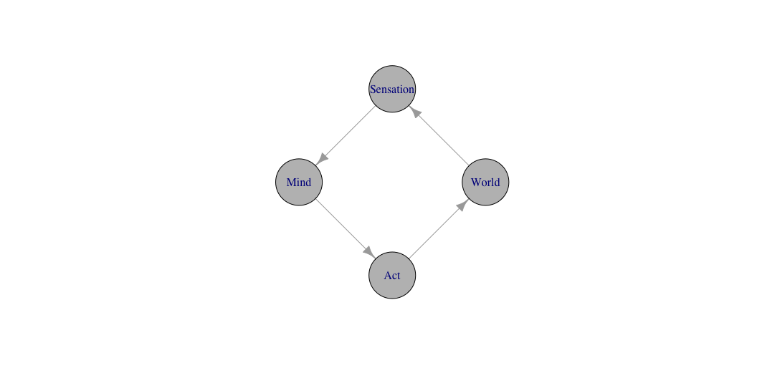
Perception/action systems

Slide 9
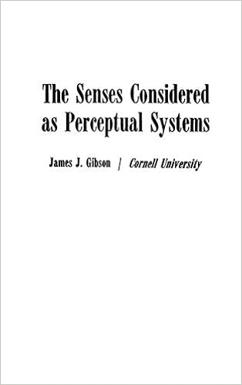
Gibson (1966)

Slide 10
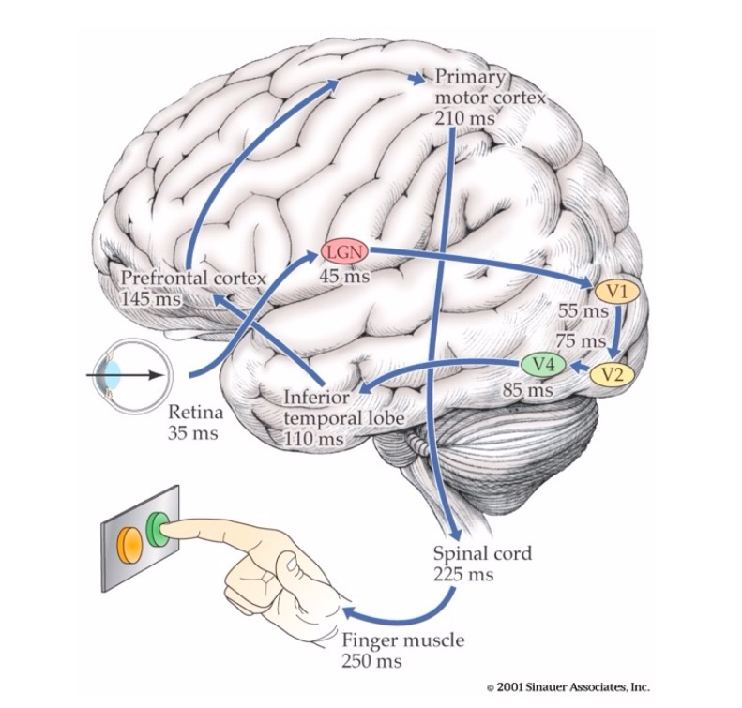

Slide 11
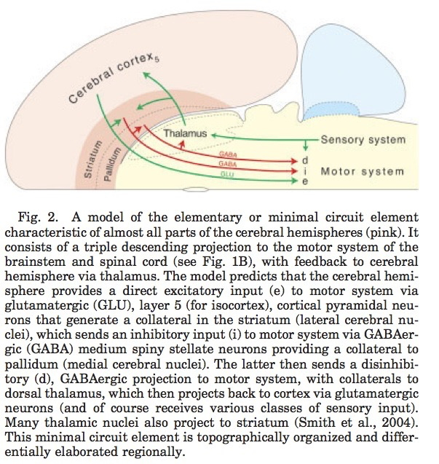
Swanson (2012) Figure 10.2

Slide 12
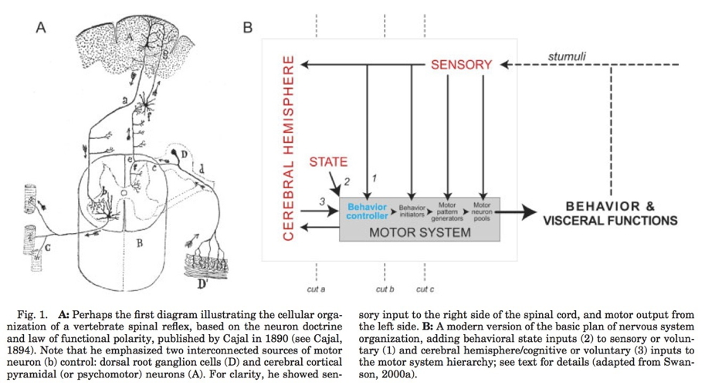
Swanson (2005) Figure 1

Slide 13

Multisensory smartphones
Accelerometer
Gyroscope
Magnetometer
Proximity sensor
Ambient light sensor

Slide 14
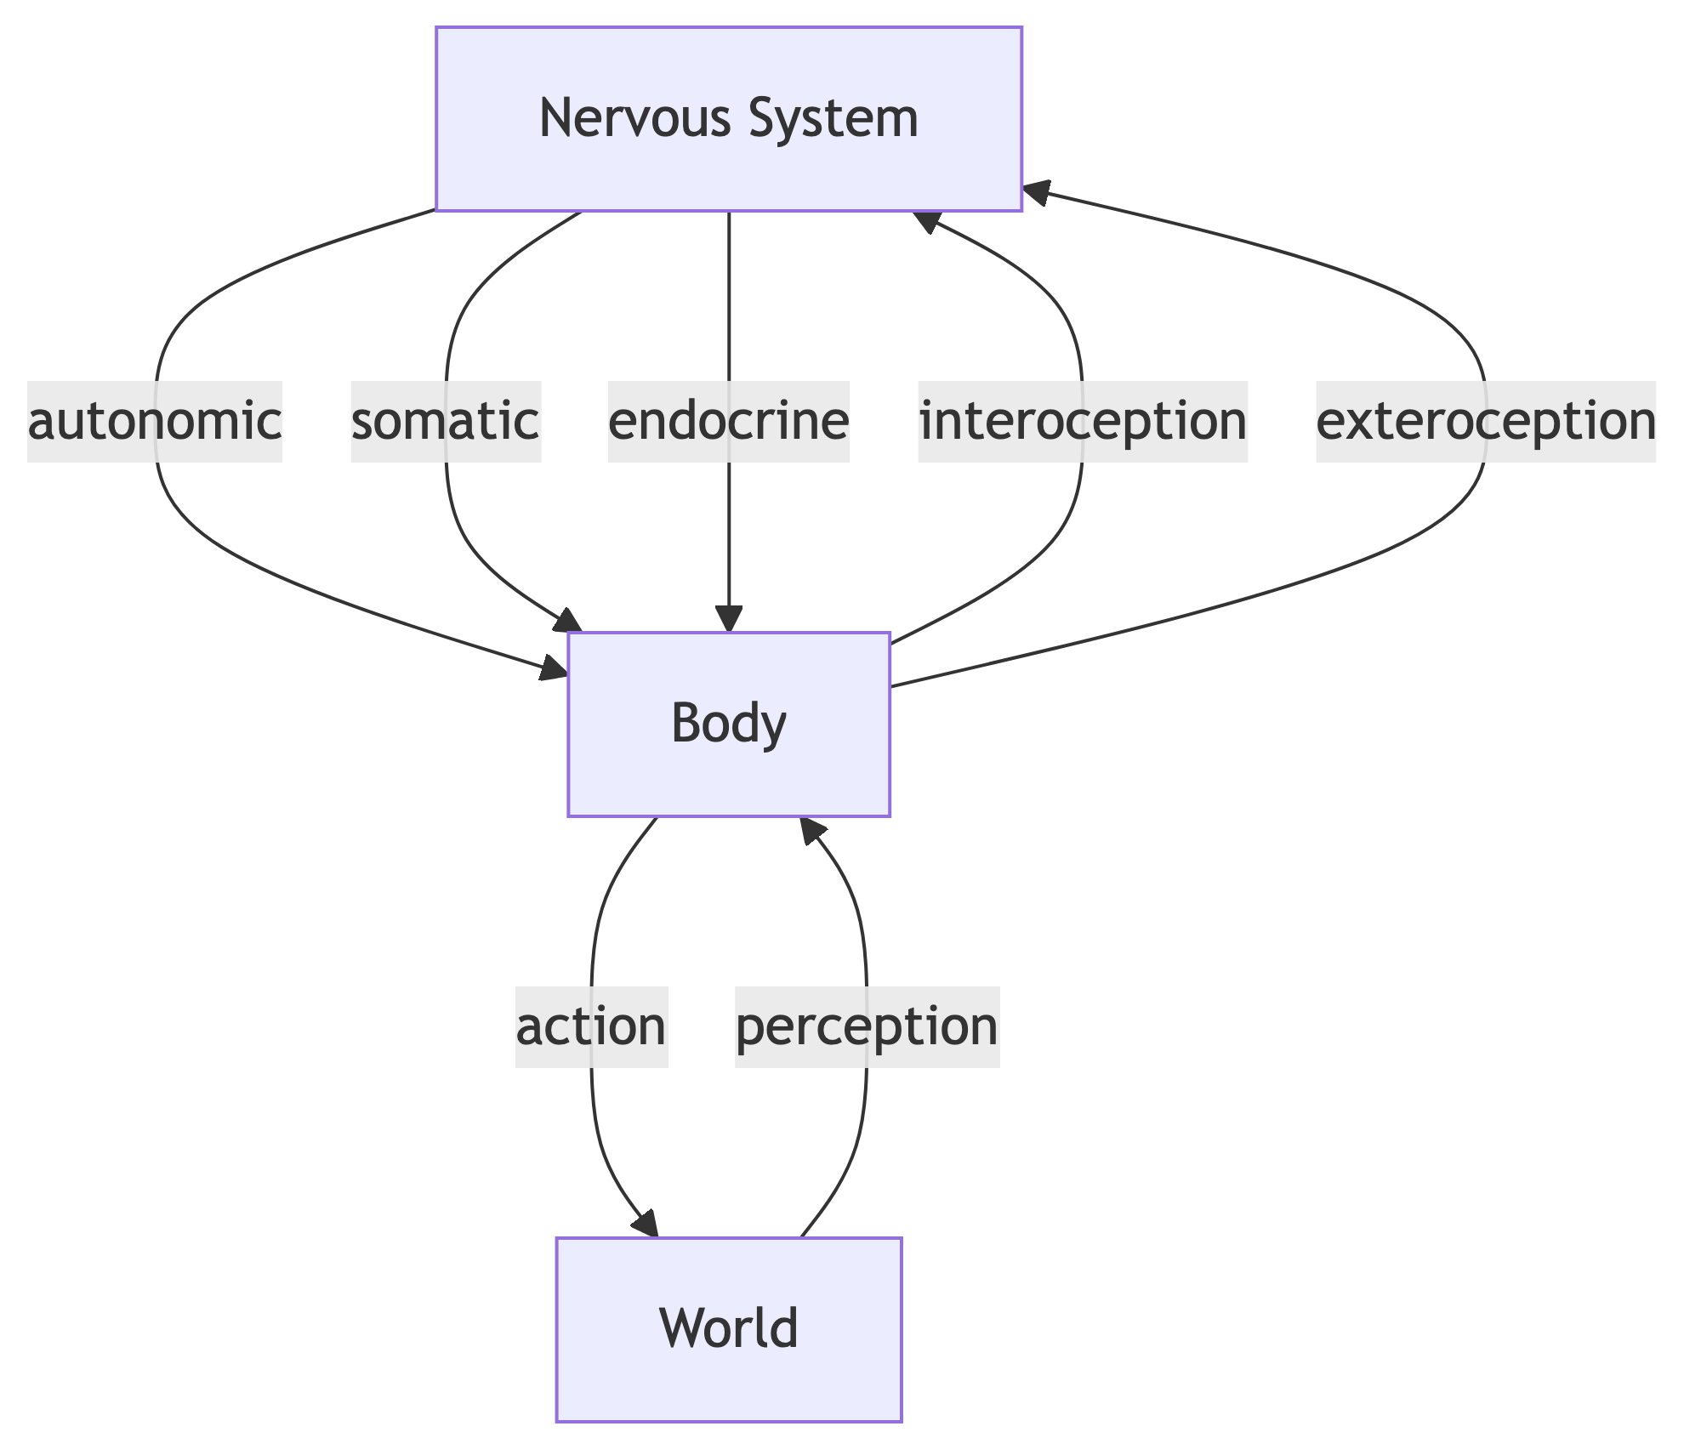
Dimensions
Interoceptive
Body position, movement, posture
Internal status
Exteroceptive
Layout of environment, contents

Slide 15
Questions for interoception
Tired or rested?
Well or ill?
Hungry or thirsty or sated?
Stressed vs. coping?
Emotional state?

Slide 16
Questions for exteroception
Who/What is out there?
Animate/inanimate?
Conspecific (same species)/non?
Threat/non?
Familiar/un?
Mate/non? or Friend/not?
Food source/non

Slide 17
Questions for exteroception
Where is it?
Distance
Proximal
Distal
Elevation, azimuth
Coordinate frames
Self/ego (left of me)
Object (top of object)
Allo/world (North of College)
Where moving?

Slide 18
Causal chains
Behaviorally relevant conditions, events, and entities…
Generate patterns…
Chemical
Photic/electromagnetic
Mechanical/acoustic

Slide 19
That specialized sensors detect, and
Neural circuitry responds to
That yield internal states (short- and long-term)
That cause actions
That cause perceptions…

Slide 20
Sensory Processing

Slide 21
Physics of sensation
Informal name | Source
Vision | Electromagnetic radiation
Audition | Mechanical vibration in air/water
Touch | Mechanical vibration of skin on surface
Vestibular | Rotation & linear acceleration of head
Olfaction | Chemical patterns in air/water

Slide 22
Physics of sensation
Informal name | Source
Gustation | Chemical patterns in mouth
Electroception | Electromagnetic radiation
Magnetoreception | Electromagnetic radiation patterns
Kinesthesia | Position, velocity, acceleration of limbs, body

Slide 23
From $Φ$ to $Ψ$
What is the energy/chemical channel?
Channels carry different types of information about
What is out there?
Where is it located or moving?
Convey information at different rates, with varied precision
Information often signaled by multiple sources

Slide 24
Example: Vision
Source: Electromagnetic radiation
Reflected from surfaces
What is it?
Shape, size, surface properties (color, texture, reflectance, etc.)
Wavelength/frequency, intensity

Slide 25
Example: Vision
Where is it?
Position: Left/right; up/down on retina
Near/far: retinal disparity, interposition, height above horizon…
Orientation, motion

Slide 26
Example: Audition
Source: Mechanical vibrations in air or water
What is it?
Pattern of frequencies, amplitudes, durations
Where is it?
Left/right or up/down: Interaural time/phase, intensity differences, pinnae filtering
Motion: Frequency shifts via Doppler effect

Slide 27
Example: Chemosensation
Source: Chemicals in mouth, nasal cavity
What is it?
Mixtures of chemicals
Where is it?
Left/right; up/down; near/far via intensity gradients

Slide 28
Somatosensation
Source: Thermal or mechanical stimulation (vibration/pressure) of skin
What is it?
Shape, size, smoothness, mass, temperature, deformability: Pattern of stimulation
Where it it?
Pattern of cutaneous receptors on skin

Slide 29
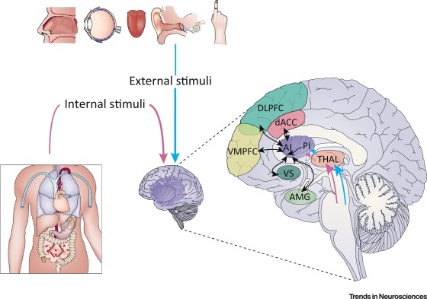
Interoception
Hunger/thirst
Receptors for nutrient, fluid levels
Energy levels
Receptors for hormones, NTs
ANS responses
Temperature
Receptors in skin, viscera
Namkung et al. (2017) Figure 2

Slide 30
Interoception
Mating interest
Receptors for hormones, NTs
ANS responses
Body position & movement (proprioception)
Receptors in muscles, joints, skin
Namkung et al. (2017) Figure 2

Slide 31
Namkung et al. (2017) Figure 2. Interoceptive Information and Its Integration with Emotional, Cognitive, and Motivational Signals from an Array of Cortical and Subcortical Regions. Interoceptive information of constantly changing body states arrives in the posterior insula by ascending sensory inputs from dedicated spinal and brainstem pathways via specific thalamic relays. This information is projected rostrally onto the anterior insula, where it is integrated with emotional, cognitive, and motivational signals from an array of cortical and subcortical regions. As a result, the anterior insula supports unique subjective feeling states. The anterior insula regulates the introduction of subjective feelings into cognitive and motivational processes by virtue of its cortical location at the cross-roads of numerous pathways involved in higher cognition and motivation. Abbreviations: AI, anterior insula; AMG, amygdala; dACC, dorsal anterior cingulate cortex; DLPFC, dorsolateral prefrontal cortex; PI, posterior insula; THAL, thalamus; VMPFC, ventromedial prefrontal cortex; VS, ventral striatum.

Slide 32
Features of sensory signals

Slide 33
Change across time
Tonic (sustained) vs. phasic (transient) responses
https://www.researchgate.net/figure/Two-types-of-receptions-differing-by-the-rate-of-adaptation-to-the-dynamical-stimulus-A_fig1_51231510

Slide 34
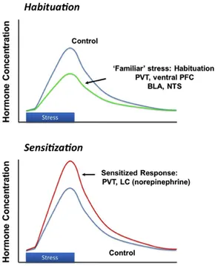
Change across time
Adaptation/habituation
Sensitization
Most sensory systems attuned to change
Herman (2013) Figure 3

Slide 35
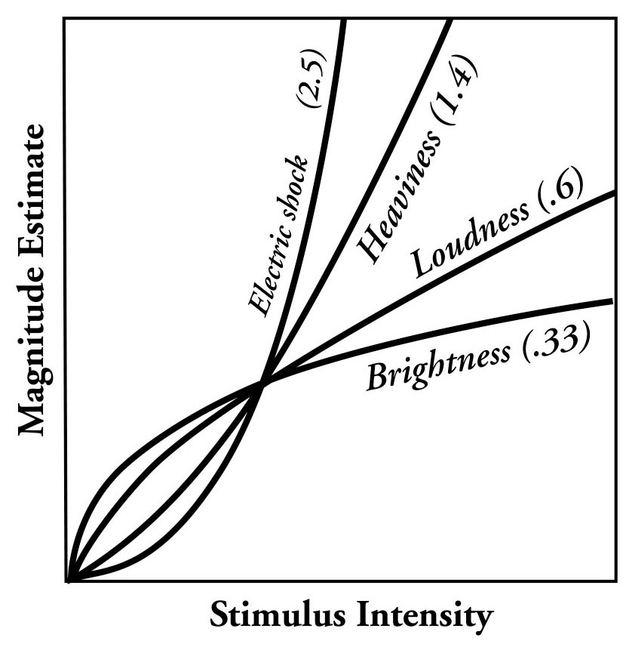
Perception not linear
Just noticeable difference (JND)
How much of a change is noticeable?
Slope of psychophysical function
JND a nonlinear function of absolute intensity

Slide 36
Beyond JNDs
Are other types of self-reported intensity or magnitude non-linear?
For example, “How happy are you on a scale from 1 to 5?”
If so, what are the implications?

Slide 37
Project to CNS at different speeds
Bigger diameter axon fiber: Faster
Thicker myelin sheath around axon: Faster

Slide 38
Repeating signals (e.g. patterns)
In space (textures)
In time

Slide 39
Vision
Roark & Stringham (2019) Figure 1

Slide 40
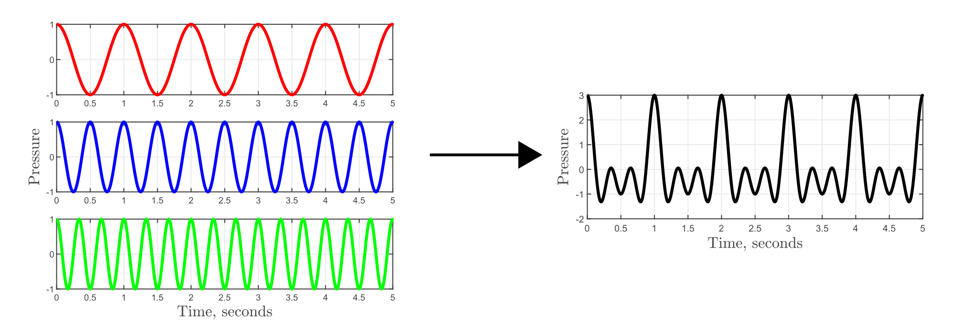
Audition
https://www.mwmresearchgroup.org/blog/key-concepts-fourier-transforms-and-signal-processing

Slide 41
By Aquegg - Own work, Public Domain, https://commons.wikimedia.org/w/index.php?curid=5544473

Slide 42
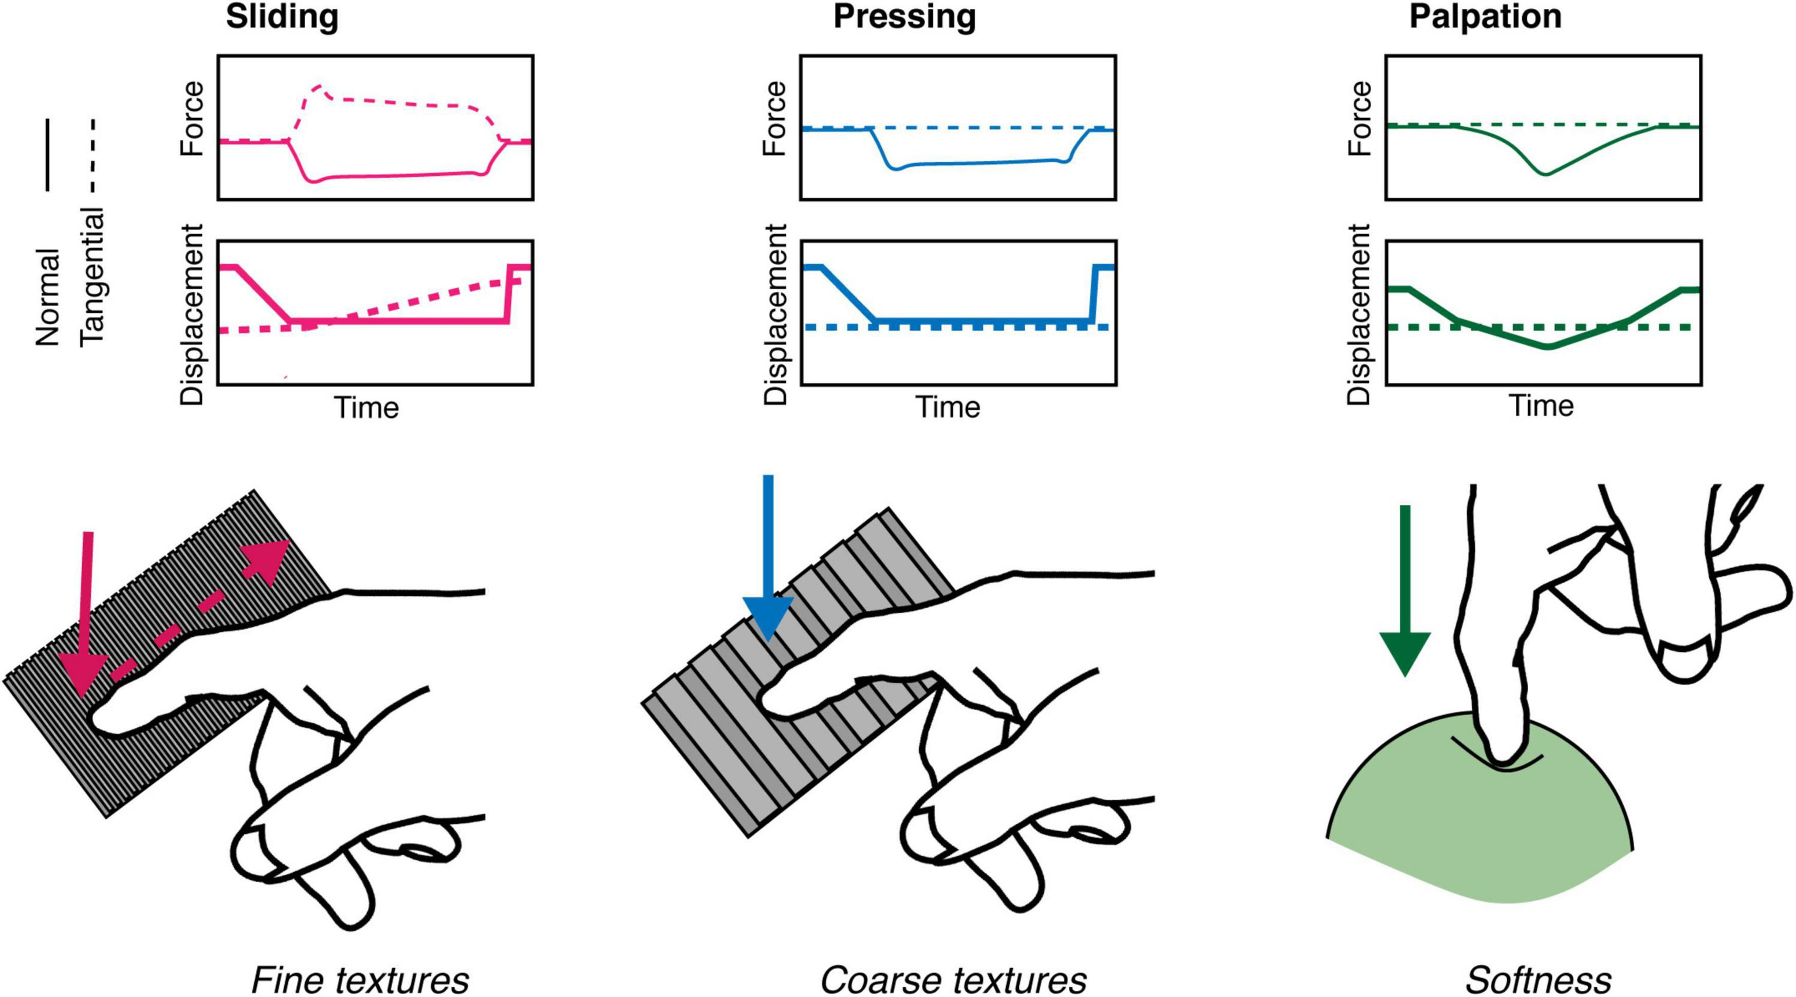
Somatosensation
Figure 1 from https://www.frontiersin.org/articles/10.3389/fnhum.2022.862344/full

Slide 43
Compare (>1) sensors located in different parts of the body
Eyes
Ears
Skin surface
Nostrils
Tongue

Slide 44
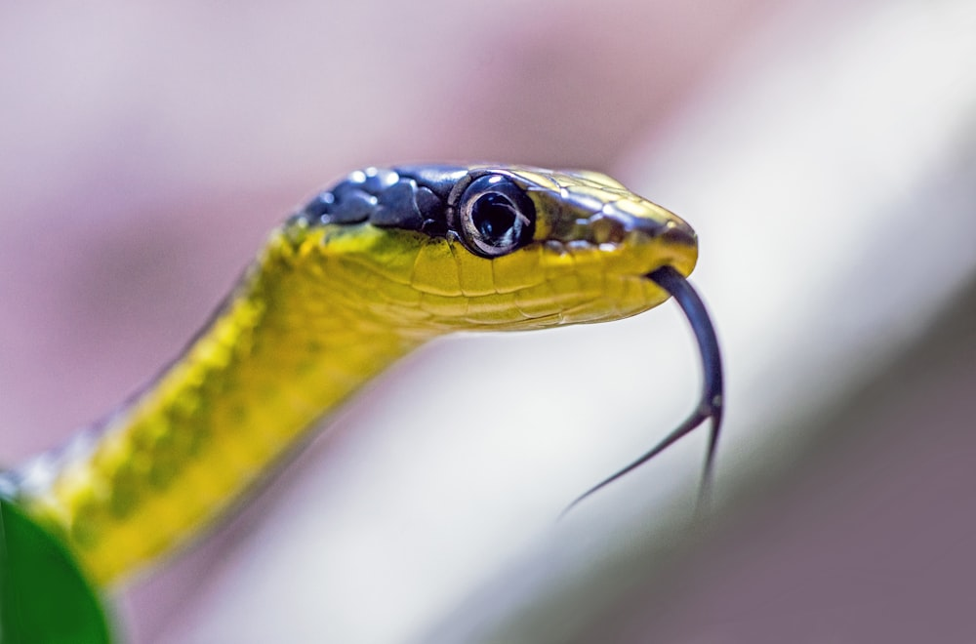

Slide 45
Specialized neurons: Vision
Photoreceptors
Wikipedia

Slide 46
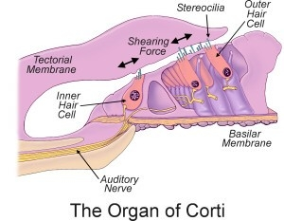
Specialized neurons: Audition
Cochlear hair cells

Slide 47
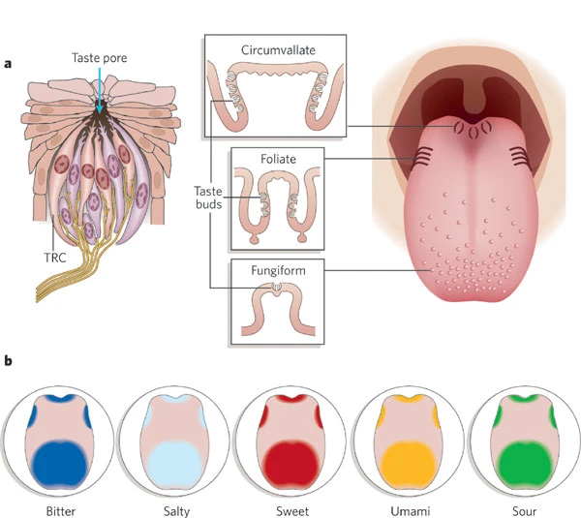
Specialized neurons: Gustation (taste)
taste receptor cells
Chandrashekar et al. (2006)

Slide 48
“Receptive fields”
The receptive field is a portion of sensory space that can elicit neuronal responses when stimulated. The sensory space can be defined in a single dimension (e.g. carbon chain length of an odorant), two dimensions (e.g. skin surface) or multiple dimensions (e.g. space, time and tuning properties of a visual receptive field).
– Alonso & Chen (2009)

Slide 49
Tactile receptive fields
https://www.nursinghero.com/study-guides/austincc-ap1/pain

Slide 50
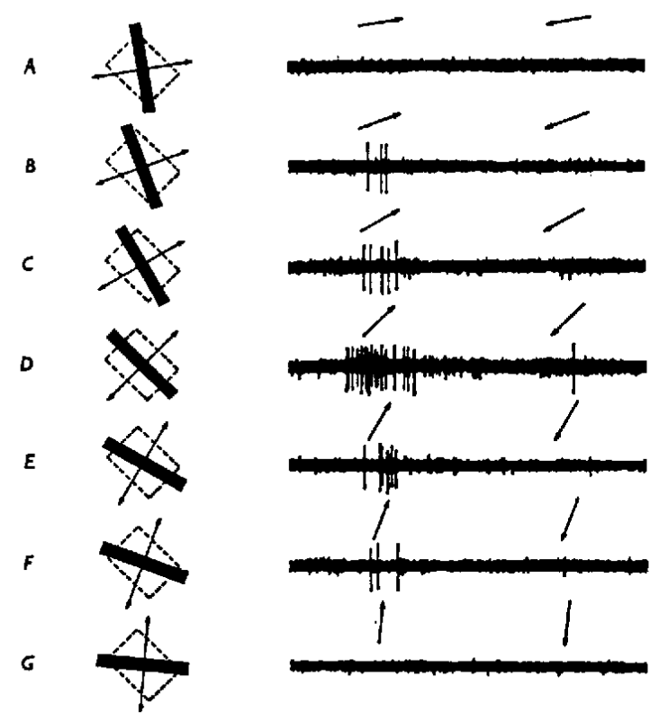
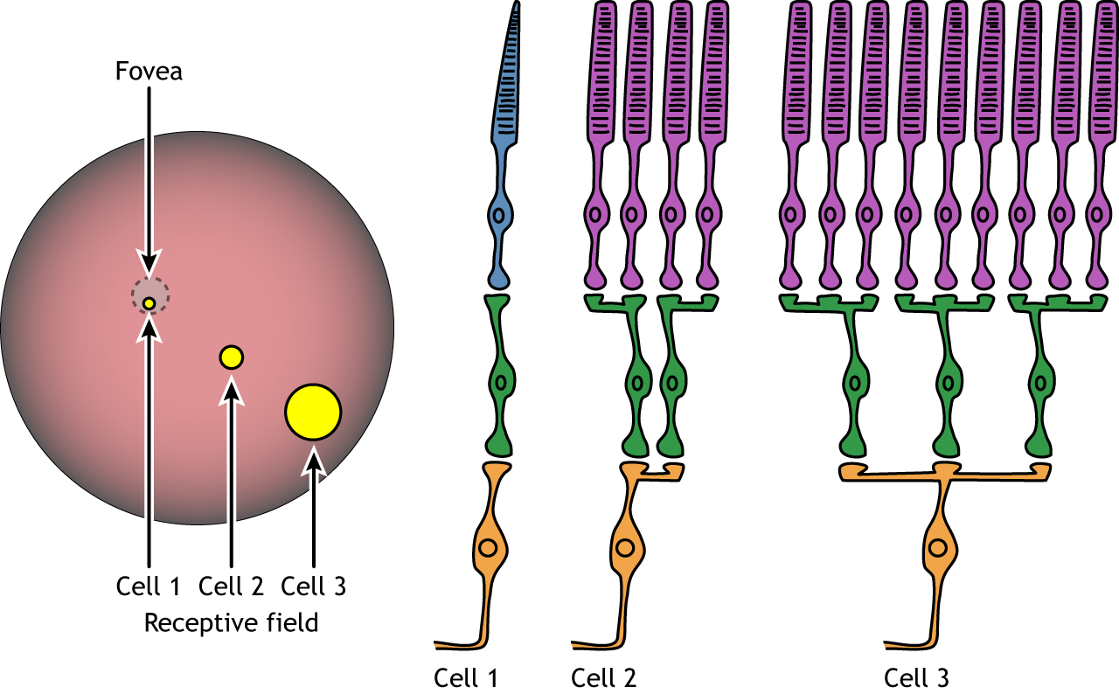
Receptive fields: Visual
https://openbooks.lib.msu.edu/neuroscience/chapter/vision-the-retina/
https://wandell.github.io/FOV-1995/

Slide 51
Topographic maps

Slide 52
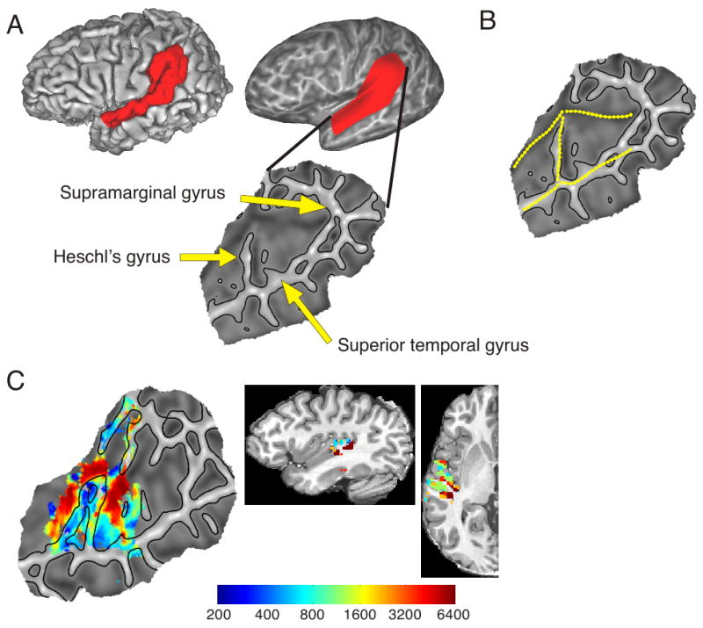
Auditory: Tonotopic maps
Humphries et al. (2010) Figure 3

Slide 53
Visual: Retinotopic maps
https://www.youtube.com/embed/f2JMbo4BZqY
https://www.youtube.com/embed/rsykP-9-moA

Slide 54
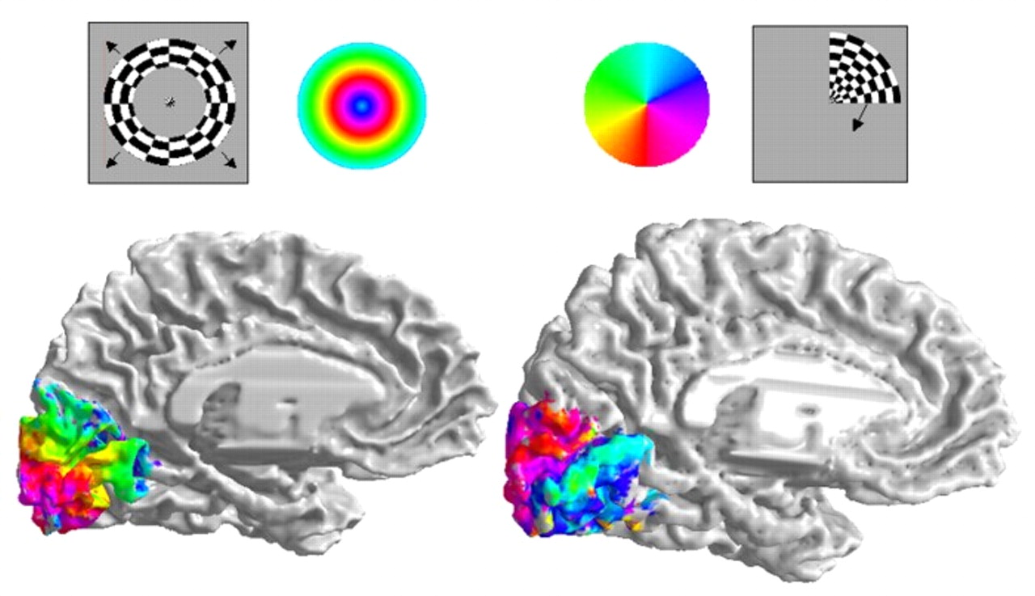
Visual: Retinotopic maps
Dougherty et al. (2003) Figure 1

Slide 55
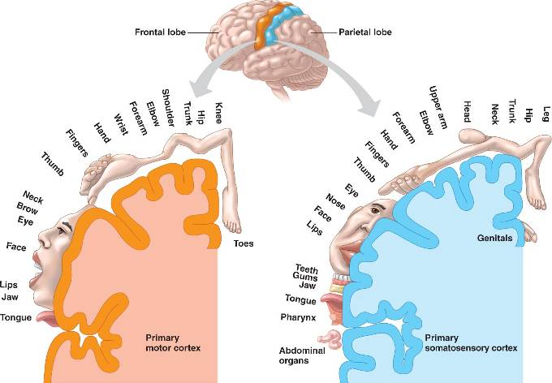
Somatosensory: Somatotopic maps in S1 & M1

Slide 56
Non-uniform sensitivity

Slide 57
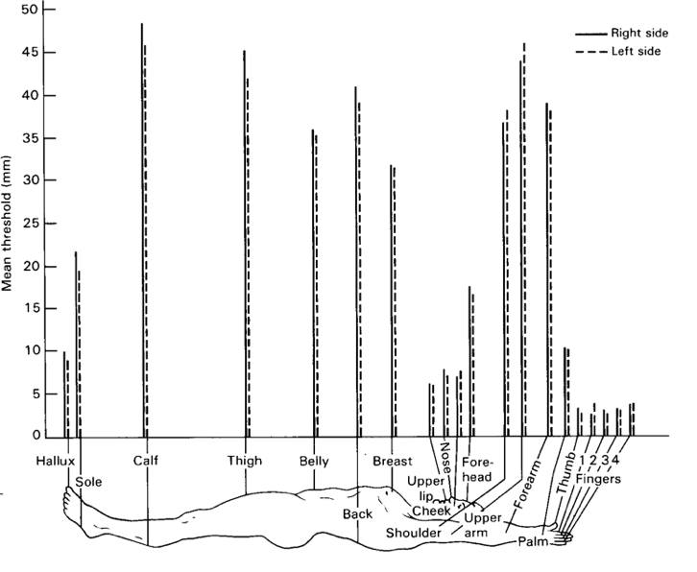
Two-point touch thresholds

Slide 58
Somatosensory homunculus

Slide 59
Visual acuity non-uniform
Wikipedia

Slide 60
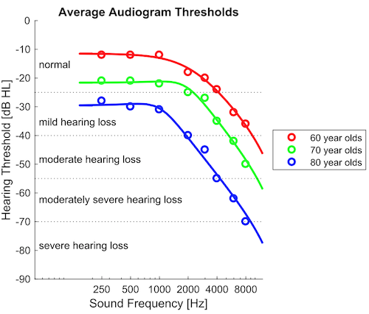
Hearing thresholds non-uniform
http://auditoryneuroscience.com/

Slide 61
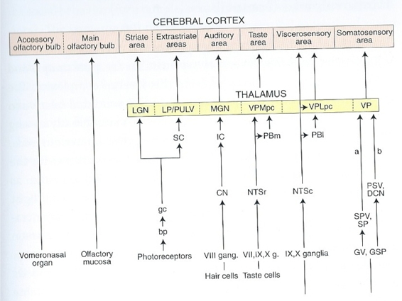
Hierarchical/sequential AND parallel

Slide 62
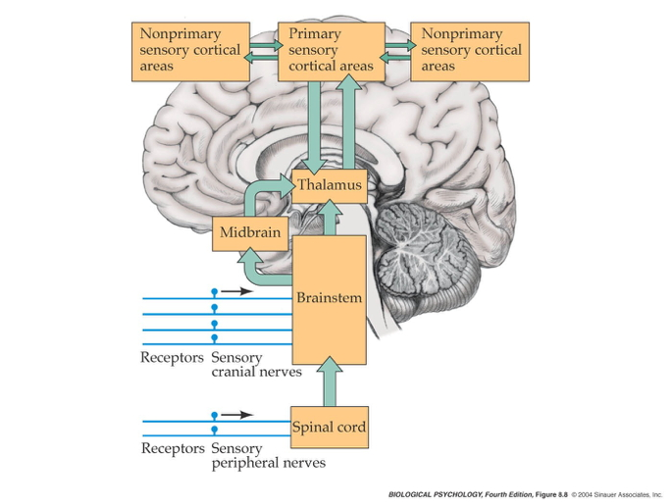

Slide 63
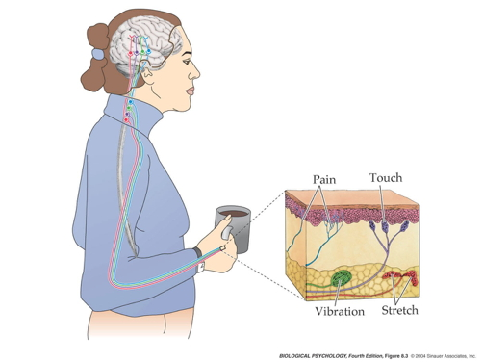

Slide 64
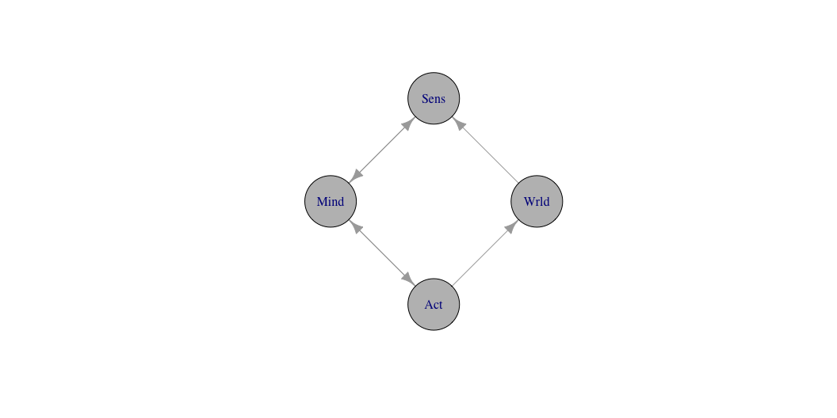
Feedforward and feedback

Slide 65
Break

Slide 66
Vision

Slide 67
Animals respond to visual illusions, too
https://www.illusionsindex.org/i/rotating-snakes

Slide 68
A cat responds…
https://www.reddit.com/r/youseeingthisshit/comments/p9y7v1/the_reaction_of_the_cat_on_the_optical_illusion/?ref=share&ref_source=embed&utm_content=title&utm_medium=post_embed&utm_name=85f1a01593f447e092c5b300e5561d6e&utm_source=embedly&utm_term=p9y7v1

Slide 69
Application in VR
https://www.youtube.com/watch?v=NPK8eQ4o8Pk
– ewakili (2021)

Slide 70
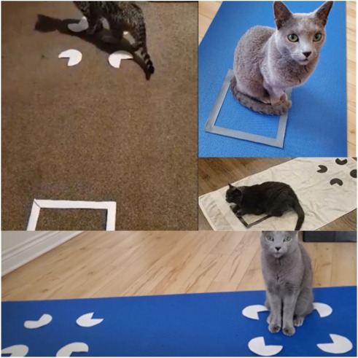
Smith et al. (2021) Figure 4

Slide 71
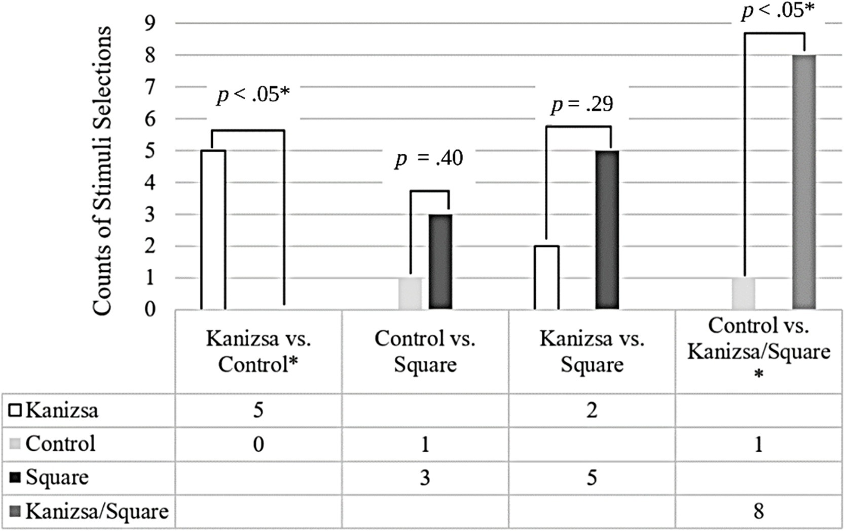
Smith et al. (2021) Figure 5

Slide 72
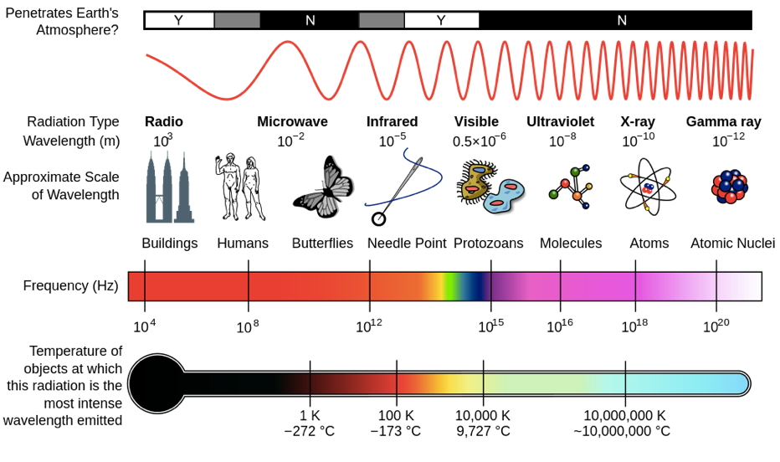
Properties of Electromagnetic (EM) radiation
Wavelength/frequency
Intensity
Location/position of source
Reflects off some materials
Refracted (bent) moving through other materials
Information across space (and time)
http://en.wikipedia.org/wiki/File:EM_Spectrum_Properties_edit.svg

Slide 73
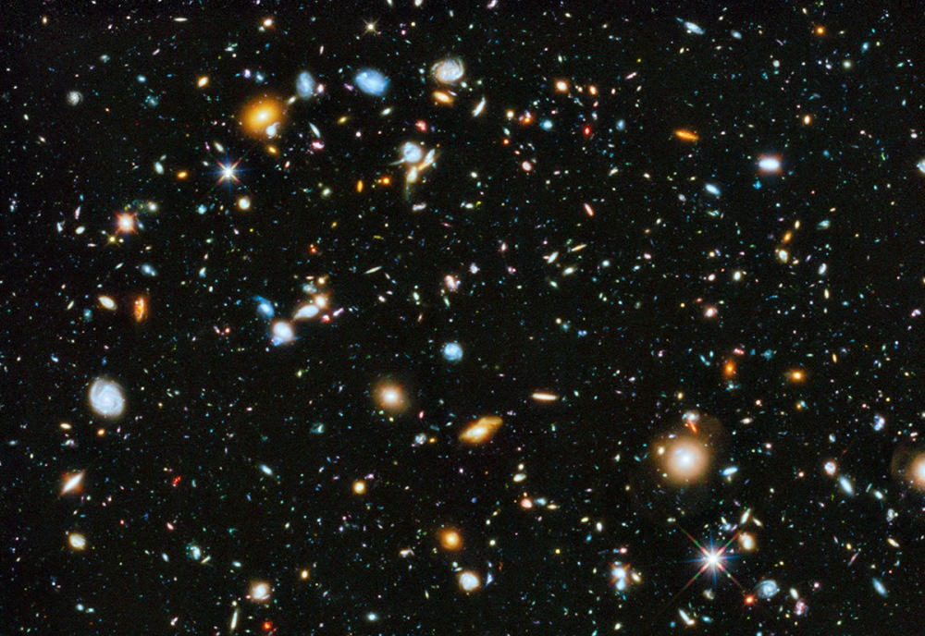
Light provides fast (2.99 million m/s; 186 million mi/hr) information about surfaces at a distance
vs. sound (340 m/s; 767 mi/hr)
vs. chemical signals (min/mi)
http://apod.nasa.gov/apod/ap140605.html

Slide 74
Reflectance spectra differ by surface
Randeberg (2005) Figure 8

Slide 75
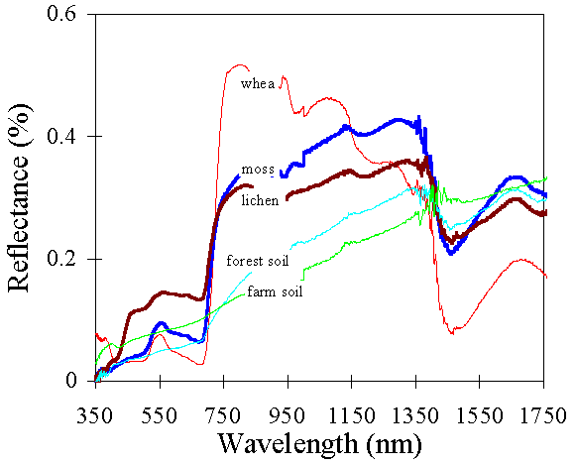
http://http://www.vgt.vito.be/userguide/book_1/4/42/ie42bd.gif

Slide 76
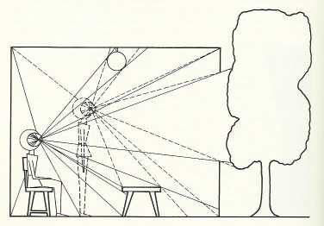
Optic array specifies geometry of environment
Gibson

Slide 77
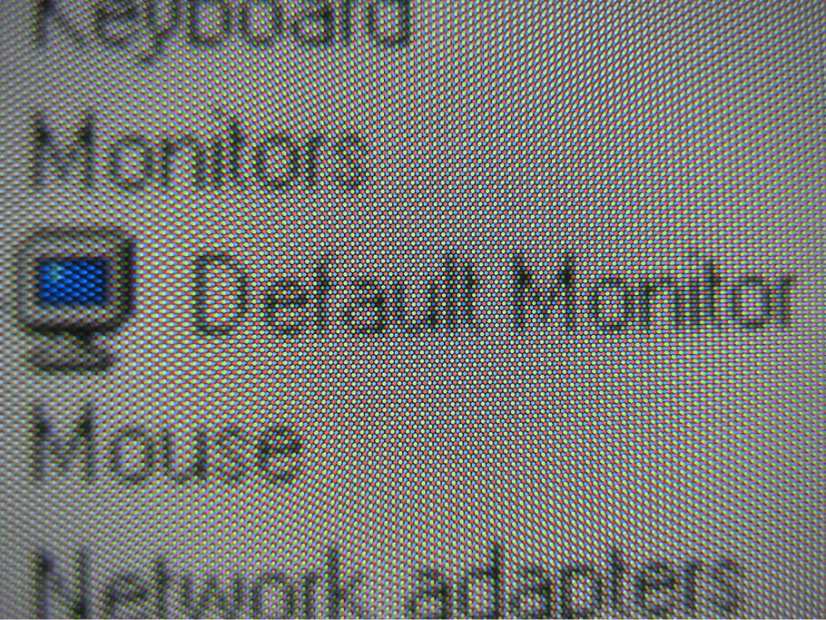
Categories of wavelength specify perception of color
Eyes categorize wavelength into relative intensities within wavelength bands
RGB ~ Red, Green, Blue
Long, medium, short wavelengths
Color is a neural/psychological construct

Slide 78
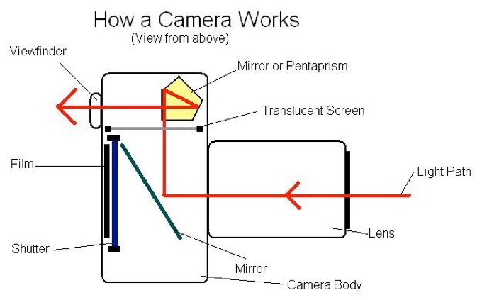
The biological camera

Slide 79
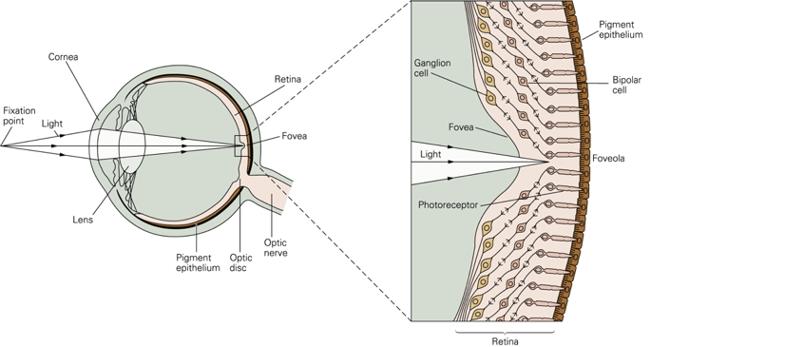

Slide 80
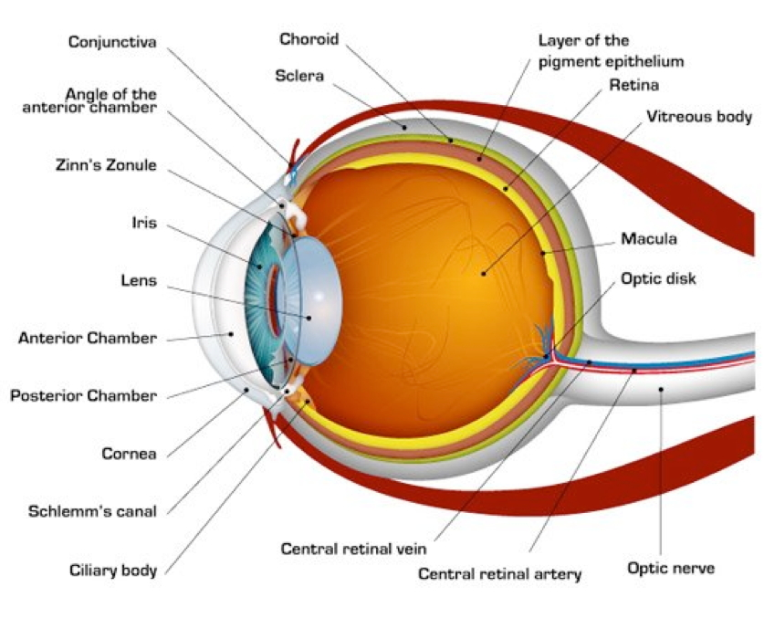

Slide 81
part of a self-stabilizing system…
https://www.youtube.com/embed/JGArTWOJtXs

Slide 82
Parts of the eye
Cornea - refraction (2/3 of total)
Pupil - light intensity; diameter regulated by Iris.
Lens - refraction (remaining 1/3; focus)
Retina - light detection
~ skin or organ of Corti in inner ear
Pigment epithelium - regenerate photopigment
Muscles - move eye, reshape lens, change pupil diameter

Slide 83
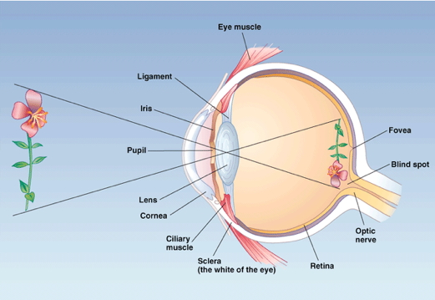
Geometry of retinal image
Image inverted (up/down)
Image reversed (left/right)
Point-to-point map (retinotopic)
Binocular and monocular zones

Slide 84
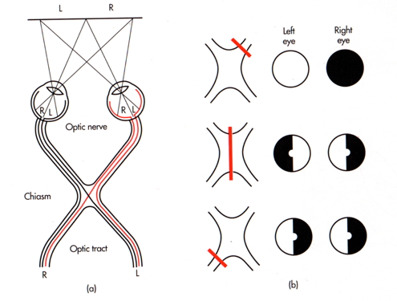

Slide 85
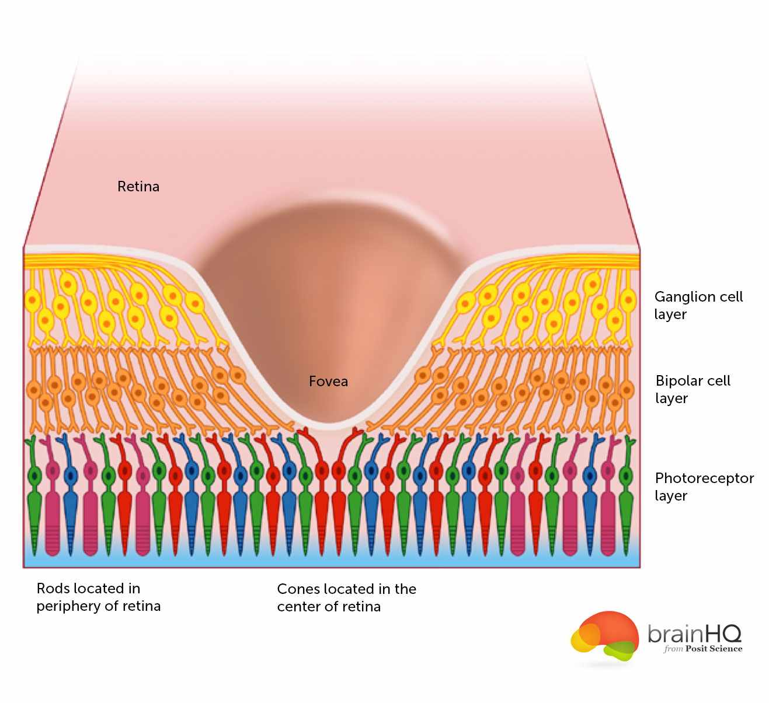
The fovea
Central 1-2 deg of visual field
Aligned with visual axis
Retinal ganglion cells pushed aside
Highest acuity vision == best for details
Acuity varies from center to periphery
http://www.brainhq.com/sites/default/files/fovea.jpg

Slide 86
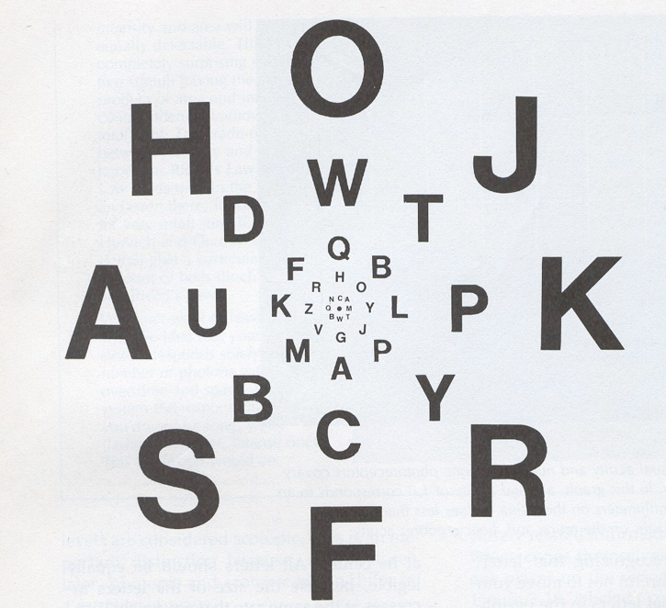

Slide 87
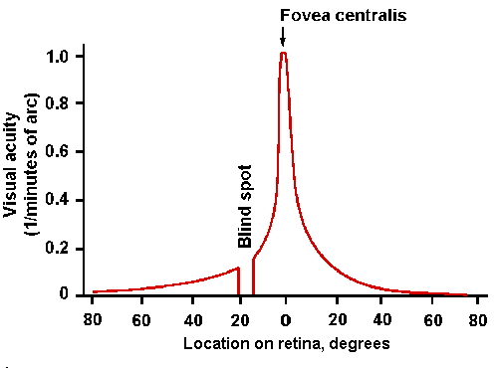
http://michaeldmann.net/pix_7/blndspot.gif

Slide 88
What part of the skin is like the fovea?

Slide 89
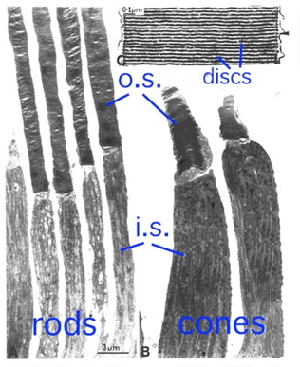
Photoreceptors in retina detect light

Slide 90
Rods
~120 M/eye
Mostly in periphery
Active in low light conditions
One wavelength range
Cones
~5 M/eye
Mostly in center
3 wavelength ranges

Slide 91
https://foundationsofvision.stanford.edu/

Slide 92
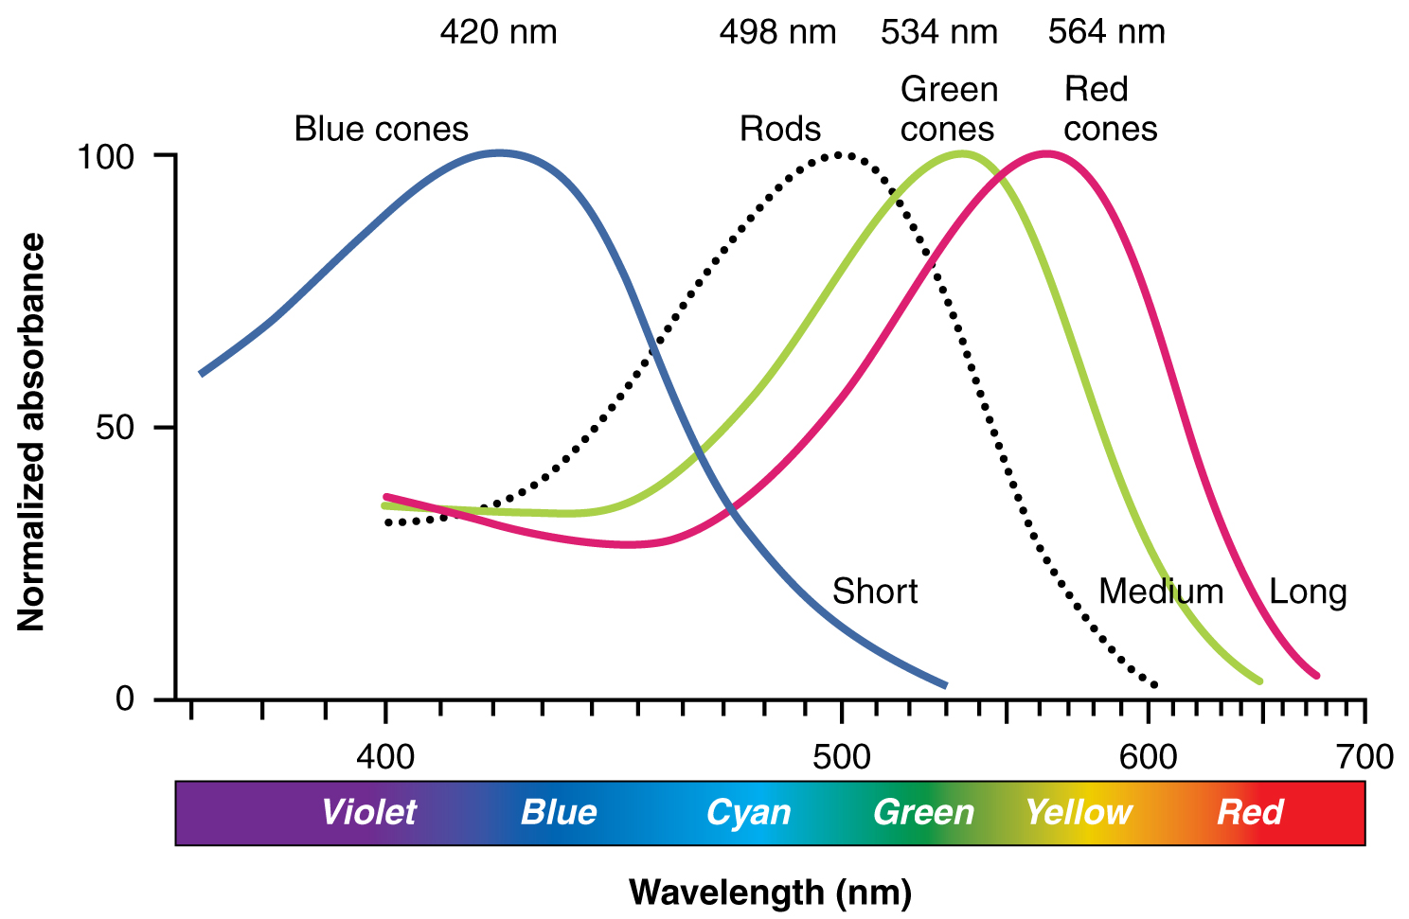
http://cnx.org/content/col11496/1.6/

Slide 93
Photoreceptor physiology
Outer segment
Membrane disks
Photopigments
Sense light, trigger chemical cascade
Inner segment
Synaptic terminal
Light hyperpolarizes photoreceptor!
The dark current

Slide 94
Retina
Physiologically backwards
Dark current
Anatomically inside-out
Photoreceptors at back of eye

Slide 95
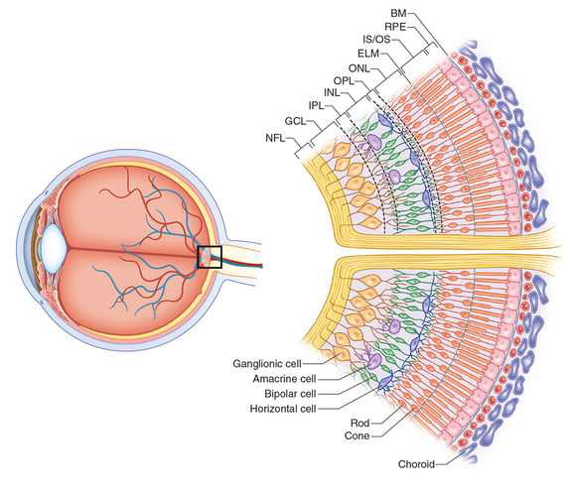
http://www.retinareference.com/anatomy/

Slide 96
Retina
Information flows…
From photoreceptors…
To Bipolar cells
<-> and Horizontal cells
To Retinal ganglion cells
<-> and Amacrine cells
To cerebral cortex

Slide 97
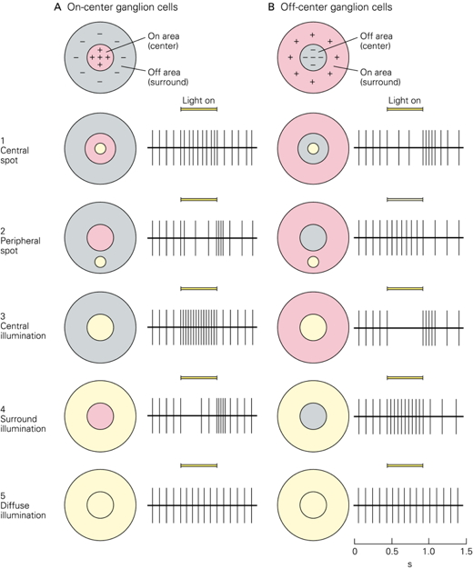
Center-surround receptive fields

Slide 98
Center region
Excites (or inhibits)
Surround region
Does the opposite
Bipolar cells & Retinal Ganglion cells ->
Most activated by “donuts” of light/dark
Local contrast (light/dark differences)

Slide 99
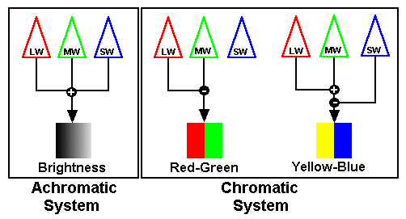
Opponent processing
Black (darker) vs. white (lighter) (achromatic)
Long (red) vs. Medium (green) wavelength cones
(Long + Medium) vs. Short cones
Can’t really see reddish-green or bluish-yellow
“Oppose” one another at cellular/circuit level
DEMO
http://www.visualexpert.com/sbfaqimages/RGBOpponent.gif

Slide 100
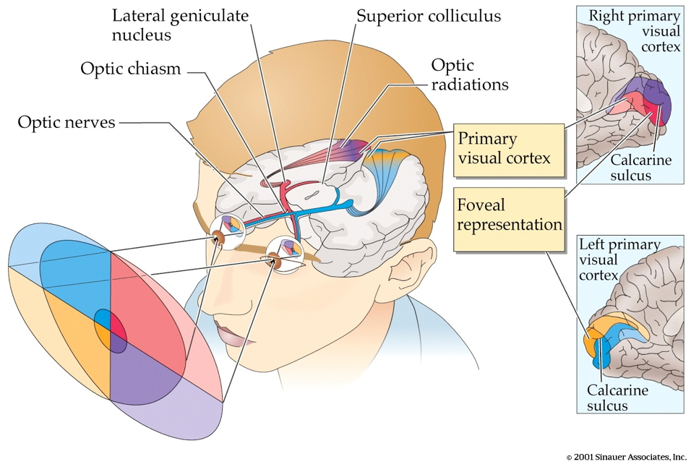
From eye to brain

Slide 101
Retinal ganglion cells
2nd/II cranial (optic) nerve
Optic chiasm ($χ$ - asm): Partial crossing of fibers
Nasal hemiretina (lateral/peripheral visual field) cross
Left visual field (from L & R retinae) -> right hemisphere & vice versa
Lateral Geniculate Nucleus (LGN) of thalamus (receives 90% of retinal projections)
Hypothalamus
Suprachiasmatic nucleus (superior to the optic chiasm): Synchronizes day/night cycle with circadian rhythms
Superior colliculus & brainstem

Slide 102
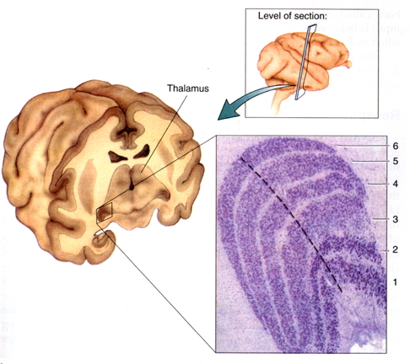
LGN

Slide 103
6 layers + intralaminar zone
Parvocellular (small cells): chromatic
Magnocellular (big cells): achromatic
Koniocellular (chromatic - short wavelength?)
Retinotopic map of opposite visual field
From LGN to V1

Slide 104
Via optic radiations
Primary visual cortex (V1) in occipital lobe
Create “stria of Gennari” (visible stripe in layer 4)
Calcarine fissure (medial occiptal lobe) divides lower/upper visual field

Slide 105
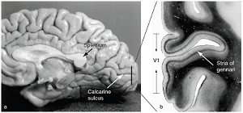
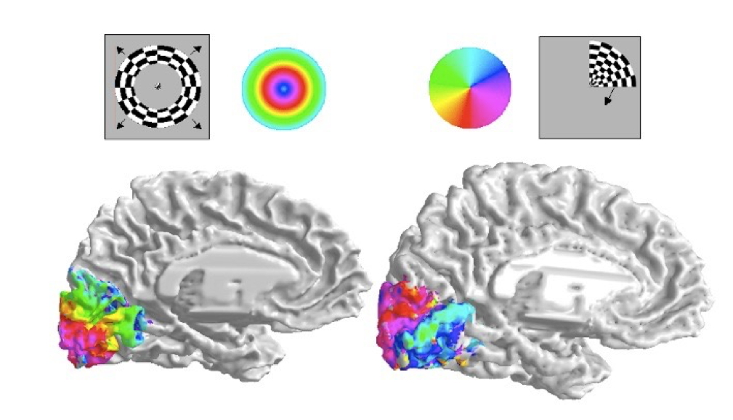
Human V1
Fovea overrepresented
Analogous to somatosensation
High acuity in fovea vs. lower outside it
Upper visual field/lower (ventral) V1 and vice versa
http://www.scholarpedia.org/w/images/3/3a/03-Human-V1.png
(Dougherty et al., 2003)

Slide 106
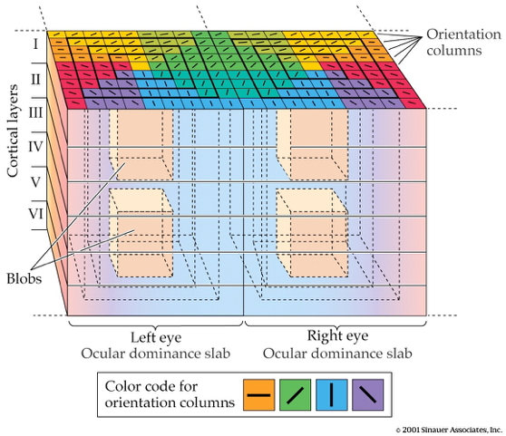
Laminar, columnar organization

Slide 107
6 laminae (layers)
Input: Layer 4 (remember stria of Gennari?)
Output: Layers 2-3 (to cortex), 5 (to brainstem), 6 (to LGN)
Columns
Orientation/angle
Spatial frequency
Color/wavelength
Eye of origin, ocular dominance

Slide 108
https://foundationsofvision.stanford.edu/wp-content/uploads/2012/02/dir.selective.png

Slide 109

From center-surround receptive fields to line detection

Slide 110

(Panichello et al., 2013)

Slide 111
Ocular dominance columns

Slide 112

Beyond V1

Slide 113
Larger, more complex receptive fields
Dorsal stream (where/how)
Toward parietal lobe
Ventral stream (what)

Slide 114
What is vision for?
What is it? (form perception)
Where is it? (space perception)
How do I get from here to there (action control)
What time (or time of year) is it?

Slide 115
Somatosensation

Slide 116
Wrap-up

Slide 117
Main points

Slide 118
Next time

Slide 119
Resources

Slide 120
About
This talk was produced using Quarto, using the RStudio Integrated Development Environment (IDE), version 2026.1.0.392.
The source files are in R and R Markdown, then rendered to HTML using the revealJS framework. The HTML slides are hosted in a GitHub repo and served by GitHub pages: https://psu-psychology.github.io/psy-511-scan-fdns-2026-spring/

Slide 121
References
Alonso, J.-M., & Chen, Y. (2009). Receptive field. Scholarpedia Journal, 4, 5393. https://doi.org/10.4249/scholarpedia.5393
Chandrashekar, J., Hoon, M. A., Ryba, N. J. P., & Zuker, C. S. (2006). The receptors and cells for mammalian taste. Nature, 444, 288–294. https://doi.org/10.1038/nature05401
Dougherty, R. F., Koch, V. M., Brewer, A. A., Fischer, B., Modersitzki, J., & Wandell, B. A. (2003). Visual field representations and locations of visual areas V1/2/3 in human visual cortex. Journal of Vision, 3(10), 1–1. https://doi.org/10.1167/3.10.1
ewakili. (2021). Foveated rendering shown by meta’s oculus, reducing compute load by 95%. Youtube. Retrieved from https://www.youtube.com/watch?v=NPK8eQ4o8Pk
Gibson, J. J. (1966). The senses considered as perceptual systems. doi.apa.org. Retrieved from http://doi.apa.org/psycinfo/1966-35026-000
Herman, J. P. (2013). Neural control of chronic stress adaptation. Frontiers in Behavioral Neuroscience, 7, 61. https://doi.org/10.3389/fnbeh.2013.00061
Humphries, C., Liebenthal, E., & Binder, J. R. (2010). Tonotopic organization of human auditory cortex. NeuroImage, 50, 1202–1211. https://doi.org/10.1016/j.neuroimage.2010.01.046
Namkung, H., Kim, S.-H., & Sawa, A. (2017). The insula: An underestimated brain area in clinical neuroscience, psychiatry, and neurology. Trends in Neurosciences, 40(4), 200–207. https://doi.org/10.1016/j.tins.2017.02.002
Panichello, M. F., Cheung, O. S., & Bar, M. (2013). Predictive feedback and conscious visual experience. Perception Science, 3, 620. https://doi.org/10.3389/fpsyg.2012.00620
Randeberg, L. (2005). Diagnostic applications of diffuse reflectance spectroscopy. Retrieved from https://www.semanticscholar.org/paper/ec9450b79923e2e2152b54ab9241b60bc5374944
Roark, M. W., & Stringham, J. M. (2019). Visual performance in the “real world”: Contrast sensitivity, visual acuity, and effects of macular carotenoids. Molecular Nutrition & Food Research, 63(15), e1801053. https://doi.org/10.1002/mnfr.201801053
Smith, G. E., Chouinard, P. A., & Byosiere, S.-E. (2021). If I fits I sits: A citizen science investigation into illusory contour susceptibility in domestic cats (felis silvestris catus). Applied Animal Behaviour Science, 240, 105338. https://doi.org/10.1016/j.applanim.2021.105338
Swanson, L. W. (2005). Anatomy of the soul as reflected in the cerebral hemispheres: Neural circuits underlying voluntary control of basic motivated behaviors. Journal of Comparative Neurology, 493(1), 122–131. https://doi.org/10.1002/cne.20733
Swanson, L. W. (2012). Brain architecture: Understanding the basic plan. Oxford University Press.

