Slide 1

Multiple group measurement invariance analysis in Lavaan
Kate Xu
Department of Psychiatry
University of Cambridge
Email: mx212@medschl.cam.ac.uk

Slide 2
Measurement invariance
In empirical research, comparisons of means or regression coefficients is often drawn from distinct population groups such as culture, gender, language spoken
Unless explicitly tested, these analysis automatically assumes the measurement of these outcome variables are equivalent across these groups
Measurement invariance can be tested and it is important to make sure that the variables used in the analysis are indeed comparable constructs across distinct groups

Slide 3
Applications of measurement invariance
Psychometric validation of new instrument, e.g. mental health questionnaire in patients vs healthy, men vs. women
Cross cultural comparison research – people from different cultures might have different understandings towards the same questions included in an instrument
Longitudinal study that look at change of a latent variable across time, e.g. cognition, mental health

Slide 4
Assessing measurement invariance
Multiple group confirmatory factor analysis is a popular method for measurement invariance analysis (Meredith, 1993)
Evaluation on whether the variables of interest is equivalent across groups, using latent variable modelling method
Parameters in the CFA model can be set equal or vary across groups
Level of measurement equivalency can be assessed through model fit of a series of nested multiple group models

Slide 5
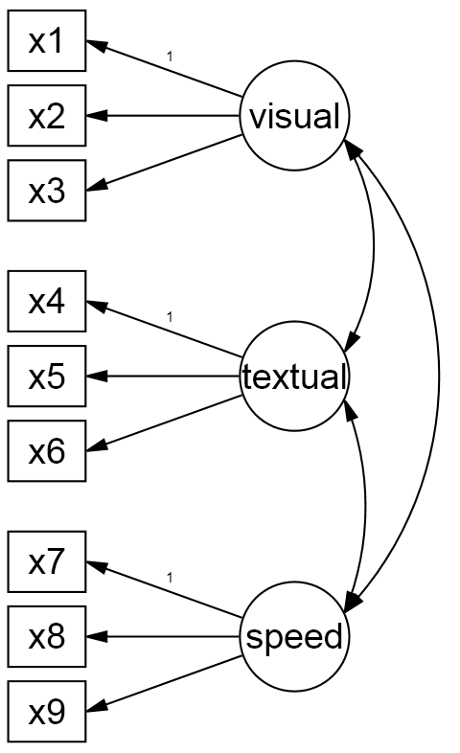
Illustration of MI analysis based on the Holzinger-Swineford study
Cognitive function tests (n=301)
Two school groups: Pasteur=156 Grant-white=145
Three factors, 9 indicators
x1 | Visual perception
x2 | Cubes
x3 | Lozenges
x4 | Paragraph comprehension
x5 | Sentence completion
x6 | Word meaning
x7 | Addition speed
x8 | Speed of counting of dots
x9 | Discrimination speed between straight and curved capitals
Some indicators might show measurement non-invariance due to different backgrounds of the students or the specific teaching style of the type of schools

Slide 6
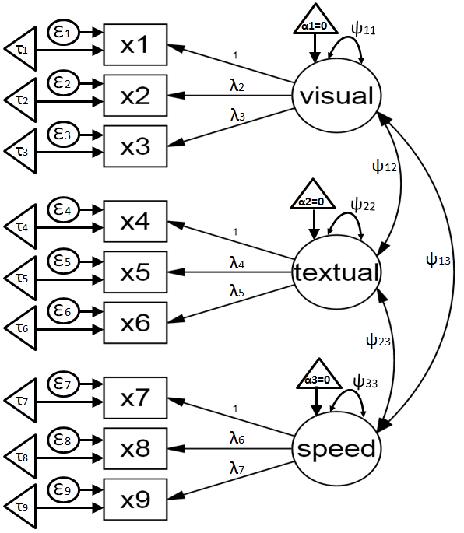
Parameter annotations
Measurement parameters
6 factor loadings
λ2, λ3, λ4, λ5, λ6, λ7
9 factor intercepts
τ1, τ2, τ3, τ4, τ5, τ6, τ7, τ8, τ9
9 Item residuals
ε1, ε2, ε3, ε4, ε5, ε6, ε7, ε8, ε9
Structural parameters
latent means
α1, α1, α3 (set to 0)
3 factor variances
ψ11 ψ22, ψ33
3 factor covariances
ψ12 ψ13, ψ23

Slide 7
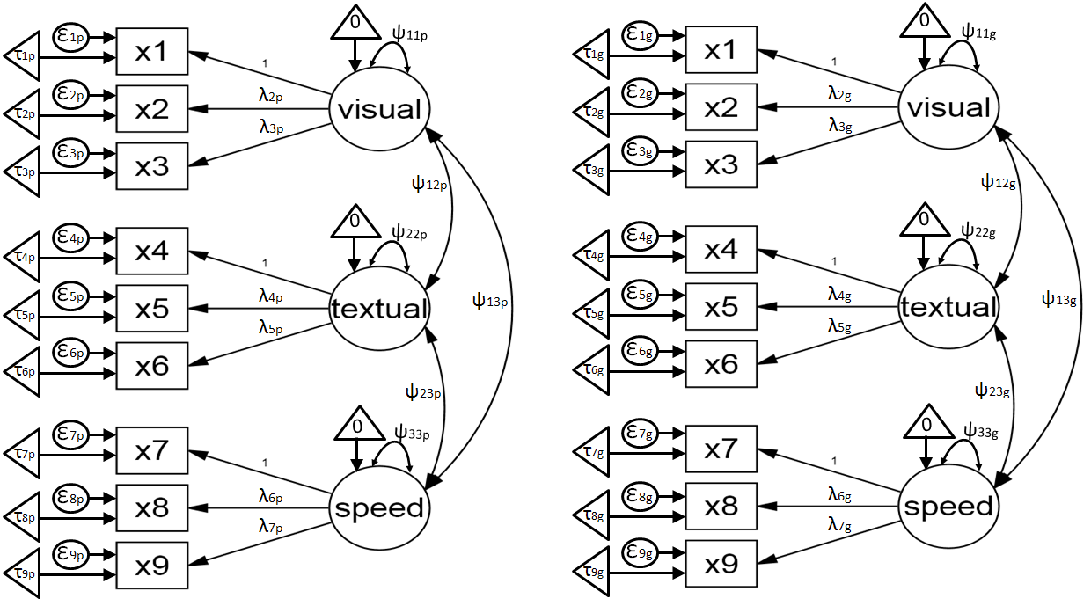
Multiple group CFA
Pasteur (n=156)
Grand-white (n=145)

Slide 8
Summary of steps in measurement invariance tests
 | Constrained parameters | Free parameters | comparison model
configural | FMean (=0) | fl+inter+res+var
Weak/loading invariance | fl+Fmean (=0) | inter+res+var | configural
Strong/scalar invariance | fl+inter | res+var+Fmean* | Weak/loading invariance
strict invariance | fl+inter+res | Fmean*+var | Strong/scalar invariance
Note. fl= factor loadings, inter = item intercepts, res = item residual variances, Fmean = mean of latent variable, var = variance of latent variable *Fmean is fixed to 0 in group 1 and estimated in the other group(s)

Slide 9
Evaluating measurement invariance using fit indices
Substantial decrease in goodness of fit indicates non-invariance
It is a good practise to look at several model fit indices rather than relying on a single one
Δχ²
ΔRMSEA
ΔCFI
ΔTLI
ΔBIC
ΔAIC
…

Slide 10
Identifying non-invariance
Modification index (MI)
MI indicates the expected decrease in chi-square if a restricted parameter is to be freed in a less restrictive model
Usually look for the largest MI value in the MI output, and free one parameter at a time through an iterative process
The usual cut-off value is 3.84, but this needs to be adjusted based on sample size (chi-square is sensitive to sample size) and number of tests conducted (type I error)

Slide 11
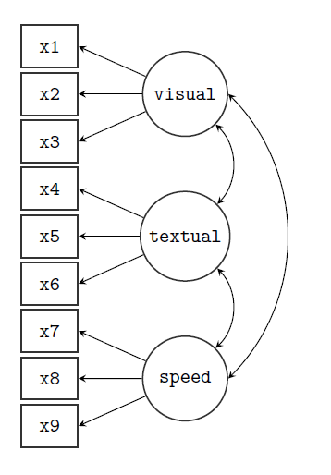
Lavaan: Measurement invariance analysis
Data: HolzingerSwineford1939
School type:
1=Pasteur (156)
2=Grand-white (145)
Define the CFA model
library(lavaan)
HS.model <-
'visual =~ x1 + x2 + x3
textual =~ x4 + x5 + x6
speed =~ x7 + x8 + x9'
semTools fits a series of increasingly restrictive models in one command:
library(semTools)
measurementInvariance(HS.model,data=HolzingerSwineford1939,
group="school")

Slide 12
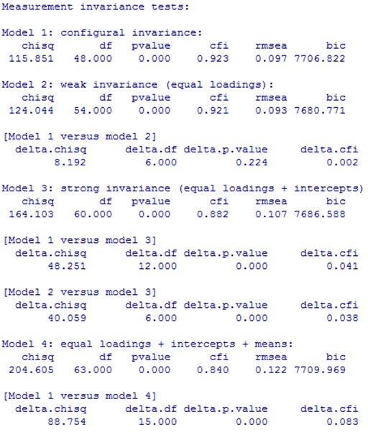
measurementInvariance(HS.model,data=HolzingerSwineford1939, group="school")
<-configural model (Model 1)
<-metric MI model (Model 2)
<- Metric MI achieved: non- significant chi-square change
<-scalar MI model (Model 3)
<- Scalar MI failed
<- Constrain latent means equal across groups, but this is no longer meaningful because of non-MI in Model 3.

Slide 13
Measurement invariance: Step 1: Configural invariance
Same factor structure in each group
First, fit model separately in each group
Second, fit model in multiple group but let all parameters vary freely in each group
No latent mean difference is estimated

Slide 14
Configural invariance
Constrained = none

Slide 15
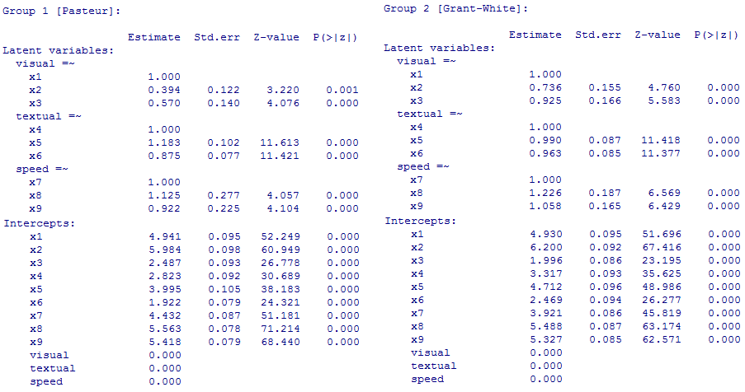
Lavaan: Model 1 configural model
model1<- cfa(HS.model, data=HolzingerSwineford1939, group="school")
summary(model1,fit.measures=TRUE)
All parameters are different across groups
chisq df pvalue cfi rmsea bic
115.851 48.000 0.000 0.923 0.097 7706.822

Slide 16
Measurement invariance: Step 2: Weak/metric invariance
Constrain factor loadings equal across groups
This shows that the construct has the same meaning across groups
In case of partial invariance of factor loadings, constrain the invariant loadings and set free the non-invariant loadings (Byrne, Shavelson, et al.;1989)
Based on separation of error variance of the items, one can assess invariance of latent factor variances, covariances, SEM regression paths
No latent mean difference is estimated

Slide 17
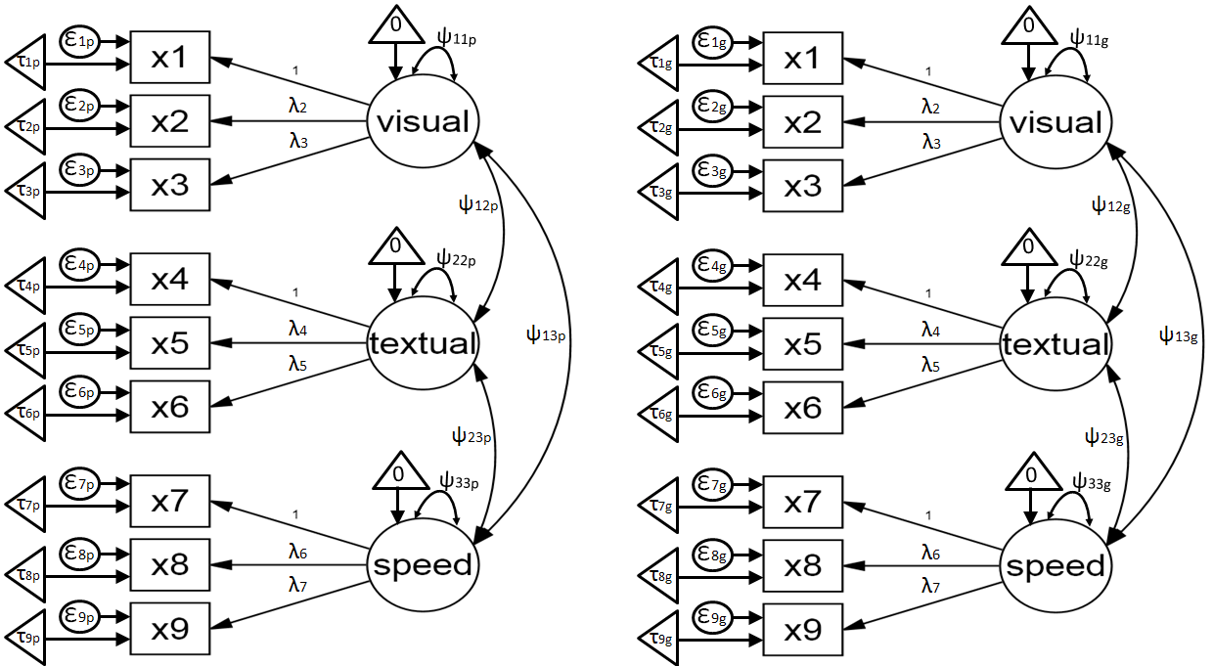
Weak/metric Invariance
Constrained = factor loadings

Slide 18
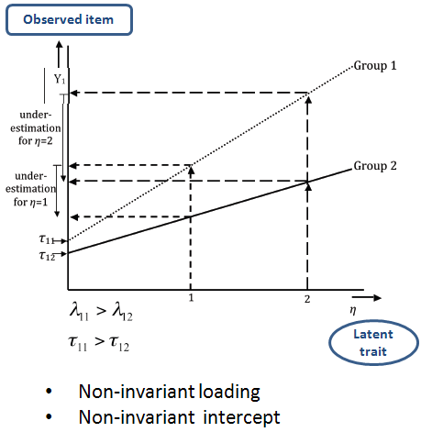
Weak/metric non-invariance
Meaning of the items are different across groups
Extreme response style might be present for some items
E.g. More likely to say “yes” in a group valuing decisiveness
Or more likely to choose a middle point in a group valuing humility
One shouldn’t compare variances and covariances of the scale based on observed scores that contain non-invariant items
(Wichert & Dolan 2011)

Slide 19

Lavaan: Model 2 metric MI
model2 <- cfa(HS.model, data=HolzingerSwineford1939, group="school", group.equal=c("loadings") )
summary(model2,fit.measures=TRUE)
Model 1: configural invariance:
chisq df pvalue cfi rmsea bic
115.851 48.000 0.000 0.923 0.097 7706.822
Model 2: weak invariance (equal loadings):
chisq df pvalue cfi rmsea bic
124.044 54.000 0.000 0.921 0.093 7680.771
anova(model1, model2)
Model fit index changes are minimal, hence, metric invariance is established.

Slide 20
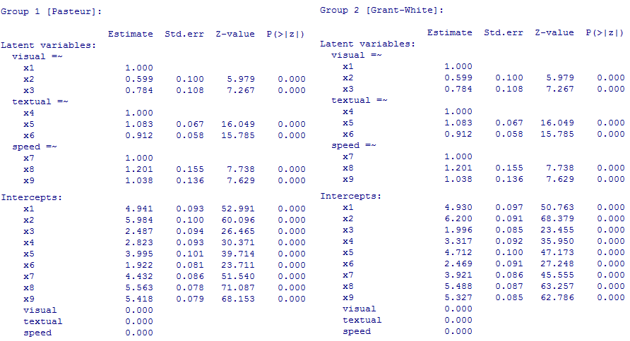
Lavaan: Model 2 metric MI
model2 <- cfa(HS.model, data=HolzingerSwineford1939, group="school", group.equal=c("loadings") )
Loadings are the same across groups, but intercepts are freely estimated

Slide 21
Measurement invariance: Step 3: Strong/scalar invariance
Constrain item intercepts equal across groups
Constrain factor loadings
This is important for assessing mean difference of the latent variable across groups
In case of partial invariance of item intercepts, constrain the invariant intercepts and set free the non-invariant intercepts (Byrne, Shavelson, et al.;1989)
Latent mean difference is estimated

Slide 22
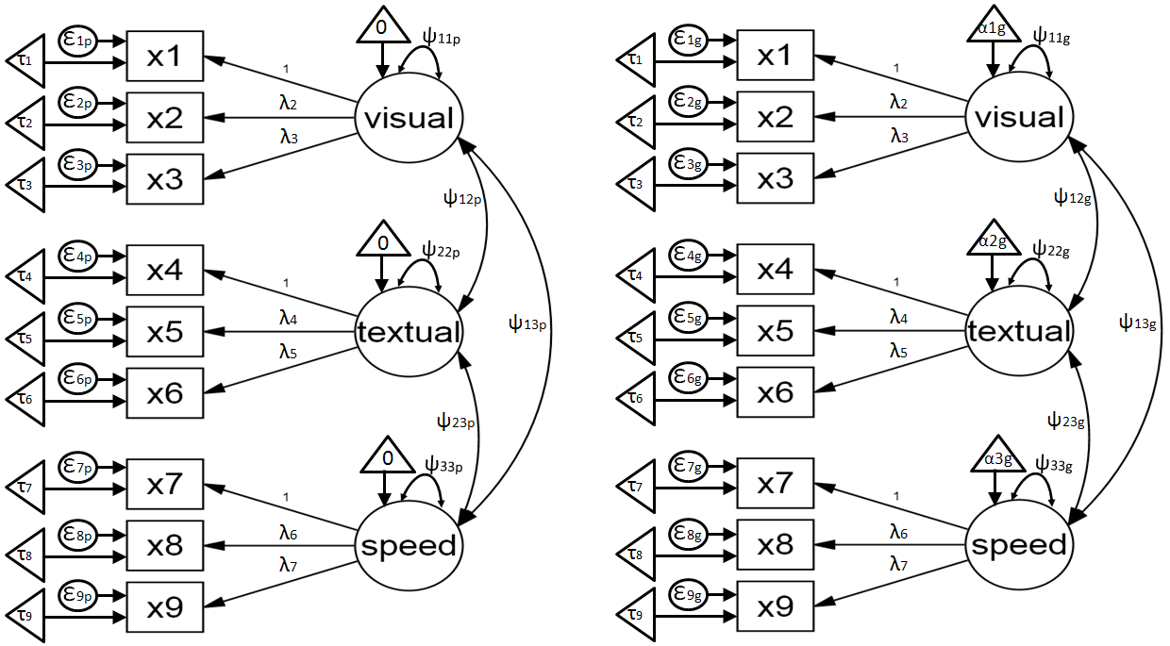
Strong/scalar invariance
Factor loadings
Constrained = + item intercepts

Slide 23
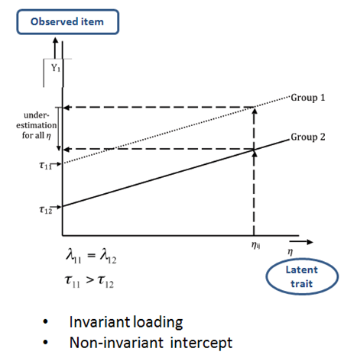
Strong/scalar non-invariance
A group tend to systematically give higher or lower item response
This might be caused by a norm specific to that group
For instance in name learning tests that involve unfamiliar names for a group
This is an additive effect. It affects the means of the observed item, hence affects the mean of the scale and the latent variable
(Wichert & Dolan 2011)

Slide 24
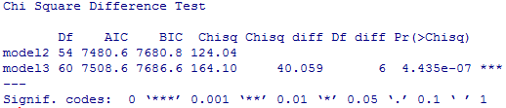
Lavaan: Model 3 scalar invariance
model3 <- cfa(HS.model, data=HolzingerSwineford1939, group="school", group.equal=c("loadings", "intercepts"))
summary(model3,fit.measures=TRUE)
Model 2: weak invariance (equal loadings):
chisq df pvalue cfi rmsea bic
124.044 54.000 0.000 0.921 0.093 7680.771
Model 3: strong invariance (equal loadings + intercepts):
chisq df pvalue cfi rmsea bic
164.103 60.000 0.000 0.882 0.107 7686.588
anova(model1, model2)
Significant χ² change indicates intercepts non-invariance
Modification index can be used to identify which item intercepts are non-invariant

Slide 25
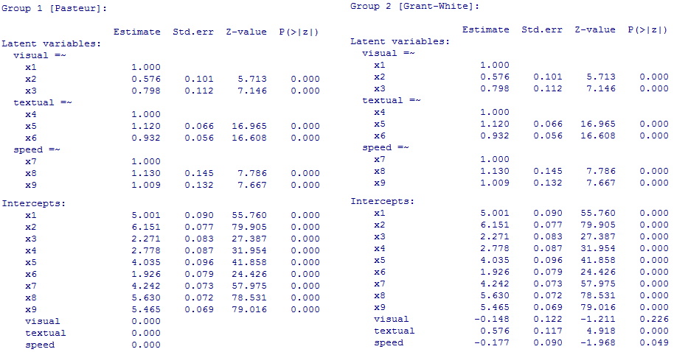
Lavaan: Model 3 scalar invariance
model3 <- cfa(HS.model, data=HolzingerSwineford1939, group="school", group.equal=c("loadings", "intercepts"))
Both intercepts and loadings are constrained across groups, but latent means are estimated

Slide 26
Lavaan: Modification index
model3 <- cfa(HS.model, data=HolzingerSwineford1939, group="school", group.equal=c("loadings","intercepts"))
modindices(model3)
lhs op group mi epc sepc.lv sepc.all sepc.nox
81 x3 ~1 1 17.717 0.248 0.248 0.206 0.206
85 x7 ~1 1 13.681 0.205 0.205 0.186 0.186
171 x3 ~1 2 17.717 -0.248 -0.248 -0.238 -0.238
175 x7 ~1 2 13.681 -0.205 -0.205 -0.193 -0.193
Modification index showed that item 3 and item 7 have intercept estimates that are non-invariant across groups.
In the next model, we allow partial invariance of item intercept, freeing the intercepts of item 3 and item 7.

Slide 27

Lavaan: Model 3a scalar invariance with partial invariance
model3a <- cfa(HS.model, data=HolzingerSwineford1939, group="school",
group.equal=c("loadings", "intercepts"), group.partial=c("x3~1", "x7~1"))
summary(model3a,fit.measures=TRUE)
Model 2: weak invariance (equal loadings):
chisq df pvalue cfi rmsea bic
124.044 54.000 0.000 0.921 0.093 7680.771
Model 3a: strong invariance (equal loadings + intercepts),
allowing intercepts of item 3 and item 7 to vary:
chisq df pvalue cfi rmsea bic
129.422 58.000 0.000 0.919 0.090 7663.322
anova(model3a, model2)
The scalar invariance model now has partial invariance, thus latent means can be compared

Slide 28
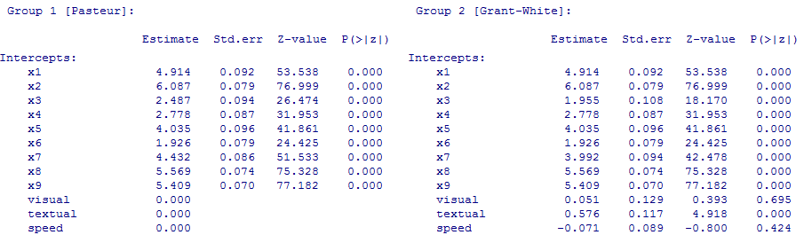
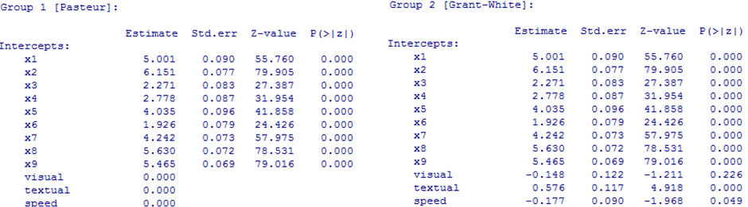
Lavaan: Model 3a scalar invariance with partial invariance (x3, x7)
Lavaan: Model 3a Scalar Invariance WITHOUT partial invariance
Grant-White school students does better on textual factor as compared to Pasteur school students
After allowing for partial invariance, there is no difference in speed between Grant-While school and Pasteur school

Slide 29
Measurement invariance: Step 4: Strict invariance
Constrain item residual variances to be equal across groups
Constrain item factor loadings and intercepts equal across groups. In case of partial invariance constrain the invariant parameters and set free the non-invariant parameters
Strict invariance is important for group comparisons based on the sum of observed item scores, because observed variance is a combination of true score variance and residual variance
Latent mean difference is estimated

Slide 30
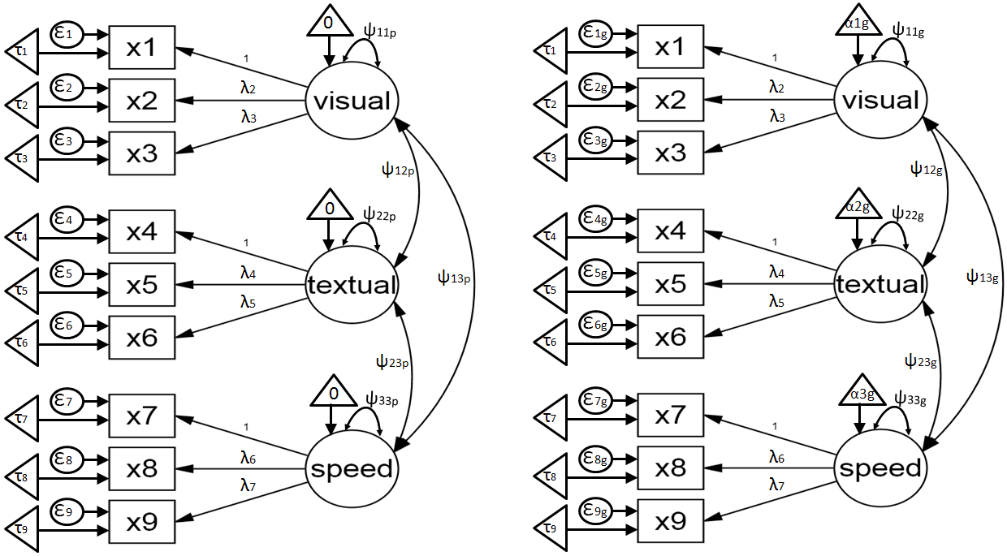
Strict invariance
Constrained = factor loadings + item intercepts + residual variances

Slide 31
Lavaan: Model 4 strict invariance
model4<- cfa(HS.model, data=HolzingerSwineford1939, group="school", group.equal=c("loadings", "intercepts", "residuals"), group.partial=c("x3~1", "x7~1"))
summary(model4,fit.measures=TRUE)
Model 3a: strong invariance (equal loadings + intercepts), allowing intercepts of item 3 and item 7 to vary:
chisq df pvalue cfi rmsea bic
129.422 58.000 0.000 0.919 0.090 7663.322
Model 4: strict invariance (equal loadings + intercepts + item residual variances)
chisq df pvalue cfi rmsea bic
147.260 67 0.000 0.909 0.089 7629.796
The chi-square difference is borderline significant (p=0.037), but the BIC and RMSEA showed improvement. Based on the number of tests in the model, it is probably safe to ignore the chi-square significance
This imply that items are equally reliable across groups. If all items were invariant, it would be valid to use sum scores for data involving mean and regression coefficient comparisons across groups

Slide 32
Structural invariances
Factor variances
Factor covariances (if more than one latent factors)
Regression path coefficients (in multiple group SEM analysis)

Slide 33
Lavaan: Model 5 factor variances and covariances
model5 <- cfa(HS.model, data=HolzingerSwineford1939, group="school",
group.equal=c("loadings", "intercepts", "residuals", "lv.variances", "lv.covariances"), group.partial=c("x3~1", "x7~1"))
summary(model5,fit.measures=TRUE)
Model 4: strict invariance (equal loadings + intercepts + item residual variances)
chisq df pvalue cfi rmsea bic
147.260 67 0.000 0.909 0.089 7629.796
Model 5: factor variance and covariance invariance (equal loadings + intercepts + item residual variances + factor var&cov)
chisq df pvalue cfi rmsea bic
153.258 73 0.000 0.909 0.085 7601.551
The chi-square difference is not significant (p= 0.42), and the RMSEA showed improvement. The variance and covariance of latent factors are invariant across groups
As a matter of fact, if one does analysis with latent variables, then strict invariance if not really a prerequisite, since measurement errors are taken into account of as part of the model

Slide 34
Summarising the MI analysis
Model | χ² | DF | CFI | RMSEA | BIC | Base | Δχ2 | ΔDF | ΔCFI | ΔRMSEA | ΔBIC
m1 | 115.851 | 48 | 0.923 | 0.097 | 7707 |  |  |  |  |  |  | inv=none, free=fl+inter+uniq+var+cov
m2 | 124.044 | 54 | 0.921 | 0.093 | 7681 | m1 | 8.193 | 6 | -0.002 | -0.004 | -26 | inv=fl, free=inter+uniq+var+cov
m3 | 164.103 | 60 | 0.882 | 0.107 | 7687 | m2 | 40.059 | 6 | -0.039 | 0.014 | 6 | inv=fl+inter, free=Fmean+uniq+var+cov
m3a | 129.422 | 58 | 0.919 | 0.090 | 7663 | m2 | 5.378 | 4 | -0.002 | -0.003 | -17 | inv=fl+inter, free=inter(x3+x7)+uniq+var+cov
m4 | 147.260 | 67 | 0.909 | 0.089 | 7630 | m3a | 17.838 | 9 | -0.010 | -0.001 | -34 | inv=fl+inter+uniq, free=inter(x3+x7)+Fmean+var+cov
m5 | 153.258 | 73 | 0.909 | 0.085 | 7602 | m4 | 5.998 | 6 | 0.000 | -0.004 | -28 | inv=fl+inter+uniq+var+cov , free=inter(x3+x7)+Fmean
MI analysis includes a series of nested models with an increasingly restrictive parameter specifications across groups
The same principle applies for longitudinal data
Testing measurement invariance of items over time
This is a basis for analysis that compares latent means over time, for instance, in a growth curve model

Slide 35
Measurement invariance – other issues
Setting of referent indicator
Identify the “most non-invariant” item to use as referent indicator
Or set factor variance to 1 to avoid selecting a referent item
Multiple testing issue
Analysing Likert scale data
Number of categories and data skewness (Rhemtulla, Brosseau-Liard, & Savalei; 2012)
Robust maximum likelihood
Ordinal factor analysis treating data as dichotomous or polytomous (Millsap & Tein, 2004; Muthen & Asparouhov, 2002)

Slide 36
Some references
Sass, D. A. (2011). "Testing Measurement Invariance and Comparing Latent Factor Means Within a Confirmatory Factor Analysis Framework." Journal of Psychoeducational Assessment 29(4): 347-363.
Wicherts, J. M. and C. V. Dolan (2010). "Measurement invariance in confirmatory factor analysis: An illustration using IQ test performance of minorities." Educational Measurement: Issues and Practice 29(3): 39-47.
Gregorich, S. E. (2006). "Do self-report instruments allow meaningful comparisons across diverse population groups? Testing measurement invariance using the confirmatory factor analysis framework." Medical Care 44(11 Suppl 3): S78.
Byrne, B. M., R. J. Shavelson, et al. (1989). "Testing for the equivalence of factor covariance and mean structures: The issue of partial measurement invariance." Psychological bulletin 105(3): 456-466.
Millsap, R. E. and J. Yun-Tein (2004). "Assessing factorial invariance in ordered-categorical measures." Multivariate Behavioral Research 39(3): 479-515.
Meredith, W. (1993). "Measurement invariance, factor analysis and factorial invariance." Psychometrika 58(4): 525-543.
Rhemtulla, M., Brosseau-Liard, P. É., & Savalei, V. (2012). When can categorical variables be treated as continuous? A comparison of robust continuous and categorical SEM estimation methods under suboptimal conditions. Psychological Methods, 17(3), 354-373. doi: 10.1037/a0029315

Slide 37
Acknowledgement: Dr. Adam Wagner provided thoughtful comments on earlier drafts

