Slide 1
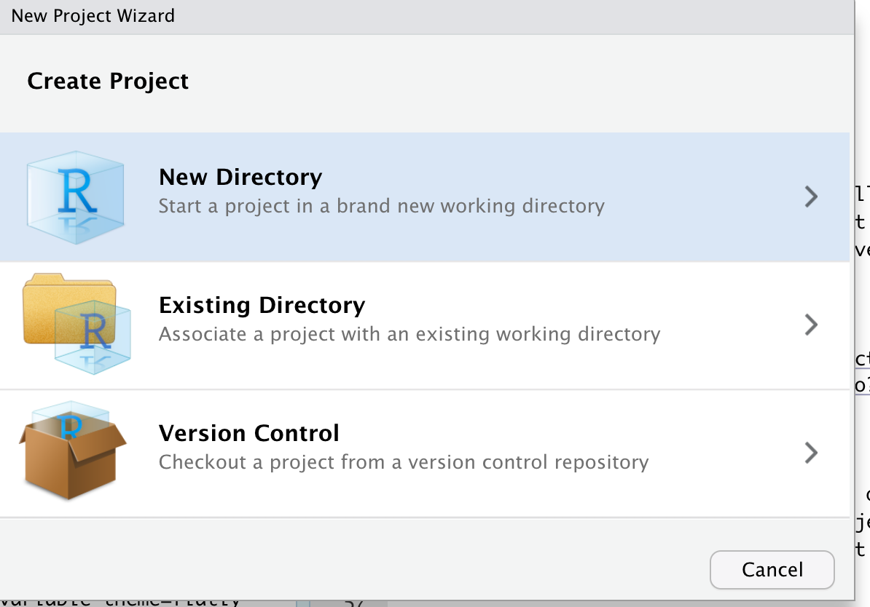
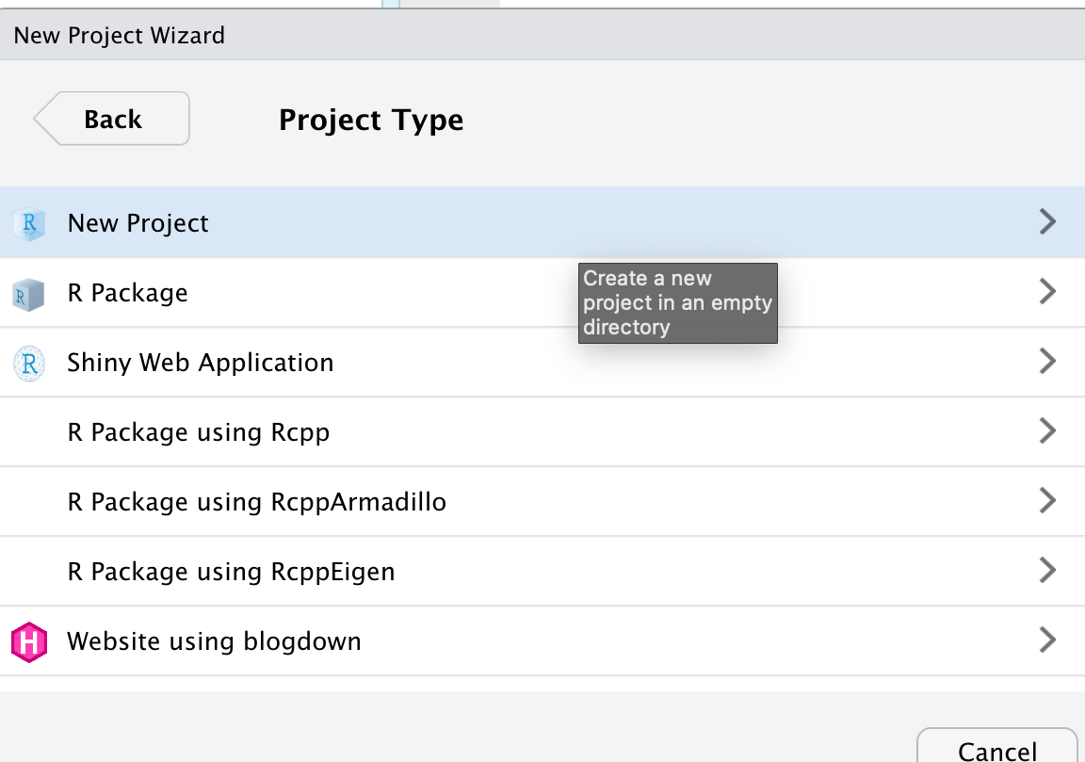
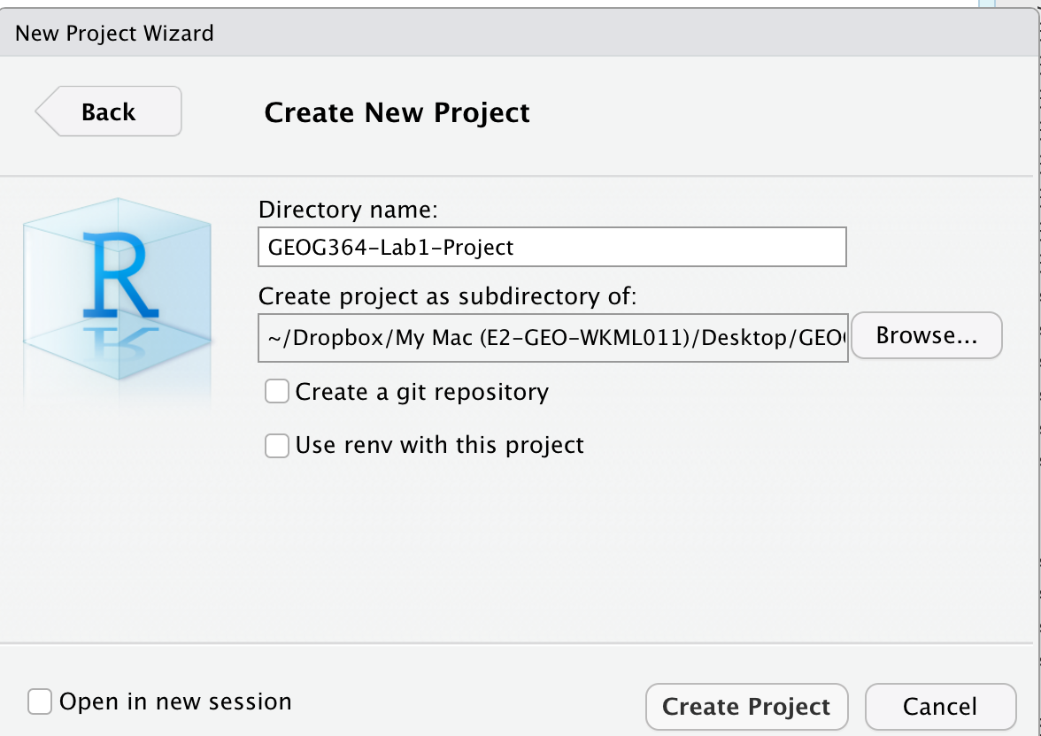

Slide 2
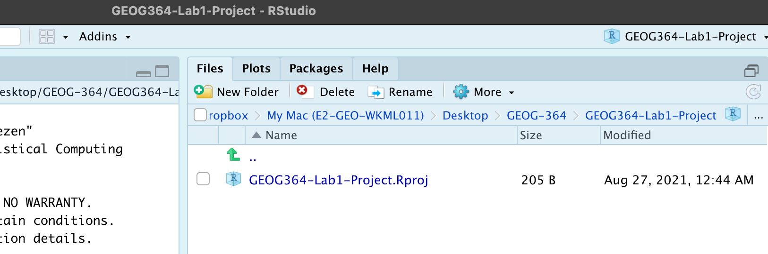

Slide 3
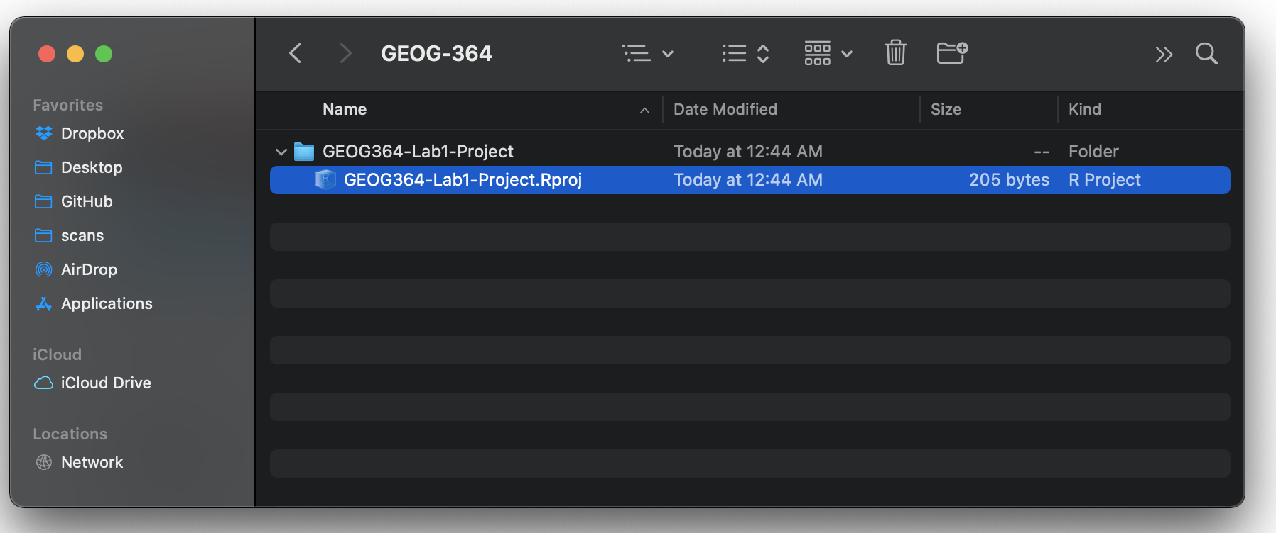
Instead of restarting RStudio from your programs, DOUBLE CLICK THIS FILE

Slide 4
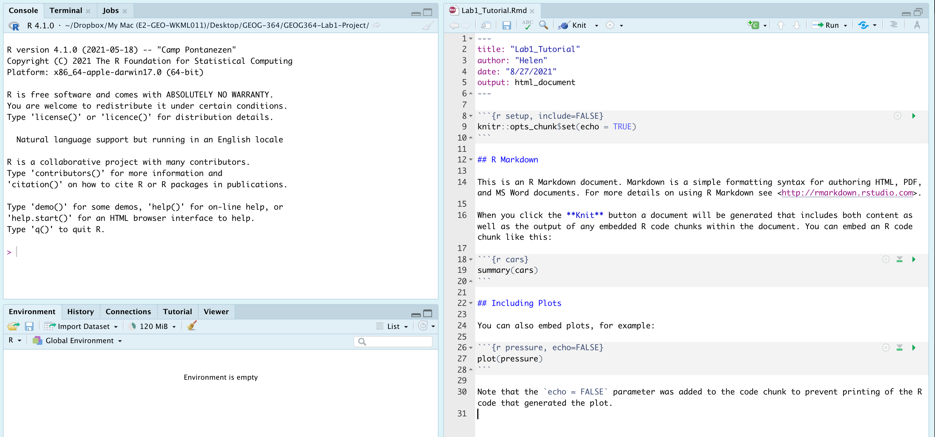
This tells the computer what type of document we want to make (e.g. website, presentation..)
Ignore this for now
Normal text
A “mini console” AKA a code chunk
A heading in your text

