Slide 1

Codechef 2nd round presentation
Submited by-subhash kumar pal

Slide 2
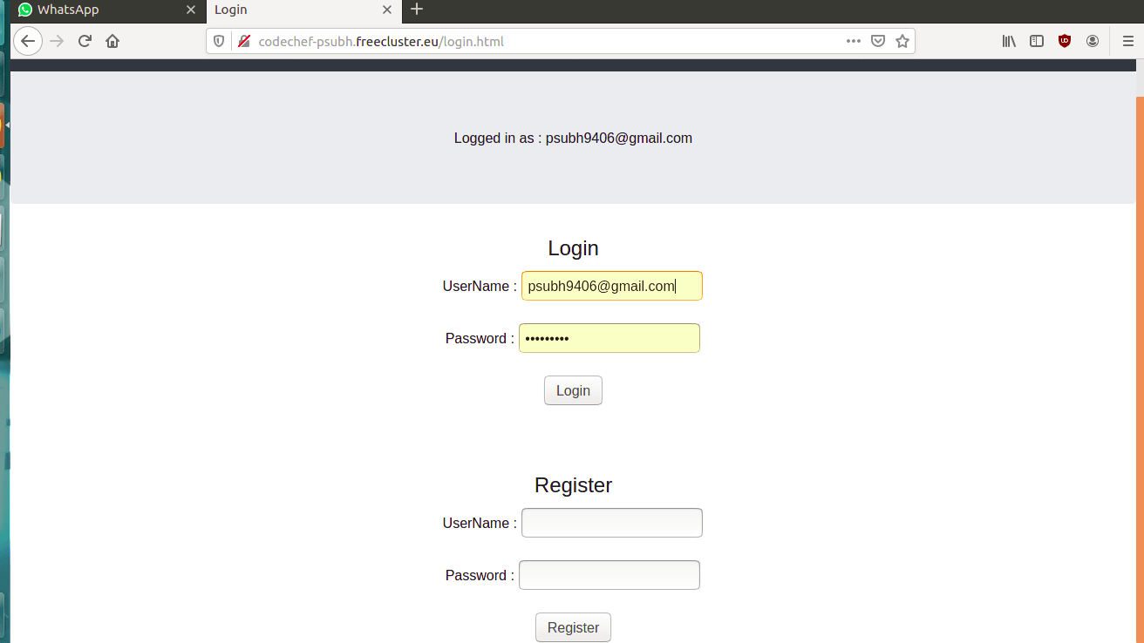
Login page
Its is the login page where we can create new account and those having already account they can login and it having feature of autosave in which you don’t need to remember password.

Slide 3
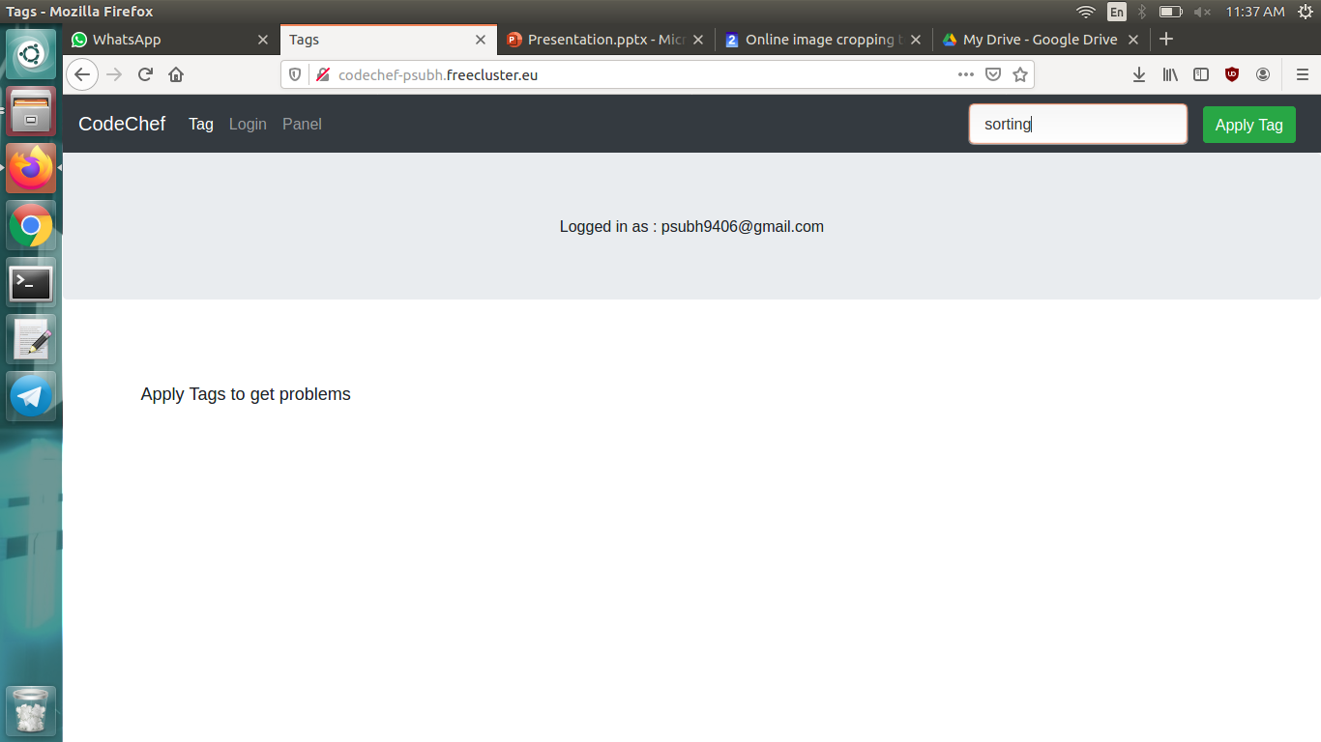
Home page
In this page we can apply different tags for searching questions related to that tag.It will send all the related questions in which that tag is avilable.

Slide 4
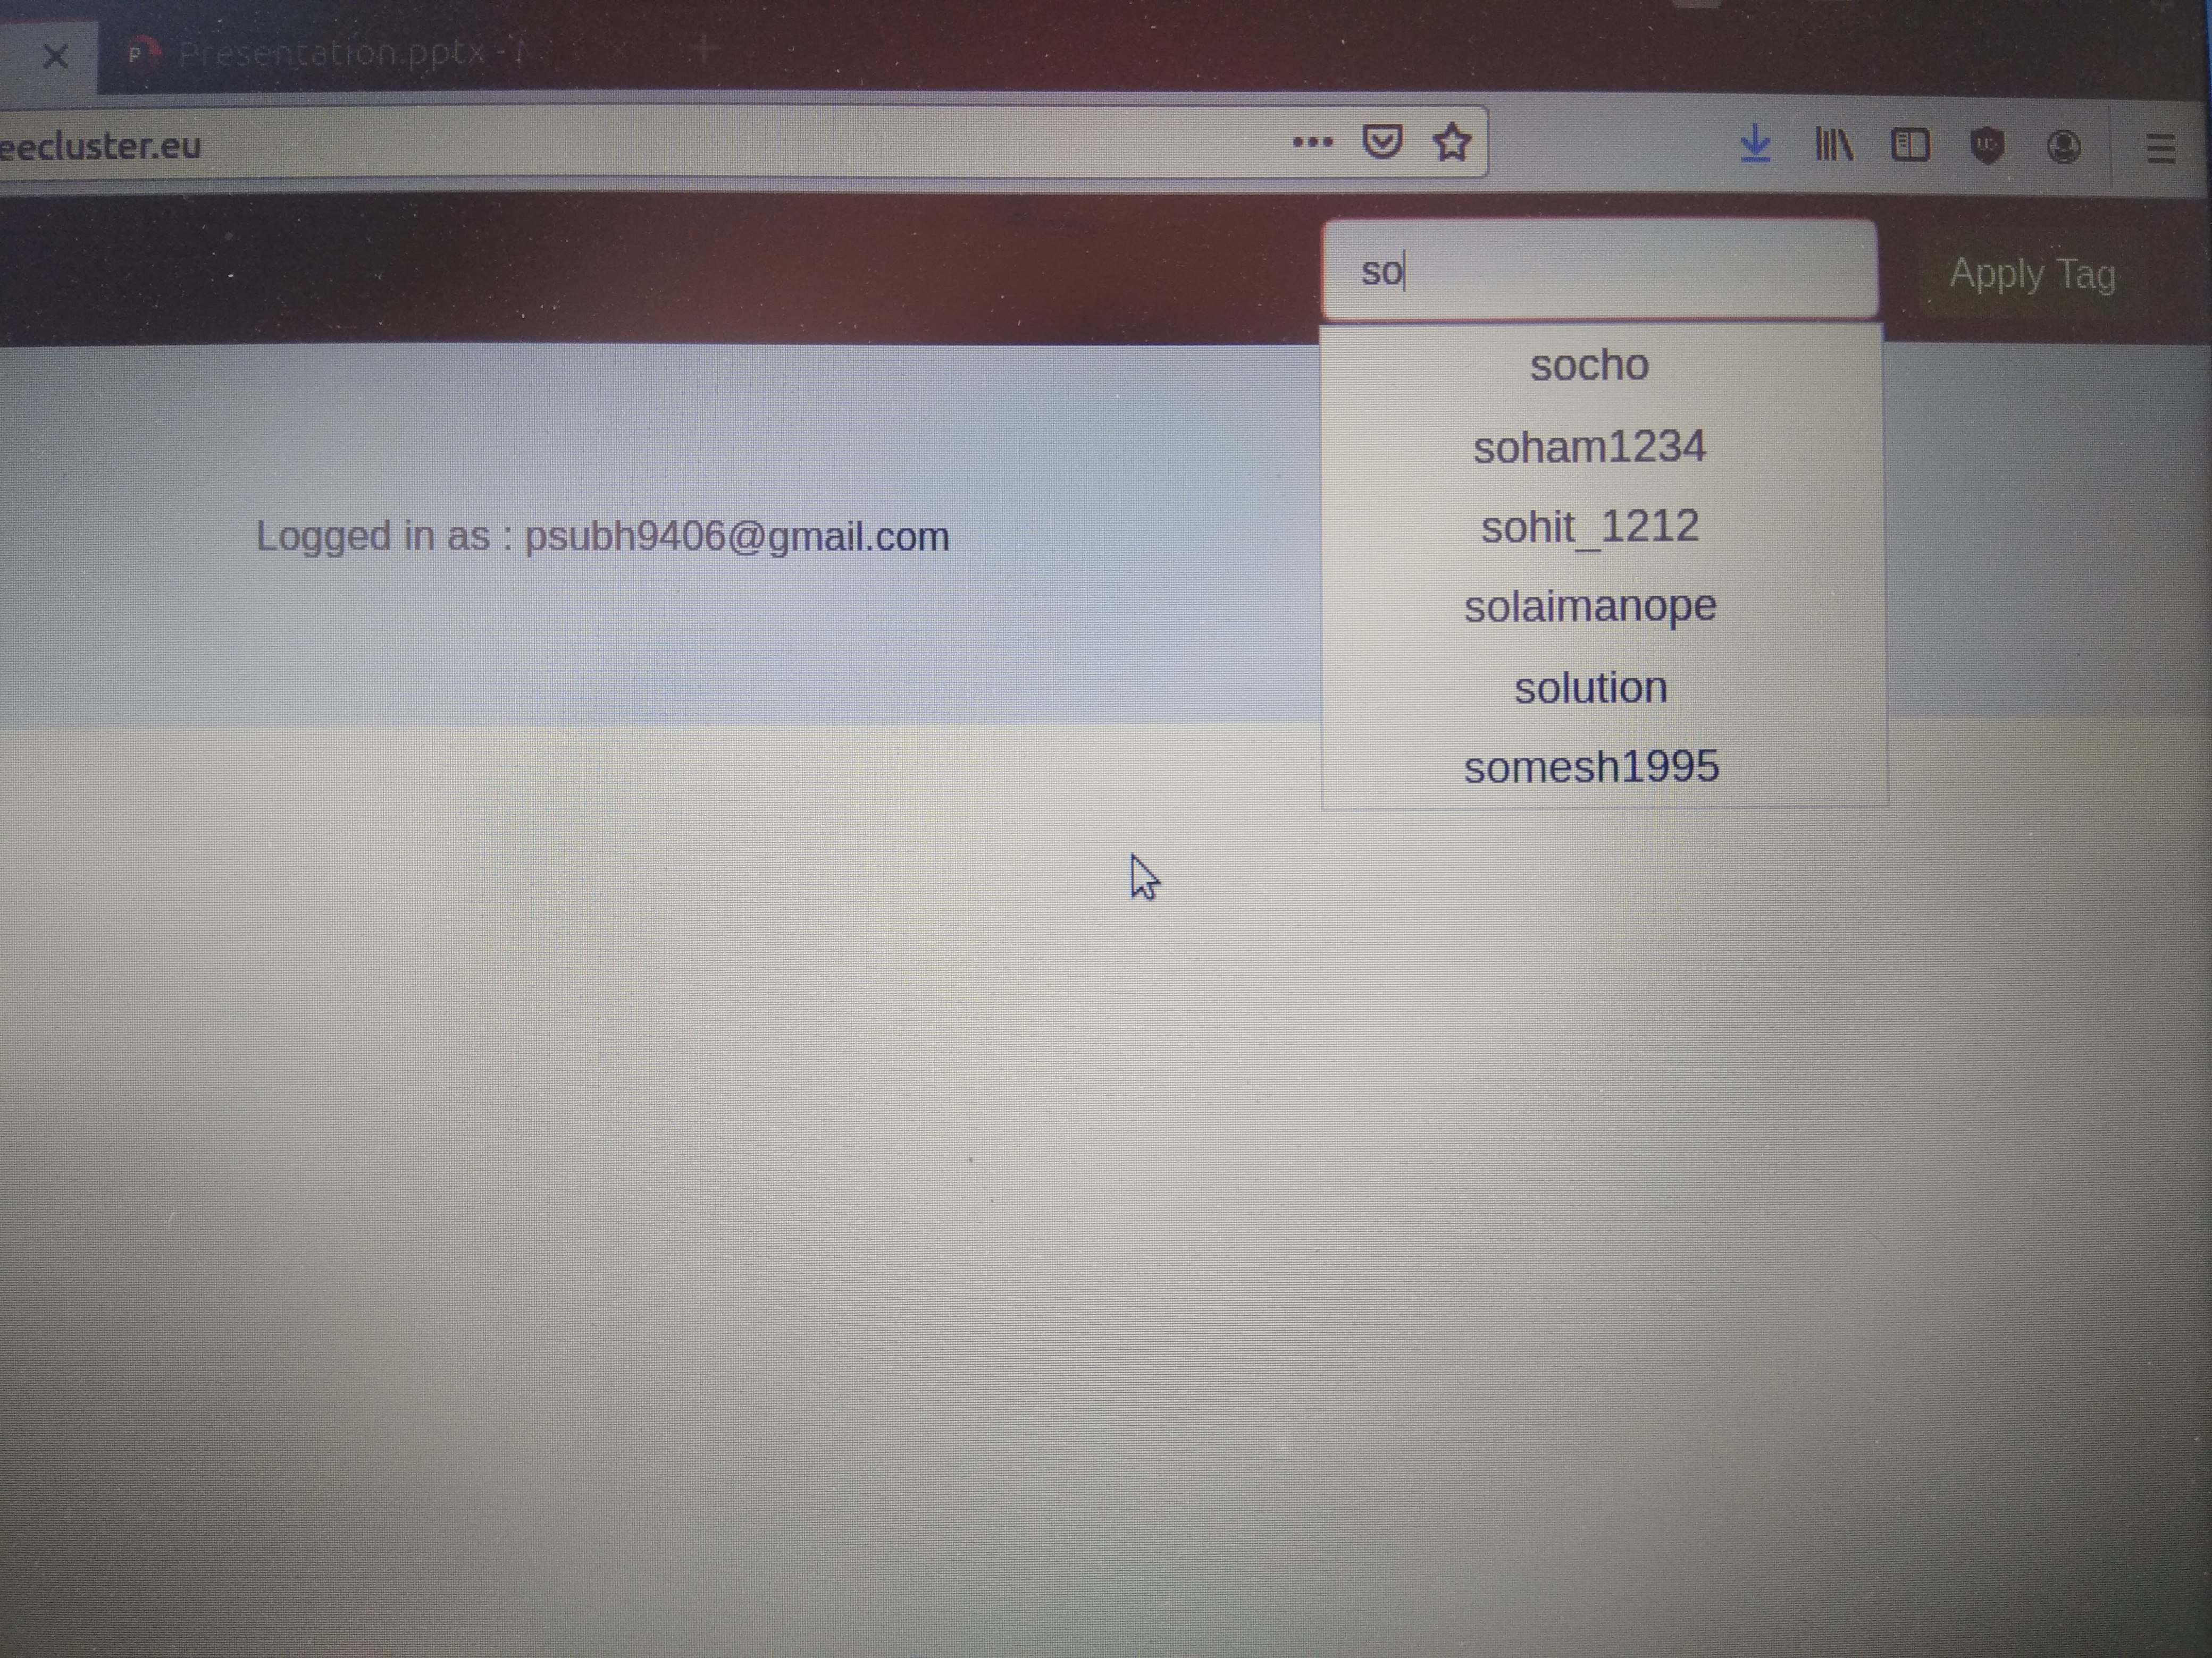
Auto suggestions in tag
In the tag searching it ia a feature of auto suggestion which help user to find the relevant tag to search problem.

Slide 5
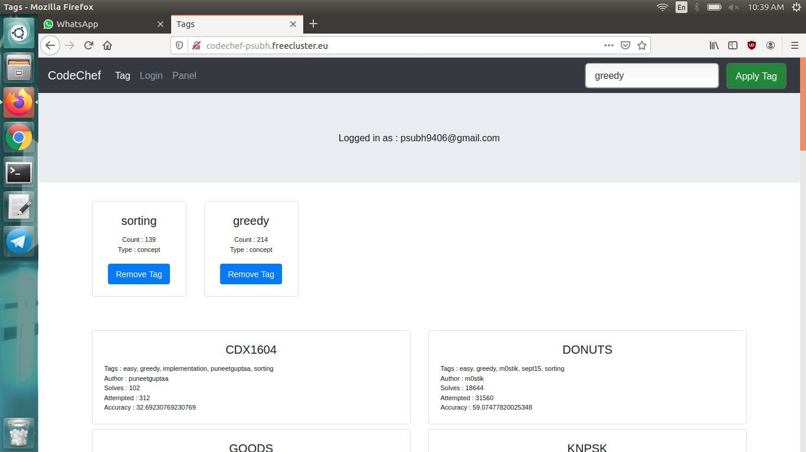
Add and remove tag according to user
In this page we can segreggate questions on the basis of applied tags and here we can apply multiple tag togethere and as a result we will get questions related to that tags.

Slide 6
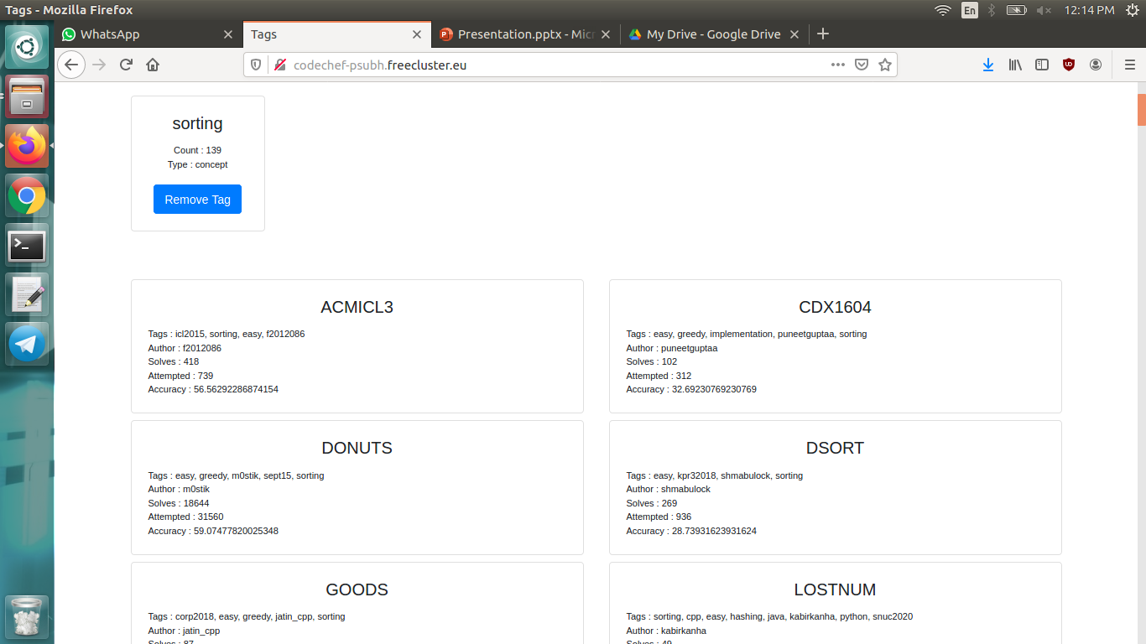
List of questions on the basis of tag
On the basis of multiple tags we will get questions list including all tags.

Slide 7
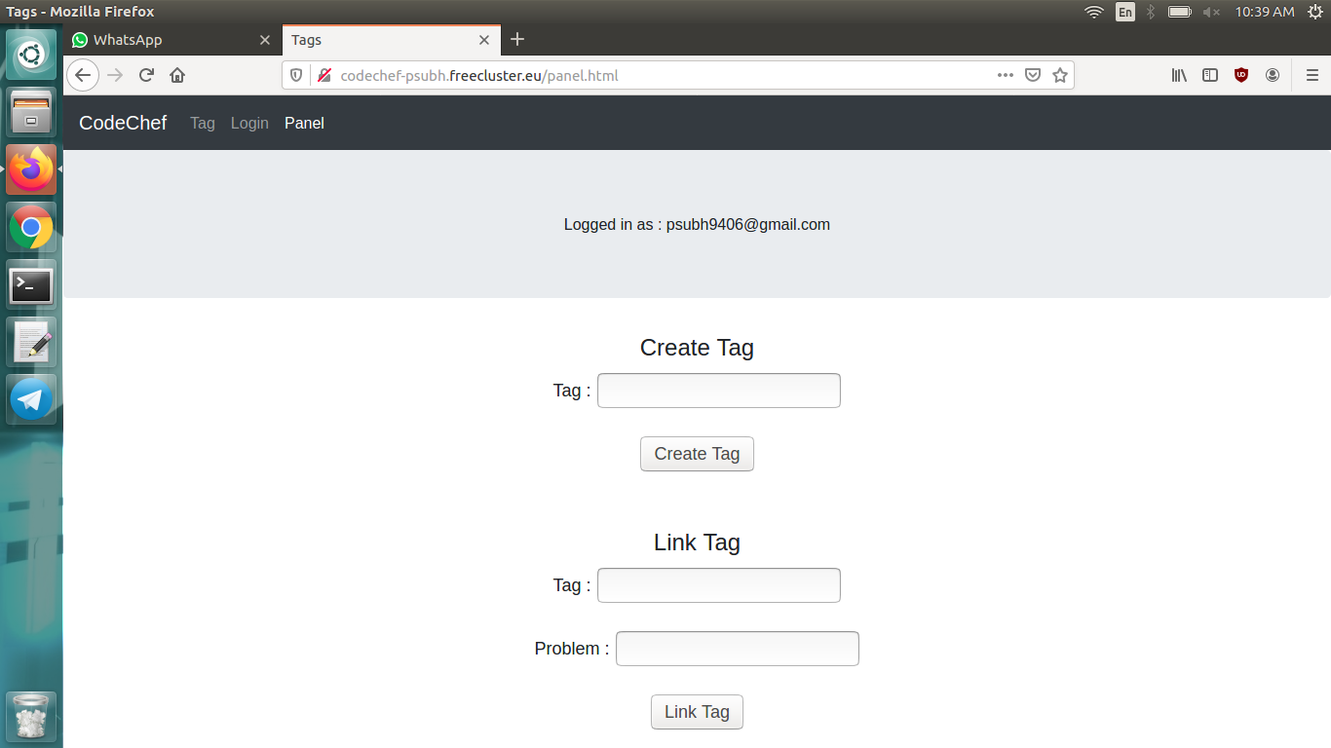
Create and link questions tag by user
In this page we can create tag and add tag to existing problem statement.This can be easily done with the create tag button and link tag button by user itself.

Slide 8
Api used
/api/problems
Type : GET
Params : None
Returns : JSON array of the name of all the problems in the database
/api/tags
Type : GET
Params : None
Returns : JSON array of the name of all the tags in the database. If a user is logged in, name of tags created by him are also returned.
/api/tag/{tag_name}
Type : GET
Params : Name of tag in URL
Returns : JSON Object of the details of the tag name provided as parameter

Slide 9
Api used
/api/problem
Type : POST
Params : JSON Array of tag names
Returns : JSON Array of an Array of problems and their details satisfying the list of tags provided as parameter
/api/login
Type : POST
Params : Username and Password entered by user
Returns : The login state of the user
/api/register
Type : POST
Params : Username and Password entered by user
Returns : The registeration state of the user

Slide 10
Api used
/api/username
Type : GET
Params : None
Returns : The login state of the user along with username if he is logged in
/api/usertags
Type : GET
Params : None
Returns : JSON Array of the name of tags created by the user if he is logged in
/api/createtag
Type : POST
Params : user tag name
Returns : Result of the tag creation for the logged in user

Slide 11
Thank you

