Slide 1
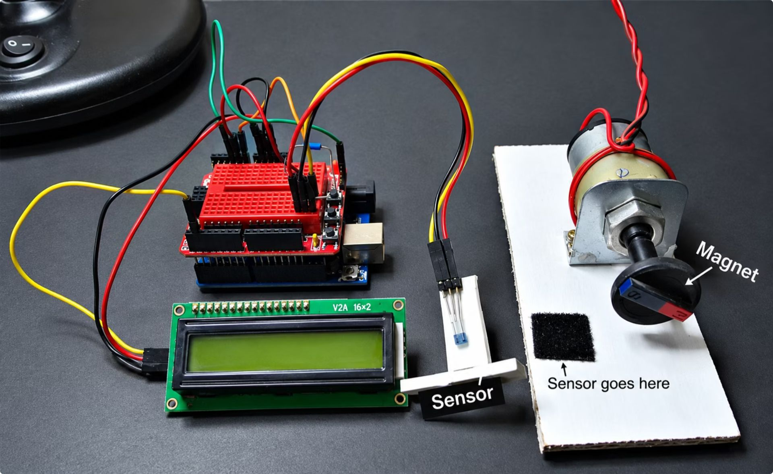

MOTOR MONITORING · PROTOTYPE SYSTEM
From motion to protection
JamGuard follows a simple chain: observe motor rotation, interpret whether motion is still present, and react when the expected movement disappears.
1 · Sense — Capture rotation as a stream of repeatable motion signals.
2 · Decide — Use the signal pattern to distinguish ongoing movement from a possible stoppage.
3 · Protect — Make the loss of motion visible and support an automatic protective response.
JAMGUARD
Smart Motor Monitoring and Automatic Protection System
SUBMITTED BY-
PATNALA SUBHAOM KUMAR PATRO (26BEC0268)
RUCHIR NILESH PATIL (26BEC0187)
AARAV GHIYA (26BEC0169)
ATHARV SAXENA (26BEC0387)
The project demonstrates an adaptable monitoring principle, not a finished industrial deployment.
GUIDED BY– Dr. KVN KAVITHA
A prototype concept for noticing lost rotation and triggering a protective response.
Notes:
Introduce JamGuard as a prototype system: it watches motor rotation, interprets a loss of motion, and supports a protective response without claiming deployment results.

Slide 2

THE FAILURE MODE
What JamGuard adds
When a motor stops, the machine can stop with it
Visible evidence
Fault awareness
Rotation becomes a readable signal instead of an unseen mechanical assumption.
A missing or interrupted motion pattern can be surfaced as a possible fault condition.
Unexpected stoppages can interrupt conveying, feeding, positioning, or access-control tasks.
Protective reaction
Adaptable principle
The earlier the loss of motion is noticed, the sooner a system can move into a safer response.
The prototype links a detected loss of motion to a response path intended to prevent the machine from carrying on blindly.
The same monitoring idea can be shaped around different small motor-driven systems.
Notes:
Frame the problem in practical terms: when rotation disappears, a wider machine may continue waiting, pushing, or feeding unless the system notices. JamGuard adds a monitoring and response concept, not a claim of existing deployment.

Slide 3
THE RESPONSE LOOP
JamGuard watches rotation and reacts to loss of motion
One signal becomes one protective response.
01
02
03
04
Measure
Detect
Protect
Report
Magnetic pulses track motor rotation.
Sustained loss of rotation becomes a fault.
The motor disables; LED and buzzer activate.
RPM and status reach the local ESP32 dashboard.
Notes:
Walk left to right. JamGuard measures movement, distinguishes a sustained loss from a momentary gap, protects the motor, and reports the state locally.

Slide 4


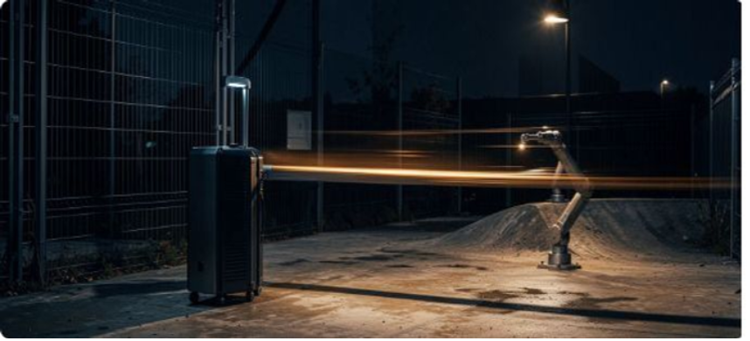

WHERE IT FITS
The same protection principle fits many motor-driven systems
Conveyor belts
Packaging machines
JamGuard demonstrates an adaptable principle, not an industrial deployment claim.
Robotics and automated gates
Small manufacturing systems
04
Notes:
These are examples of where the principle could transfer. Keep the claim appropriately bounded: this is an adaptable prototype concept, not an industrial deployment certification.

Slide 5


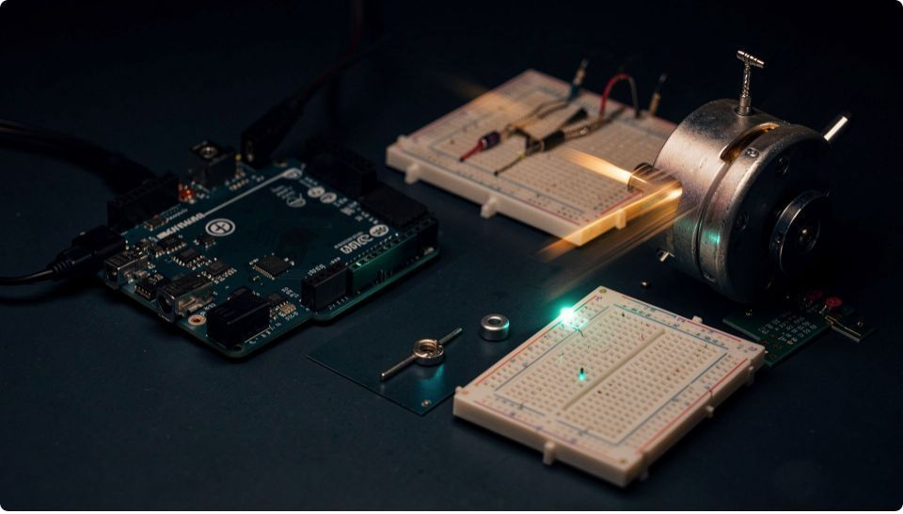




THE PROTOTYPE STACK
Each component has one clear job
Arduino Uno
ESP32
Sensing, RPM calculation, control logic.
Serial data, Wi-Fi access point, local webpage.
DC motor + L298N
Breadboard, jumper wires,motor supply
Hall sensor + 5 mm magnet
LED, buzzer, resistor, reset button
Monitored motor and driver stage.
Rotation pulse detection.
Prototype connections and power.
Alerts and manual restart.
Notes:
Emphasize the separation of responsibility. The Arduino thinks, the ESP32 communicates, the sensor observes, the L298N drives, and the alert components make the state visible.

Slide 6
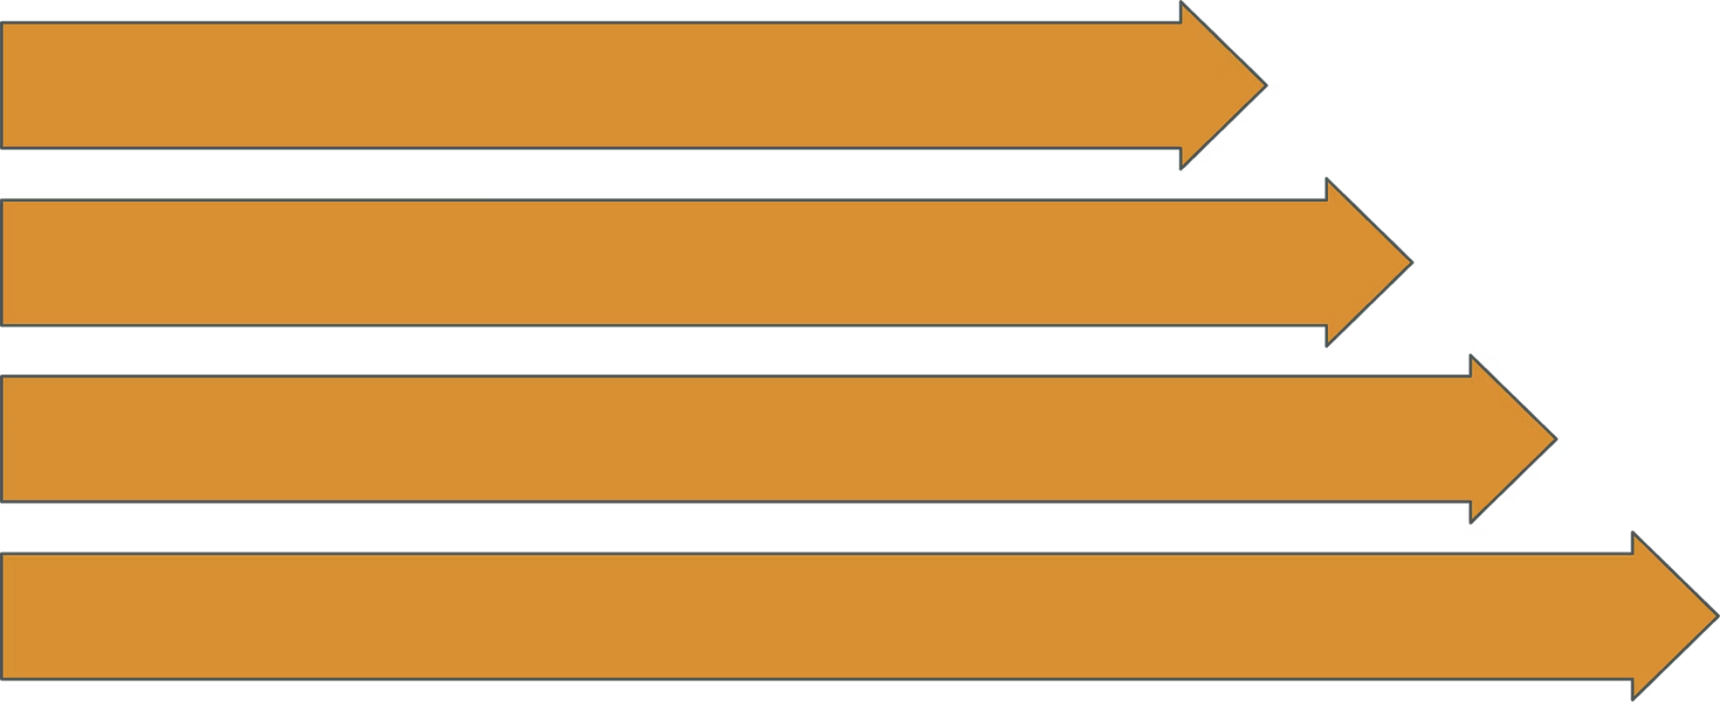
WORKING PRINCIPLE
From magnetic pulse to automatic protection
Magnet Passes Sensor
Each stage leaves evidence for the next stage to use.
Sensor Produces Pulses
Arduino Calculates RPM
Detect Missing Pulses
Pulse detection → decision → protection → dashboard update
Notes:
Describe the chain as evidence moving through the system. Physical rotation creates pulses, pulses become an RPM reading, missing pulses become a fault decision, and the response is both local and visible on the dashboard.

Slide 7

THE READOUT
From pulse stream to a trustworthy motor state
RPM is one useful summary, but JamGuard first checks whether the pulse evidence is consistent enough to trust.
EVIDENCE
PULSE
ILLUSTRATIVE CALCULATION
arrival pattern
Worked example — 8 pulses/second × 60 ÷ 1 pulse/revolution = 480 RPM.
DECISION
Illustration only; not a measured project result.
VALID
1 · Observe — The Hall sensor produces an event whenever the magnet passes its field.
2 · Validate — The controller watches pulse timing across a short window, rejecting gaps or bursts that do not form a stable rotation pattern.
3 · Decide — If expected pulses disappear for long enough, JamGuard flags a possible stoppage and hands the state to the protection logic.
or possible fault
Sensor events become a monitored motor state
This interpretation step separates a momentary irregularity from a sustained loss of motion; it does not claim a tested threshold or deployment result.
Notes:
Emphasize that the useful engineering step is not just converting pulses into a number. JamGuard interprets the event pattern over time, validates that rotation is credible, and distinguishes an irregular moment from a sustained loss before raising a possible fault.

Slide 8

PROPOSED HARDWARE PATH
SIGNAL PATH
The proposed hardware path separates logic from motor power
Hall sensor + magnet → Arduino → ESP32 dashboard
Low-voltage pulse and status signals
MOTOR POWER
OUTPUT
L298N driver
DC motor
Signals move into the Arduino; motor current stays in the driver path.
Switches motor current
Protected load
Proposed L298N-module configuration
POWER BOUNDARY
SENSE
LOGIC
Motor supply → L298N → motor
Hall sensor + magnet
Arduino
Keep motor current out of the Arduino logic path.
RPM, timeout, alarm
Pulse input
08

Slide 9
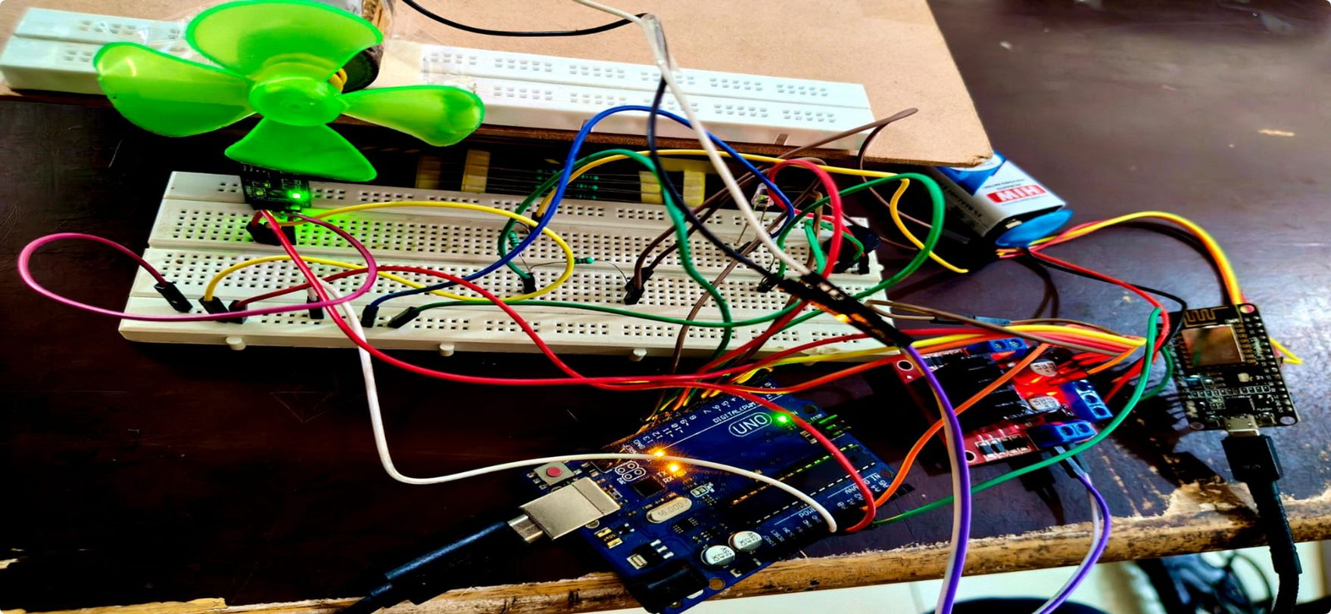
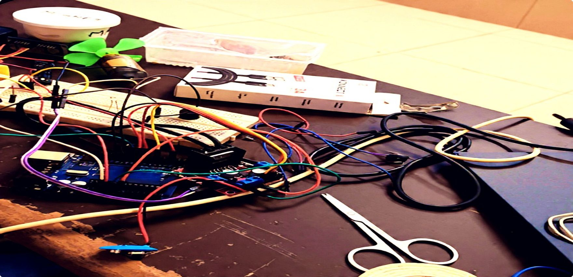
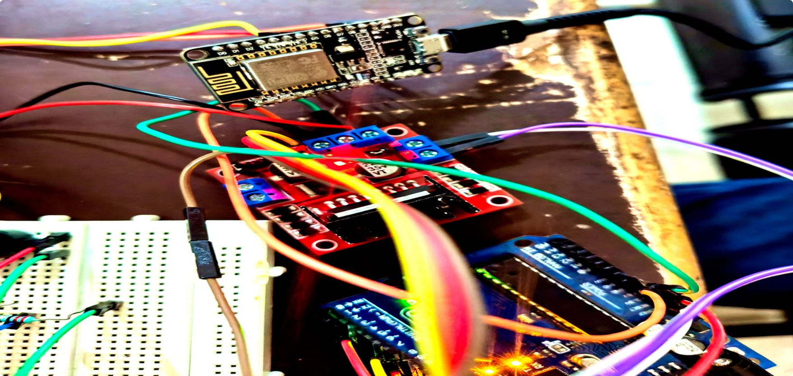
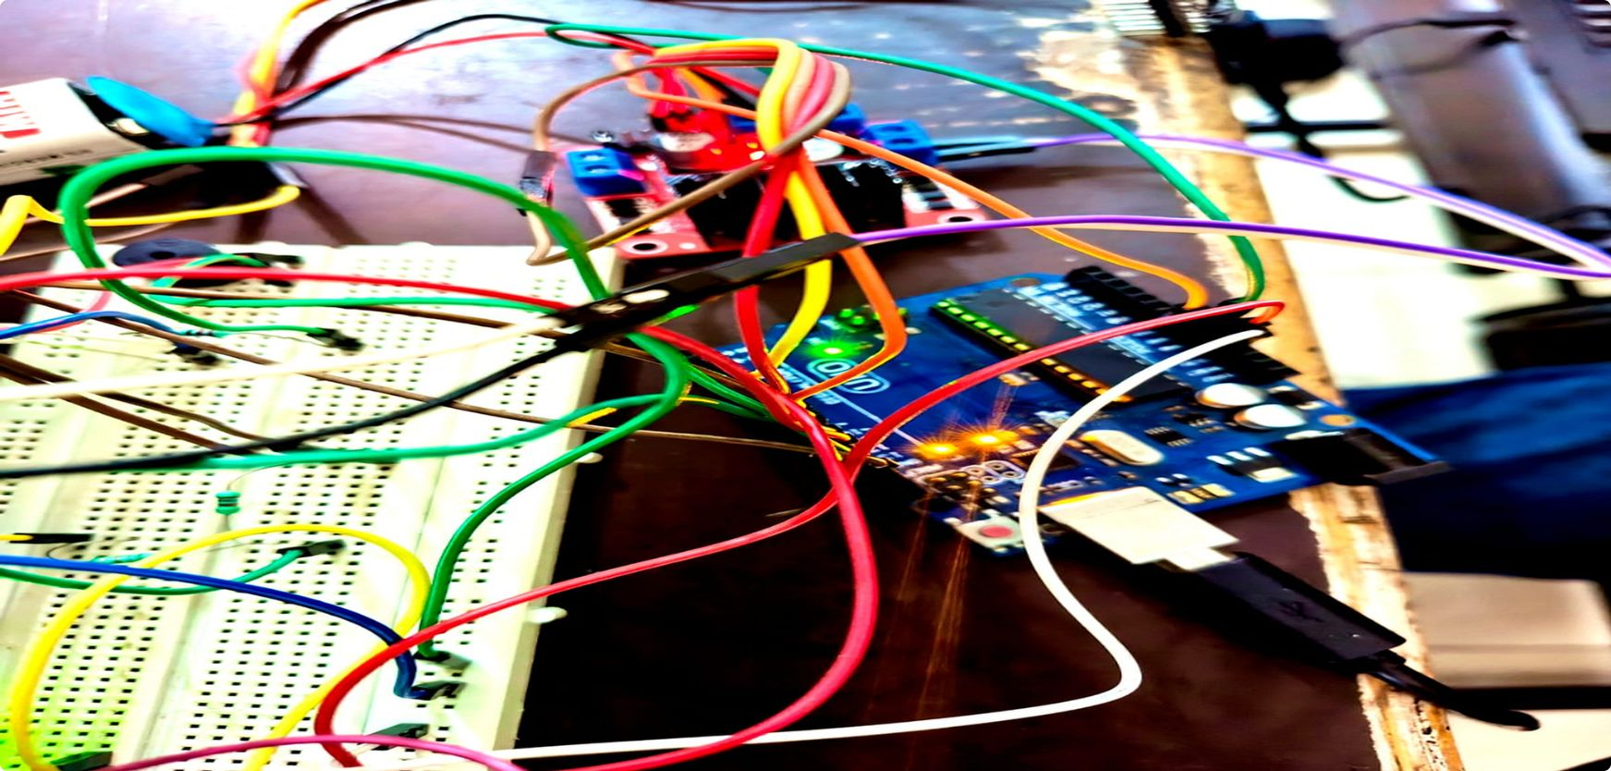
PROJECT LOG · IMAGE SPACES
Project Build Steps
Use these four frames for the project photos. Record observed results only after each check.
PHOTO SPACE
PHOTO SPACE
ADD PROJECT IMAGE
ADD PROJECT IMAGE
Sensor + magnet setup
Motor + driver wiring
PHOTO SPACE
PHOTO SPACE
ADD PROJECT IMAGE
ADD PROJECT IMAGE
Fault / alarm test
ESP32 dashboard verification

Slide 10
SOFTWARE ARCHITECTURE
Three software layers power JamGuard
01
02
03
Arduino Uno · sense + protect
ESP32 · publish + connect
Browser · monitor + alert
Reads Hall pulses, calculates RPM, detects jams, and trips the motor alarm.
Receives motor state over UART and serves a local Wi-Fi dashboard—no cloud required.
Live RPM, motor status, and jam alerts help operators respond quickly.
Arduino decides. ESP32 publishes. The browser displays. UART + local Wi-Fi keep JamGuard fast and cloud-free.
Notes:
Show the architecture as three layers rather than one large program. The browser is the local readout, while the control decision remains close to the motor on the Arduino.

Slide 11
VALIDATION VIEW
Normal and fault states use different evidence
NORMAL
FAULT
Motion is confirmed
Protection is active
Motor commanded to run, pulses detected, RPM reported.
No pulses beyond the configured timeout, motor disabled, LED illuminated, buzzer activated.
Prototype settings
Current logic detects loss of rotation, not every slowdown or every possible motor fault.
3-second startup grace period · 1.5-second no-pulse timeout
Notes:
Close with the evidence the prototype should show: a normal state, a controlled fault, and the matching dashboard update. The four photo zones are reserved for the team’s own step-by-step demonstration images.

Slide 12
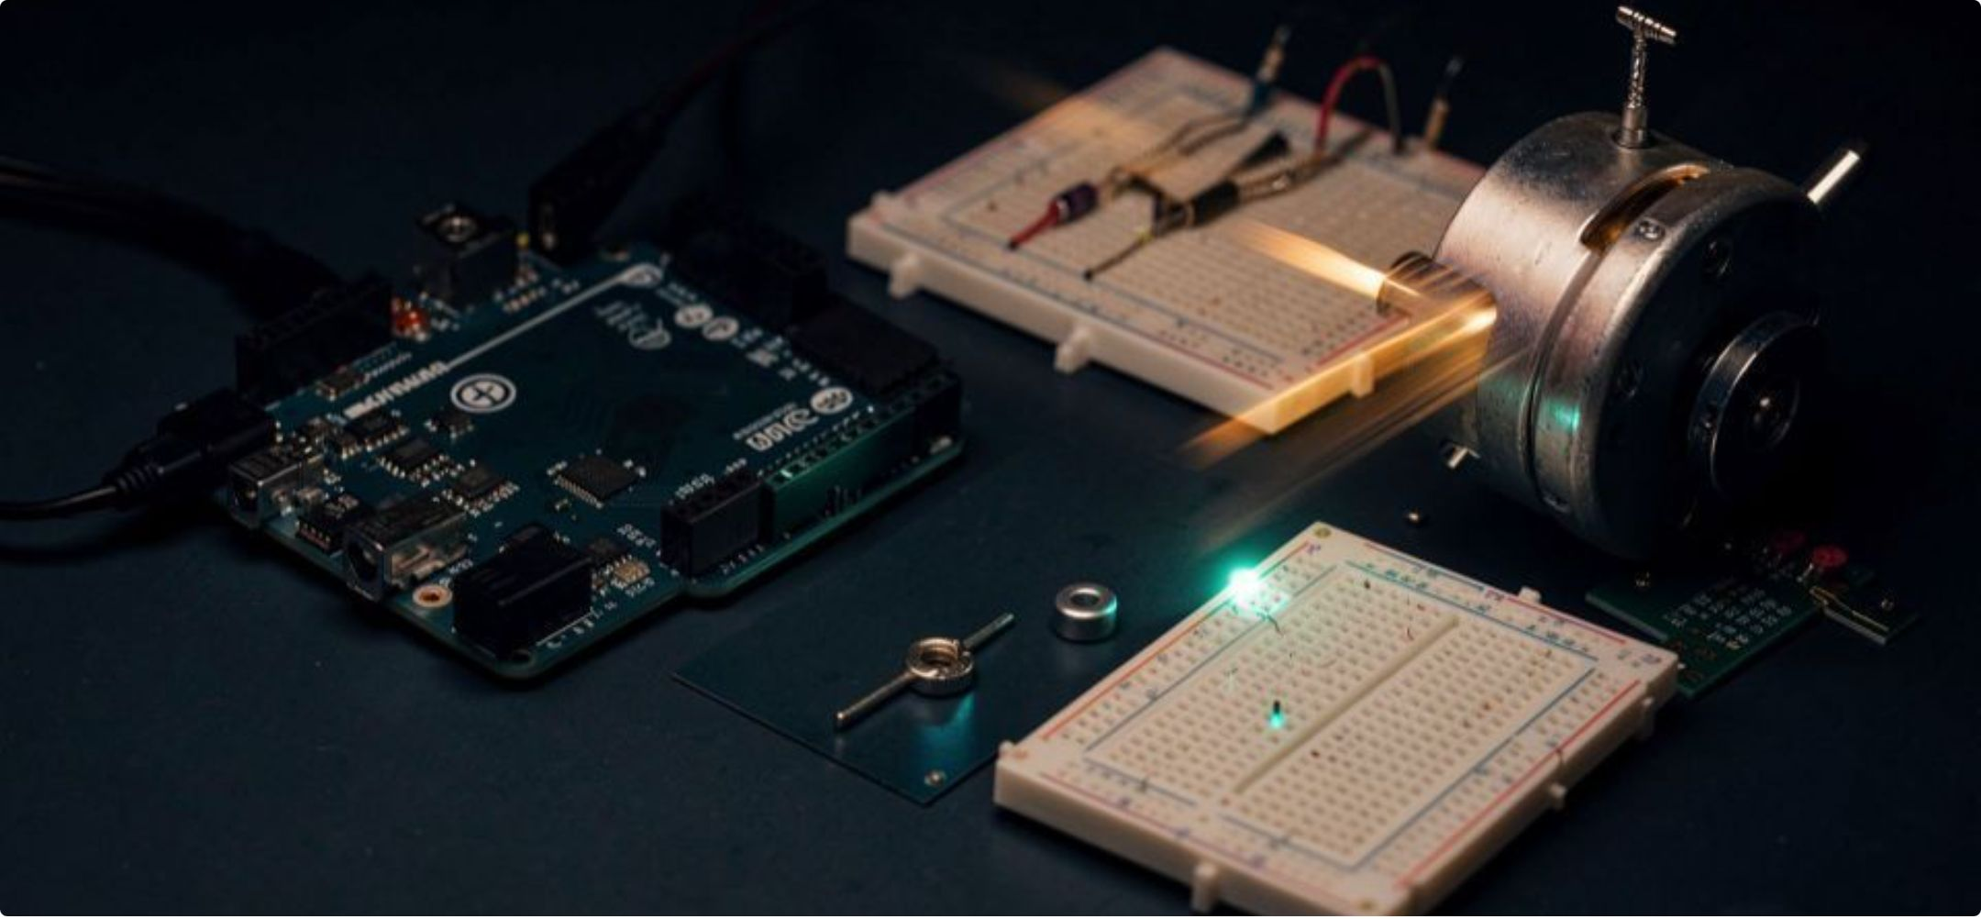
BUILD DETAIL · ALERT LOGIC
Component details
Small parts turn the motion signal into a visible, actionable protection response.
Prototype hardware · sensor, motor, and controller
Alert conditions
Resistor code
Brown · Green · Red · Gold
Tolerance: ±5%
LED glows when RPM is below 2100.
LED + buzzer glow when the motor is off or any fault occurs.
Current-limiting protection.
Response: make the loss of motion impossible to miss.
13
Notes:
Use this slide to connect the build details to the protection behavior. The resistor bands are brown, green, red, and gold, indicating ±5% tolerance. The LED glows below 2100 RPM; when the motor is off or any fault is detected, both the LED and buzzer glow.

Slide 13
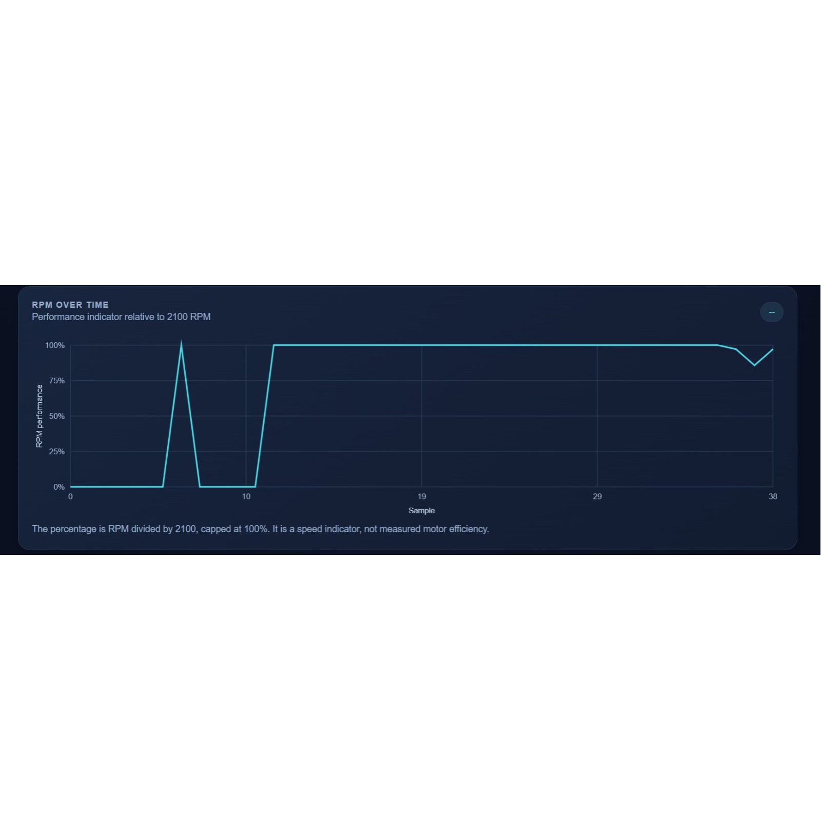

JAMGUARD · MOTOR PROTECTION
RPM over time
When RPM vanishes, efficiency hits zero
Efficiency (η) = Mechanical Power Out (Pout) / Electrical Power In (Pin) × 100%
The stalling paradox
When a conveyor or packaging machine jams, the motor can experience its highest possible torque (stall torque), but because RPM is zero, net efficiency is 0%.
Why JamGuard is essential
During a jam, incoming electrical power (V × I) is converted into heat inside the motor windings; JamGuard protects the motor by shutting it down when RPM vanishes.
The graph shows RPM performance relative to 2100 RPM, with the signal dropping to zero during a stall and returning to normal operation.

Slide 14
Conveyor belts
Packaging machines
Problem: A belt can stop while upstream material keeps arriving.
Solution: Monitor rotation and surface a possible stoppage for a protective response.
Problem: A missed feed or jam can leave the cycle waiting on motion that is no longer there.
Solution: Use rotation evidence to flag the missing movement.
APPLICATIONS · PROBLEM · RESPONSE
Real-Life Problems and JamGuard Solutions
Automated gates
Robotics
Problem: A gate may stall mid-cycle while the command has already been issued.
Solution: Watch for continued rotation and react when it disappears.
Problem: A motor-driven axis may fail to move as expected.
Solution: Add a motion-loss check to the system's awareness.
One adaptable principle for small motor-driven systems: notice lost motion, make the condition visible, and support a protective reaction.
JamGuard is demonstrated here as a prototype concept, not an already deployed industrial product.
Small motor-driven manufacturing systems
Problem: A compact machine can keep running logically while mechanical motion stops.
Solution: Apply the sense–decide–protect pattern to the mechanism.
12
Notes:
Close by showing the breadth of the principle. These are application examples, not claims that JamGuard is already deployed in any of them. The prototype demonstrates how rotation monitoring can make a loss of motion visible and support a protective response.

