Slide 1
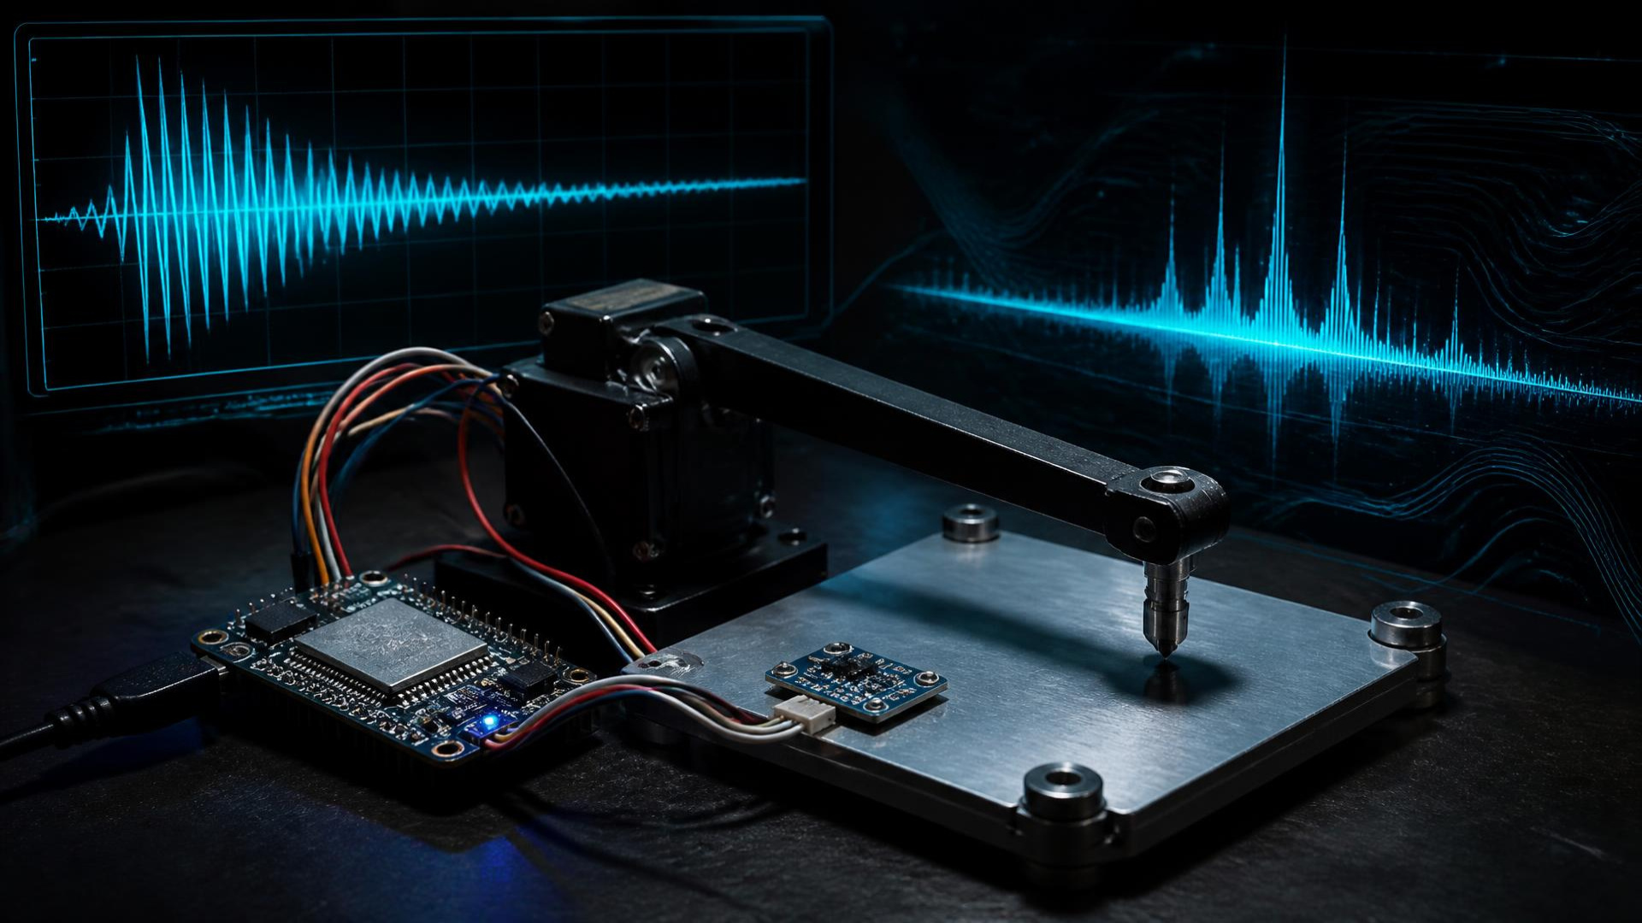
ENGINEERING INNOVATION • EDGE-AI • NDT SCREENING
THERMOACOUSTIX: EDGE-BASED ANOMALY DETECTION SYSTEM
A low-cost automated vibration-based material screening prototype
FROM IMPACT TO INSIGHT
Presented by TEAM VOLTAGE MAFIA
Submitted By:
SAKSHAM DHAWAN (26BVD0024)
PATNALA SUBHAOM KUMAR PATRO (26BEC0268)
AYAAN GARG (26BEC0472)
VIT Vellore • B.Tech ECE AND VLSI
VIT VELLORE • B.TECH ECE AND VLSI 01 / 18

Slide 2
01 • NON-VISIBLE DIFFERENCES
THE PROBLEM WE ARE SOLVING
Identical outside. Mechanically different inside.
Defects, damage and material variation can hide beneath a normal surface — across brackets, structural parts, machine components and glass samples.
TRADITIONAL
HUMAN
HAMMER
EAR / EYE
SUBJECTIVE
OUR APPROACH
CONTROLLED IMPACT
ADXL345
FFT + REFERENCE
DECISION
COST • HUMAN VARIABILITY • ENVIRONMENT • LIMITED AUTOMATION
How can repeatable excitation + digital vibration features reveal deviation from a known reference?
VIT VELLORE • B.TECH ECE AND VLSI 02 / 18

Slide 3
02 • PHYSICAL RESPONSE → DIGITAL EVIDENCE
OUR CORE IDEA
Every material answers an impact with a characteristic vibration signature.
MATERIAL
SERVO STRIKE
VIBRATION
ADXL345
RAW SIGNAL
FFT
REFERENCE
ANOMALY
“Converting a physical vibration response into measurable digital information.”
Repeatable excitation makes responses comparable. Frequency features make them computable.
VIT VELLORE • B.TECH ECE AND VLSI 03 / 18

Slide 4
03 • ESP32 AS THE CENTRAL BRAIN
SYSTEM ARCHITECTURE
SENSORS / CONTEXT
ACTUATION / OUTPUT
SERVO
striker
POTENTIOMETER
profile
ESP32
CONTROL • ACQUIRE
COMMUNICATE
LCD
status
PYTHON
advanced DSP
DHT11
T + RH
ADXL345
vibration
FFT →
DECISION
Actuator → Material → ADXL345 → ESP32 / Python → FFT → Decision
VIT VELLORE • B.TECH ECE AND VLSI 04 / 18

Slide 5
04 • AUTOMATED TEST SEQUENCE
HOW THE SYSTEM WORKS
01
02
03
04
05
LOAD SAMPLE
PRESENCE CHECK
SELECT PROFILE
VERIFY CHAMBER
SERVO STRIKE
06
07
08
09
10
CAPTURE VIBRATION
LOG ENVIRONMENT
FILTER + WINDOW
FFT
EXTRACT FEATURES
11
12
13
COMPARE BASELINE
CHECK TOLERANCE
DISPLAY + ALERT
VIT VELLORE • B.TECH ECE AND VLSI 05 / 18

Slide 6
05 • COORDINATION, NOT JUST COMPUTATION
ESP32 — THE BRAIN
SENSOR READING
TEST SEQUENCING
SERVO CONTROL
ESP32
COORDINATED
INSPECTION
PYTHON LINK
SAFETY MONITORING
LCD
USER INPUT
“Transforms components into a coordinated automated inspection system.”
IoT • industrial automation • smart monitoring • robotics • sensor networks
VIT VELLORE • B.TECH ECE AND VLSI 06 / 18

Slide 7
06 • REPEATABILITY MEETS MEASUREMENT
CONTROLLED EXCITATION & VIBRATION SENSING
SERVO STRIKER
ADXL345
Repeatable mechanical impact
• reduces manual variation
• automates testing
• improves comparability
Time-domain acceleration response
• transient amplitude
• oscillation behaviour
• decay characteristics
ROBOTICS • ACTUATION • POSITIONING
CONDITION MONITORING • MOTION • VIBRATION
SERVO → CONTROLLED IMPACT → MATERIAL → VIBRATION → ADXL345
VIT VELLORE • B.TECH ECE AND VLSI 07 / 18

Slide 8
07 • TIME DOMAIN → FREQUENCY DOMAIN
FFT — THE FREQUENCY SIGNATURE
TIME DOMAIN
FREQUENCY DOMAIN
When and how vibration changes
Which frequencies — and their strengths
FEATURES dominant frequency • peak amplitude • spectral energy • ratios • band energy • decay
FFT extracts features. It does not, by itself, decide defect presence.
VIT VELLORE • B.TECH ECE AND VLSI 08 / 18

Slide 9
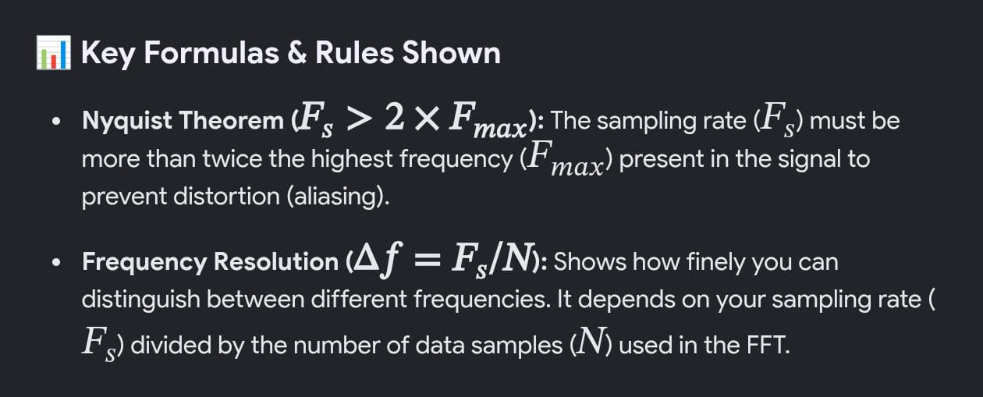
08 • SIGNAL PROCESSING PIPELINE
FROM RAW ACCELERATION TO ANOMALY SCORE
Δf = Fs / N
Nyquist: Fs > 2 × Fmax
Sampling rate must capture the frequency range of interest.
Sampling digitises • filtering removes noise • windowing reduces leakage • spectrum exposes strengths • comparison creates a threshold or model-based decision
VIT VELLORE • B.TECH ECE AND VLSI 09 / 18

Slide 10
09 • CONDITION-AWARE MEASUREMENT
WHY DHT11?
VIBRATION DATA
TEMPERATURE
CONDITION-AWARE
DATASET
CALIBRATION /
COMPENSATION MODEL
HUMIDITY
DHT11 temperature + humidity
Context aids future calibration — it does not automatically remove false positives.
VIT VELLORE • B.TECH ECE AND VLSI 10 / 18

Slide 11
10 • HARDWARE → FUNCTION → ENGINEERING VALUE
EVERY COMPONENT HAS A PURPOSE
ESP32
Central control + communication
IoT / automation
ADXL345
Vibration measurement
Condition monitoring
Servo motor
Controlled excitation
Robotics / actuation
Potentiometer
Profile selection
Analogue interface
LCD
Status, result, alert
Human–machine interface
DHT11
T, RH and pressure context
Environmental sensing
VIT VELLORE • B.TECH ECE AND VLSI 11 / 18

Slide 12
11 • THE INNOVATION IS THE INTEGRATION
WHAT MAKES OUR SYSTEM INNOVATIVE?
01
02
03
CONTROLLED EXCITATION
DIGITAL SIGNATURE
FFT ANALYSIS
Automated, repeatable impact
Physical response becomes data
Comparable frequency features
04
05
06
ENVIRONMENTAL CONTEXT
EMBEDDED AUTOMATION
SAFETY INTERLOCKS
Conditions recorded per test
ESP32 coordinates the system
Physical conditions gate testing
MECHANICS + SENSORS + EMBEDDED CONTROL + DSP + CONTEXT + ANOMALY DETECTION
VIT VELLORE • B.TECH ECE AND VLSI 12 / 18

Slide 13
12 • BUILT FOR ACCESSIBLE EXPERIMENTATION
BENEFITS & ADVANTAGES
LOW COST
AUTOMATED
REPEATABLE
FAST
Affordable prototype hardware
Less manual intervention
Controlled excitation
Rapid capture + processing
PORTABLE
DATA-DRIVEN
SCALABLE
Compact desktop potential
Measurable signatures
Upgradeable sensing + AI
ECE + EMBEDDED SYSTEMS + SENSORS + CONTROL + DSP + FFT + AI / ML
VIT VELLORE • B.TECH ECE AND VLSI 13 / 18

Slide 14

13 • FROM LAB BENCH TO SMART FACTORY
REAL-WORLD APPLICATIONS
01 Manufacturing quality screening
02 Machine condition monitoring
03 Structural response research
04 Material deviation screening
05 Small workshops & labs
06 Educational NDT demonstrations
07 Future smart-factory integration
EXPERIMENTAL SCREENING PLATFORM — NOT A CERTIFIED REPLACEMENT FOR INDUSTRIAL NDT.
VIT VELLORE • B.TECH ECE AND VLSI 14 / 18

Slide 15
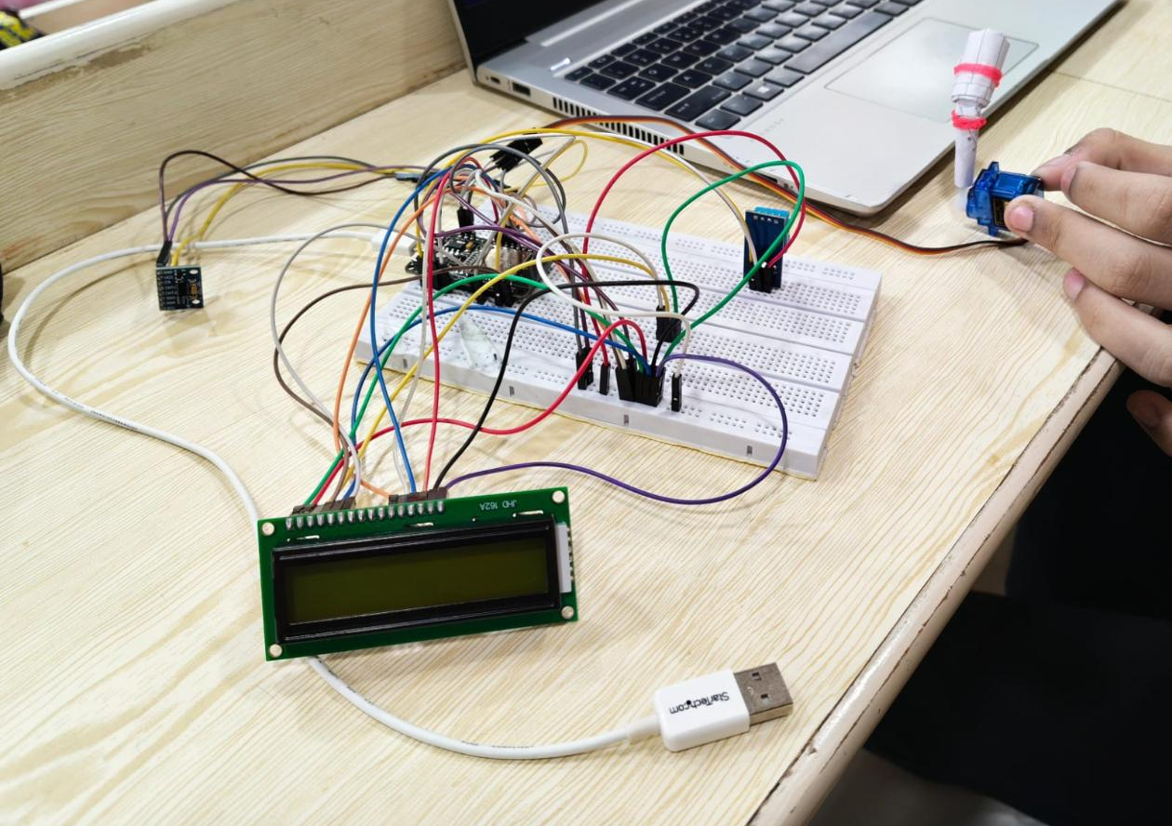
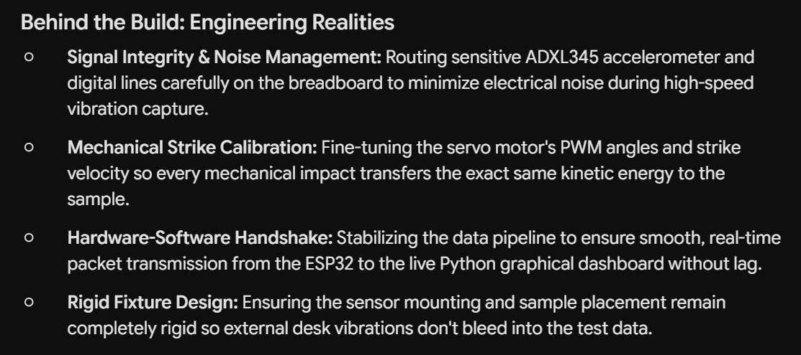
14 • PROTOTYPE
PROTOTYPE PHOTO
PROTOTYPE CREATION!!
VIT VELLORE • B.TECH ECE AND VLSI 15 / 18

Slide 16
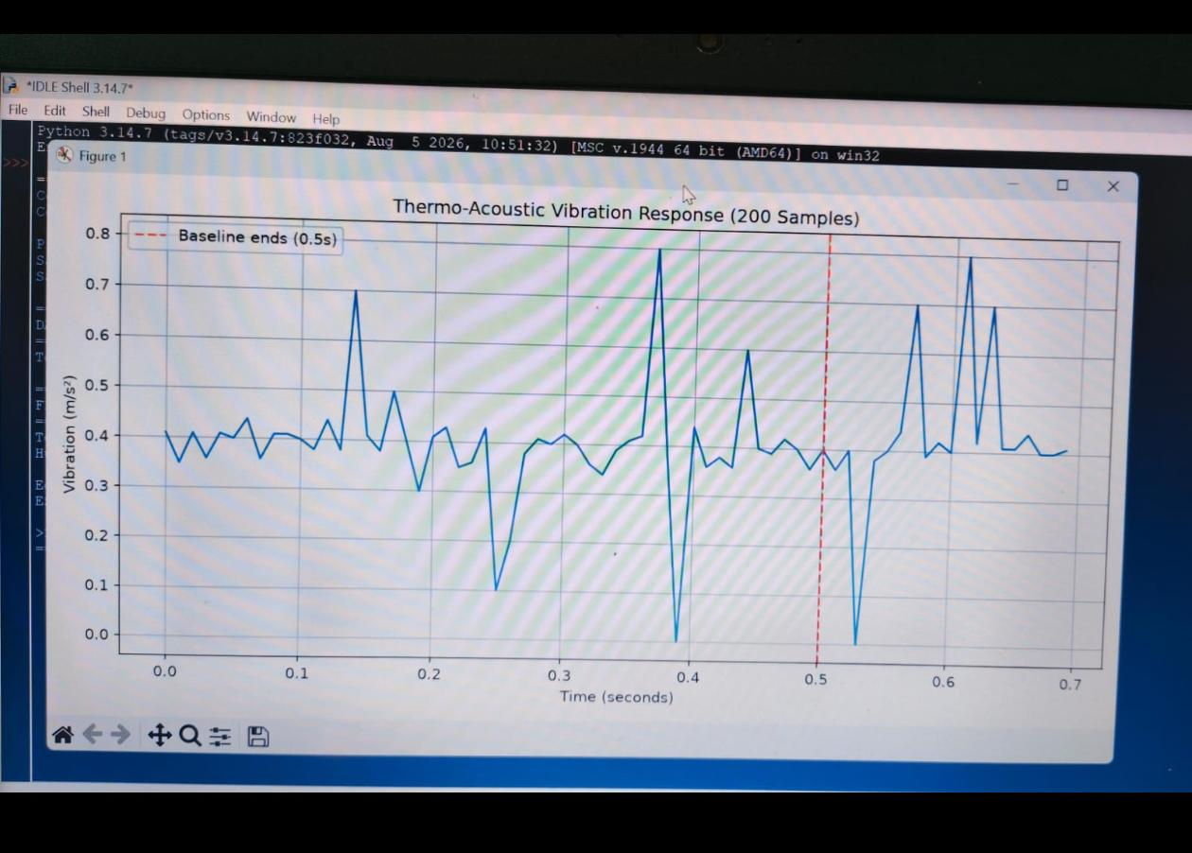
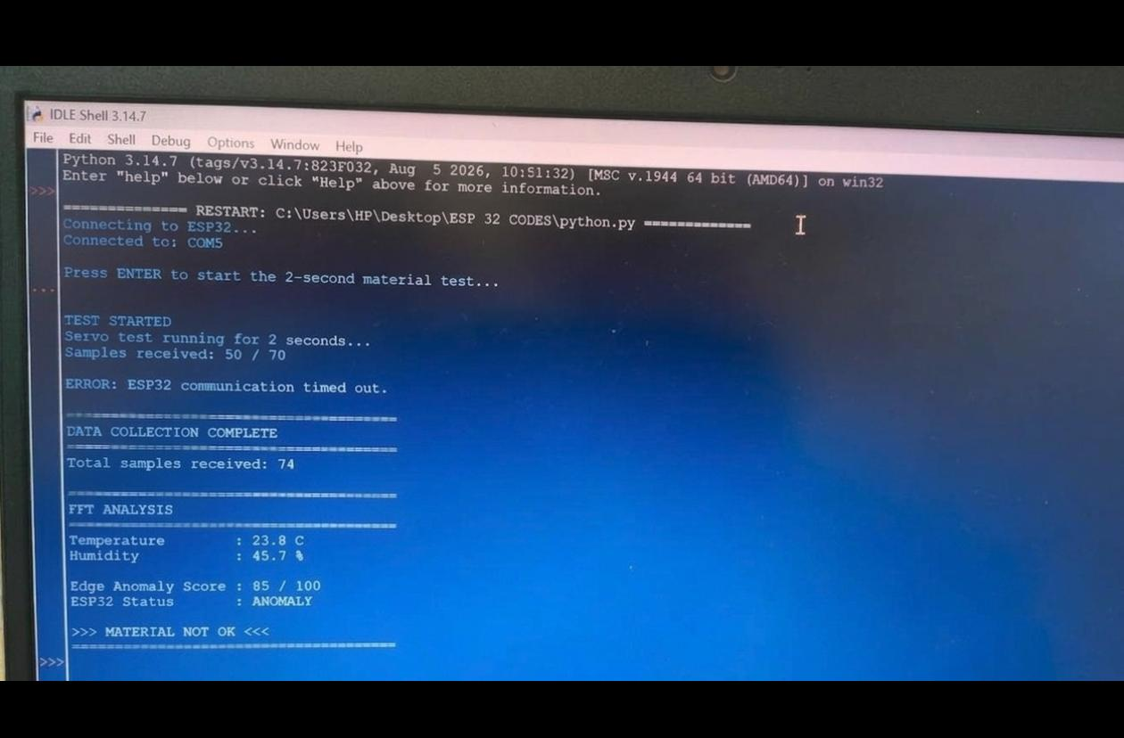
15 • RESULTS
RESULTS
WHEN THE HAMMER HITS AN OBJECT/METAL, IT DETECTS THE ANOMALY AND INTERNAL DEFECTS PRESENT. THESE PHOTOS SHOWS THE NO OF SAMPLES AND THE FFT GRAPH CONFIGURED DURING THE HAMMER HIT.
VIT VELLORE • B.TECH ECE AND VLSI 16 / 18

Slide 17
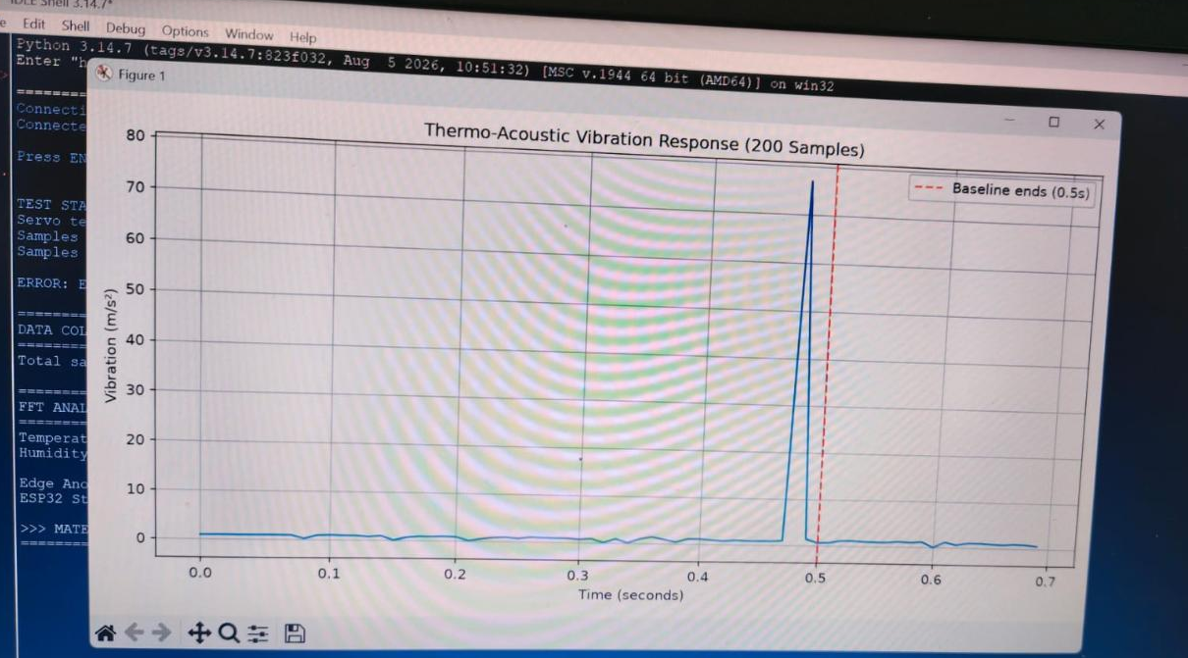
16 • RESULTS
RESULTS
WHEN THE HAMMER DOESN’T HIT ANY KIND OF OBJECT OR METAL, IT DOES NOT DETECT ANY DEFECTS, THUS, SHOWING A STRAIGHT GRAPH WITH VERY FEW DISTURBANCES OR ANOMALY DETECTIONS.
VIT VELLORE • B.TECH ECE AND VLSI 17 / 18

Slide 18
17 • FOUR-LEVEL ROADMAP
FROM PROTOTYPE TO SMART INSPECTION
LEVEL 1
BETTER SENSING
LEVEL 2
High-bandwidth accelerometers • piezo • force sensing • isolation
BETTER DSP
LEVEL 3
Digital filters • wavelets • resonance tracking • optimised FFT
REAL MACHINE LEARNING
LEVEL 4
Python training → optimise → TinyML → ESP32 edge inference
INDUSTRIAL SCALE
Calibrated impact • multi-sensor line • database • dashboard
We are not simply measuring vibration. We are turning vibration into information — and information into a decision.
FROM IMPACT TO INSIGHT.
VIT VELLORE • B.TECH ECE AND VLSI 18 / 18

